Slide 1
From fractionalized topological insulators to fractionalized Majoranas
Ady Stern (Weizmann)

Slide 2
Outline:
The context
Questions and results
Zoom on – fractionalized Majorana modes
(with N. Lindner, E. Berg, G. Refael)
see also: Clarke et al., Meng, Vaezi
Zoom on - Construction of an exactly solvable model for a 3D fractional topological insulator
(with M. Levin, F. Burnell, M. Koch Janucsz)

Slide 3
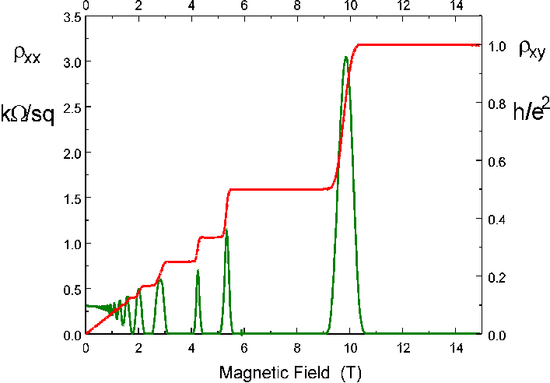
The context: Topological phases of matter
The quantum Hall effect
The Hall conductivity as a topological quantum number
Protected as long as the bulk energy gap does not close
Gapless modes at the edges
Interactions enable the Fractional Quantum Hall Effect – fractionalized charges, anyonic statistics, topological ground state degeneracy etc. etc.

Slide 4
Quantized spin Hall effect - a generalization of the QHE to systems that are symmetric under time reversal
A useful toy model – two copies of the IQHE
Red electrons experience a magnetic field B
Green electrons experience a magnetic field -B
ν=odd per each color – a topological insulator
Gapless edge protected by time reversal symmetry
ν=even per each color – a trivial insulator, no protection
These are examples of 2D non-interacting topological / trivial insulators.
Will interactions introduce new fractionalized states?

Slide 5
Three dimensional (3D) non-interacting topological insulators
Gapless edge modes are now Dirac cones on each of the surfaces
The Dirac cone cannot be gapped without breaking of time reversal symmetry.
When time reversal symmetry is broken on the surface, a quantum Hall state forms, with half-integer Hall conductivity.
When a finite thin solenoid is inserted into the 3D bulk, charges of ±e/2 are bound to its ends (“charge-monopole binding”).
Will interactions induce new fractionalized states (FQHE on the surface, “fractional charge-monopole binding” ?)

Slide 6
What did topological insulators add to the world of topological states of matter?
Edge modes that are protected only as long as a symmetry is not broken
Three dimensional systems
Implications to the world of fractional phases?

Slide 7
Questions and answers:
Fractional 2D quantum spin Hall states – are the edge modes protected by time reversal symmetry?
Can fractional topological phases that are time reversal symmetric be listed?
Answer: so far, 2D systems that are abelian have been listed. The most general K-matrix is
Can there be interesting structure at the edge when symmetries are broken?
Fractional topological phases in 3D

Slide 8
The first example (Bernevig et al)
Red electrons at a fraction ν
Green electrons at a fraction -ν
The question – can the edge states be gapped out without breaking time reversal symmetry ?
The answer is determined by the parity of ν/e*:
Even –Yes
Odd - No
(Levin & Stern)
Not directly generalizable to three dimensions

Slide 9
Questions and answers:
Fractional quantum spin Hall states – are the edge modes protected by time reversal symmetry?
Yes, when ν/e* is odd
Can there be interesting structure at the edge when the protecting symmetries are broken?
For the integer quantum spin Hall state:
Super-conductor
ferromagnet
Majorana mode
Ground state degeneracy, Non-abelian statistics etc.

Slide 10
And for a similar fractional system?
“Fractional topological insulator”: Laughlin Quantum Hall state with: ν=1/m for spin up ν=-1/m for spin down
(m odd)
FM₁
SC₁
Fractional
Topological
Insulator
(FTI)
SC₂
FM₂
For m=1 – the Fu-Kane Majorana operators form on the interfaces
Notes:
Thank you for the opportunity to present this work that we did recently. I'll be presenting two projects, one of which is summarized in this paper and the other still unpublished.

Slide 11
Two alternative systems with the same edge structure:
I.
SC
SC₁
FQH
FQH
ν =1/m
FQH
ν =1/m
FQH
g>0
g<0
SC₂
Notes:
Thank you for the opportunity to present this work that we did recently. I'll be presenting two projects, one of which is summarized in this paper and the other still unpublished.

Slide 12
II. Bi-layer electron-hole system
(electrons)
SC₁
(holes)
SC₂
Notes:
12
Thank you for the opportunity to present this work that we did recently. I'll be presenting two projects, one of which is summarized in this paper and the other still unpublished.

Slide 13
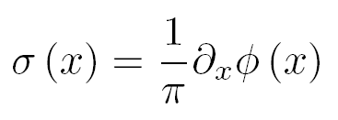
Effective Edge Model
Density:
Spin density:
Electron:
(charge 1, spin 1)
Laughlin q.p.:
(charge 1/m, spin 1/m)
Notes:
Thank you for the opportunity to present this work that we did recently. I'll be presenting two projects, one of which is summarized in this paper and the other still unpublished.

Slide 14
Effective Edge Model
Large cosine terms (strong coupling to SC/FM)
θ pinned :
θ₂
φ ₁
φ ₂
Ground states:
θ₁
φ pinned:
θ₃
θ₄
φ ₃
Notes:
Thank you for the opportunity to present this work that we did recently. I'll be presenting two projects, one of which is summarized in this paper and the other still unpublished.

Slide 15
Unless j=l
the operator transfers a single q.p. from the j+1’th super-conductor to the j’th one.
N pairs of “canonically conjugate” variables, 2m values per operator.

Slide 16
Ground state degeneracy
S₁
Charges
Q₁
Q₂
Spins
S₃
S₂
Q₃
2N domains, fixed .
(2m)^{N-1} ground states
Quantum dimension -
Notes:
Thank you for the opportunity to present this work that we did recently. I'll be presenting two projects, one of which is summarized in this paper and the other still unpublished.

Slide 17
Topological manipulations (a.k.a. quantum non-abelian statistics)?
First, general comments on the operation and on the outcome
In 2D: degeneracy is kept for as long as quasi-particles are kept away from one another. Braiding is spatial.
1D is different. Braiding is not really spatial. It is better to think about trajectories in parameter space. Parameters are tunnel-couplings at interfaces.

Slide 18
The idea – introduce tunnel couplings that keep the degeneracy fixed throughout the process.
The outcome is a unitary transformation applied within the ground state subspace.
Simplest example – Majorana opeartors:
γ₁
γ₂
γ₃
γ₄
Two zero energy modes – 3 and 4
γ₁
γ₂
γ₃
γ₄
One zero energy mode was copied from 3 to 1.
Degeneracy is fixed – one pair of coordinates is involved.

Slide 19
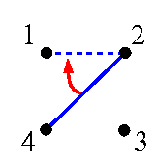
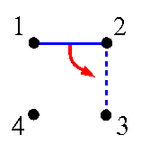
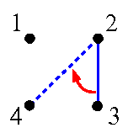
Braiding (Alicea et al.)
Braiding interfaces :
S₂
Q₁
Q₂
S₁
S₃
Q₃
fixed g.s. degeneracy in all intermediate stages
result independent of microscopic details
Notes:
Thank you for the opportunity to present this work that we did recently. I'll be presenting two projects, one of which is summarized in this paper and the other still unpublished.

Slide 20
What is the unitary transformation corresponding to interchanging the interfaces at the edges of a single segment?
Majoranas: interchanging γ_{i} ⇄ γ_{i+1}
S₂
Q₁
Q₂
S₁
S₃
Comments:
The +/- refers to different signs of tunnel couplings
Q is either zero or one.
U² is the parity, U⁴=1
Doesn’t take you too far…
Q₃
For example, only to states where

Slide 21
For the fractional case,
Several possible tunneling objects(q.p’s with spin-up, with spin-down, electrons). To keep the degeneracy fixed throughout the process, tunneling objects should be carefully chosen (electrons or one spin q.p’s).
The unitary transformation U depends on the tunneling object and on the tunneling amplitudes. The possible transformations:
α is determined by the type of tunneling object.
For electrons , while for quasi-particles
K=0..(2m-1)
3. Limited set of states to be reached (no universal TQC).

Slide 22
Questions and answers:
Fractional quantum spin Hall states – are the edge modes protected by time reversal symmetry?
Can there be interesting structure at the edge when symmetries are broken?
Can we list all possible fractional topological phases that are time reversal symmetric?
Answer: so far, 2D systems that are abelian have been listed (Levin & Stern, 2012).
The edge theory of an abelian 2D topological state is
What is the most general K-matrix symmetric to time reversal?

Slide 23
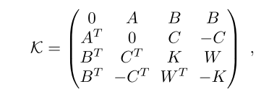
The most general K-matrix is
Bosonic, toric-code-type system
Boson-fermion coupling
Fermionic quantum spin Hall state

