Slide 1
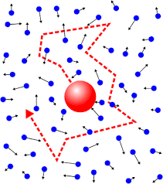
(How) Do heavy quarks equilibrate?
Urs Achim Wiedemann
CERN Theory Department

Slide 2
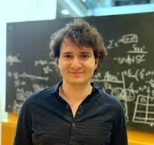
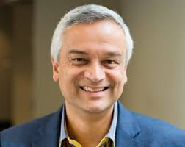
in collaboration with
Bruno Scheihing-Hitschfeld
Kavli Institute, Santa Barbara
Krishna Rajagopal
MIT
KR, BSH & UAW, JHEP 07 (2025) 013 [2501.06289]
PRL 135 (2025) 24 [2504.21139]
in preparation

Slide 3
What do we see in PbPb @ LHC?
ALICE Run Control Center

Slide 4
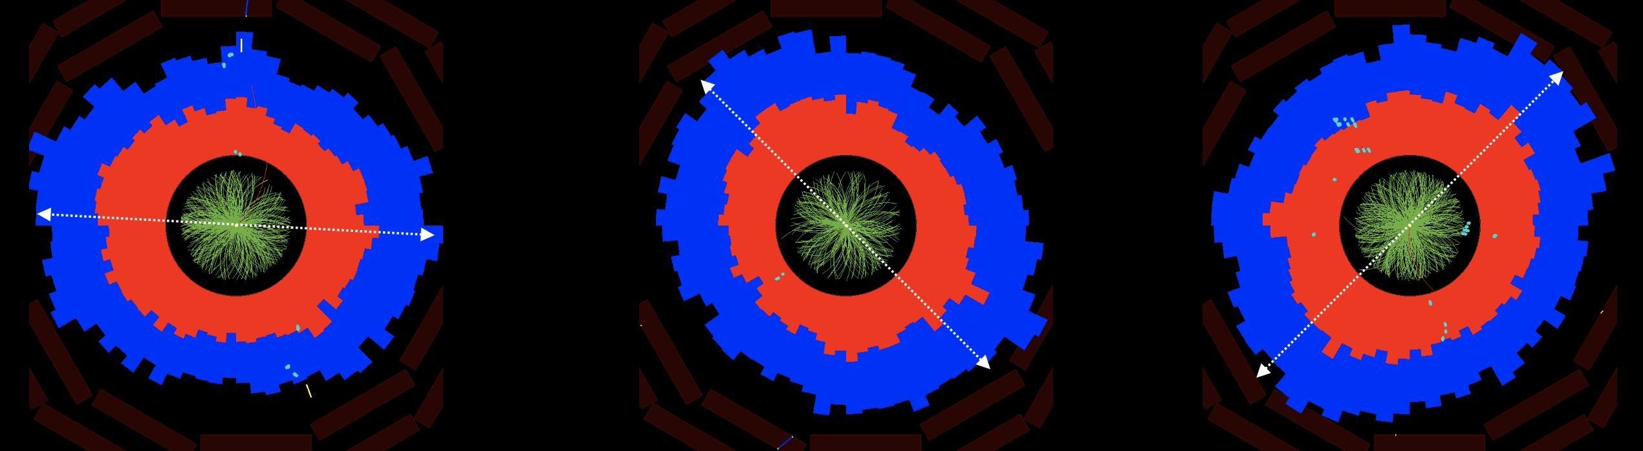
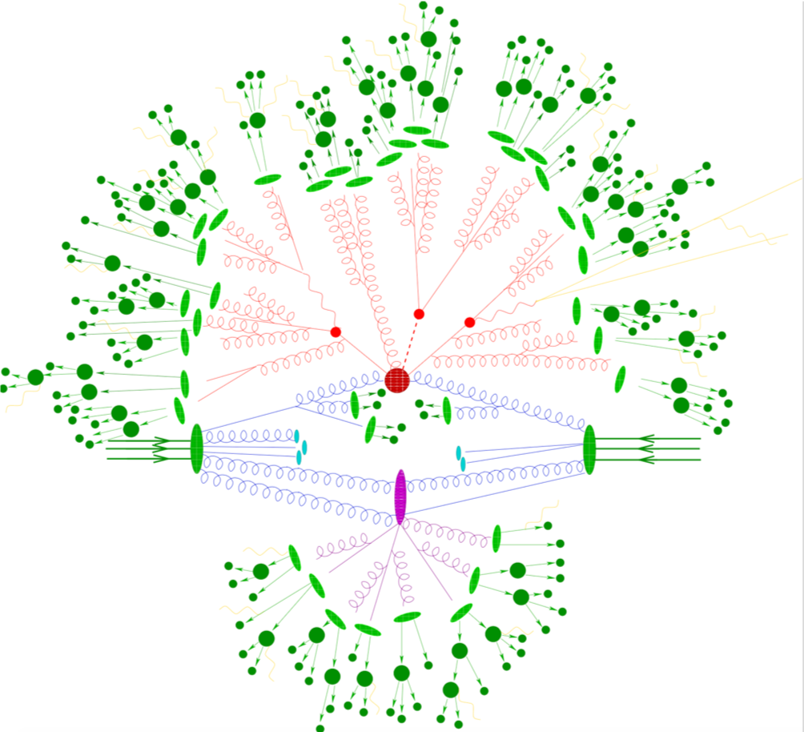
Single event calorimeter distribution of O(10’000) particles in PbPb @ LHC, CMS Coll.
Flow
Collectivity at soft p_{T}
Not explained in pp default picture!
Dissipative fluid dynamics
Perfect fluid dynamics
Free streaming
QCD transport theory
Ruled out !
To be tested quantitatively !

Slide 5


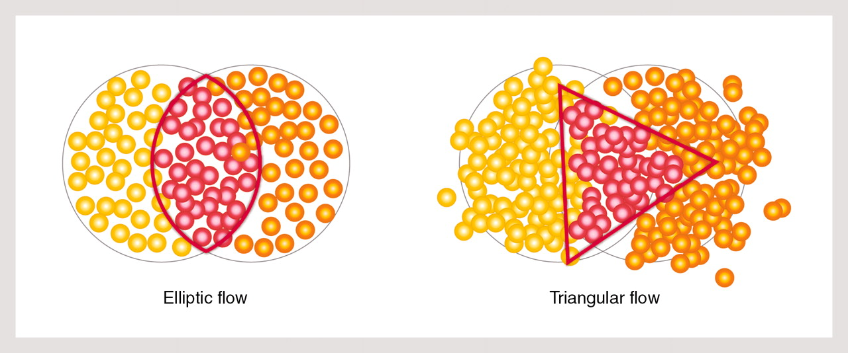
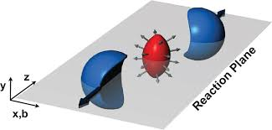
How do we test medium properties?
Excite medium
Listen to response
Analyze
In theory:
In experiment:
Prepare different excitations measure their response

Slide 6
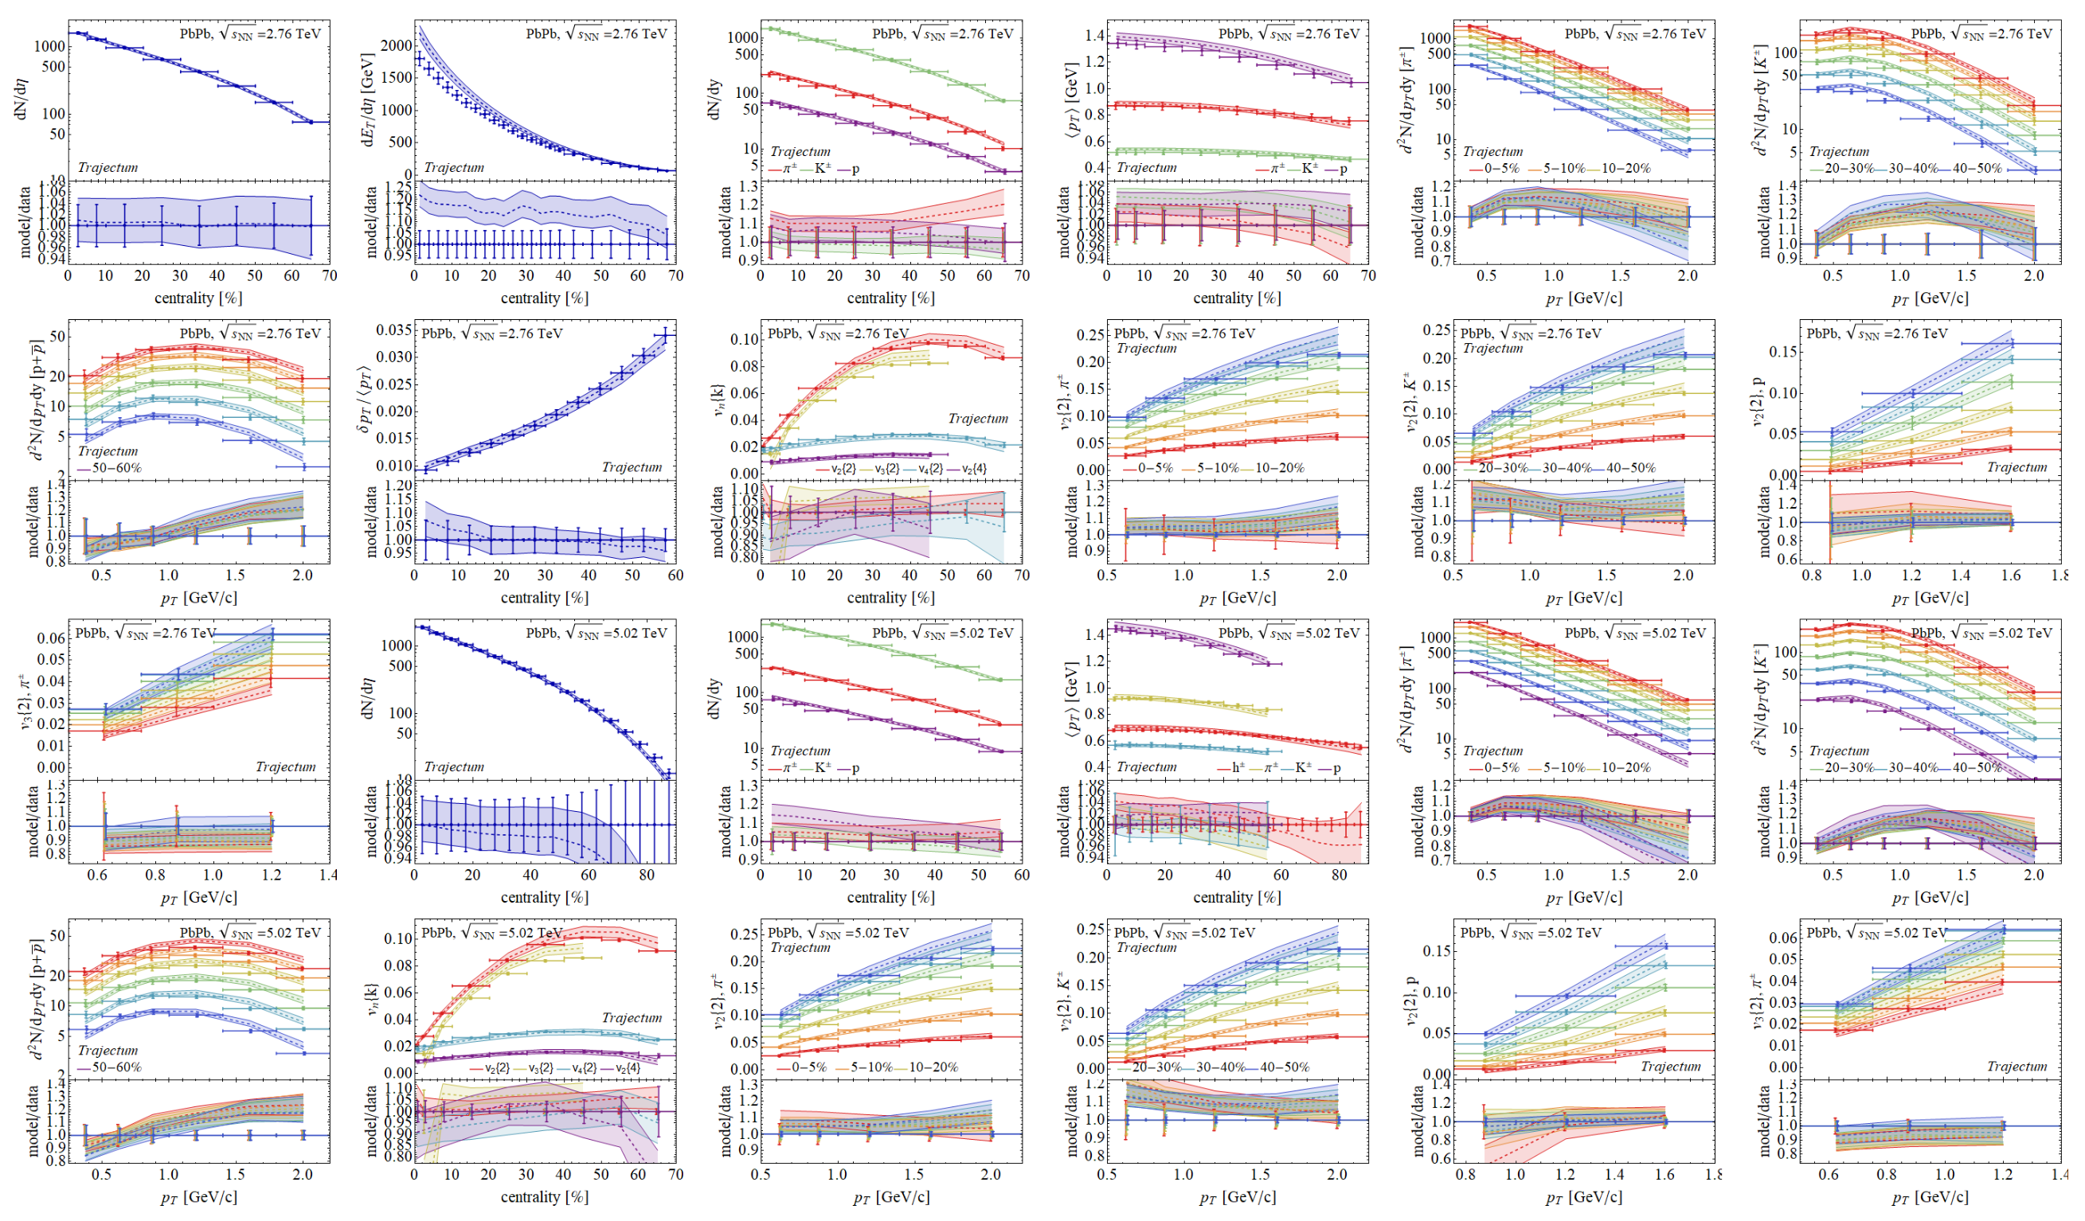
Comparison to Hydro-Models
Quantifies QGP properties and QGP evolution
Largely restricted to light-flavored hadrons so far.
Bayesian inference analysis involving 670 LHC data points.
All light-flavored hadrons seem to decouple from same common flow field.
* G. Nijs, W. van der Schee, 2304.06191.

Slide 7
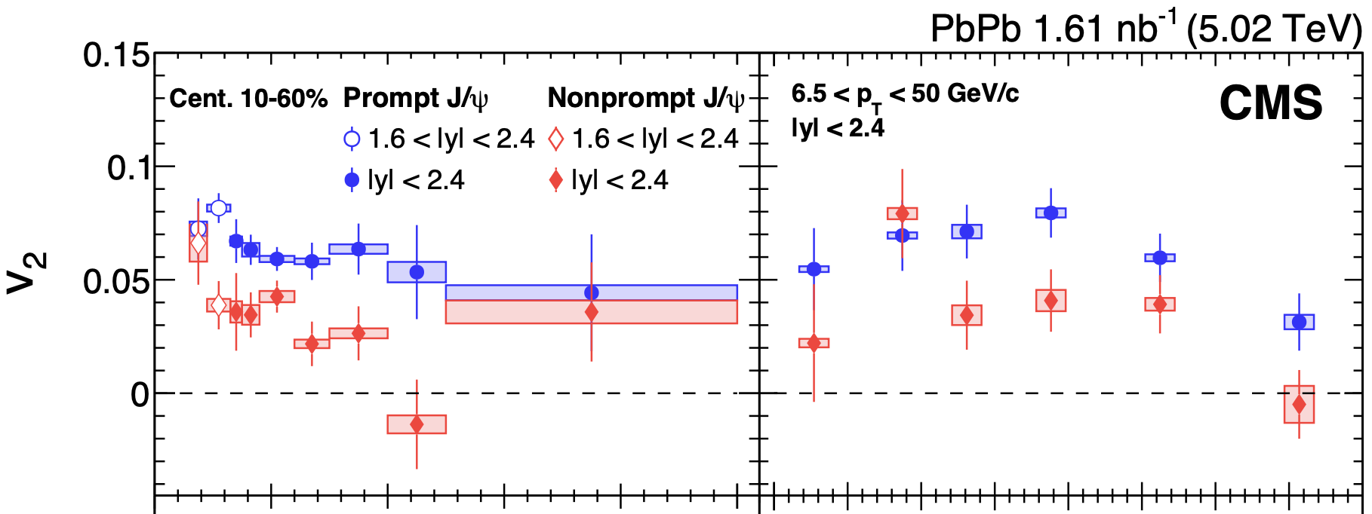
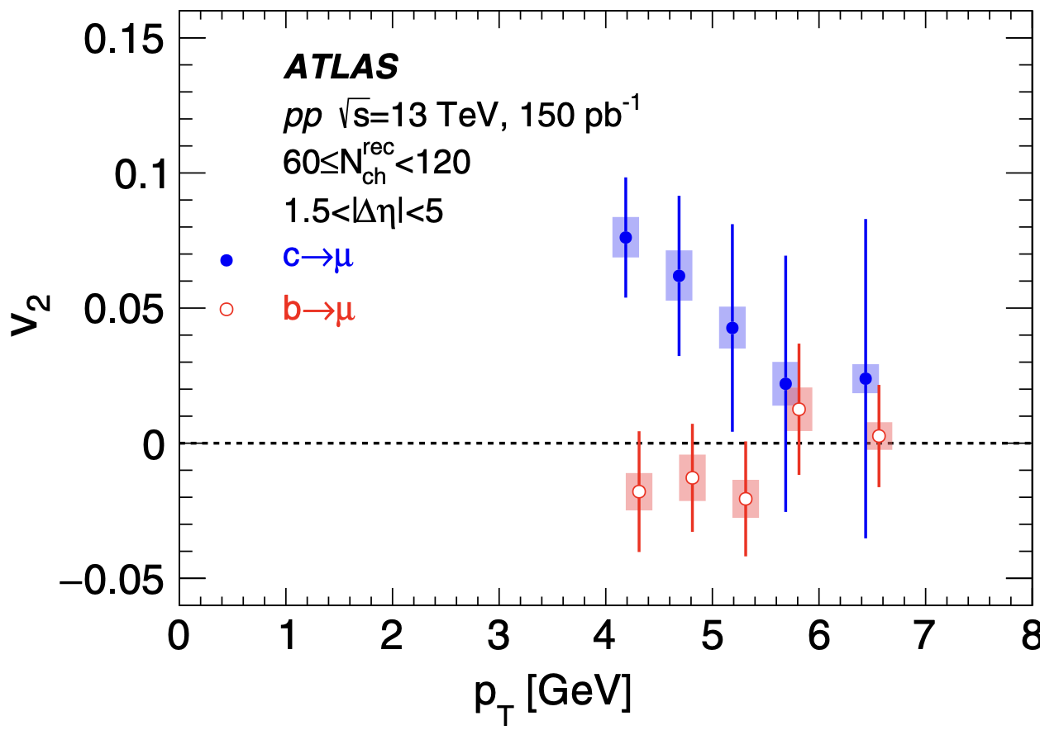
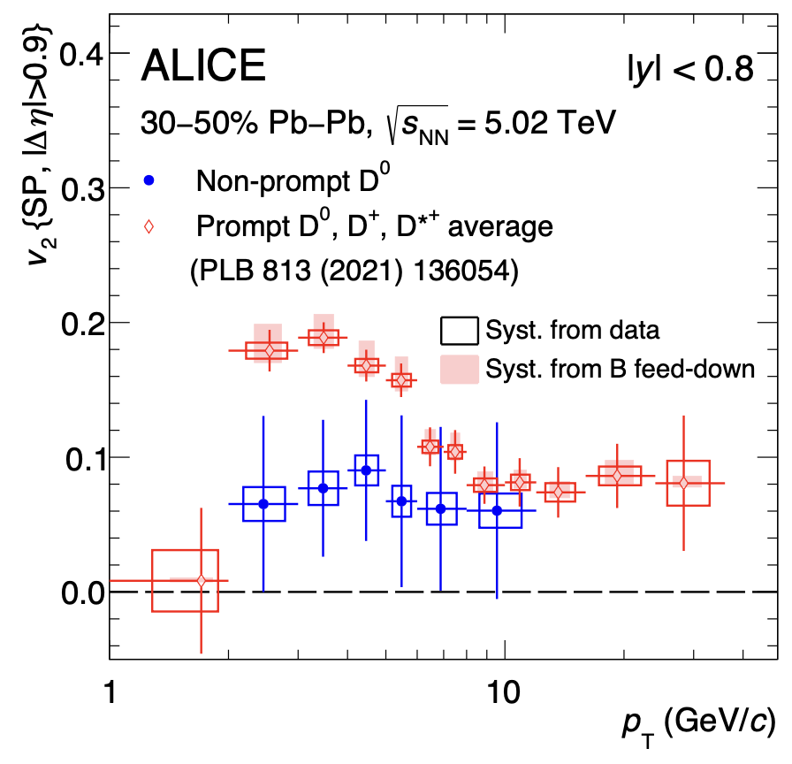
Heavy Flavor flow and quenching
EXP: evidence that beauty flows less¹ and is less quenched than charm.
CMS
CMS
Mass hierarchy of incomplete kinetic equilibration ?
TH: Does charm equilibrate a factor faster than b?
EXP: Precision at small p_{T} needed
CMS, JHEP10 (2023) 115; ATLAS PRL 124, 082301 (2020)
2. R. Rapp et al Nucl.Phys.A 979 (2018) 21-86;

Slide 8
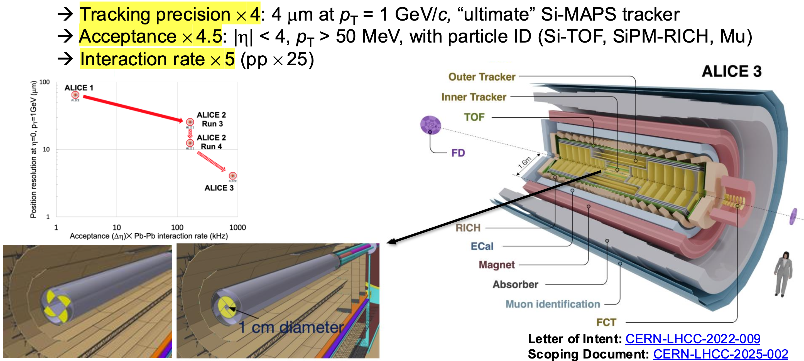
ALICE 3 – unprecedented heavy flavor capabilities
Yayun He et al, arXiv:2201.08408

Slide 9
Heavy Quark Transport
- introductory remarks

Slide 10
Langevin dynamics
Diffusion time scale
Charges subject to drag. Random force leads to momentum broadening
Solution:
Requiring thermal equipartition, one finds the fluctuation-dissipation theorem
Spatial diffusion coefficient D
Spatial probability distribution
for diffusion from x(t=0)=0
1.3

Slide 11
Spectral function for Langevin dynamics
Consider evolution of initial number density over time t
This specifies the retarded correlator (use )
diffusion
drag
Spectral function shows transport peak of width
Hierarchy between spatial diffusion and relaxation time
1.4

Slide 12
Fokker-Planck dynamics
Equivalent to Langevin dynamics, here allowing for distributions of finite particle velocity
Ansatz:
Consider 1-dimensional isotropic case to leading order in T/M
FP admits a stationary solution of equilibrium form if
“Einstein relation”
1.5

Slide 13
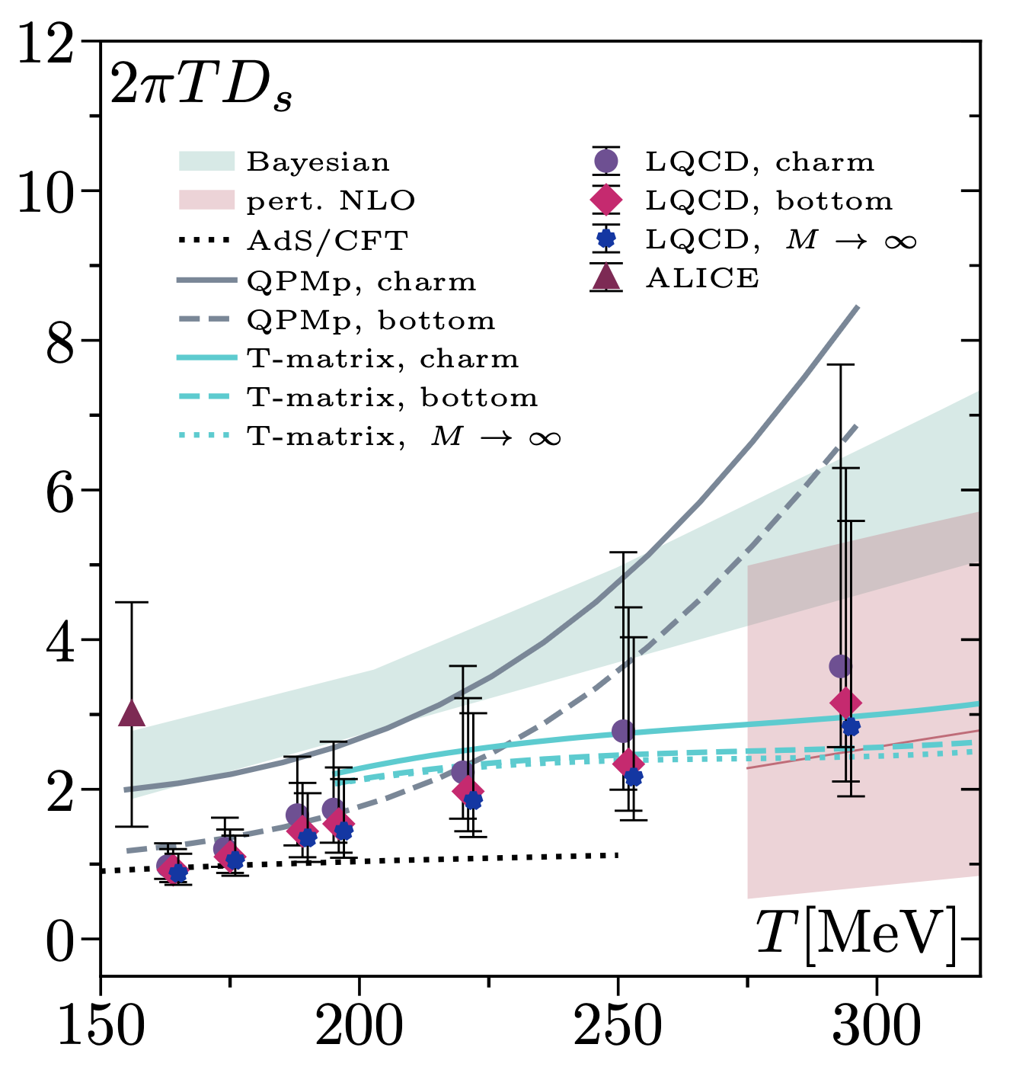
What is known about HQ transport coefficients in QCD
pQCD: (start from Boltzmann eq, linearize collision kernel, match to FP)
Parametric LO:
HTL resummed LO^{2,3} :
Einstein relation violated at finite v.³
HTL resummed NLO⁴ :
NLO correction⁴
2506.11958
Non-perturbative (lattice QCD):
“formally straightforward”
Calculate Euclidean correlator
Spectral function from analytic continuation
D from slope of spectral function at origin
B. Svetitsky PRD 37 (1988), 2484
E. Braaten & M. Thoma, PRD 44 (1991)
3. G. Moore & D. Teaney, PRC71 (2005) 064904
4. S. Caron-Huot & G. Moore, JHEP 02 (2008) 081
5. HotQCD, L. Altenkort et al, PRL 132 (2024) 5, 051902
6. TUMQCD, N. Brambilla et al. PRD 102 (2020) 7, 074503
1.6
Notes:
At LO, HQ interacts via 2->2, dominant contribution from t-channel gluon exchange regulated by m_D^2 \sim g^2 T^2. Scale separation of hard modes of order T and soft modes of order gT leads to logarithms

Slide 14
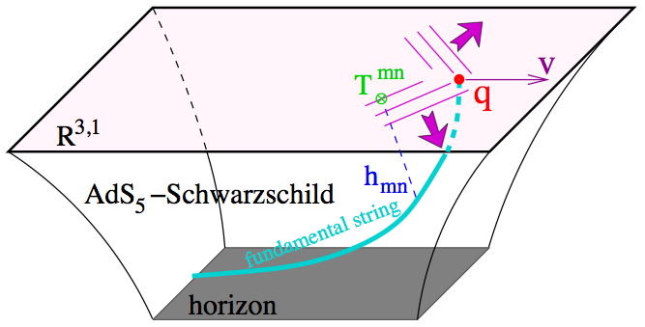
HQ transport coefficients in strongly coupled N=4 SYM
Calculation of drag force via trailing string^{1,2}
Fluctuations on trailing string^{3,4}
“Because of the dramatic failure of the Einstein relation, it doesn’t make sense to plug the trailing string predictions into a Langevin description … “ Gubser 2006
Problem: - non-relativistic limit not applicable for e.g.
- Langevin fails for QCD and (more amenable) strongly coupled QFTs
- Boltzmann transport⁵ equilibrates, of course, but no direct access to
transport coefficients calculable from QFT. Various phenomenologically motivated ad hoc procedures.⁵
1. Gubser hep-th/0605182
2. HKKKY hep-th/0605158
3. Casalderrey-Solana & Teaney hep-ph/0605199, hep-th/0701123
4. Gubser hep-th/0612143
5. R. Rapp et al Nucl.Phys.A 979 (2018) 21-86
1.7

Slide 15
Our work:
Kolmogorov equation

Slide 16
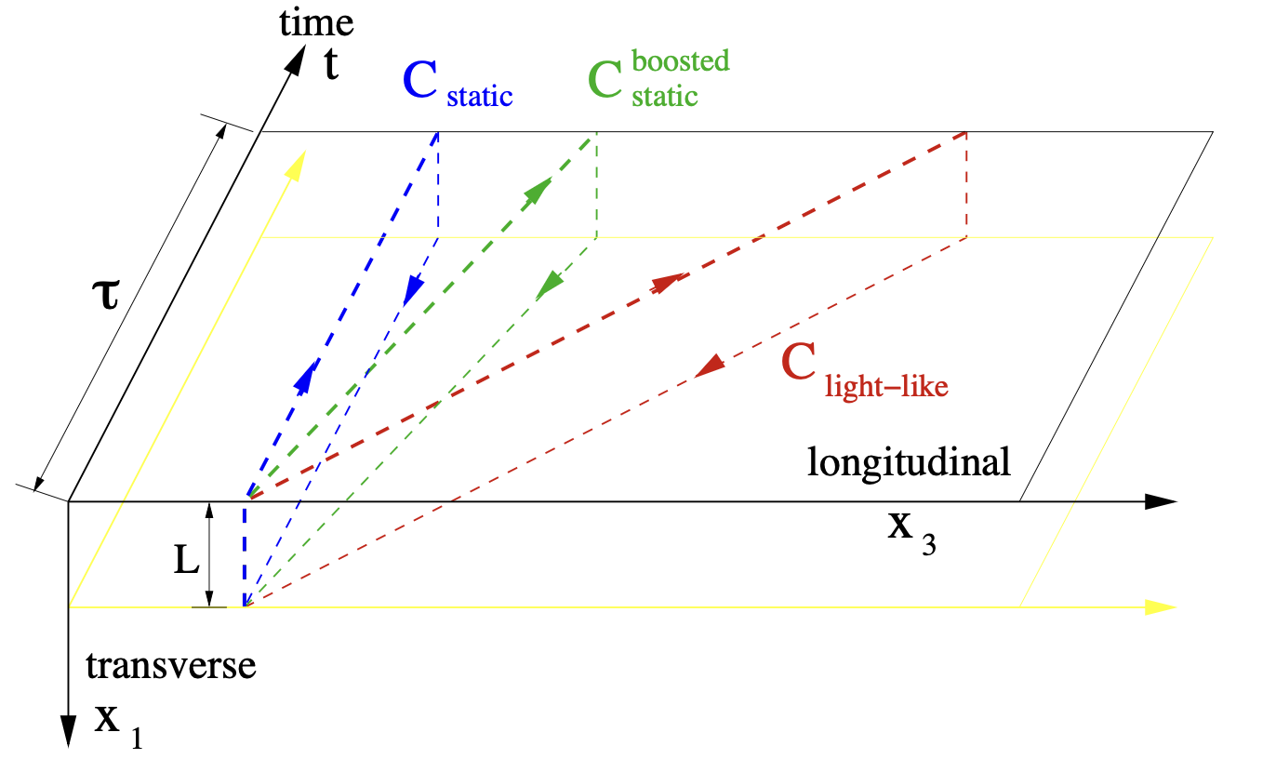
Momentum broadening in HQET
HQ propagator is Wilson line along
Probability for momentum transfer k in time
t
2.1

Slide 17
Kolmogorov equation
Kolmogorov equation
Kolmogorov equation to leading order in M/T takes form of Hamilton-Jacobi equation
2.4

Slide 18
The Kolmogorov kernel guarantees kinetic equilibration
One can show (PT-invariance & KMS):¹
This implies:
Stationary solutions of the Kolmogorov equation satisfy:¹
recall that in equilibrium
1. K. Rajagopal, B. Scheihing-Hitschfeld, UAW, PRL 135 (2025) 24, 24
2.5

Slide 19
An explicit example
HQ transport in strongly coupled N=4 SYM

Slide 20
Result: HQ transport in strongly coupled N=4 SYM
Integration over via saddle point approximation, requiring
Starting from Nambu-Goto actions, one finds simple equations of motion for
Result:¹
can be given algebraically in terms of Appell hypergeometric series
1. K. Rajagopal, B. Scheihing-Hitschfeld, UAW, JHEP 07 (2025) 013
3.3

Slide 21
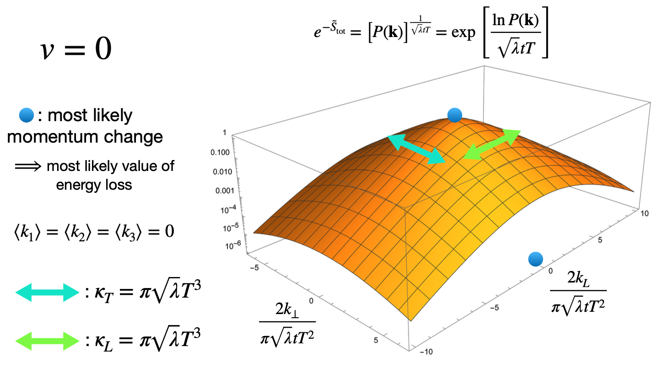
Momentum transfer probability in strongly coupled N=4 SYM
3.4

Slide 22
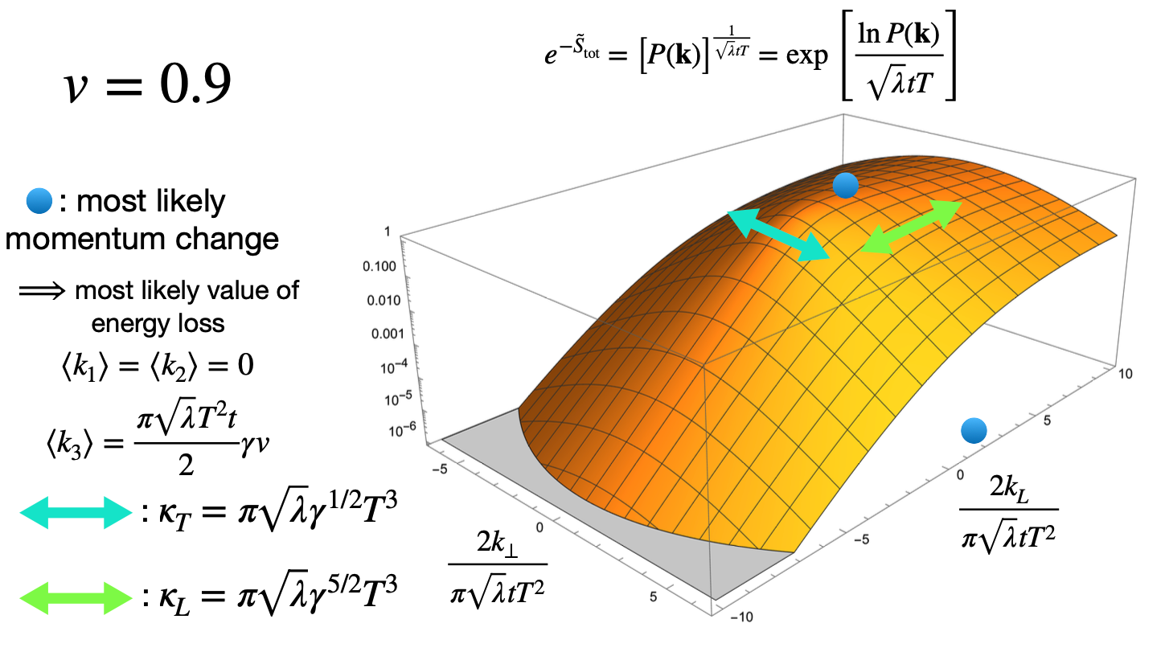
Momentum transfer probability in strongly coupled N=4 SYM
consistent with Gubser
3.5

Slide 23
From Kolmogorov to Kramers-Moyal
S(L,v) is the logarithm of P(k,v) and thus the generating functional of connected momentum moments of P(k,v).
Writing the Kolmogorov equation as series expansion in
leads to an expansion in moments of P(k,v,t) first studied by Kramers¹ and Moyal².
For isotropic case, equilibrium condition reads
(any truncation violates equilibration, equilibration requires all moments)
This solves Gubser’s problem.
If the Kolmogorov eq. reduces to FP eq. and Einstein relation holds
However, for N=4 SYM, one finds³ for v -> 1:
H.A. Kramers, Physica 7 (1940) 284-304
J.E. Moyal, J. Roy. Stat. Society, B 11 (1949) 150-210
3. K. Rajagopal, B. Scheihing-Hitschfeld, UAW, JHEP 07 (2025) 013
3.6

Slide 24
Numerical results
HQ transport in strongly coupled N=4 SYM

Slide 25
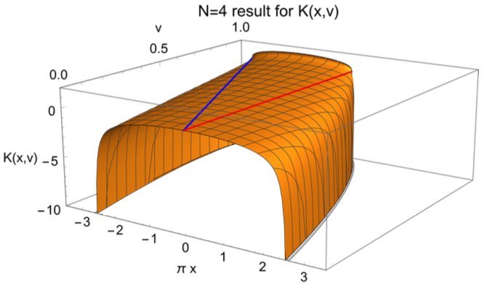
The Kolmogorov kernel in N=4 SYM
Legendre transform again
Numerically easier:
The Kolmogorov kernel has a unstable (unphysical) and a (equilibrium) stationary solution.
4.1

Slide 26
The Kolmogorov equation as a Hamilton-Jacobi equation
To solve system whose evolution is governed by hamiltonian K(x,u) and described by distribution f,
f function of generalized coordinates and generalized momenta
find canonical transformation relating (x,u) to (x₀,u₀) at t₀
Such canonical transformations preserve the variational principle if
Hamilton-Jacobi equation
The Kolmogorov equation can thus be solved by solving the equivalent Hamiltonian problem
We set initial conditions in the form .
4.2

Slide 27
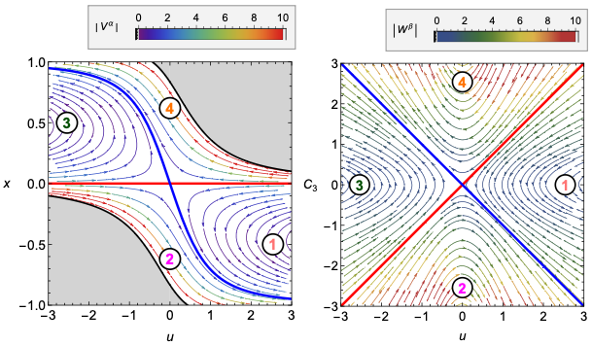
Hamiltonian flow in (u,x)
4.3

Slide 28
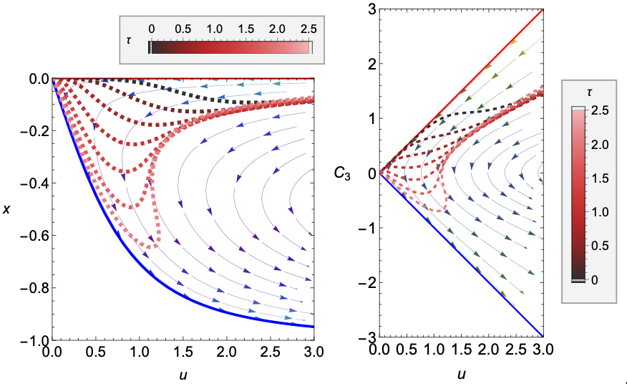
Evolving FONLL-motivated initial conditions
4.4

Slide 29
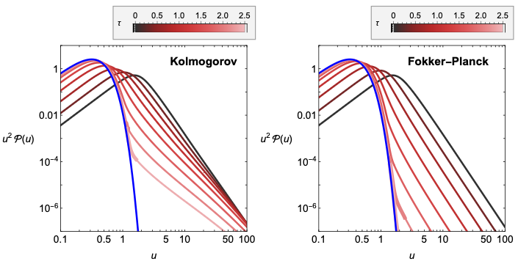
Resulting evolved distributions
For b-like parameters
with Einstein-relation imposed artifically
4.5

Slide 30
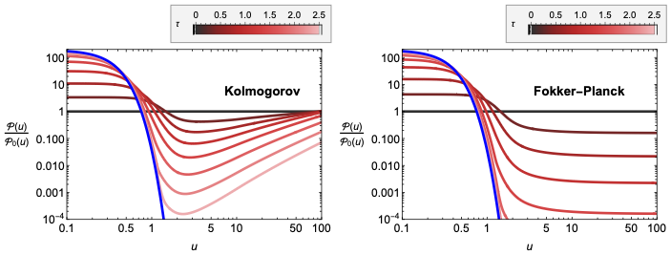
A “kind of” nuclear modification factor
For b-like parameters
with Einstein-relation imposed artificially
At low p_{T}: Kolmogorov and FP approach equilibrium similar
At high p_{T}: Kolmogorov equilibrates characteristically slower and differently.
4.6

Slide 31
Summary
For strongly coupled N=4 SYM, we have calculated the entire momentum transfer function P(k,v,t)
We have calculated all moments of P(k,v,t).
The first moment is the familiar drag
The second moment agrees with Gubser’s result for D but violates Einstein relation.
With P(k,v,t), we have derived an evolution equation for the momentum distribution of heavy quarks.
The generalized equilibration condition is satisfied by P(k,v,t) but requires all higher moments.
All higher moments governed by single scale .
Q: generalization to other QFTs with gravity duals?
For HQs in any QFT
We know generalized equilibration condition for Kolmogorov equation
For QCD
Einstein relation violated but no known techniques available for calculating the entire P(k,v,t) .
Q: Can we learn more about the lowest momentum moments of P(k,v,t) ?
Towards HI - Phenomenology
Noteworthy that Kolmogorov transport accounts for non-trivial shape of “nuclear modification factor” beyond the minimum.

Slide 32
Back-up slides

Slide 33
Linear response
Adiabatic perturbation of number density
Linear response
Initial condition is set by static susceptibility
Relaxation back to equilibrium determines the retarded correlator, is basis of Kubo formula
1.1

Slide 34
Hydrodynamics
Conservation law supplemented by “constitutive equation” (here: Fick’s law) leads to diffusion equation
Solution:
The spectral function is
This yields the Kubo formula for the longitudinal current correlator
1.2

Slide 35
…. getting P(k,v,t) from S(L,v) …
restricted to t - extensive piece
2.2

Slide 36
Evolution of HQ distribution function
Kolmogorov equation
[to leading O(M/T) ]
2.3

Slide 37
A symmetry of the Kolmogorov kernel
It also follows from
that
This generalizes the Einstein relation. It is the equilibration condition for the Kolmogorov equation in any QFT.¹
It is an incarnation of detailed balance:
1. K. Rajagopal, B. Scheihing-Hitschfeld, UAW, PRL 135 (2025) 24, 24
2.6

Slide 38
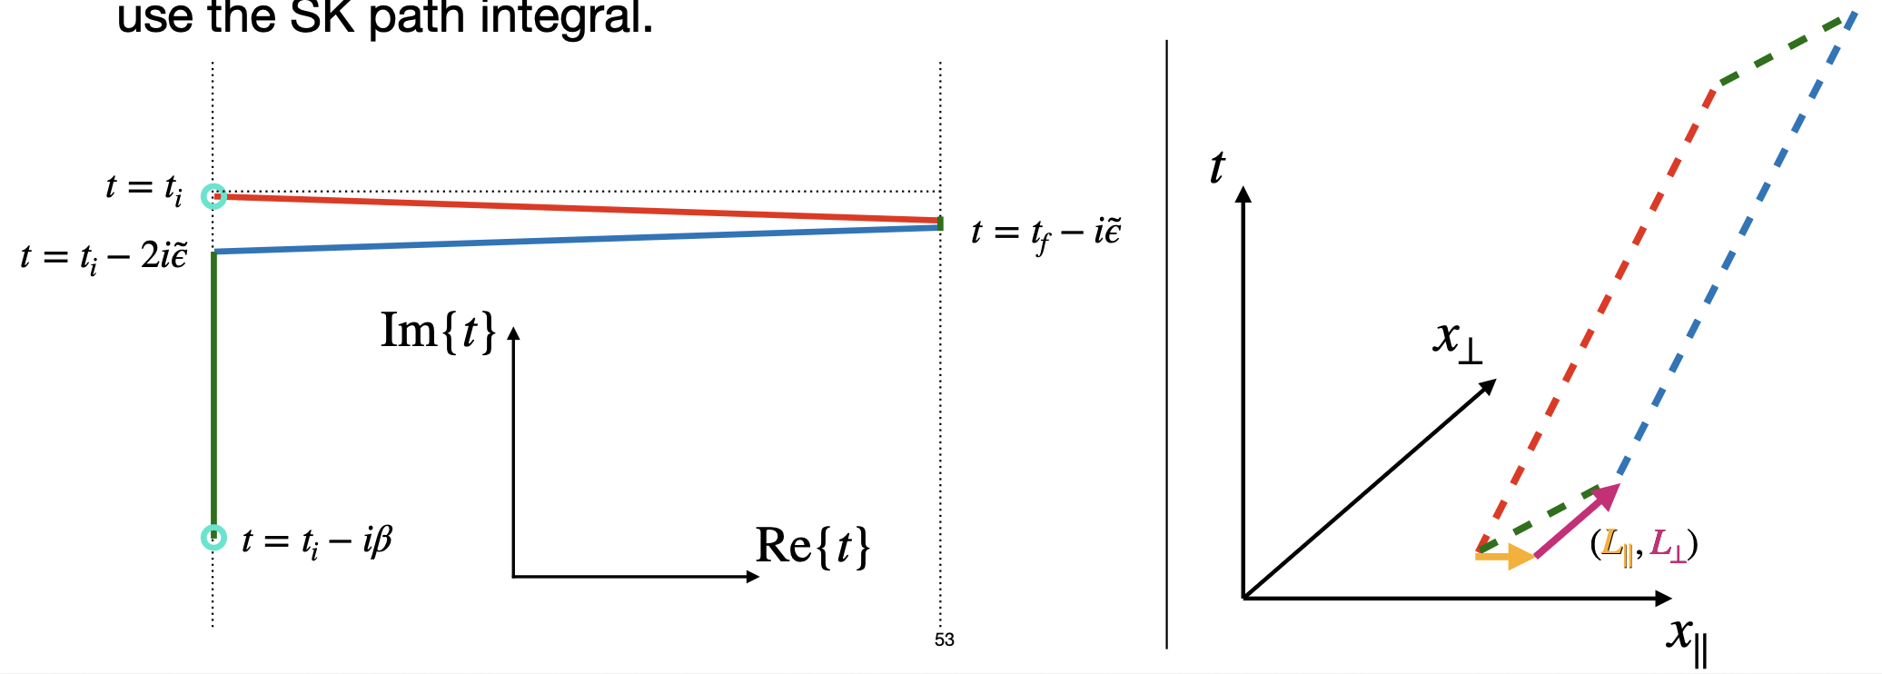
HQ transport in strongly coupled N=4 SYM
BACK-UP
According to gauge-gravity duality, Wilson loop along contour C obtained from Nambu-Goto action of a string in higher-dimensional space-time with boundary conditions set by C.
Metric is that of a black brane with temperature T
The Wilson loop wraps around a Schwinger – Keldysh contour
Rey & Yee, hep-th/9803001, Maldacena hep-th/9803002, Drukker, Gross & Ooguri hep-th/9904191
3.1

Slide 39
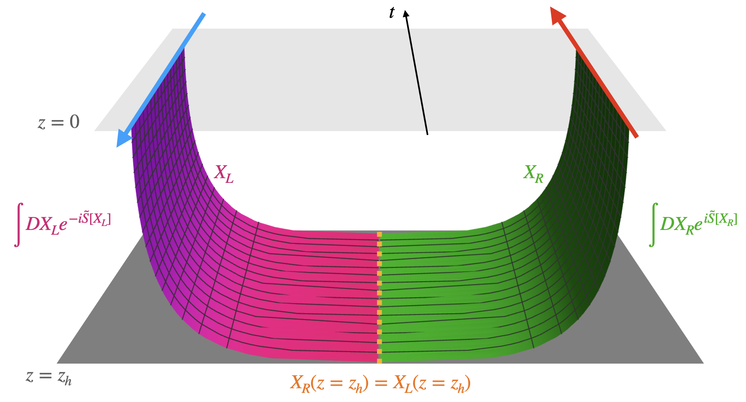
BACK-UP
HQ transport in strongly coupled N=4 SYM
Euclidean part non-extensive
and therefore
1. K. Rajagopal, B. Scheihing-Hitschfeld, UAW, JHEP 07 (2025) 013
3.2

