Slide 1
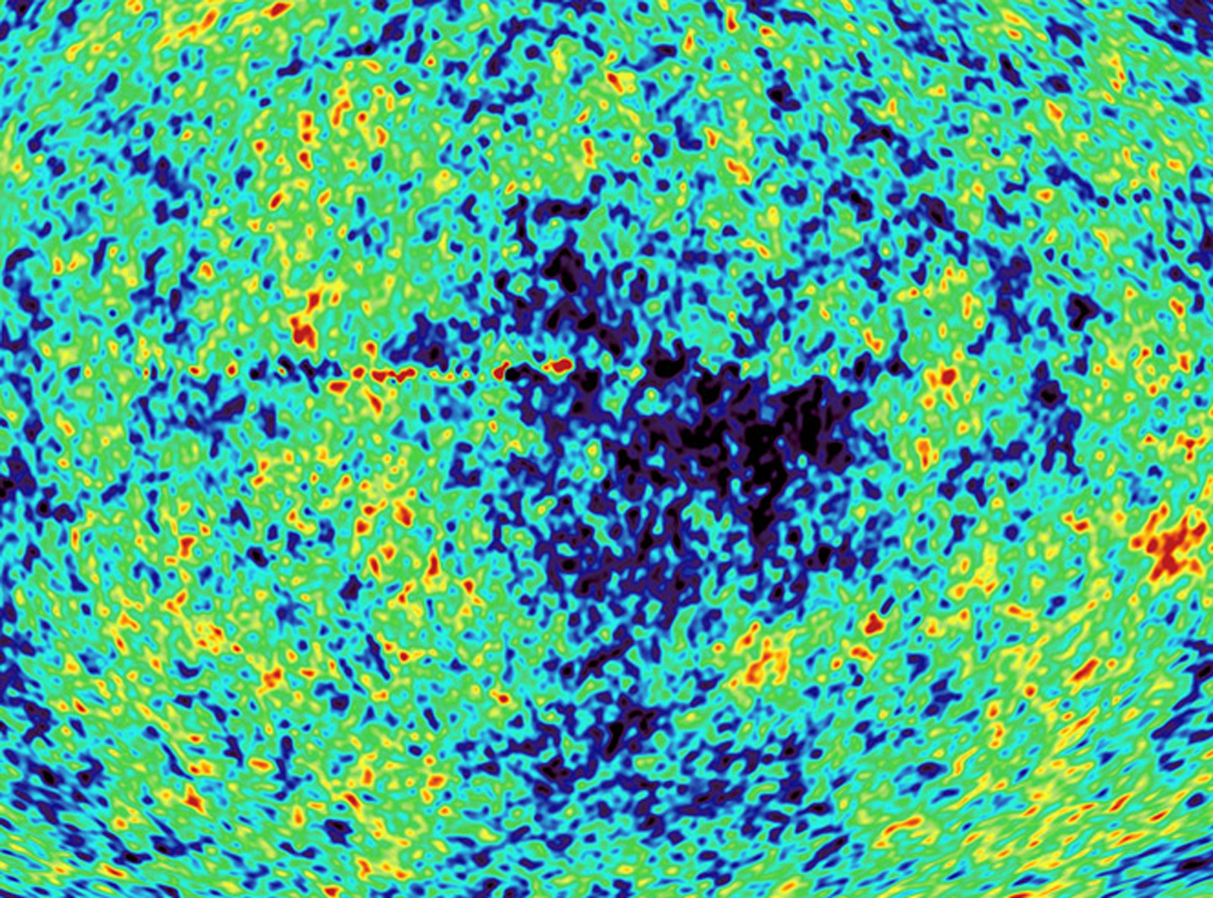
Precision cosmology, status and perspectives
GGI Conference on
“The Dark Matter connection: Theory & Experiment”
Florence, May 17th 2010
Alessandro Melchiorri
Universita’ di Roma, “La Sapienza”
INFN, Roma-1

Slide 2
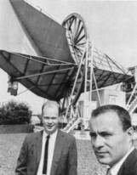
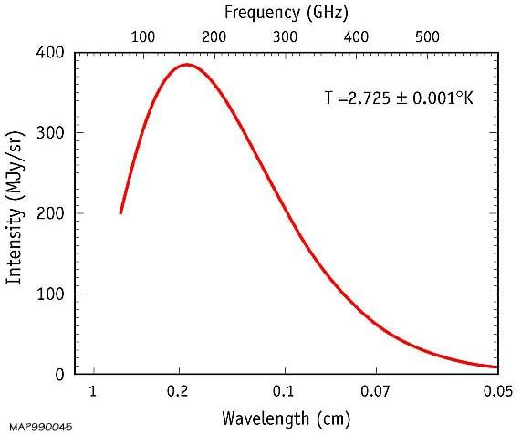
The Cosmic Microwave Background
Discovered By Penzias and Wilson in
1965.
It is an image of the universe at the
time of recombination (near
baryon-photons decoupling), when the
universe was just a few thousand years
old (z~1000).
The CMB frequency spectrum
is a perfect blackbody at T=2.73 K:
this is an outstanding confirmation
of the hot big bang model.

Slide 3
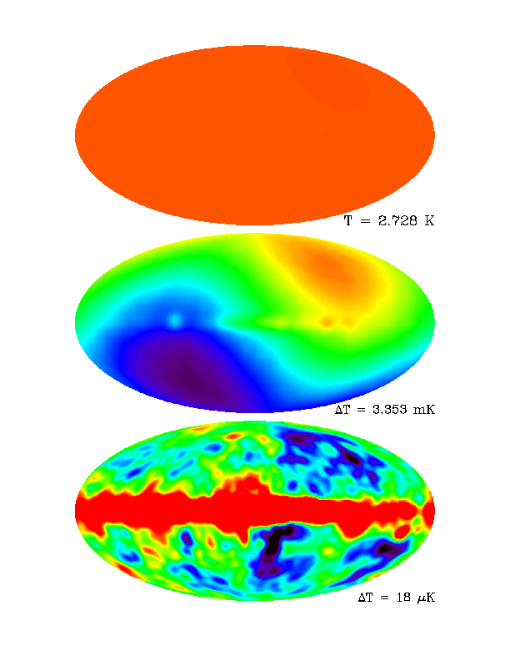
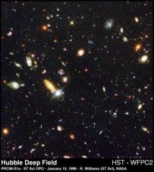
The Microwave Sky
COBE
Uniform...
Dipole...
Imprint left by primordial
tiny density inhomogeneities
(z~1000)..
Galaxy (z=0)

Slide 4
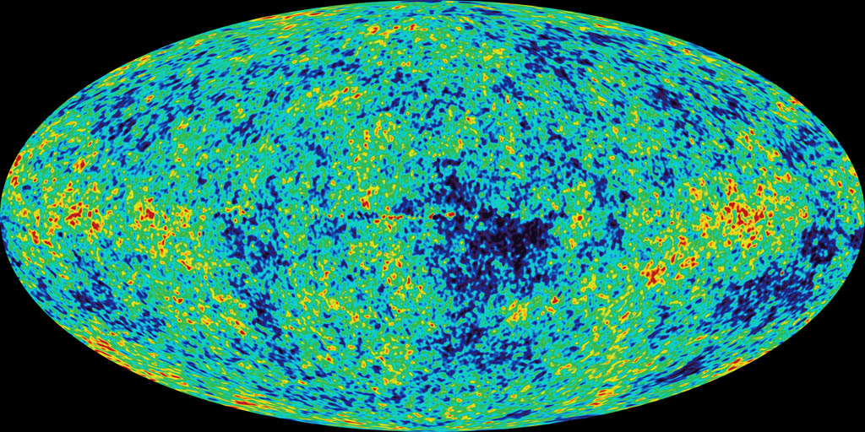
WMAP

Slide 5
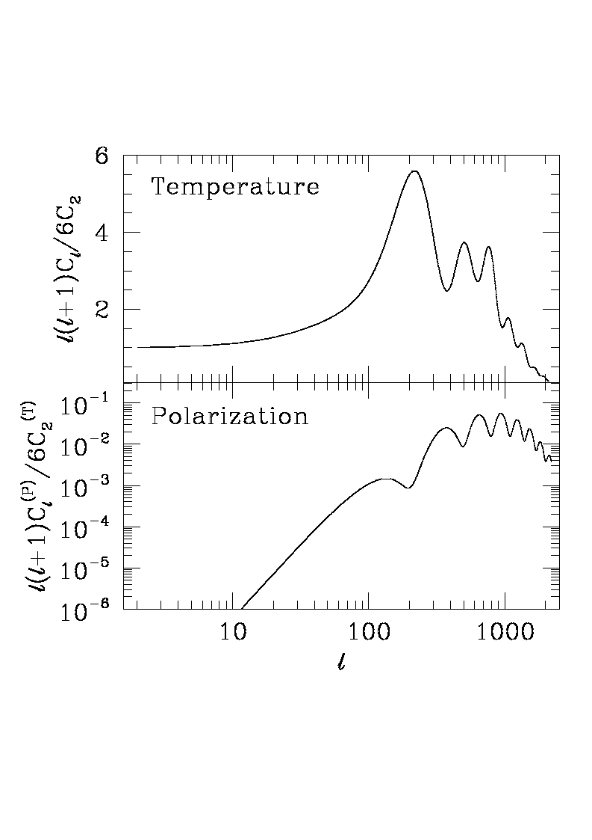
Larger scales

Slide 6
CMB Anisotropies
Visibility
Function
Gravity
ISW
Doppler
Adiabatic
Four mechanisms are responsable for CMB anisotropies:
Gravity (Sachs-Wolfe effect)
Intrinsic (Adiabatic) Fluctuations
Doppler effect
Time-Varying Potentials (Integrated Sachs-Wolfe Effect)

Slide 7
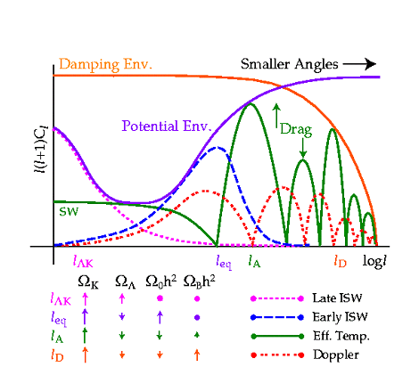
Hu, Sugiyama, Silk, Nature 1997, astro-ph/9604166

Slide 8
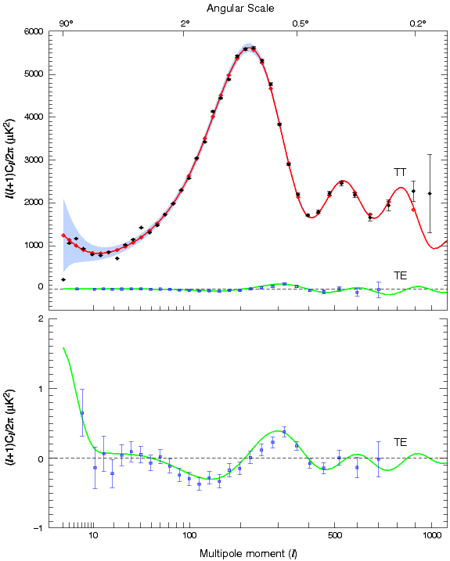
WMAP

Slide 9
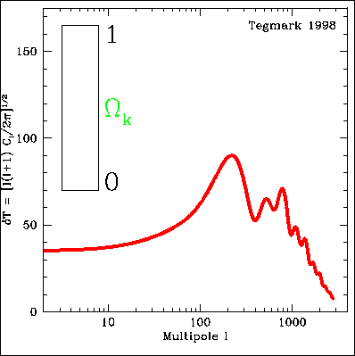
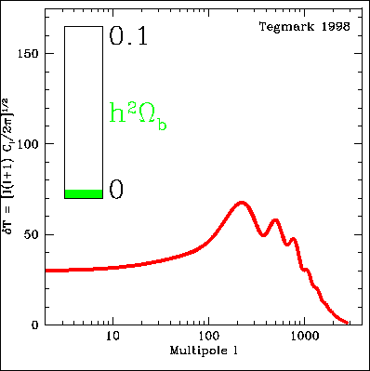
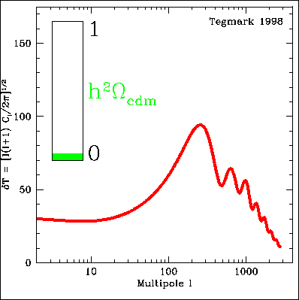
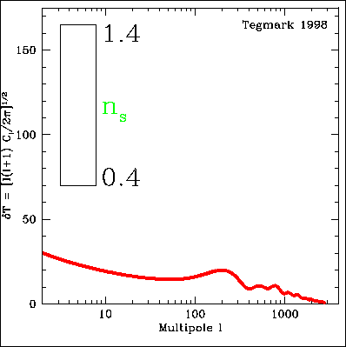
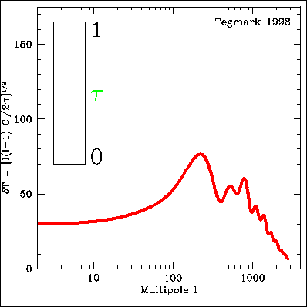
We can measure cosmological parameters with CMB !
Temperature Angular spectrum varies with
Ωtot , Ωb , Ωc, Λ, τ, h, ns, …

Slide 10
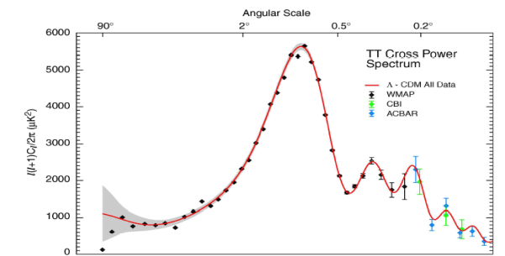
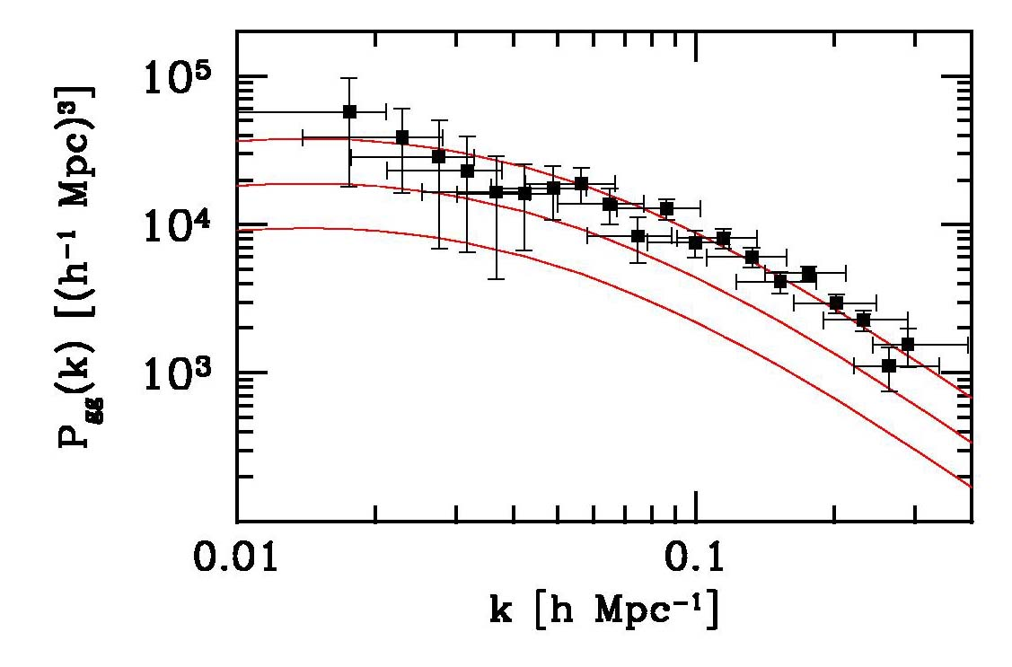
How to get a bound on a cosmological parameter
Fiducial cosmological model:
(Ω_{b}h² , Ω_{m}h² , h , n_{s} , τ, Σm_{ν} )
DATA
PARAMETER
ESTIMATES

Slide 11
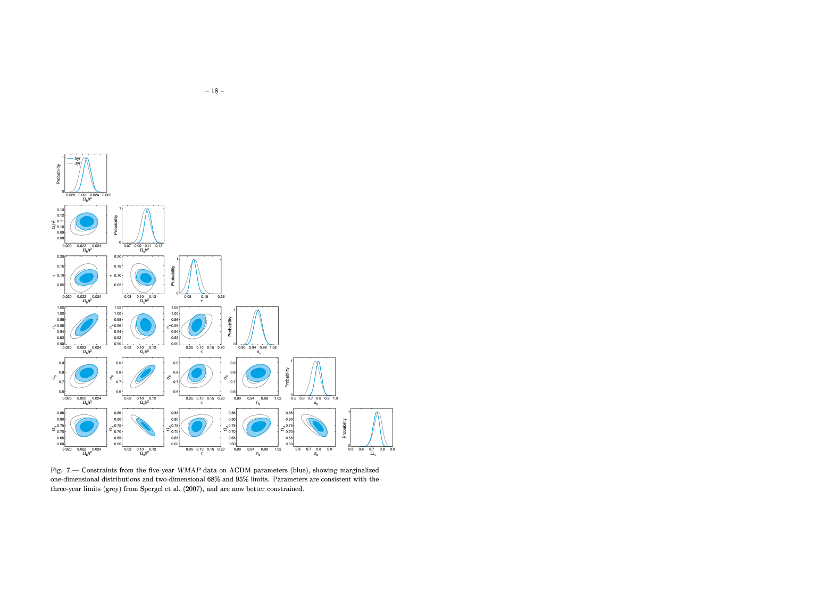
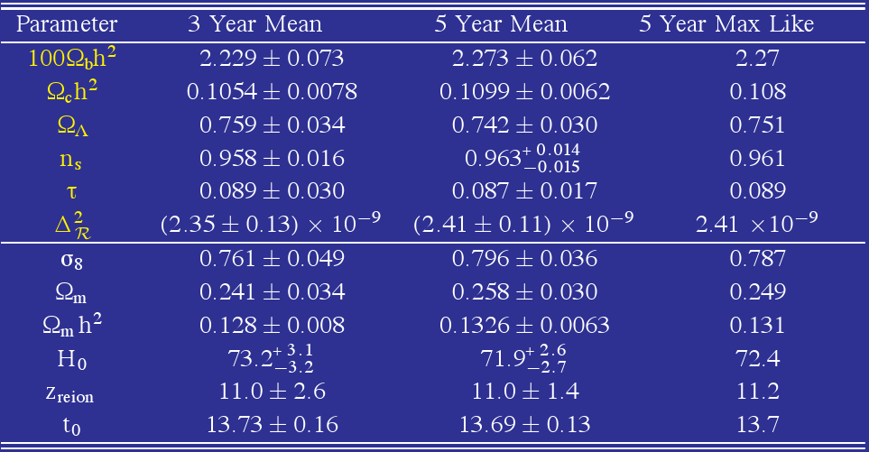
Dunkley et al., 2008

Slide 12
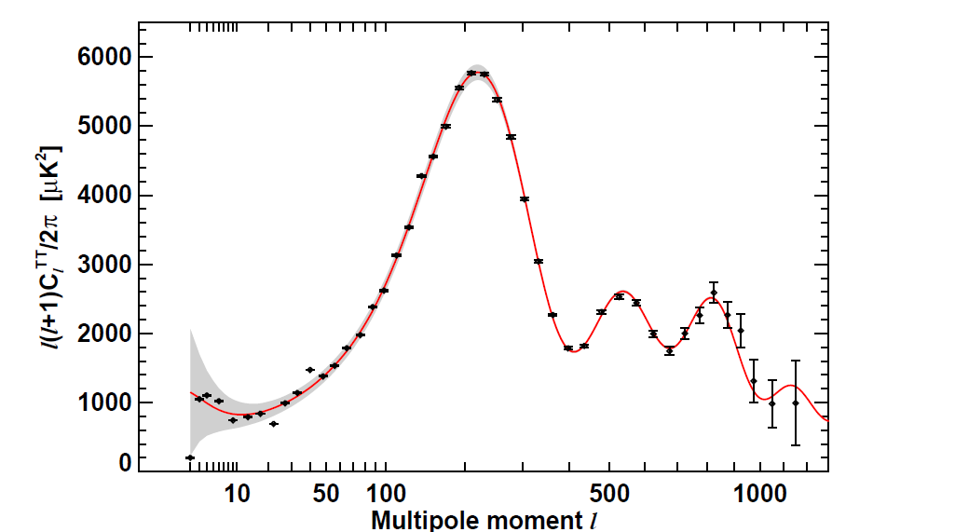
New WMAP results from 7 years of observations
Komatsu et al, 2010, 1001.4538

Slide 13
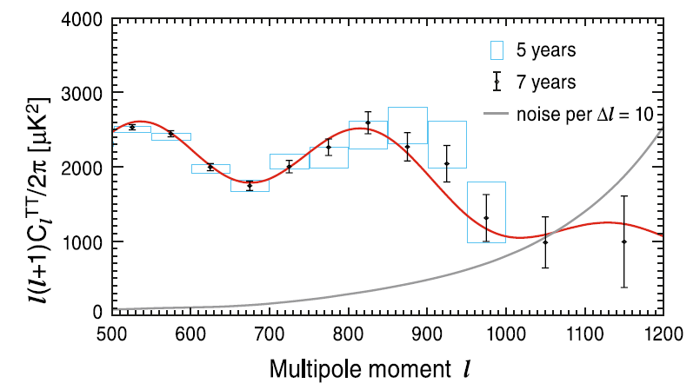

Slide 14
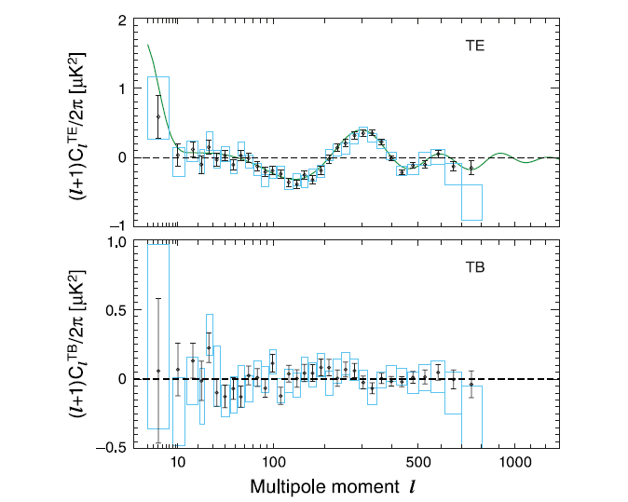

Slide 15
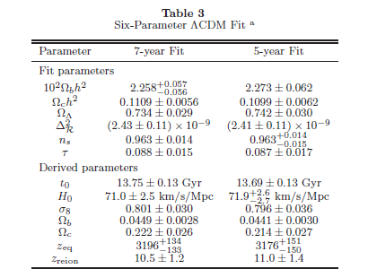

Slide 16
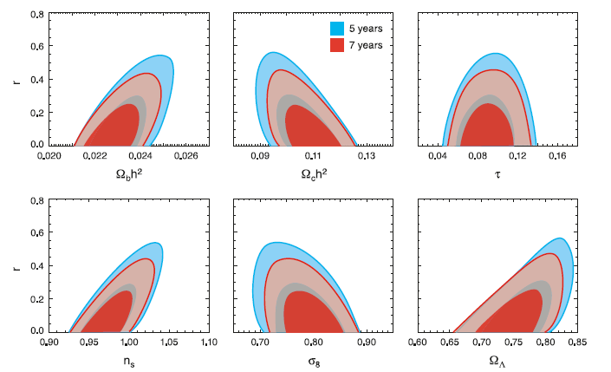
Improvement in constraining Inflationary Parameters from WMAP5 to WMAP7
Ruling out n=1 (HZ spectrum) would be a great success for inflation (primordial pertubations
are produced by a dynamical mechanism).

Slide 17
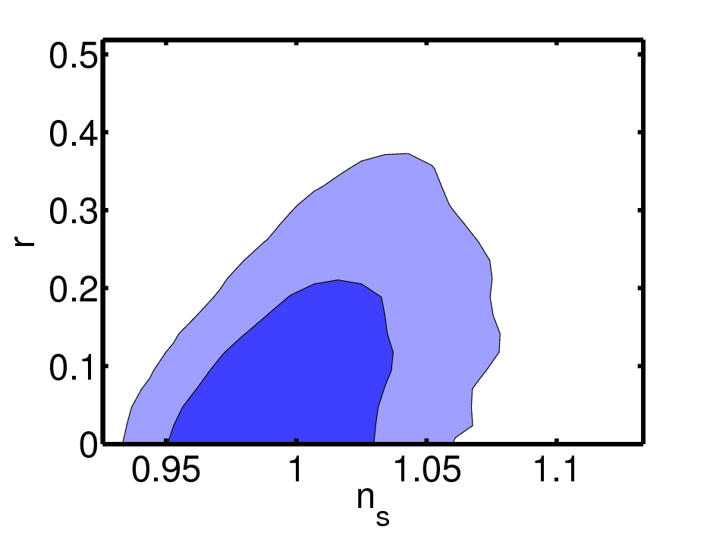
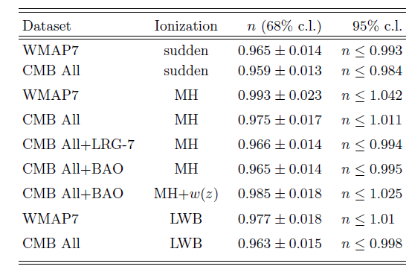
Caveat (example): Constraints on inflationary parameters depend on assumption of
Sudden reionization scenario. A more general scheme based on principal components
(Mortonson and Hu, MH) can put n=1 back in agreement with observations.
Planck will settle the issue.
(no tensor)
WMAP7
+MH
+ Tensors
Pandolfi, Cooray, Giusarma, Kolb, Melchiorri, Mena, Serra, 2010
Dark Matter Annihilation -> extra photons -> different ionization scenario -> n=1 ok !

Slide 18
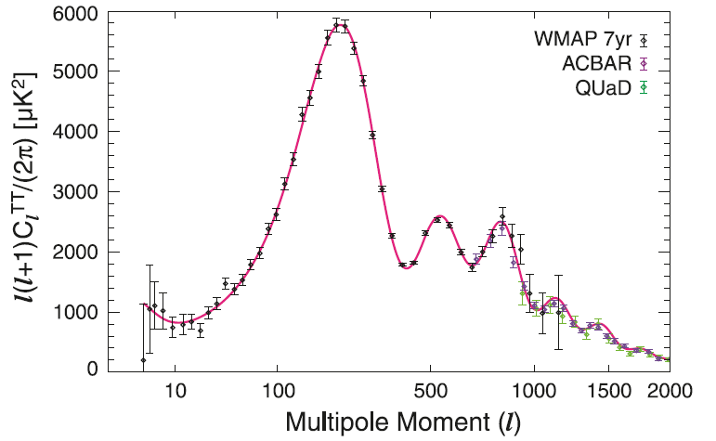
Komatsu et al, 2010, 1001.4538

Slide 19
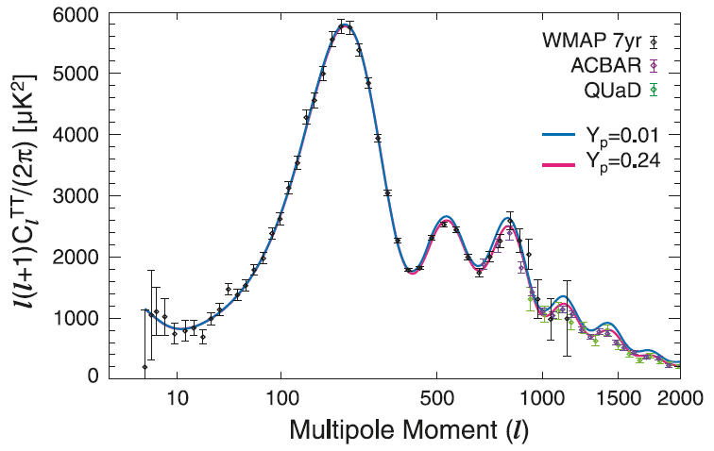
Small scale CMB can probe Helium abundance at recombination. Changes in the visibility
function.

Slide 20
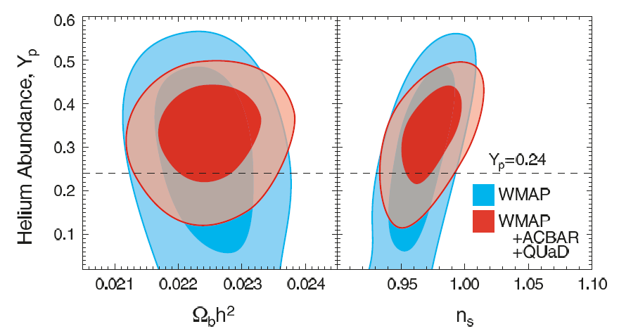
Komatsu et al, 2010, 1001.4538

Slide 21
CMB Anisotropies
Visibility
Function
Gravity
ISW
Doppler
Adiabatic
Four mechanisms are responsable for CMB anisotropies:
Gravity (Sachs-Wolfe effect)
Intrinsic (Adiabatic) Fluctuations
Doppler effect
Time-Varying Potentials (Integrated Sachs-Wolfe Effect)

Slide 22
Hu, Sugiyama, Silk, Nature 1997, astro-ph/9604166

Slide 23
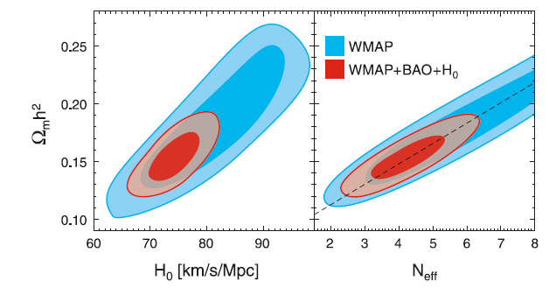
Komatsu et al, 2010, 1001.4538
Neutrino background.
Changes early ISW.
Hint for N>3 ?

Slide 24
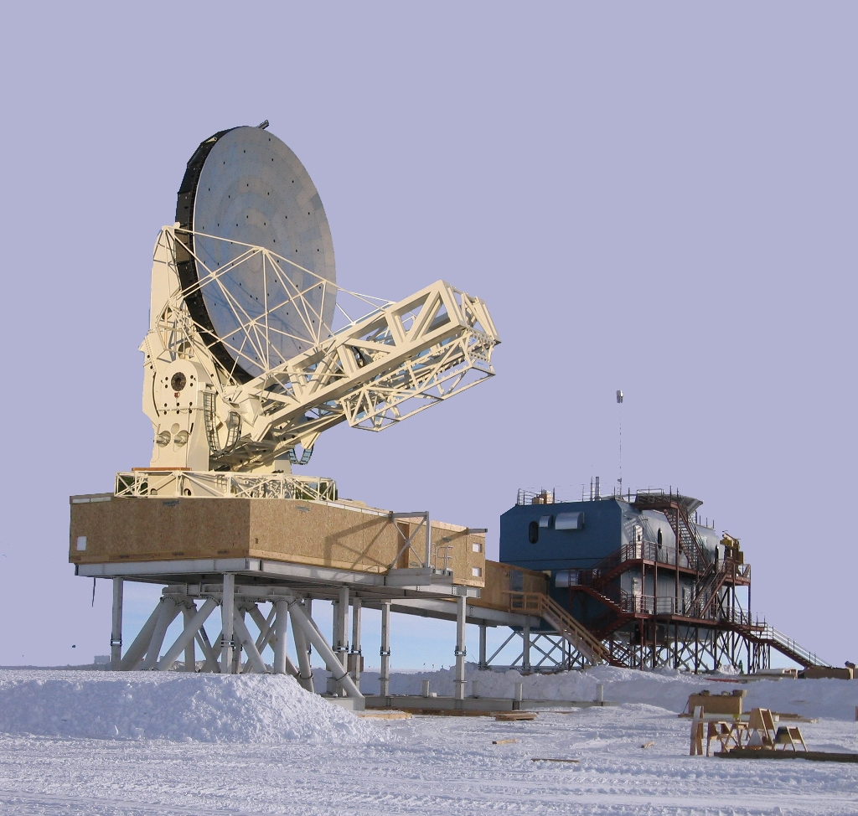
South Pole Telescope- SPT

Slide 25
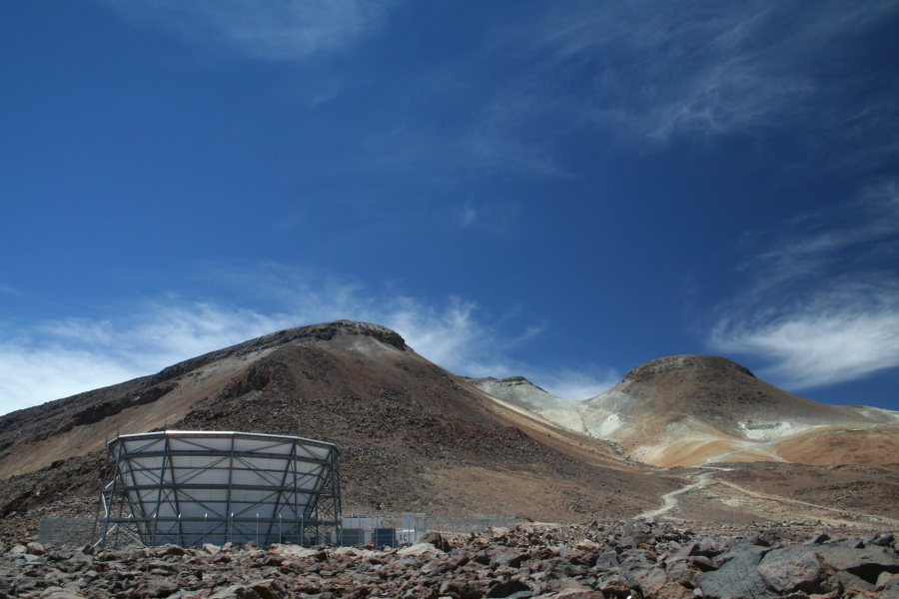
Atacama Cosmology Telescope ACT

Slide 26
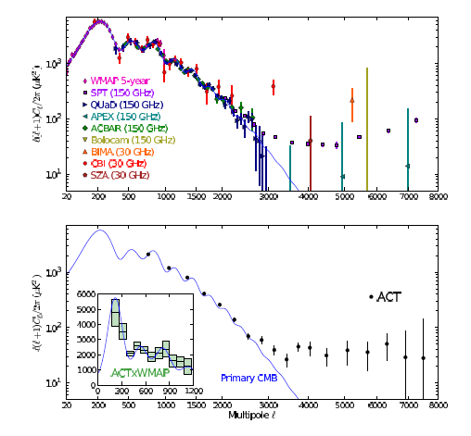
New small-scale CMB measurements by ACT and SPT
Flowler et al (ACT collaboration), 2010

Slide 27
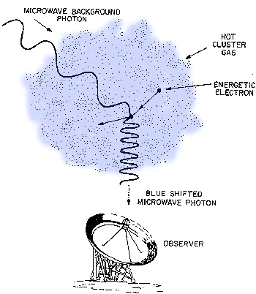
Thermal Sunyaev-Zel’dovich effect SPT sampling frequencies at 150 and 220 GHz can
discriminate it from Dusty Star Forming Galaxies (DSFG) foregrounds (ACT can’t).

Slide 28
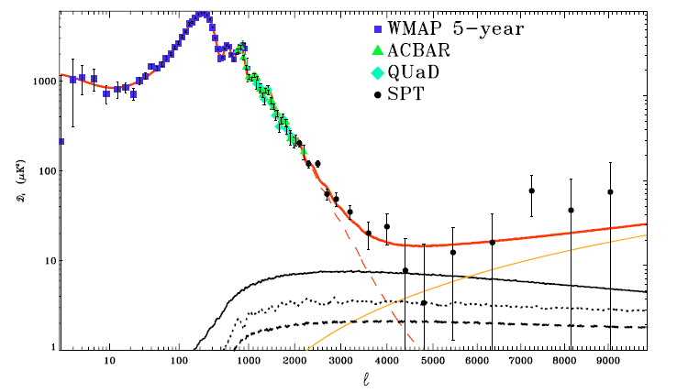
Unresolved
Point
Sources
Thermal SZ
Kinetic SZ
M. Lueker et al (SPT collaboration), 2009

Slide 29
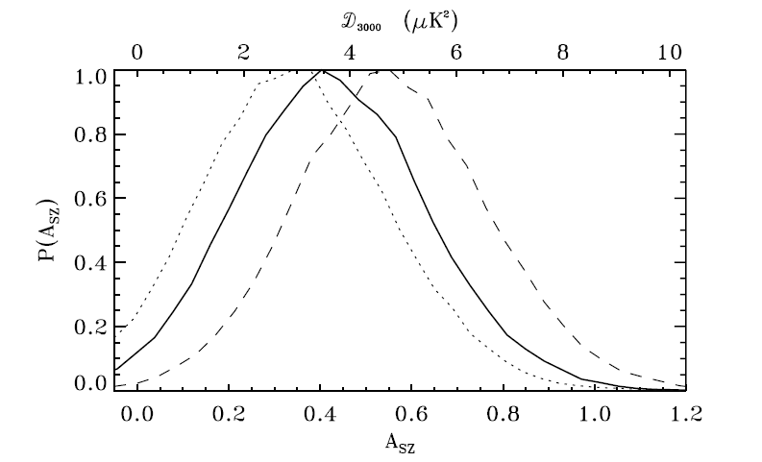
SPT measures an SZ amplitude lower by a factor 2 than expected !
Systematics ?
SZ model ?
New physics ? (Dark coupling, modified GR, Dark Matter) ?

Slide 30
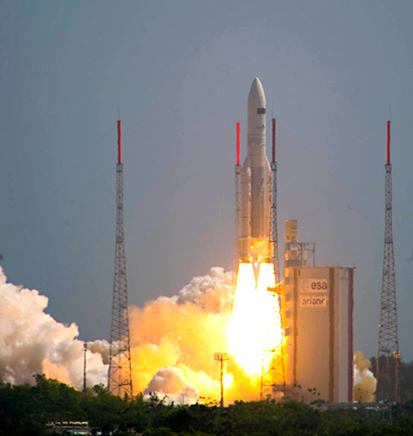
Planck
Satellite launch
14/5/2009

Slide 31
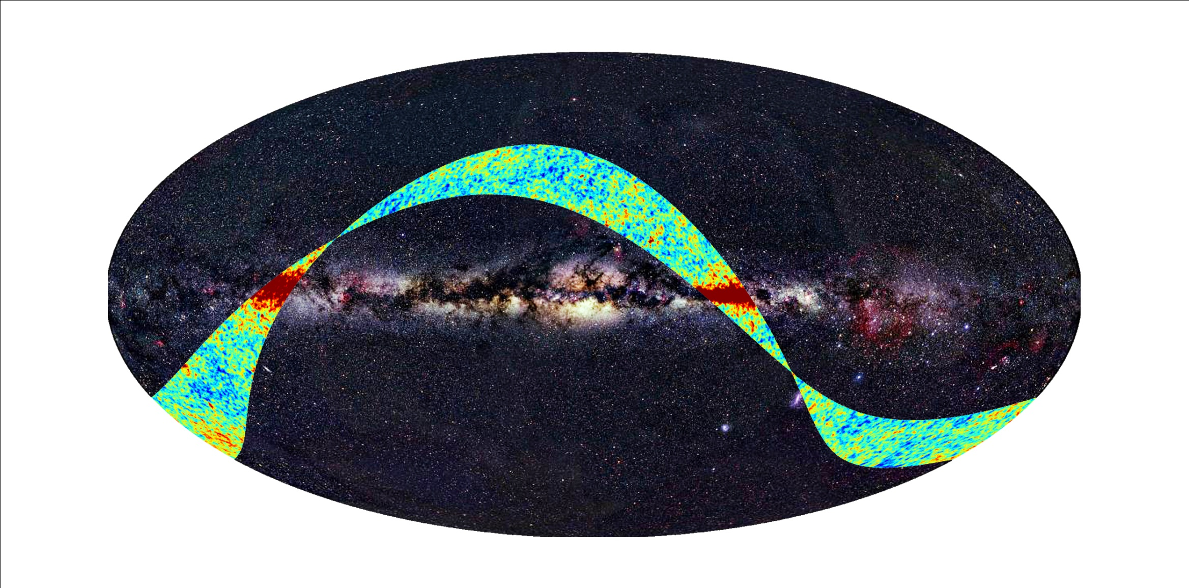
Planck First Light Survey (September 2009). Experiment is working as expected

Slide 33
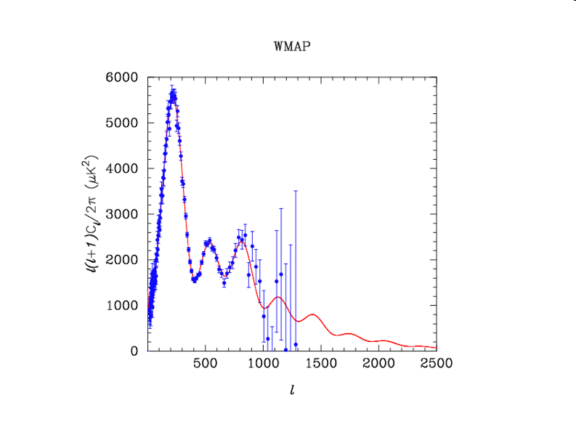
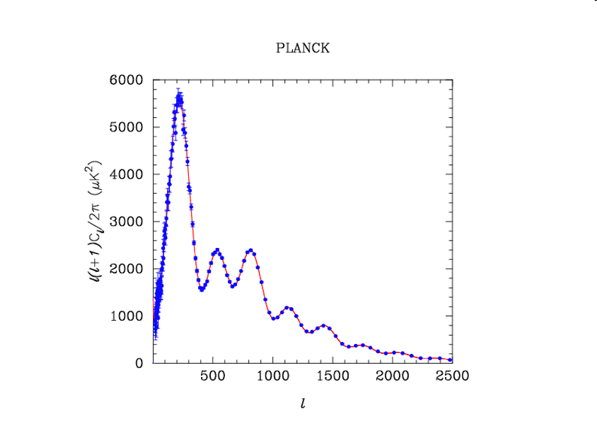

Slide 34
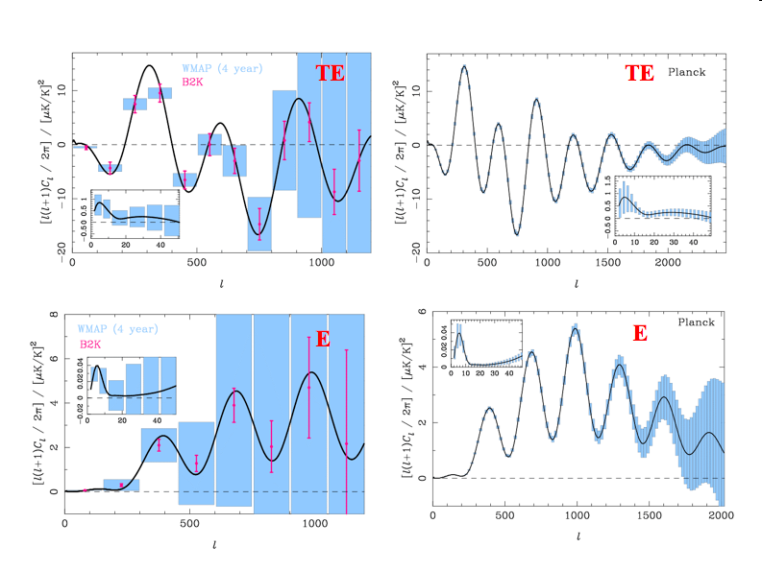

Slide 35
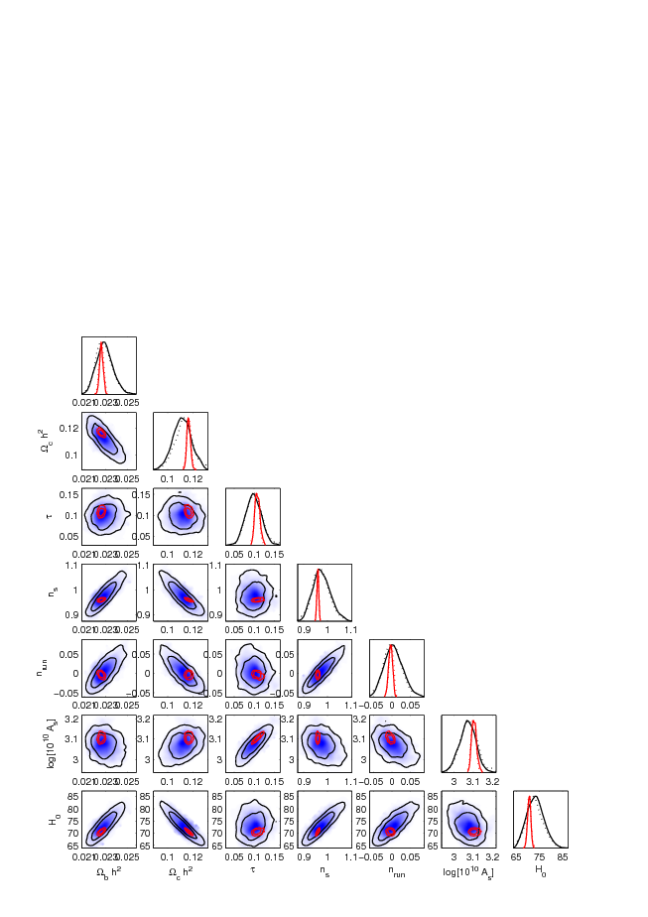
Blue: current data
Red: Planck

Slide 36
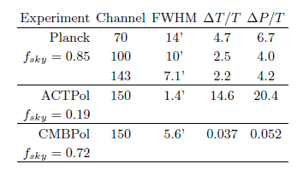
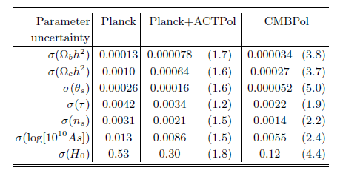

Slide 37
New Measurements, New Parameters !
Neutrino masses
Neutrino effective number
Primordial Helium
Fundamental Constants

Slide 38
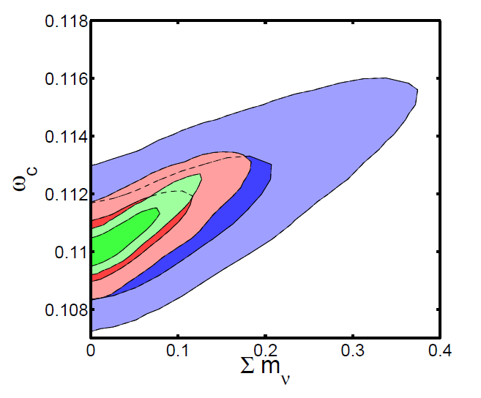
Galli, Martinelli, Melchiorri, Pagano, Sherwin, Spergel, to be submitted 2010

Slide 39
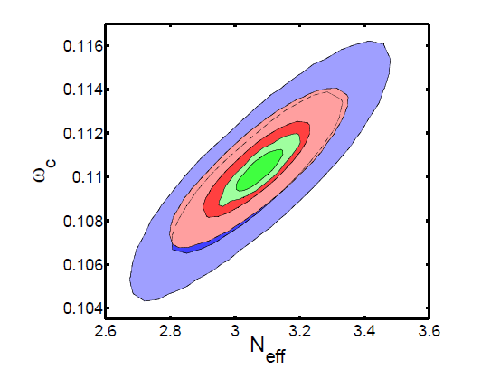
Galli, Martinelli, Melchiorri, Pagano, Sherwin, Spergel, to be submitted 2010

Slide 40
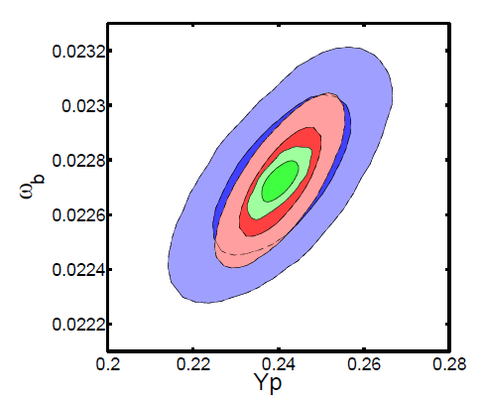
Galli, Martinelli, Melchiorri, Pagano, Sherwin, Spergel, to be submitted 2010

Slide 41
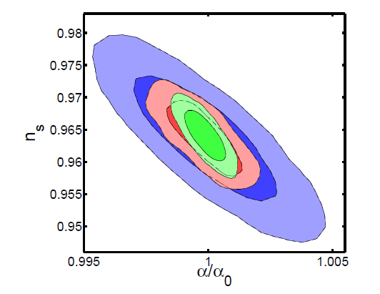
Galli, Martinelli, Melchiorri, Pagano, Sherwin, Spergel, to be submitted 2010

Slide 42
CONCLUSIONS
Recent CMB measurements fully confirm Λ-CDM. Improved constraints on inflation
Ionization History still to be probed by observations.
Problems with integrated SZ effect on small scales (now too low).
With future measurements constraints on new parameters related to laboratory
Physics could be achieved.

Slide 43
