Slide 1
On Holographic nuclear attraction and nuclear matter
GGI May 2011
V. Kaplunovsky
A. Dymarsky, D. Melnikov and S. Seki,

Slide 2
Introduction
In recent years holography or gauge/gravity duality has provided a new tool to handle strong coupling problems.
It has been spectacularly successful at explaining certain features of the quark-gluon plasma such as its low viscosity/entropy density ratio.
A useful picture, though not complete , has been developed for glueballs , mesons and baryons.
This naturally raised the question of whether one can apply this method to address the questions of nuclear interactions and nuclear matter.

Slide 3
Nuclear binding energy puzzle
The interactions between nucleons are very strong so why is the nuclear binding non-relativistic, about 17% of Mc^2 namely 16 Mev per nucleon.
The usual explanation of this puzzle involves a near-cancellation between the attractive and the repulsive nuclear forces. [Walecka ]
Attractive due to σ exchange -400 Mev
Repulsive due to ω exchange + 350 Mev
Fermion motion + 35 Mev
------------
Net binding per nucleon - 15 Mev

Slide 4


Limitations of the large Nc and holography
Is nuclear physics at large Nc the same as for finite Nc?
Lets take an analogy from condensed matter – some atoms that attract at large and intermediate distances but have a hard core- repulsion at short ones.
The parameter that determine the state at T=0 p=0 is
de Bour parameter
and where
is the kinetic term rc is the radius of the atomic hard core and ε is the maximal depth of the potential.

Slide 5

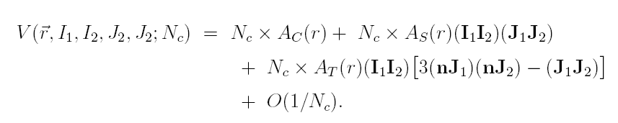
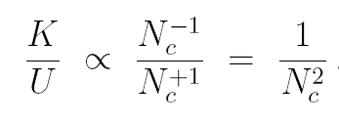
Limitations of Large Nc and holography
When exceeds 0.2-0.3 the crystal melts.
For example,
Helium has ΛB = 0.306 K/U ≈ 1 quantum liquid
Neon has ΛB = 0.063 , K/U ≈ 0.05; a crystalline solid
For large Nc the leading nuclear potential behaves as
Since the well diameter is Nc independent and the mass M scales as~Nc

Slide 6



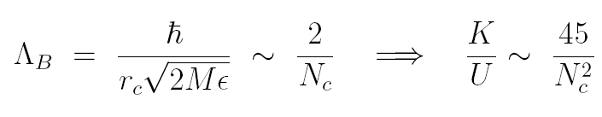
Limitations of Large Nc and holography
The maximal depth of the nuclear potential is ~ 100 Mev
so we take it to be , the mass as
and .
Consequently
Hence the critical value is Nc=8
Liquid nuclear matter Nc<8
Solid Nuclear matter Nc>8

Slide 7
Limitations of the large Nc limit
Why is the attractive interaction between nucleons only a little bit stronger than the repulsive interaction?
Is this a coincidence depending on quarks having precisely 3 colors and the right masses for the u, d, and s flavors?
Or is this a more robust feature of QCD that would persist for different Nc and any quark masses (as long as two flavors are light enough)?

Slide 8
Outline
The puzzle of nuclear interaction
Limitations of large Nc nuclear physics
Stringy baryons of holography
Digression –Baryon as a string in Nc=3
Baryons as flavor gauge instantons
The laboratory: a generalized Sakai Sugimoto model

Slide 9
Outline
Nuclear attraction in the gSS.
Problems of holographic baryons.
Nuclear physics in other holographic models
Attraction versus repulsion in the DKS model
Lattice of Nuclei and multi-instanton solutions.
Summary and open questions

Slide 10
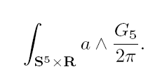
Baryons in hologrphy
How to identify a baryon in holography ?
Since a quark corresponds to a string, the baryon has to be a structure with N_{c} strings connected to it.
Witten proposed a baryonic vertex in AdS₅xS⁵ in the form of a wrapped D5 brane over the S⁵.
On the world volume of the wrapped D5 brane there is a CS term of the form
Scs=

Slide 11

Baryonic vertex
The flux of the five form
It implies that there is a charge N_{c} for the abelian gauge field. Since in a compact space one cannot have non-balanced charges there must be N _{c} strings attached to it.

Slide 12
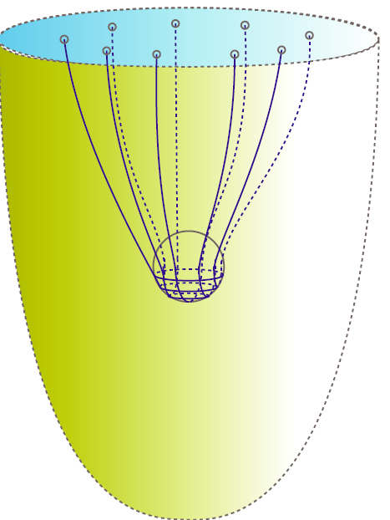
External baryon
External baryon – Nc strings connecting the baryonic vertex and the boundary
boundary
Wrapped
D4 brane

Slide 13
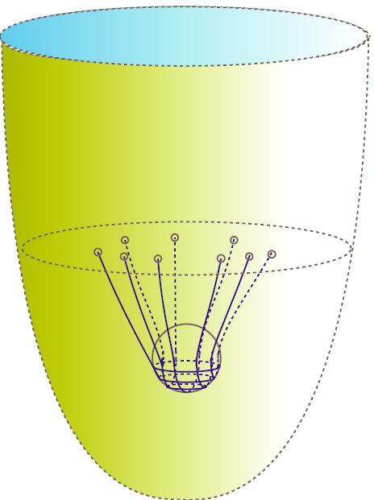
Dynamical baryon
Dynamical baryon – Nc strings connecting the baryonic vertex and flavor branes
boundary
Flavor brane dynami
Wrapped D4
brane

Slide 14
Possible experimental trace of the baryonic vertex?
Let’s set aside holography and large Nc and discuss the possibility to find a trace of the baryonic vertex for Nc=3.
At Nc=3 the stringy baryon may take the form of a baryonic vertex at the center of a Y shape string junction.

Slide 15
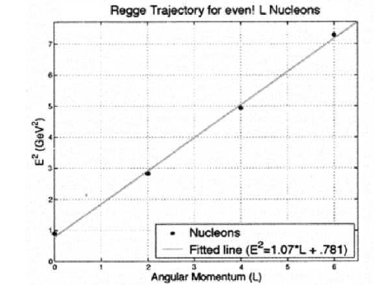
Possible experimental trace of the baryonic vertex?
Baryons like the mesons furnish Regge trajectories
For N_{c}=3 a stringy baryon may be similar to the Y shape “old” stringy picture. The difference is massive baryonic vertex.

Slide 16
Baryonic vertex in experimental data?
The effect of the baryonic vertex in a Y shape baryon on the Regge trajectory is very simple. It affects the Mass but since if it is in the center of the baryon it does not affect the angular momentum
We thus get instead of the naïve Regge trajectories
J= α’_{mes} M² + α₀ → J= α’_{bar}(M-mbv)² ⁺α₀
and similarly for the improved trajectories with massive endpoints
Comparison with data shows that the best fit is for
m_{bv} =0 and α’_{bar} ~ α’_{mes}

Slide 17
Excited baryon as a single string
Thus we are led to a picture where an excited baryon is a single string with a quark on one end and a di-quark (+ a baryonic vertex) at the other end.
This is in accordance with stability analysis which shows that a small perturbation in one arm of the Y shape will cause it to shrink so that the final state is a single string

Slide 18
Stability of an excited baryon
‘t Hooft showed that the classical Y shape three string configuration is unstable. An arm that is slightly shortened will eventually shrink to zero size.
We have examined Y shape strings with massive endpoints and with a massive baryonic vertex in the middle.
The analysis included numerical simulations of the motions of mesons and Y shape baryons under the influence of symmetric and asymmetric disturbances.
We indeed detected the instability
We also performed a perturbative analysis where the instability does not show up.

Slide 19
Baryonic instability
The conclusion from both the simulations and
the qualitative analysis is that indeed the
Y shape string configuration is unstable to
asymmetric deformations.
Thus an excited baryon is an unbalanced single
string with a quark on one side and a diquark
and the baryonic vertex on the other side.

Slide 20
The location of the baryonic vertex
Back to holography
We need to determine the location of the baryonic vertex in the radial direction.
In the leading order approximation it should depend on the wrapped brane tension and the tensions of the Nc strings.
We can do such a calculation in a background that corresponds to confining and to deconfining gauge theories. Obviously we expect different results for the two cases.

Slide 21

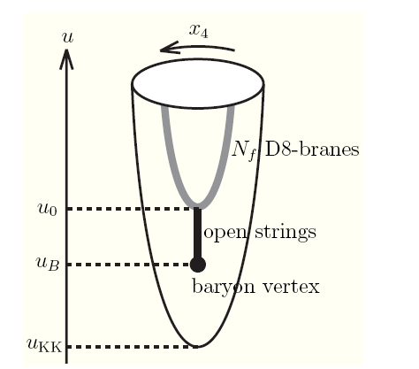
The location of the baryonic vertex in the radial direction is determined by ``static equillibrium”.
The energy is a decreasing function of x=uB/uΛ and hence it will be located at the tip of the flavor brane

Slide 22
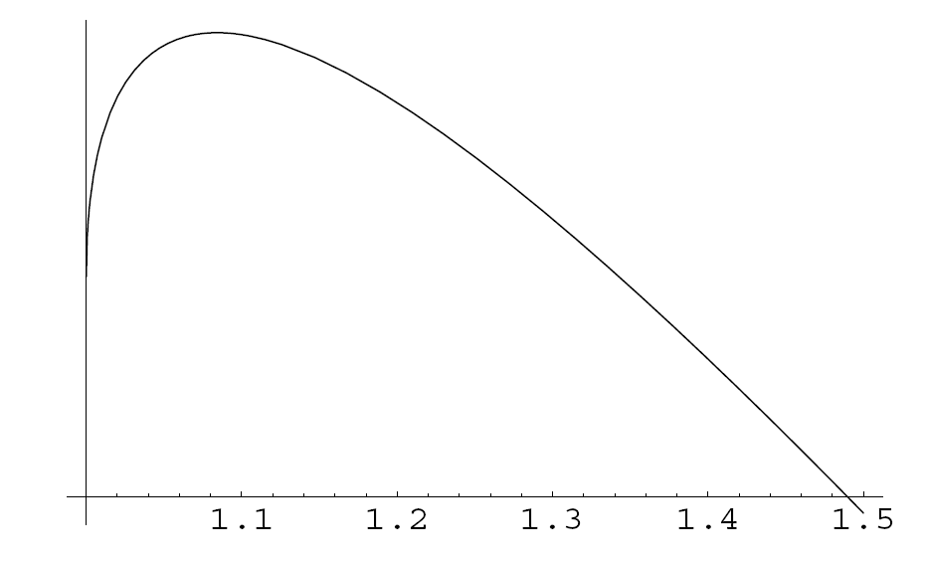
It is interesting to check what happens in the deconfining phase.
For this case the result for the energy is
For x>xcr low temperature stable baryon
For x<xcr high temperature disolved baryon
The baryonic vertex falls into the black hole

Slide 23
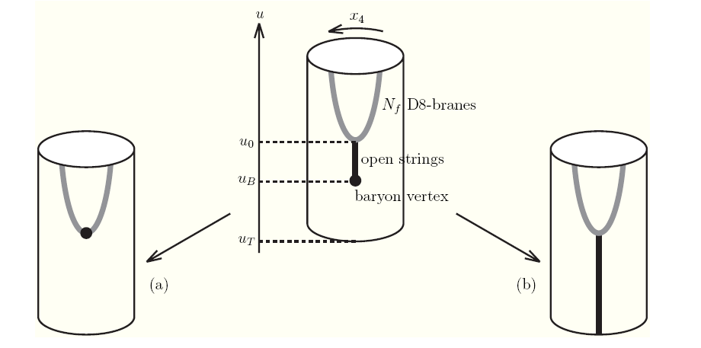
The location of the baryonic vertex at finite temperature

Slide 24
Baryons in a confining gravity background
Holographic baryons have to include a baryonic vertex embedded in a gravity background ``dual” to the YM theory with flavor branes that admit chiral symmetry breaking
A suitable candidate is the Sakai Sugimoto model which is based on the incorporation of D8 anti D8 branes in Witten’s model

Slide 25
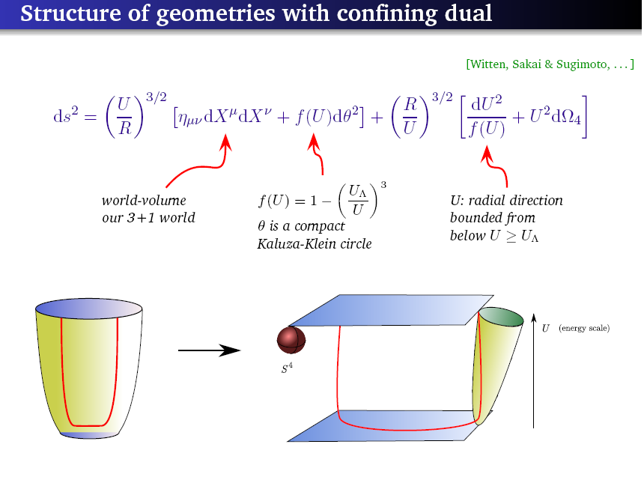

Slide 26
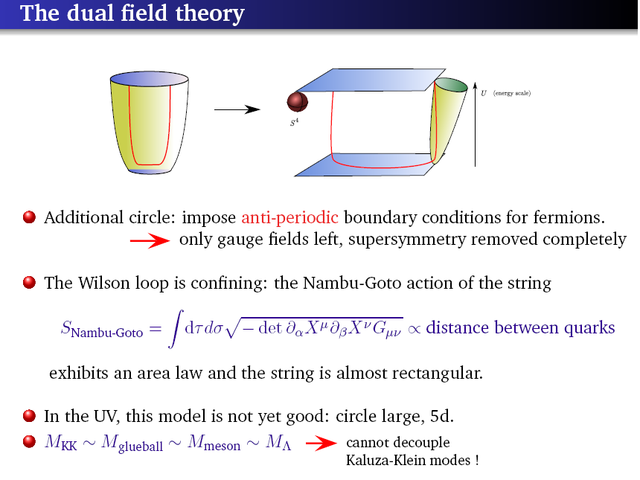

Slide 27
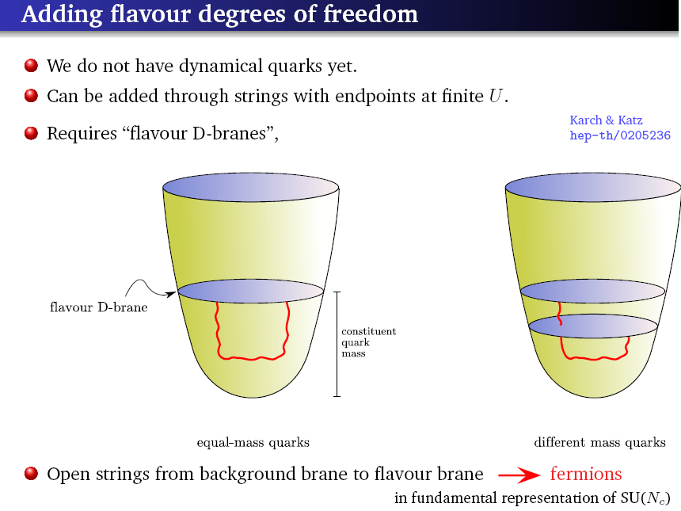

Slide 28
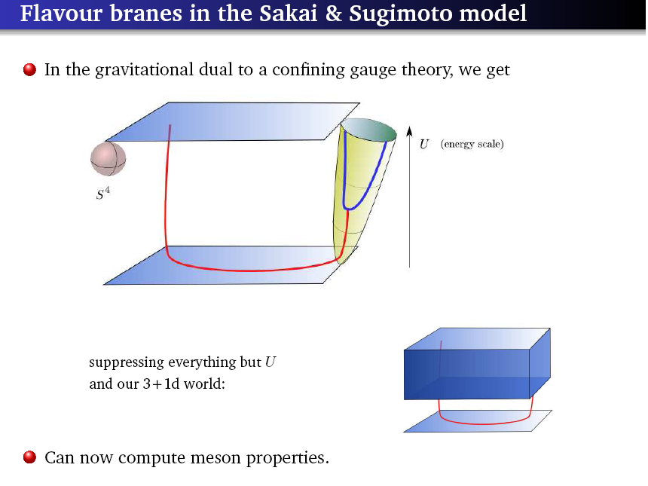

Slide 29
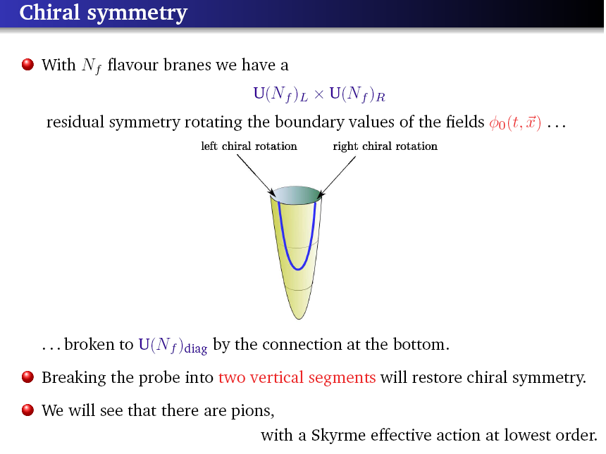

Slide 30
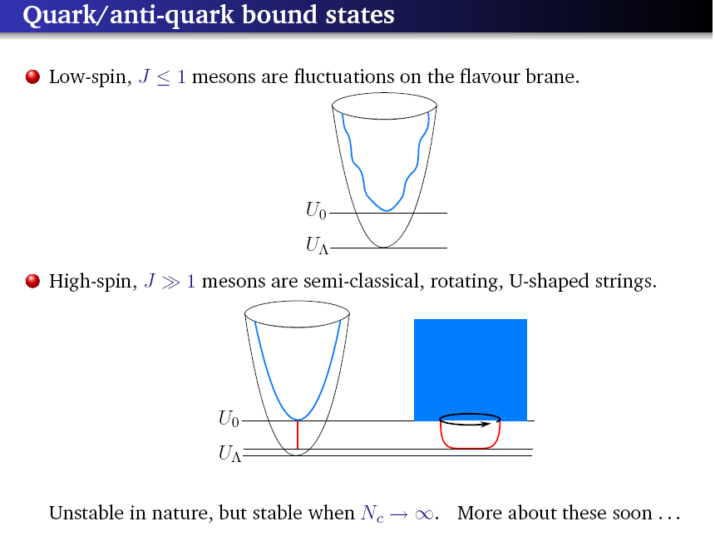

Slide 31
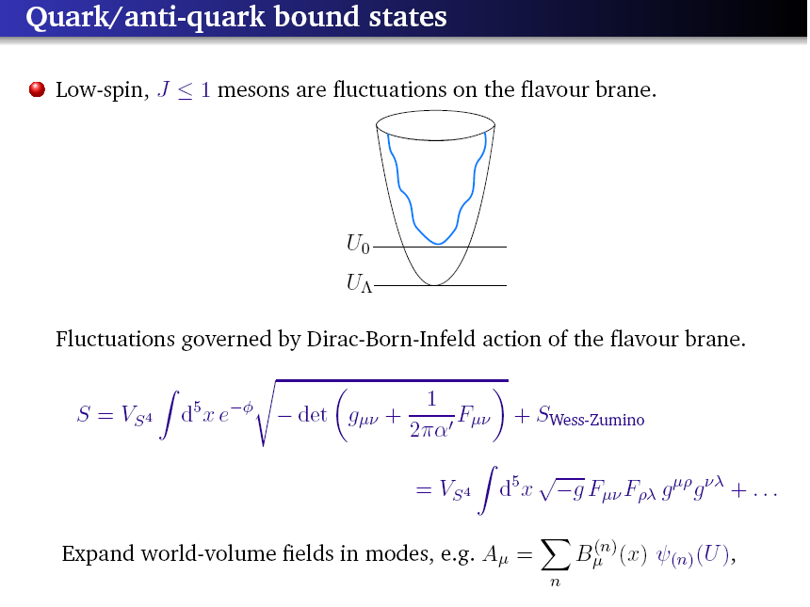

Slide 32
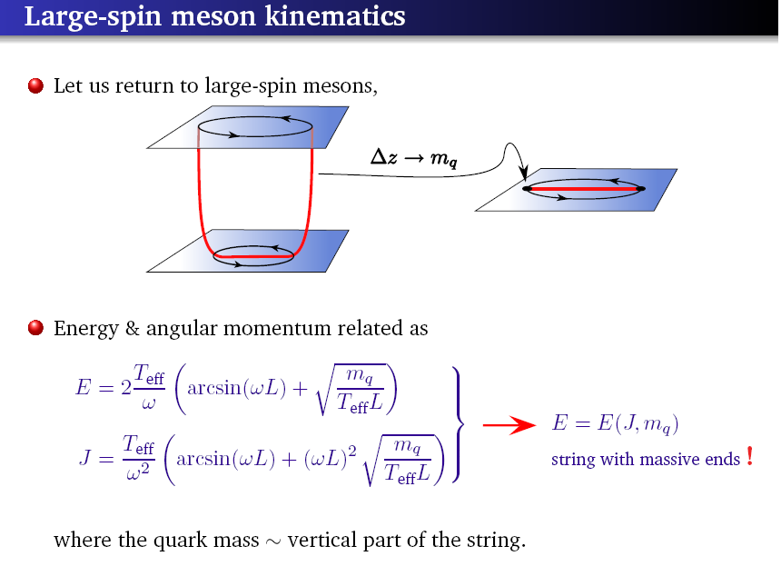

Slide 33
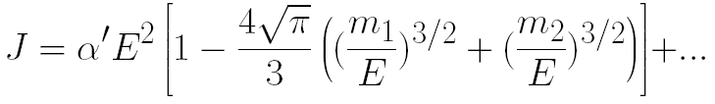
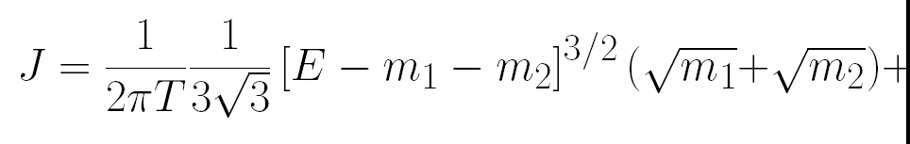

Corrected Regge trajectories for small and large mass
In the small mass limit ωR -> 1
In the large mass limit ωR -> 0

Slide 34
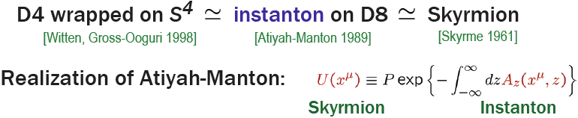

Baryons as Instantons in the SS model
In the SS model the baryon takes the form of an instanton in the 5d U(N_{f}) gauge theory.
The instanton is the BPST-like instanton in the (xi,z) 4d curved space. In the leading order in λ it is exact.

Slide 35
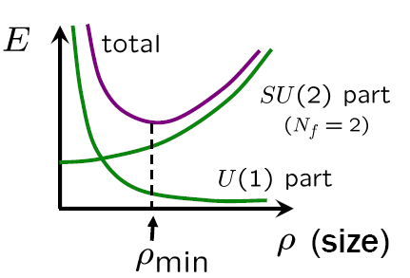
Baryon ( Instanton) size
For Nf= 2 the SU(2) yields a rising potential
The coupling to the U(1) via the CS term has a run away potential .
The combined effect
“stable” size but unfortunately on the order of λ^{-1/2} so stringy effects cannot be neglected in the large λ limit.

Slide 36
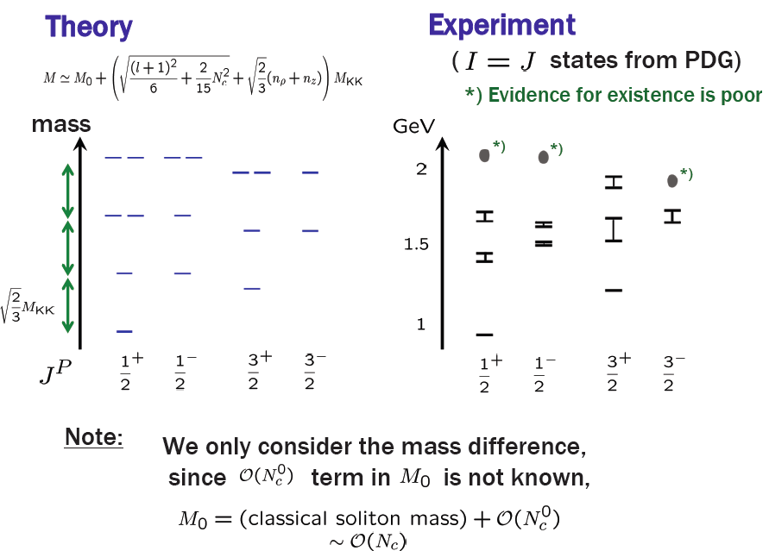
Baryonic spectrum

Slide 37
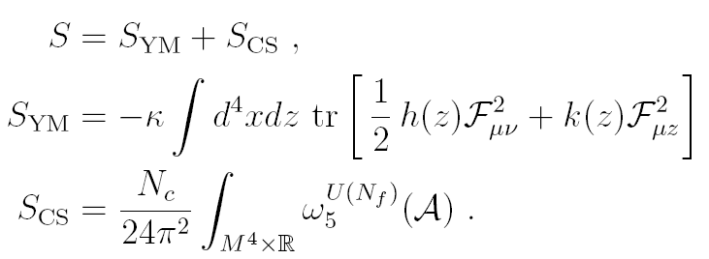
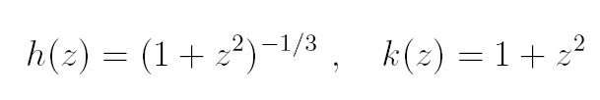
Baryons in the Sakai Sugimoto model( detailed description)
The probe brane world volume 9d → 5d upon
Integration over the S⁴. The 5d DBI+ CS read
where

Slide 38
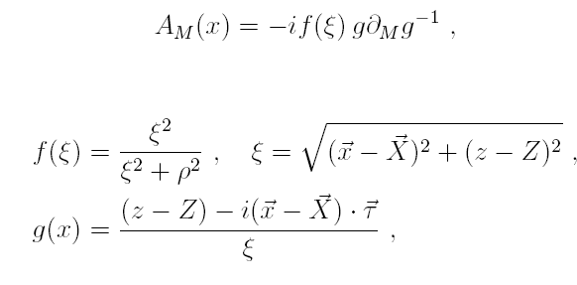
Baryons in the Sakai Sugimoto model
One decomposes the flavor gauge fields to SU(2) and U(1)
In a 1/λ expansion the leading term is the YM
Ignoring the curvature the solution of the SU(2) gauge field with baryon #= instanton #=1 is the BPST instanton

Slide 39
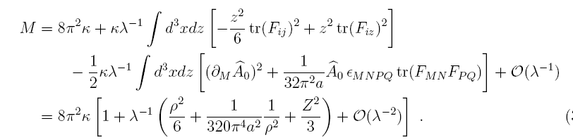
Baryons in the Sakai Sugimoto model
Upon introducing the CS term ( next to leading in 1/λ, the instanton is a source of the U(1) gauge field that can be solved exactly.
Rescaling the coordinates and the gauge fields, one determines the size of the baryon by minimizing its energy

Slide 40
Baryons in the Sakai Sugimoto model
Performing collective coordinates semi-classical analysis the spectra of the nucleons and deltas was extracted.
In addition the mean square radii, magnetic moments and axial couplings were computed.
The latter have a similar agreement with data than the Skyrme model calculations.
The results depend on one parameter the scale.
Comparing to real data for Nc=3, it turns out that the scale is different by a factor of 2 from the scale needed for the meson spectra.

Slide 41
Baryons in the generalized SS model
With the generalized non-antipodal with non trivial msep namely for u0 different from uΛ with general
ζ =u₀ / u_{KK}
We found that the size scales in the same way with λ. We computed also the baryonic properties

Slide 42
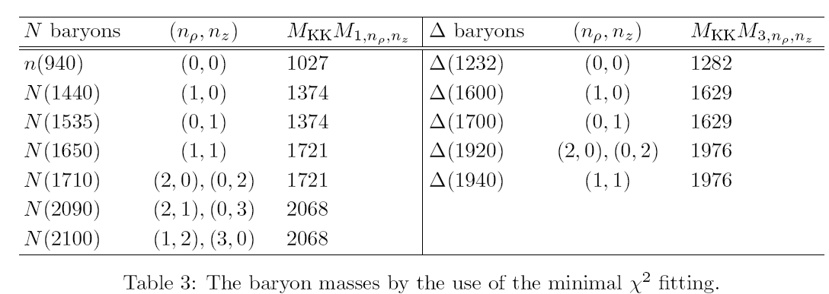
The spectrum of nucleons and deltas
The spectrum using best fit approach

Slide 43
Inconsistency of the generalized SS model?
We can match the meson and baryon spectra and properties with one scale
MΛ= 1 GEV and ζ =u₀ / u _{Λ}= 0.94
Obviously this is unphysical since by definition
ζ>1
This may signal that the Sakai Sugimoto picture of baryons has to be modified ( Baryon backreaction, DBI expansion, coupling to scalars)

Slide 44
Zones of the nuclear interaction
In real life, the nucleon has a fairly large radius , Rnucleon ∼ 4/Mρmeson.
But in the holographic nuclear physics with λ ≫ 1, we have the opposite situation
Rbaryon ∼ λ^(−1/2)/M,
Thanks to this hierarchy, the nuclear forces between two baryons at distance r from each other fall into
3 distinct zones

Slide 45
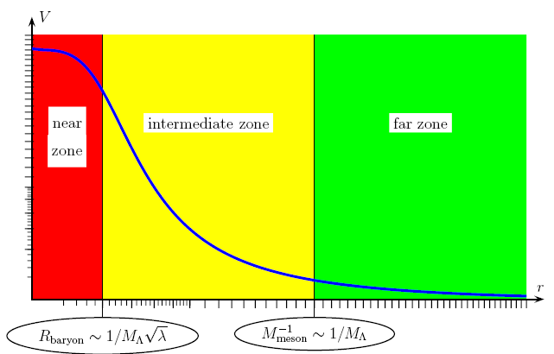
Zones of the nuclear interaction
The 3 zones in the nucleon-nucleon interaction

Slide 46
Near Zone of the nuclear interaction
In the near zone - r <Rbaryon ≪ (1/M), the two baryons overlap and cannot be approximated as two separate instantons ; instead, we need the ADHM solution of instanton #= 2 in all its complicated glory.
On the other hand, in the near zone, the nuclear force is 5D: the curvature of the fifth dimension z does not matter at short distances, so we may treat the U(2) gauge fields as living in a flat 5D space-time.
To leading order in 1/λ, the SU(2) fields are given by the ADHM solution, while the abelian field is coupled to the instanton density .
Unfortunately, for two overlapping baryons this density has a rather complicated profile, which makes calculating the nearzone nuclear force rather difficult.

Slide 47

Far Zone of the nuclear interaction
In the far zone r > (1/M) ≫ Rbaryon poses the opposite problem: The curvature of the 5D space and the z–dependence of the gauge coupling becomes very important at large distances.
At the same time, the two baryons become well-separated instantons which may be treated as point sources of the 5D abelian field . In 4D terms, the baryons act as point sources for all the massive vector mesons comprising the massless 5D vector field Aμ(x, z), hence the nuclear force in the far zone is the sum of 4D Yukawa forces

Slide 48

Intermediate Zone of the nuclear interaction
In the intermediate zone Rbaryon ≪ r ≪ (1/M), we have the best of both situations:
The baryons do not overlap much and the fifth dimension is approximately flat.
At first blush, the nuclear force in this zone is simply the 5D Coulomb force between two point sources,
Overlap correction were also introduced.

Slide 49
Holographic Nuclear force
Hashimoto Sakai and Sugimoto showed that there is a hard core repulsive potential between two baryons ( instantons) due to the abelian interaction of the form
V_{U(1)} ~ 1/r²
In nuclear physics one believes that there is repulsion between nucleons due to exchange of isoscalar mesons: a vector particle ( omega) and an attraction due to exchange of an scalar ( sigma)

Slide 50
Nuclear attraction
We expect to find a holographic attraction due to the interaction of the instanton with the fluctuation of the embedding which is the dual of the scalar fields .
Kaplunovsky J.S
The attraction term should have the form
L_{attr} ~φTr[F²]
In the antipodal case ( the SS model) there is a symmetry under δx₄ -> -δx₄ and since asymptotically x₄ is the transverse direction
φ∼δx₄
such an interaction term does not exist.

Slide 51
Attraction versus repulsion
Indeed the 5d effective action for A_{M} and φ is
For instantons F=*F so there is a competition between
repulsion attraction
A TrF² φTr F²
Thus there is also an attraction potential
V_{scalar} ~ 1/r²

Slide 52

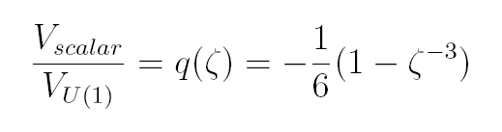

Attraction versus repulsion
The ratio between the attraction and repulsion in the intermediate zone is

Slide 53
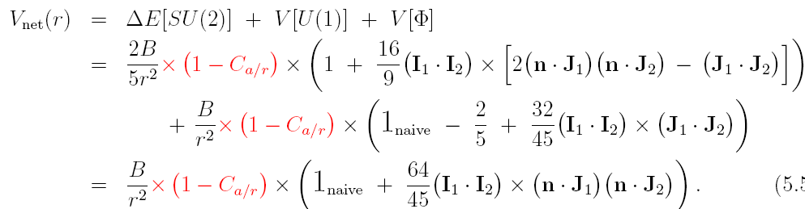
The net ( scalar + tensor) potential

Slide 54
Nuclear potential in the far zone
We have seen the repulsive hard core and attraction in the intermediate zone.
To have stable nuclei the attractive potential has to dominate in the far zone.
In holography this should follow from the fact that the isoscalar scalar is lighter that the corresponding vector meson.
In SS model this is not the case.
Maybe the dominance of the attraction associates with two pion exchange( sigma?).

Slide 55
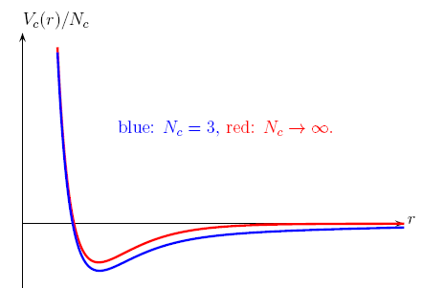
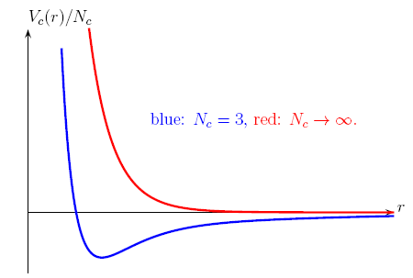
Holography versus reality
If the σ remain in
spectrum at large N_{c}
and mσ<mw
If the σ disappears
at large N_{c} no nuclei

Slide 56
Holography versus reality
But suppose tomorrow somebody discovers a holographic model of the real QCD and — miracle of miracles — it has a realistic spectrum of mesons, including the σ(600) resonance, and even the realistic Yukawa couplings of those mesons to the baryons.
Even for such a model, the two-body nuclear forces would not be quite as in the real world because the semi-classical holography limits Nc → ∞, λ → ∞ suppress the multiple meson exchanges between baryons.
Although in this case, the culprit is not Nc but the large ’t Hooft coupling λ .

Slide 57
Holography versus reality –the role of large λ
Indeed, from the hadronic point of view, nuclear forces arise from the mucleons exchanging one, two, or more mesons, and in real life the double-meson exchanges are just as important as the single-meson exchanges.
In holography, the single-meson exchanges happen at the tree level of the string theory while the multiple meson exchanges involve string loops, and the loop amplitudes are suppressed by the powers of 1/λ relative to the tree amplitudes.

Slide 58
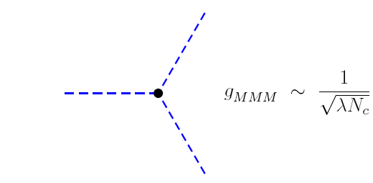
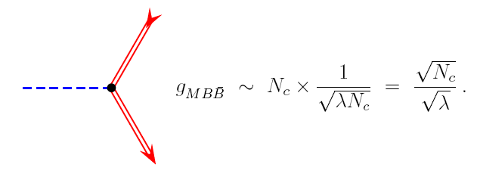
The role of the large λ limit
The flavor field are weakly coupled [Cherman,Cohen]
The baryon-meson coupling is enhanced by an extra factor of Nc,

Slide 59
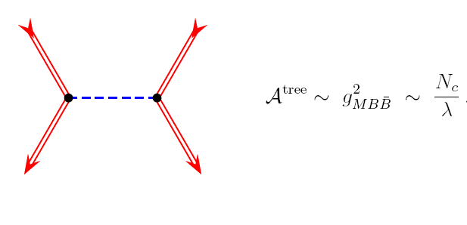
The role of the large λ limit
At the tree level baryon-baryon scattering follows

Slide 60
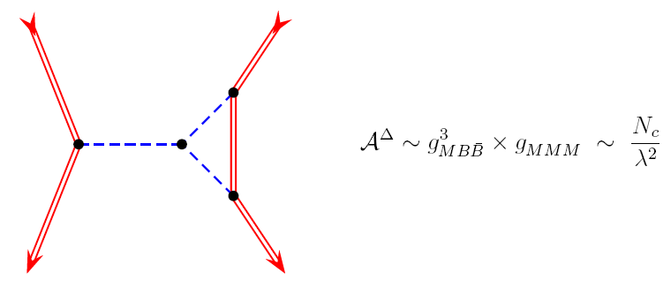
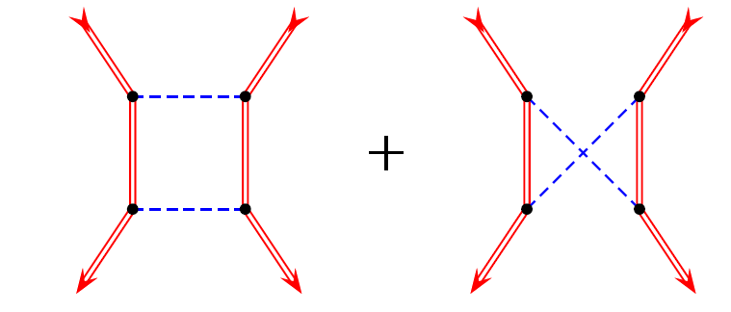

The role of the large λ limit
At one loop there are two types of diagrams

Slide 61

However, for nonrelativistic baryons, the box and the crossed-box diagrams almost cancel each other from the effective potential between the baryons, with the un-canceled part having a lower
In other words, the contribution of the double-meson exchange carries the same power of Nc but is suppressed by a factor 1/λ

Slide 62
Searching for a better lab for hol. Nuclear physics
Holographic nuclear physics based on the gSS model suffers from :
String scale (1/λ )^(1/2) size of the baryon
Repulsion dominates over attraction.
Can one find another holographic laboratory where the lightest scalar particle is lighter than the lightest vector particle ( that interact with the baryon).
Can we find a model of an almost cancelation ?
Similar to the gSS in other holographic models the vector is lighter.
An exception is the DKS model

Slide 63
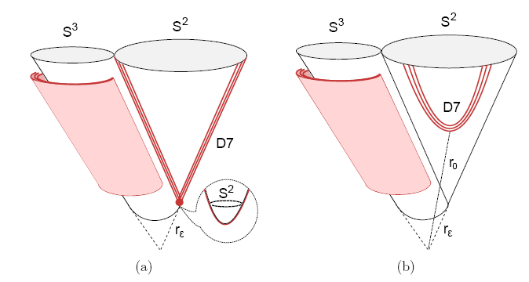
The DKS model
Nf D7 and anti-D7 branes are placed in the Klebanov Strassler model.
Adding the D7−D7 branes spontaneously breaks conformal symmetry by a vev of a marginal operator

Slide 64

The DKS model
This takes place at some scale r0.
When this scale is larger than the internal scale of the gauge theory rε ≡ ε^2/3, the lightest scalar meson is parametrically light as a pseudo-Goldstone boson of the conformal symmetry.
This meson gives the leading contribution to the attractive force and we will retain the notation σ.
The model in question has the following hierarchy of light particles.
The mass of glueballs remains the same as in the KS and therefore is r0-independent. The typical scale of the glueball mass is

Slide 65


In the regime r0 ≫ rε the theory is (almost) conformal and therefore the mass of mesons can depend only on the scale of symmetry breaking r0
The pseudo-Goldstone boson σ is parametrically lighter

Slide 66
As r0 approaches rε the mesons become lighter, while the pseudo-Goldstone grows heavier.
Around the minimal value r0 = rε all mesons have approximately the same mass of order mgb.
This is the most interesting regime of parameters because for r0 ∼ re the approximate cancelation of the attractive and the repulsive force can occur naturally
Recently it was shown that
mσ < m0++ < mω < m1++ .
Here 0++ and 1++ denote the lightest glueballs

Slide 67
The location of the BV in the DKS model
A baryon in our setup is represented by a D3-brane wrapping the S3 of the conifold and a set of M strings connecting it to the D7−D7 branes
For r0≫ rε the string tension is smaller than the force exerted on D3 due to curved geometry.
To minimize the energy D3-brane will settle near the tip of the conifold at r ∼ rǫ with the D3−D7 strings stretched all the way between r and r0.
When r0 is significantly close to re the geometry can be effectively approximated by a flat one and creates only a mild force.
The string tension wins, and the D3-brane is pulled towards the D7−D7 branes and dissolves there becoming an instanton.

Slide 68
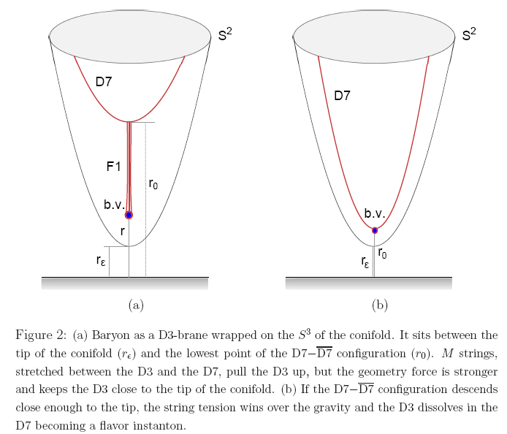
The location of the BV in the DKS model

Slide 69

Net baryonic potential
In the regime r0 → rε. For r0 small enough the wrapped
D3-brane will dissolve in the D7−D7 and will be described by an instanton.
When r0 ~re, the D7−D7 branes are invariant under an emergent U(1) symmetry.
The wavefunction of σ is odd underZ2 ∈ U(1) and therefore the leading coupling of σ to baryons vanishes.
The same phenomena also occurs in the Sakai-Sugimoto model .
By varying r0 near the point r0 = rε one can tune the coupling of σ to be small.
The net potential in this case can be written in the form

Slide 70

Binding energy
It is valid only for |x| large enough..
If mσ < mω, the potential is attractive at large distances no matter what the couplings are.
On the other hand if gσ is small enough, at distances shorter than m^(−1) ω the vector interaction “wins” and the potential becomes repulsive.
The binding energy
is suppressed by a small dimensionless number κ, which is related to the smallness of the coupling gσ and the fact that mσ and mω are of the same order.
The extra factor κ is phenomenologically promising as it represents the near-cancelation of the attractive and repulsive forces responsible for the small binding energy in hadronphysics.

Slide 71
Summary and conclusions
We have discussed properties of baryons that follow from the holographic SUGRA picture as well as
their stringy description.
Unfortunately to bridge the SUGRA and stringy pictures requires t’ Hooft parameter ( and hence curvature ) of order 1. ( This may hint for non-critical strings)
The modern stringy picture is not so different than the old one.

Slide 72
Summary
The stringy picture for a baryon with high spin seems to be that of a single string with a quark and a di-quark
Baryons as instantons lead to a picture that is similar to the Skyrme model.
From the results for baryons made out of quarks with string end point masses we deduce that the naïve instanton picture should be improved.
We showed that on top of the repulsive hard core due to the abelian field there is an attraction potential due the scalar interaction.

Slide 73
Summary
The is no `` nuclear physics” in the gSS model
We showed that in the DKS model one may be able to get an attractive interaction at the far zone with an almost cancelation which will resolve the binding energy puzzle.

