Slide 1
Soft QCD @ CMS
Galileo Galilei Institute
High-energy QCD after the start of the LHC
September 7 2011
Paolo Bartalini (National Taiwan University)

Slide 2
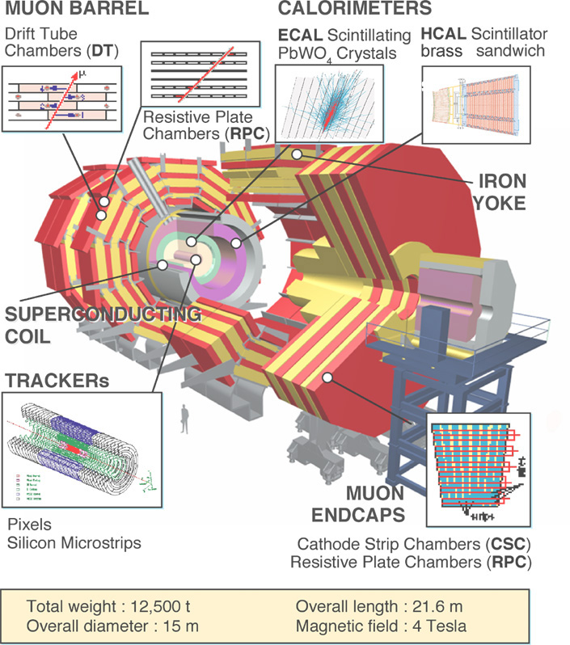
CMS Design features
Detectors
CMS design choice: optimize performance for muon/track momentum resolution and electromagnetic energy resolution....
Long 4 Tesla Solenoid containing Tracker, ECAL and HCAL
Tracking up to η ~ 2.4
μ system in return iron
First μ chamber just after Solenoid
(max. sagitta)
Big lever arm for P_{T} measurement
Event Rates: ~10⁹ Hz
Event size: ~1 MByte
Level-1 Output 100kHz
Mass storage 10²Hz
Event Selection: ~1/10¹³
9/20/2011
P.Bartalini - NTU
2

Slide 3
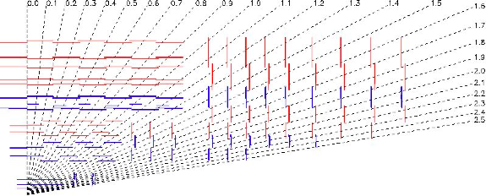
Measuring tracks in CMS
CMS Tracker
3.8 T
p_{T} resolution @ 1 GeV/c is:
0.7% at η = 0 and
2% at |η| = 2.5
“CMS Tracking Performance Results from early LHC Operation”, [Eur. Phys. J. C70 (2010) 1165–1192]
Beam Scintillator Counters (BSC) → 96.3% efficiency for MIPs and time resolution of 3 ns.
Beam Pick-up Timing for eXperiments (BPTX)
time resolution better than 0.2 ns.
9/20/2011
P.Bartalini - NTU
3
Notes:
The central feature of the CMS apparatus is a superconducting solenoid, of 6 m
internal diameter. Within the field volume are the silicon pixel and strip tracker, the crystal
electromagnetic calorimeter (ECAL) and the brass-scintillator hadronic calorimeter (HCAL).
Muons are measured in gaseous detectors embedded in the iron return yoke.
The forward calorimeters provide almost hermetic coverage. They include
ZDC (>8.5), CASTOR (-6.6<eta<-5.3), and HF (2.9<eta<5.2). HF we use in the study
to see rap.gap.
HF, consists of steel absorbers and embedded radiation-hard quartz fibers, which provide a fast collection of Cherenkov light.
----------------------------------------------------------------------------------------------------
CMS uses a right-handed coordinate system, with the origin at the collision point,
the x-axis pointing to the centre of the LHC, the y-axis pointing up (perpendicular to the LHC
plane), and the z-axis along the anticlockwise-beam direction. The polar angle is measured from the positive z-axis and the azimuthal angle is measured in the x-y plane.
--------------------------------------
Two elements of the CMS detector monitoring system, the Beam Scintillator Counters (BSCs) and the Beam Pick-up Timing for the eXperiments (BPTX) devices , were used to trigger
the detector readout. The two BSCs are located at a distance of 10.86 m from the nominal
interaction point (IP) and are sensitive in the eta range from 3.23 to 4.65. Each BSC is a set of 16 scintillator tiles. The BSC elements have a time resolution of 3 ns and an average minimum ionizing-particle detection efficiency of 96.3%, and are designed to provide hit and coincidence rates. The two BPTX devices, located around the beam pipe at a distance of 175m from the IP on either side, are designed to provide precise information on the bunch structure and timing of the incoming beam, with better than 0.2 ns time resolution.

Slide 4
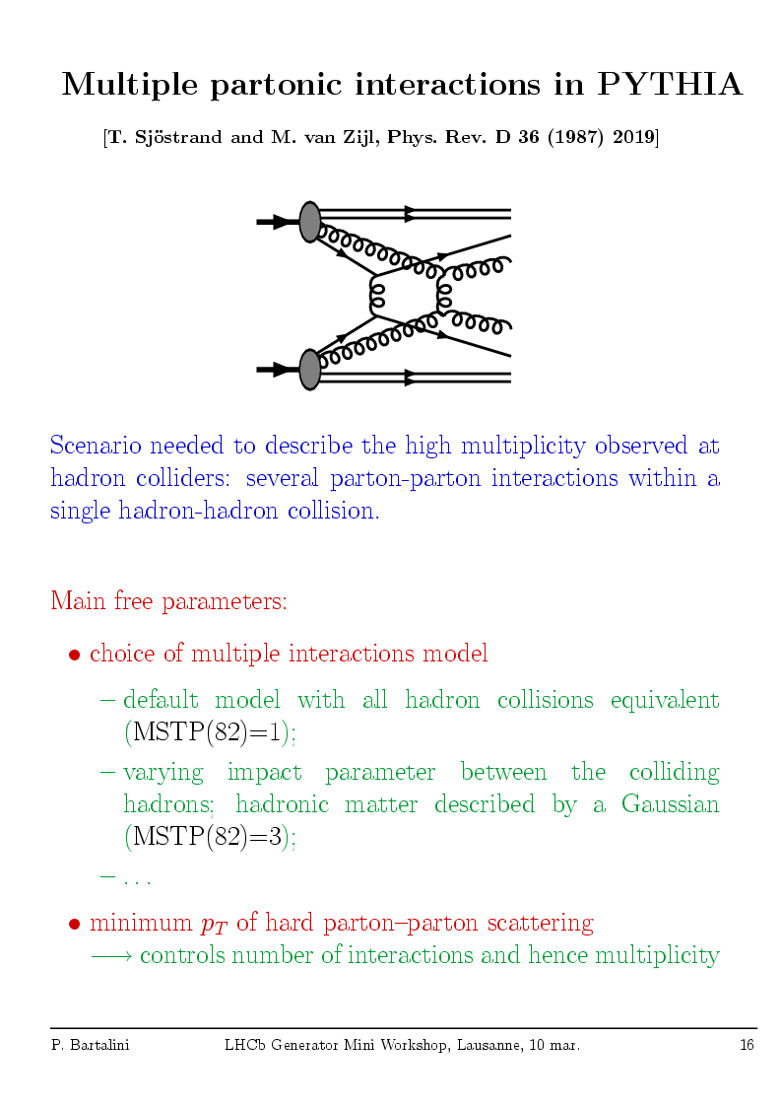
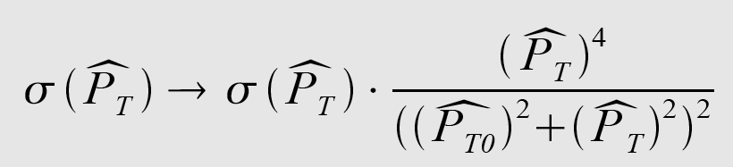
pQCD Models
The Pythia solution:
[T. Sjöstrand et al. PRD 36 (1987) 2019]
Multiple Parton Interactions (MPI)
(now available in other general purpose MCs: Herwig/Jimmy, Sherpa, etc.)
RADIATION, SPECTATORS…
not enough to account for
the observed multiplicities
& p_{T} spectra
→
Inspired by observations of
double high P_{T} scatterings
Main Parameter: P_{T} cut-off P_{T0}
(dampening)
Cross Section Regularization for P_{T}→ 0.
P_{T0} can be interpreted as inverse of effective colour screening length.
Controls the number of interactions hence the Multiplicity:
< N_{int} > = σ_{parton-parton} /σ_{proton-proton}
Tuning for the LHC: Emphasis on the Energy-dependence of the parameters.
“post Hera” PDFs have increased color screening at low x ?
  x g(x,Q²) → x^{-ε/2} for x → 0
P_{T0}^{s’} = P_{T0}^{s} (√s’ / √s)^{ε}
9/20/2011
P.Bartalini - NTU
4

Slide 5
Pythia Tunes in CMS
  Pythia 6 Virtuality ordered showers, old MPIs
    CTEQ5L pre-LHC Tune DW(T) and LHC (UE@0.9 TeV) Tune CW(T)
    CTEQ6LL pre-LHC Tune D6(T)
    [arXiv:1003.4220]
    Describe UE@Tevatron, describe other very important observables at Tevatron like p_{T}(heavy bosons) and Jet azimuthal decorrelation
  Pythia 6 new MPIs with interleaved p_{T}-ordered showers (MORE RADIATION, LESS MPIs)
    CTEQ5L LHC Tune Z1 uses Professor AMBT1 LEP fragm. & ATLAS Min Bias: Updated Color Rec.
    CTEQ6LL LHC Tune Z2 by hand from Z1: decreased p_{T} cut off
    [arXiv:1012.5104, arXiv:1010.3558v1]
  Pythia 8, brand new MPI model, inteleaved p_{T}-ordered showers
    CTEQ5L pre-LHC Tune 1 first Pythia 8 Tune proposed by Peter Skands
    CTEQ6LL Tevatron Tune 2C describes the relevant Tevatron phenomenology
    CTEQ6LL LHC Tune 4C describes ATLAS MB & UE (leading track)
    [arXiv:1011.1759]
p_{T0}^{LHC} = p_{T0}^{Tevatron} (√s^{LHC} / √s^{Tevatron})^{ε}
Where ε = PARP(90) or MultipleInteractions:EcmPow
T versions (for example D6T) 2C, 4C → small ε ≈ 0.16 - 0.21 (CTEQ6LL)
Tune 1, DW, Z1, Z2, CW → large ε ≈ 0.24 - 0.30 (CTEQ5L, guess in Z2 wrong?)
Still no coherent description of Tevatron and LHC (more info in backup slides)
9/20/2011
P.Bartalini - NTU
5

Slide 6
Basic Low pT QCD measurements @ CMS
Measuring tracks and identifying hadrons in pp Minimum Bias (MB) events:
QCD-09-010: “Transverse momentum and pseudorapidity distributions of charged hadrons in pp collisions at √s = 0.9 and 2.36 TeV ”. J. High Energy Phys. 02 (2010) 041
QCD-10-006: “Transverse-momentum and pseudorapidity distributions of charged hadrons in pp collisions at √s = 7 TeV ”.
Phys. Rev. Lett. 105 (2010) 022002
QCD-10-024: “Pseudorapidity distributions of charged particles in pp collisions at √s = 7 TeV with at least one central charged particles”. CMS-PAS-QCD-10-024
QCD-10-004: “Charged particle multiplicities in pp interactions at √s = 0.9, 2.36, and 7.0 TeV ”. J. High Energy Phys. 01 (2011) 079
QCD-10-007: “Strange particle production in pp collisions at √s = 0.9 and 7 TeV”.
arXiv:1104.3547 CERN-PH-EP-2011-049 submitted to JHEP.
Using also high p_{T} triggers to explore the tails:
QCD-10-008: “Charged particle transverse momentum spectra in pp collisions at √s = 0.9 and 7 TeV ”.
arXiv:1104.3547 CERN-PH-EP-2011-049 submitted to JHEP.
…
QCD-XX-YYY: ….
NB. The number of primary charged particles (N_{ch}) is defined to include decay products of particles with proper lifetimes less than 1 cm.
9/20/2011
P.Bartalini - NTU
[QCD-XX-YYY]
6

Slide 7
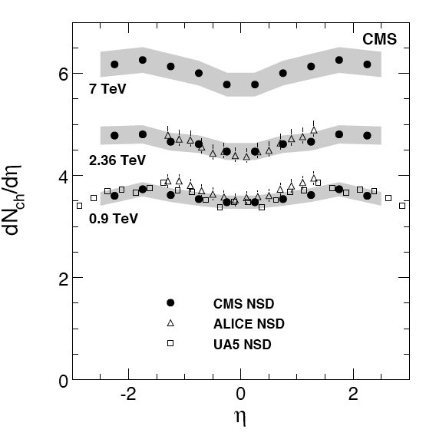
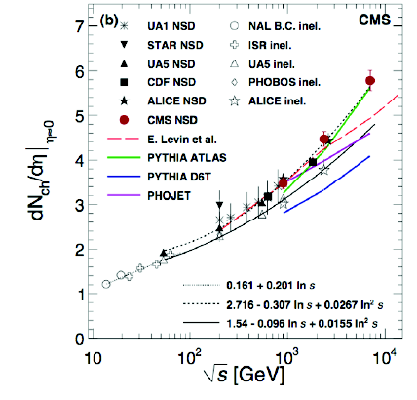
Single charged particle spectra: dN_{ch}/dη
The dN_{ch}/dη distributions are obtained with three redundant methods, based on counting:
Reconstructed clusters in the barrel part of the pixel detector (p_{T}^{MIN} = 30 MeV).
Pixel tracklets composed of pairs of clusters in different pixel barrel layers (p_{T}^{MIN} = 50 MeV).
Tracks reconstructed in the full tracker volume (p_{T}^{MIN} = 100 MeV) → also allows for p_{T} measurement.
At 7 TeV: dN_{ch}/dη|(|η|<0.5) = 5.78 ± 0.01 (stat.) ± 0.23 (syst.) for non-single-diffractive events.
Relative increase from √s = 0.9 to 7 TeV = (66.1 ± 1.0 (stat.) ± 4.2 (syst.))%.
→LHC measurements clearly confirm trend to have a rise stronger than ln (s)!
9/20/2011
P.Bartalini - NTU
7
[QCD-09-010, QCD-10-006]

Slide 8
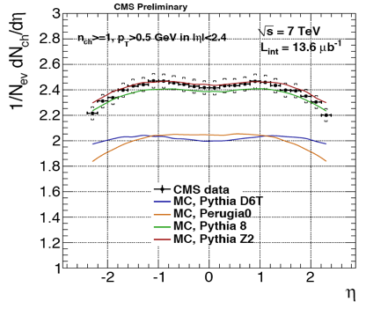
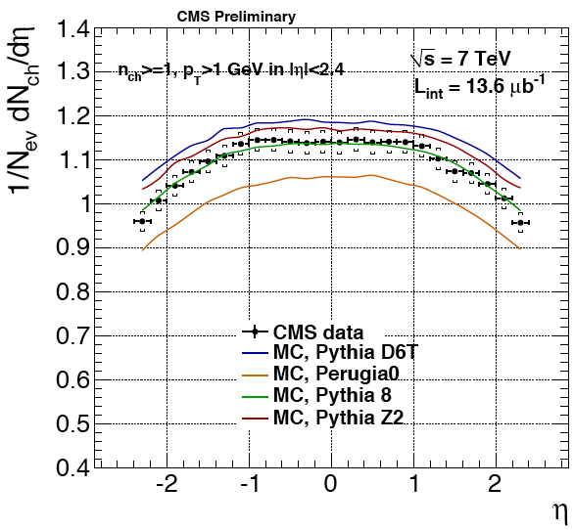
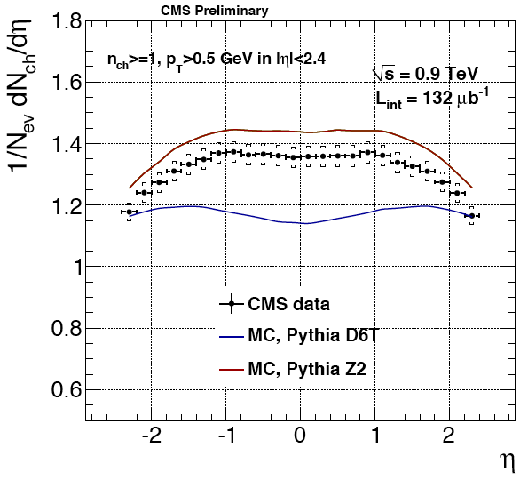
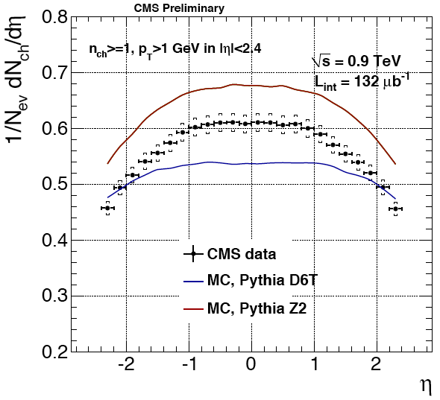
Single charged particle spectra: dN_{ch}/dη
Minimum Bias events
with at least one charged particle with:
- P_{T} > 0.5 GeV (left)
- P_{T} > 1 GeV (right)
√s = 7 TeV
√s = 0.9 TeV
→ MC tuning effort on LHC data ongoing (see http://lpcc.web.cern.ch/LPCC/ )
9/20/2011
P.Bartalini - NTU
[QCD-10-024]
8

Slide 9
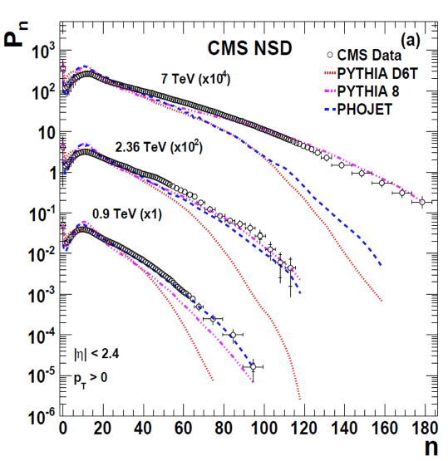
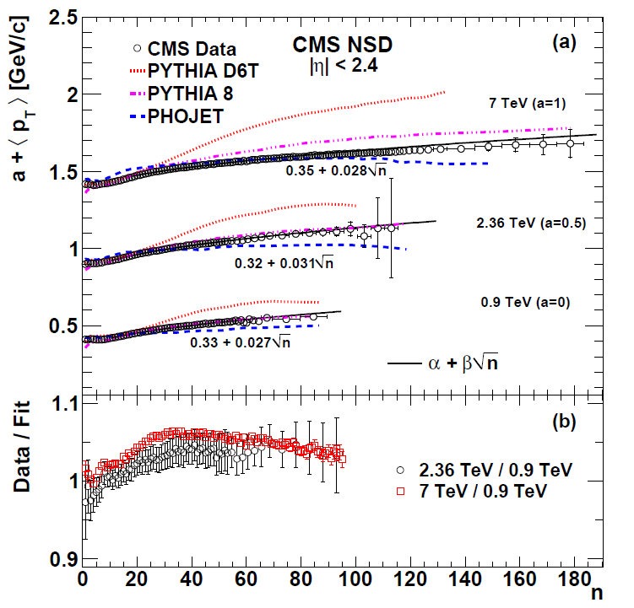
Charged multiplicity N_{ch}
P(N_{ch})
N_{ch}
N_{ch}
Charged particle multiplicities in Non Single Diffractive (NSD) events.
P(N_{ch}) = probability to produce N_{ch} charged particles.
Large multiplicity tail observed at 7 TeV. <p_{T}> vs N_{ch} scales with energy.
9/20/2011
P.Bartalini - NTU
[QCD-10-004]
9

Slide 10
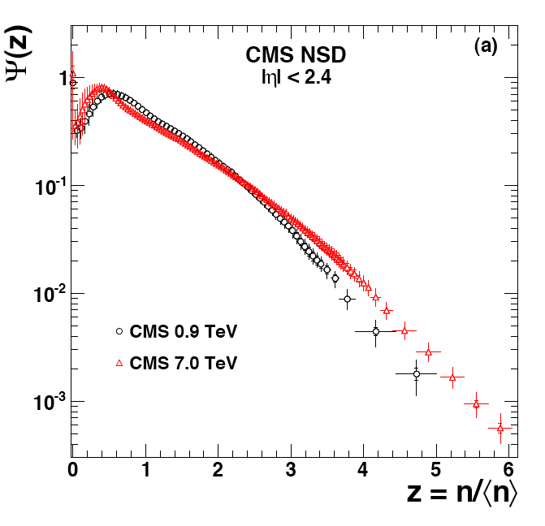
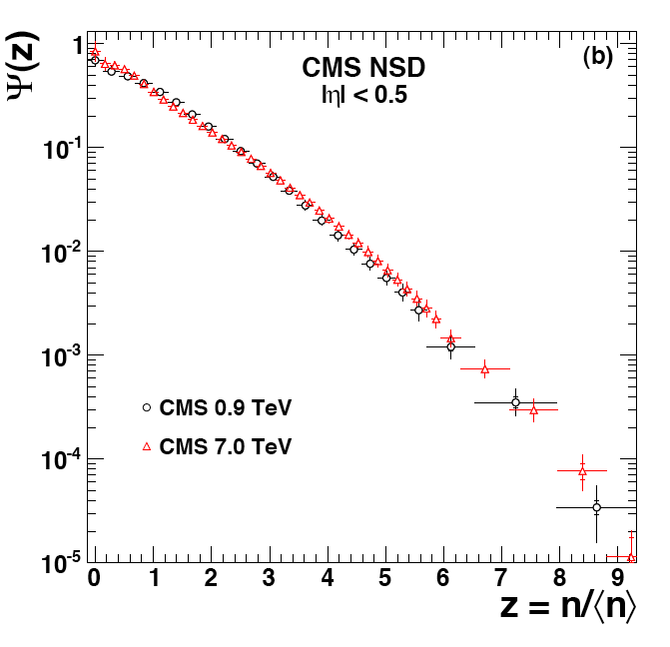
Violation of the KNO scaling
|η| < 2.4
|η| < 0.5
Ψ(z) = <N_{ch}> P(N_{ch})
Ψ(z) = <N_{ch}> P(N_{ch})
z = N_{ch} /<N_{ch}>
z = N_{ch} /<N_{ch}>
KNO Scaling [Koba, Nielsen, Olesen, Nucl. Rev. B40 (1972) 371].
Violation already reported by UA5 (and comparing ISR, SPS, Tevatron).
CMS confirms violation for |η|<2.4. Sensitive effect in the tails (large z = N_{ch} /<N_{ch}>).
→ Interpretation: connected to the presence of Multiple Parton Interactions.
9/20/2011
P.Bartalini - NTU
[QCD-10-004]
10

Slide 11
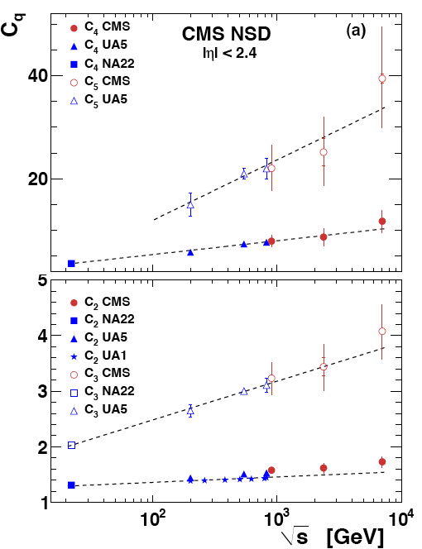
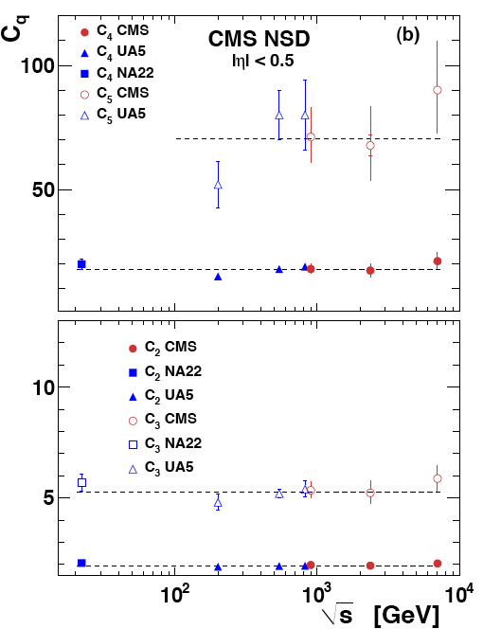
Normalized order-q moments C_{q} = <N_{ch}>^{q}/<N_{ch}^{q}>
√s dependence of the normalized moments C_{q} of the multiplicity distribution for:
|η| < 2.4 and
|η| < 0.5
→ln(s) linear fits
→constant fits
If KNO scaling holds, also C_{q} are independent from √s.
Violation sensitive for |η|< 2.4, i.e. large pseudo-rapidity.
No clear violation for |η|< 0.5 at least up to the order 4.
9/20/2011
P.Bartalini - NTU
[QCD-10-004]
11

Slide 12
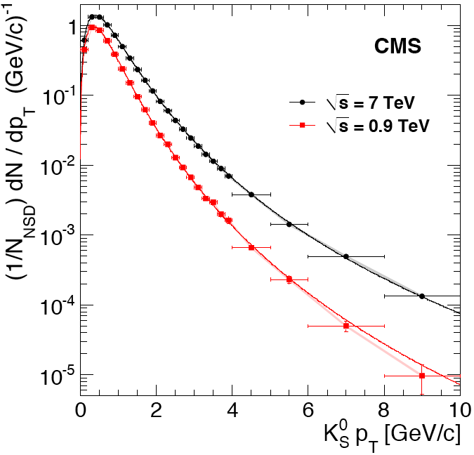
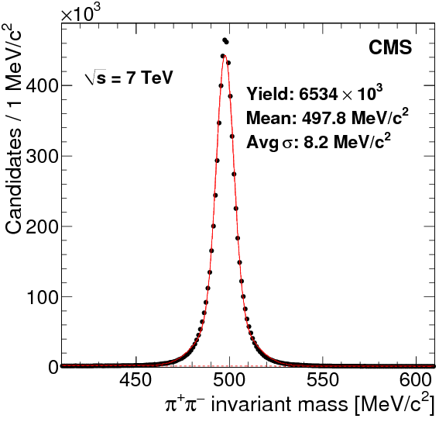
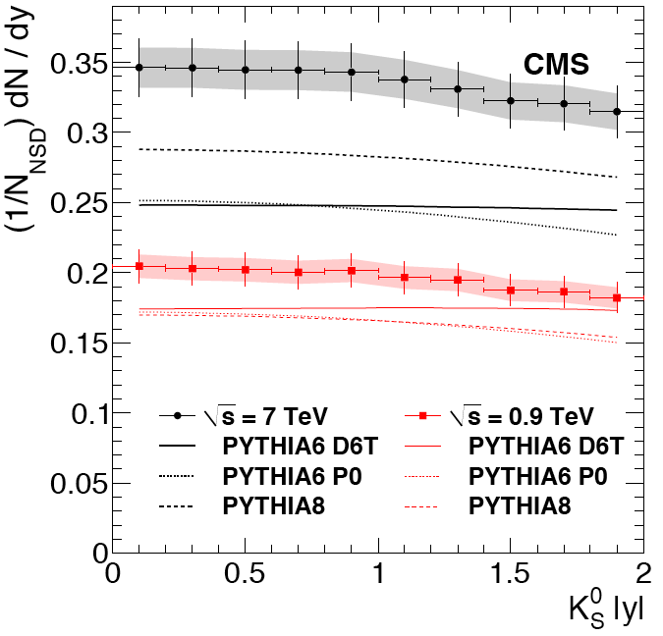
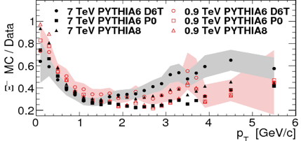
Strange Particle Production: K⁰_{s}, Λ, Ξ⁻
Exploiting the low-momentum track reconstruction capabilities of CMS: reconstructed p_{T} → 0
Not Single Diffractive (NSD) Events.
K⁰_{s} reconstructed from ππ, Λ from πp and Ξ⁻ from π⁻Λ
K⁰_{s}
K⁰_{s}
K⁰_{s}
K⁰_{s}
The solid curves are fits to the Tsallis functions
p_{T} [GeV/c]
Invariant Mass [MeV/c²]
Rapidity |y|
The tested pre-LHC Pythia tunes underestimate strange particle production at the LHC:This is particularly pronounced for: high p_{T}, hyperons, high √s.
Ξ⁻
p_{T} [GeV/c]
9/20/2011
P.Bartalini - NTU
[QCD-10-007]
12

Slide 13
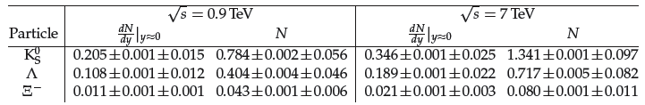
Strange Particle Production: K⁰_{s}, Λ, Ξ⁻
Exploiting the low-momentum track reconstruction capabilities of CMS: reconstructed p_{T} → 0
Not Single Diffractive (NSD) Events.
K⁰_{s} reconstructed from ππ, Λ from πp and Ξ⁻ from π⁻Λ
K⁰_{s}
(|y| < 2)
(|y| < 2)
K⁰_{s}
K⁰_{s}
K⁰_{s}
The solid curves are fits to the Tsallis functions
p_{T} [GeV/c]
Invariant Mass [MeV/c²]
Rapidity |y|
The tested pre-LHC Pythia tunes underestimate strange particle production at the LHC: this is particularly pronounced for: high p_{T}, hyperons, high √s.
Ξ⁻
p_{T} [GeV/c]
9/20/2011
P.Bartalini - NTU
[QCD-10-007]
13

Slide 14
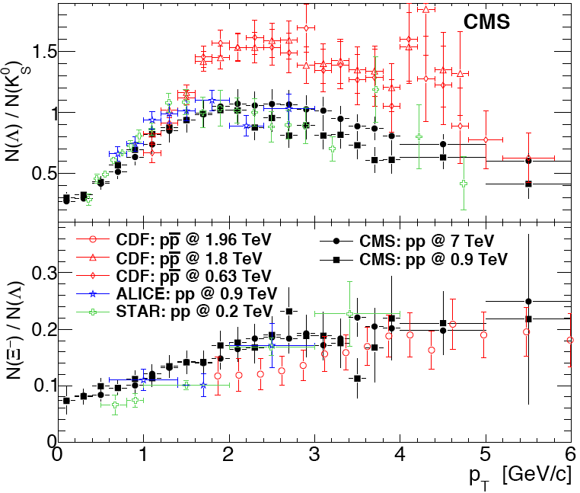
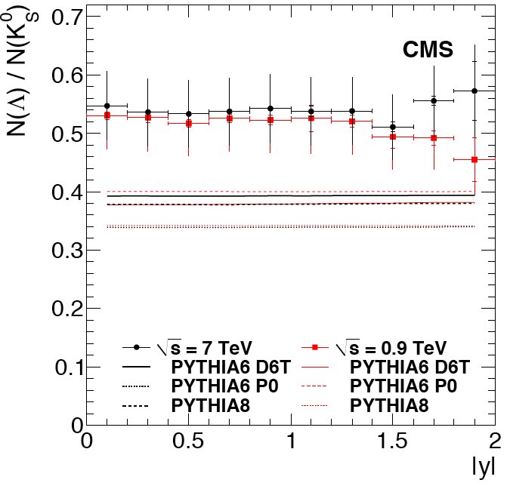
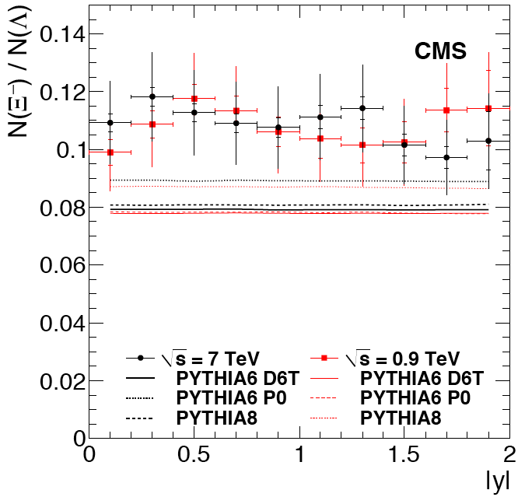
Strange Particle Production: K⁰_{s}, Λ, Ξ⁻
Ratio of s-rates in NSD events
CDF: arXiv:1101.2996 (CDF MB trigger)
ALICE: arXiv:1012.3257 (NSD)
STAR: Phys. Rev. C75 (2007) 064901 (NSD)
p_{T} [GeV/c]
Rapidity |y|
Rapidity |y|
If a quark-gluon plasma or other collective effects were present, we might expect enhancement of double-strange baryons to single-strange baryons and/or enhancement of strange baryons to strange mesons. However…
→ The production ratios N(Λ)/N(K⁰_{s}) and N(Ξ⁻)/N(Λ) versus rapidity and transverse momentum show no change with centre-of-mass energy.
9/20/2011
P.Bartalini - NTU
[QCD-10-007]
14

Slide 15
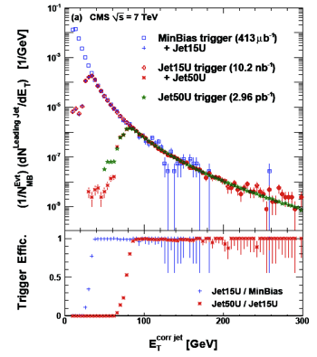

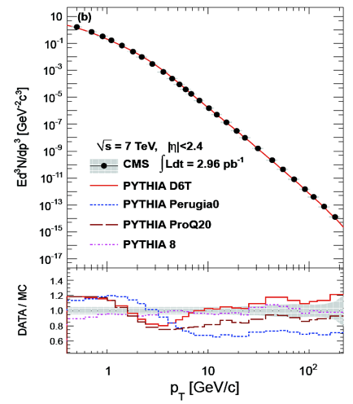
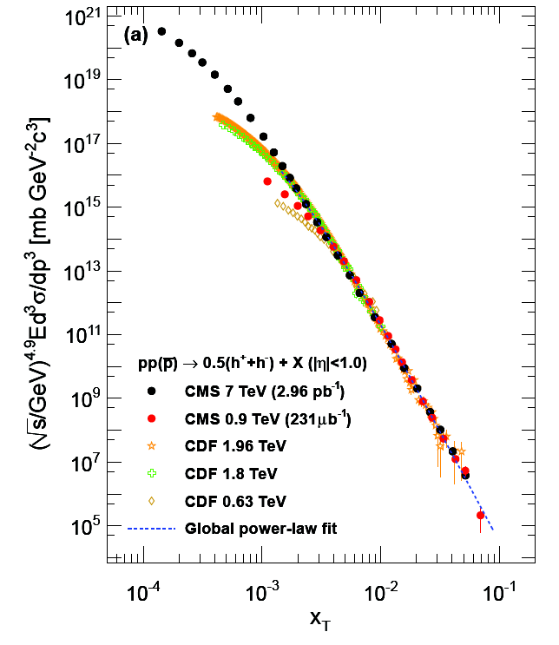
Single Charged Particle Spectra: dN_{ch}/dp_{T}
≈ large p_{T} tracks (for pp interactions at √s = 0.9 and 7 TeV)
driven by pQCD + fragmentation → power-law x_{T} = 2p_{T}/√s scaling:
[F. Arleo et al. JHEP 583 06 (2010) 035]
Systematic Uncertainty
(incl. lumi) ≈ 10%
Power-law fit:
n=4.9±0.1
optimized in range
0.9 ÷ 7.0 TeV
E_{t}^{corr jet} [GeV]
Measuring charged tracks
up to p_{T} ~ 200 GeV/c.
→ Using jet triggers
to enhance statistics at high p_{T}
p_{T} [GeV/c]
x_{T} = 2pT/√s
Interpolation → 2.76 TeV pp result used also to normalize nuclear modification factors in the corresponding PbPb measurement
9/20/2011
P.Bartalini - NTU
15
[QCD-10-006, QCD-10-008]

Slide 16
Basic Low pT QCD measurements @ CMS
BOTTOM LINE
Charged tracks: measurement of the pT spectrum and multiplicity per unit of pseudo-rapidity vs pseudo-rapidity in Not Single Diffractive events at different √s (0.9 TeV, 2.36 TeV, 7 TeV).
  Exploits the performances of the CMS Tracker for track reconstruction from p_{T} ≈ 50 MeV.
  Fast increase (> ln (s)) confirmed by the data, described by few TH models not well taken by the pre-LHC MC tunes, in particular at low p_{T}. (retuning/decrease of the color re-connections helps).
  Complementary approach (triggering leading tracks in inelastic events) also contributed for combinations and MC tuning purposes in the context of the LPCC/MBUE w/s.
  Using also high p_{T} triggers to explore the high p_{T} tails.
Measurement of the charged multiplicity in NSD events at different √s (0.9 TeV, 2.36 TeV, 7 TeV).
  MPI MC models essential to describe the N_{ch} tails. Scaling of <p_{T}> vs N_{ch}.
  Violation of KNO scaling confirmed in many different ways (also looking at normalized order q-moments) in particular when extending to large pseudo-rapidity (|η|<2.4).
  KNO scaling seems to apply when restricting to small pseudo-rapidity (|η|<0.5).
Strange particle production (K⁰_{s}, Λ, Ξ⁻) at √s = 0.9 and 7 TeV
  Few MeV resolutions, measuring p_{T} and η spectra.
  Pre-LHC MC tunes underestimate strange production in particular hyperons, high p_{T}, high √s.
  No indication of quark-gluon plasma or other collective effects.
X-sections: to come shortly…
[QCD-09-010, QCD-10-003,004,006,007,008,023,024]

Slide 17
Correlations @ CMS
Concentrating on correlations:
QCD-10-003: “First measurement of Bose–Einstein correlations in proton-proton collisions at √s = 0.9 and 2.36 TeV at the LHC ”. Phys. Rev. Lett. 105 (2010) 032001
QCD-10-023: “Measurement of Bose–Einstein Correlations in pp Collisions at √s = 0.9 and 7 TeV at the LHC ”. CERN-PH-EP-2010-091 Accepted by J. High Energy Phys.
QCD-10-002: “Observation of Long-Range, Near-Side Angular Correlations in Proton-Proton Collisions at the LHC ”. J. High Energy Phys. 09 (2010) 091 → A QCD measurement in large multiplicity pp events
Connected HI highlights…
HIN-11-001: “Long-range and short-range di-hadron angular correlations in central PbPb collisions at √s_{NN} = 2.76 TeV”. CERN preprint: CERN-PH-EP-2011-056
HIN-11-006: “Centrality and multiplicity dependence of dihadron correlations in PbPb and pp collisions”.
CDS Record: 1353583
…
HIN-XX-YYY: ….
9/20/2011
P.Bartalini - NTU
[HIN-XX-YYY]
17

Slide 18
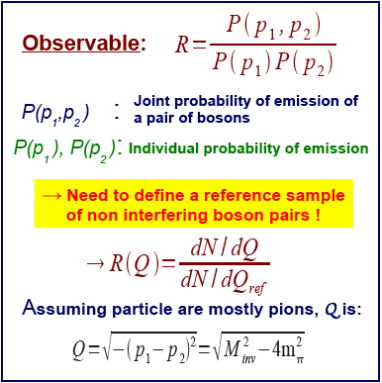
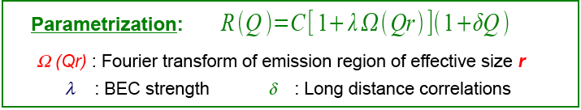
Bose-Einstein Correlations
When wave-functions of identical bosons overlap, Bose-Einstein statistics changes their dynamics
→ Production probability enhanced for identical light boson with similar momenta.
→ BEC measurements give information about size, shape and space-time development of emitting source.
→ First observation in pion-production from pp annihilations – [Phys. Rev. 120 (1960) 300].
→ Many experimental results: e⁺e⁻ @ PETRA, SLAC, LEP / pp @ SPS / ep @ HERA / fix target: NaXX, NOMAD, ...
9/20/2011
P.Bartalini - NTU
18
[QCD-10-003, QCD-10-023]

Slide 19
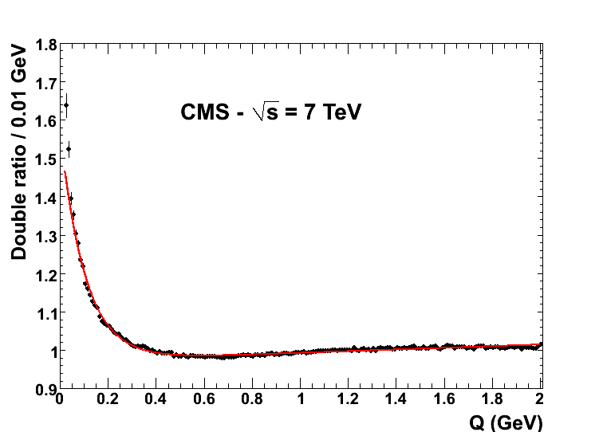
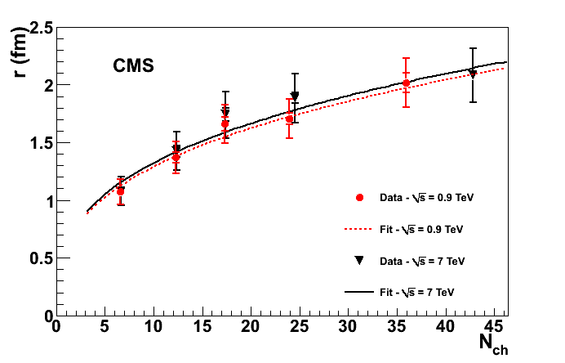

Bose-Einstein Correlations
Reference samples:
- Opposite-charge pairs: natural reference sample, but containing resonances.
- Opposite-hemisphere pairs: Pairing after the inverting of the 3-momenta of one of the two particles (for like- and unlike-sign).
- Rotate particles: pairing happen changing sign of x and y component of one particle.
Pairs from mixed events: (i) random events, (ii) events w/ similar charge multiplicity in the same η region, (iii) events in the same invariant mass region of the signal.
Double ratio (normalization to R_{MC}) to avoid biases.
√s | 0.9 TeV | 7 TeV
r (fm) | 1.56 ± 0.02 ± 0.15 | 1.89 ± 0.02 ± 0.21
λ | 0.616 ± 0.011 ± 0.029 | 0.618 ± 0.009 ± 0.042
→ BEC effective emission region grows with √s while strength is similar.
→ Fit with Ω (Qr) = exp(-Qr):
→ BEC effective emission region grows with N_{ch}, as observed by previous experiments.
→ r vs N_{ch} ≈ scales with √s.
9/20/2011
P.Bartalini - NTU
19
[QCD-10-003, QCD-10-023]

Slide 20
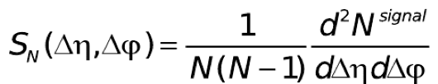
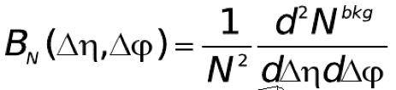
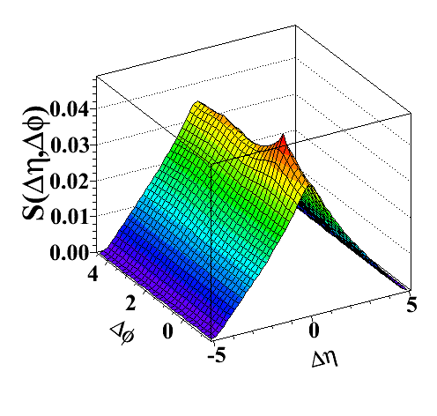
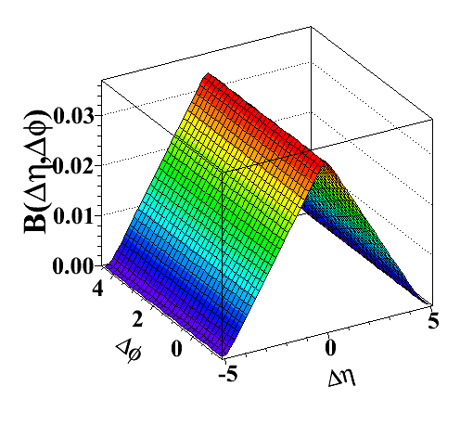
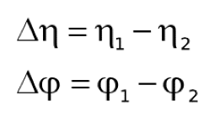
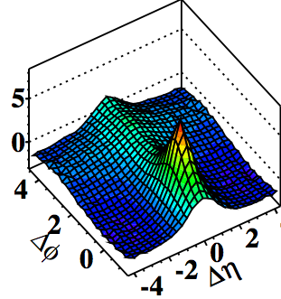
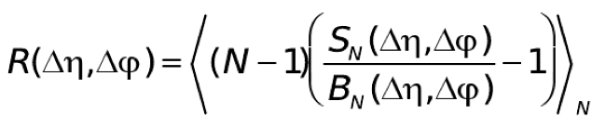
Definition of di-hadron correlation function
Signal distribution:
Background distribution:
Particle pairs
from same event
Pairs from
mixed events
Ratio Signal/Background = Associated 2D Yields:
bins
Can specify selected pair of
trigger (p_{T}^{trig} ) and associated (p_{T}^{assoc} ) particle p_{T} ranges.
9/20/2011
P.Bartalini - NTU
20

Slide 21
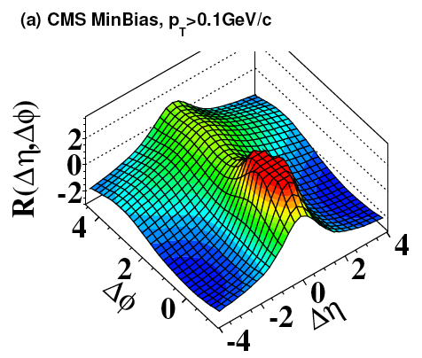
Long and short range correlations
“Away-side” jet correlations:
Correlation of particles between
back-to-back jets
pp minimum bias events √s = 7 TeV
Bose-Einstein correlations:
(Δφ,Δη) ~ (0,0)
Momentum conservation:
~ cos(Δφ)
“Near-side”, Δφ~ 0 jet peak:
Correlation of particles
within a single jet
Short-range correlations (|Δη| < 2):
Resonances, string or cluster fragmentation
9/20/2011
P.Bartalini - NTU
21

Slide 22
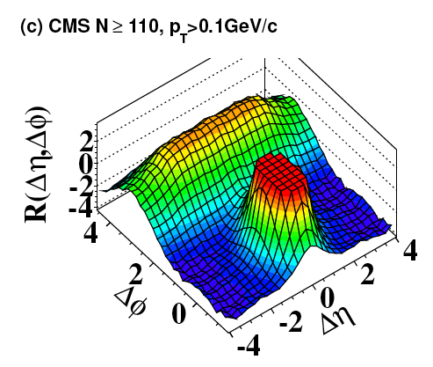
Associated 2D Yields for Particles with P_{T} > 0.1 GeV
pp interactions at 7 TeV
High Multiplicity (N>110)
MinBias
Special trigger developed to collect these rare O(10⁻⁵) events.
It doesn’t rely on jet triggers!
The jet peak is cut for better visibility of the correlations.
Jet peak correlations with away-side – stronger in the high multiplicity events (more jet events)
No significant “new” structure seen in the high multiplicity events.
9/20/2011
P.Bartalini - NTU
22
[QCD-10-002, HIN-11-006]

Slide 23
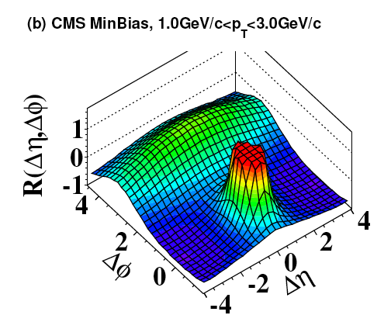
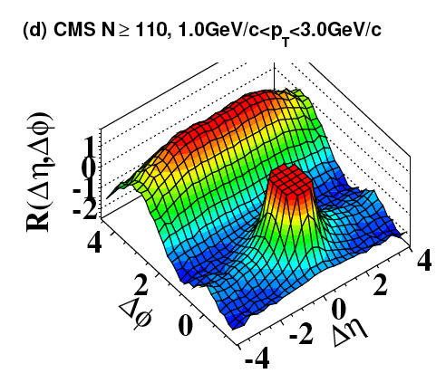
Associated 2D Yields for Particles with 1.0 < P_{T} < 3 GeV
MinBias
High Multiplicity (N>110)
Special trigger developed to collect these rare O(10⁻⁵) events.
It doesn’t rely on jet triggers!
Limiting p_{T} of particles to 1<p_{T}<3 GeV
  Gives a stronger correlation between the away region and the jet region in both MB
  and high multiplicity events.
  Gives a pronounced structure at large Δη around ΔΦ=0 in the high multiplicity events.
9/20/2011
P.Bartalini - NTU
23
[QCD-10-002, HIN-11-006]

Slide 24
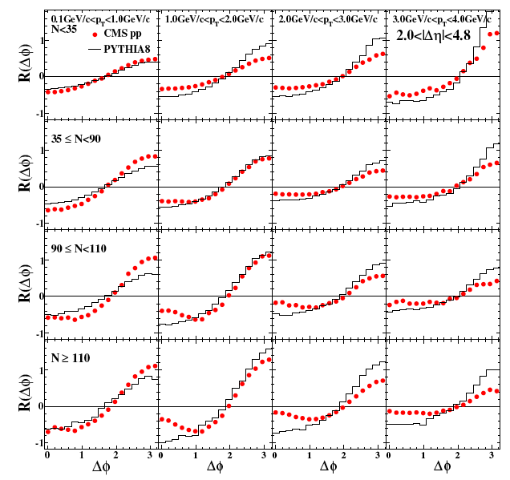
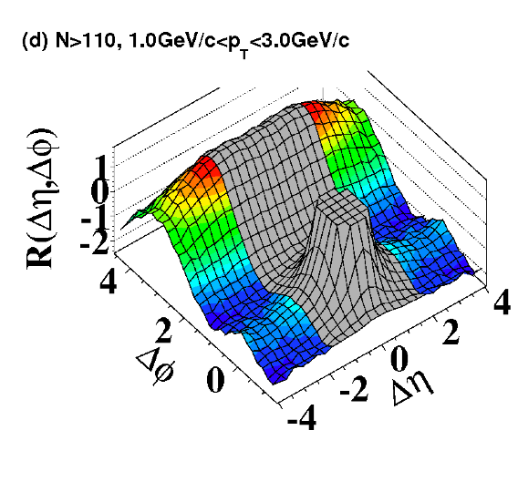
Associated 1D yields in bins of p_{T} and N_{ch}
Long range:
Project 2 < |Δη| < 4.8 onto Δφ:
Increasing p_{T}
Increasing multiplicity
Ridge most pronounced for
high multiplicity events and
at 1 < p_{T} < 3 GeV.
No ridge seen in tested MC models
(Pythia 8, Pythia6, Herwig++, etc.)
Several interpretations proposed for
this HI-like effect in pp interactions.
[Cf. Mark Strikman, this w/s]
9/20/2011
P.Bartalini - NTU
24
[QCD-10-002, HIN-11-006]

Slide 25
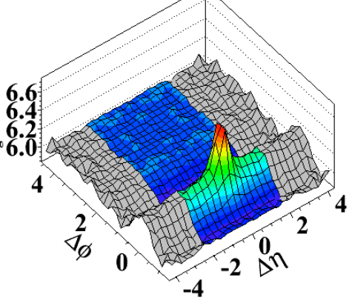
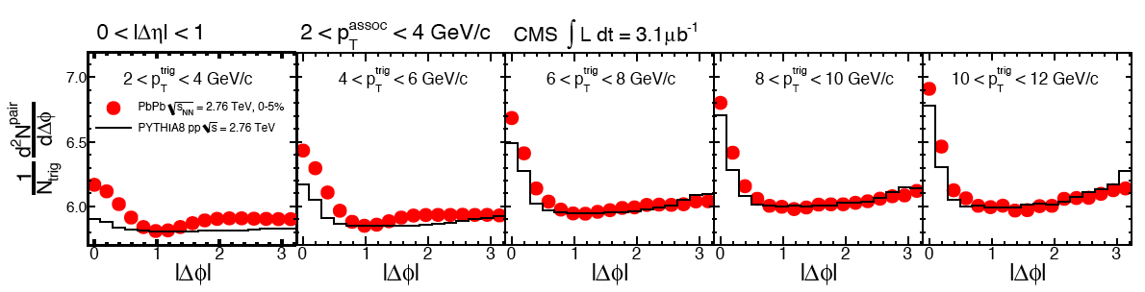
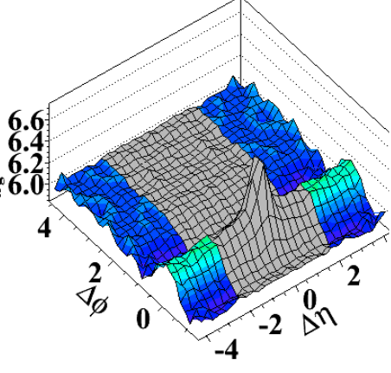
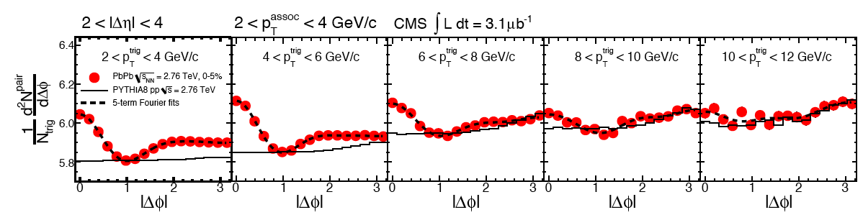
Short and Long Range Correlations in PbPb (√s_{NN} = 2.76 TeV)
Ridge seen in Heavy Ion collsions.
Centrality
0-5%
Short range (0 < |Δη| < 1)
Long range (2 < |Δη| < 4)
Short & long range correlations studied for different p_{T}^{trig}.
Long range correlations: large deviation from predictions (No ridge in MC).
Ridge effect maximal for p_{T}^{trig} ≈ 2-6 GeV then it does disappear beyond 10 GeV! (also in pp)
NEW!
9/20/2011
P.Bartalini - NTU
[HIN-11-001]
25

Slide 26
Correlations @ CMS
BOTTOM LINE
CMS presents the first LHC measurements of Bose–Einstein (short range) correlations at different √s (0.9 TeV, 2.36 TeV, 7 TeV).
  BEC effective emission region grows with √s and N_{ch}, as observed by previous experiments.
CMS reports observation of ridge structures (long range correlations) in pp and HI events.
  Not described by the QCD models.
  Most pronounced for particles with p_{T} in the “few” GeV range. It does disappear at high p_{T}.
[QCD-10-002, HIN-10-001,002,005,006, HIN-11-001,006]

Slide 27
Underlying Event measurements @ CMS
Underlying Event (Hadrons in events with a hard scale)
QCD-10-001: “First Measurement of the Underlying Event Activity at the LHC with √s = 0.9 TeV”. Eur. Phys. J. C 70 (2010) 555-572
QCD-10-010: “Measurement of the Underlying Event Activity at the LHC with √s = 7 TeV and Comparison with √s = 0.9 TeV”. arXiv:1107.0330 submitted to JHEP.
QCD-10-040: “Measurement of the Underlying Event Activity in the Drell-Yan process in proton-proton collisions at √s = 7 TeV”. http://cdsweb.cern.ch/record/1369227.
QCD-10-005: “Measurement of the Underlying Event Activity with the Jet Area/Median Approach at 0.9 TeV”.
http://cdsweb.cern.ch/record/1278706
Connected FWD highlights…
FWD-10-011: “Forward energy flow in the CMS detector”. CERN-PH-EP-2011-086.
FWD-10-008: “Forward Energy Flow and Central Track Multiplicities in W and Z boson Events at 7 TeV pp Collisions”. CDS Record: 1357054.
…
FWD-XX-YYY: ….
“There would not be a vertex in H → γγ events without the Underlying Event…”
Actually UE is interesting per se! Handle on soft MPI.
9/20/2011
P.Bartalini - NTU
[FWD-XX-YYY]
27

Slide 28
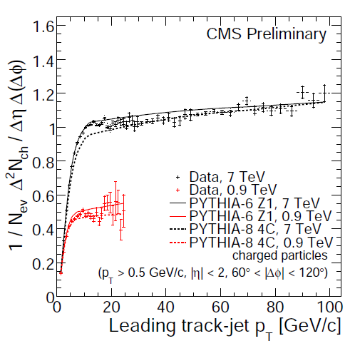
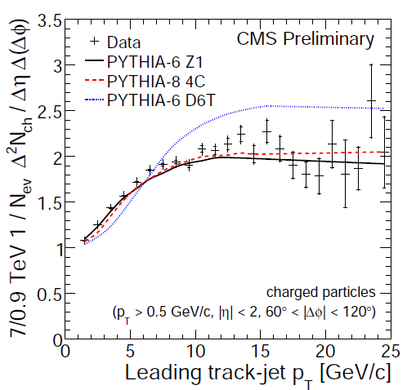


Jets: Densities in the Transverse Region
7 TeV and 0.9 TeV results for the reference charged multiplicity density profiles including Z1 (solid) and 4C (dashed) MC predictions.
    d²Ν_{ch}/dηdφ vs p_{T} (7 TeV)
    d²Ν_{ch}/dηdφ vs p_{T} (0.9 TeV)
    d²Ν_{ch}/dηdφ
Stat. (inner) &
total uncertainty
<N_{ch}> ratio from
Phys. Rev. Lett. 105 (2010) 022002 (NSD)
Stat.
dominating
at high p_{T}
Leading track-jet
Leading track-jet
Fast rise for p_{T} < 8 GeV/c (4 GeV/c), attributed mainly to the increase of MPI activity, followed by a Plateau-like region with ≈ constant average number of selected particles in a saturation regime.
A factor 2 UE increase going from 0.9 TeV to 7 TeV to be compared with 1.66 for MB.
Nota bene: corrected distributions!
See interpretation of M.Strikman et al. Phys. Rev. D83 (2011) 054012
more details in back-up slides
9/20/2011
P.Bartalini - NTU
28
[QCD-10-001, QCD-10-010]

Slide 29






Jets: √s = 7 TeV. N_{ch}, Σ(p_{T}) and p_{T} in Transverse Region
p_{T} track-jet > 20 GeV (UNIVERSAL!) vs p_{T} track-jet > 3 GeV (RISE)
HARD!
MC/DATA: 7 TeV. p_{T} track-jet > 20 GeV
9/20/2011
P.Bartalini - NTU
29
[QCD-10-001, QCD-10-010]

Slide 30



A new approach to UE: Jet Area/Median
Based on the paper: “On the characterization of the underlying event”; JHEP04(2010)065; M. Cacciari, G. Salam, S. Sapeta.
The underlying event activity is given by ρ=median{p_{T}/A}. (less sensitive to outliers!)
  To estimate the jet area η−φ cells are filled by ghost deposits of O(10⁻¹⁰⁰ GeV).
    FastJet [arXiv:hep-ph/0512210] essential to speed up the calculation.
    0.9 TeV: ghost jets dominate the median!!!
    →CMS Adjusted observable for low occupancy:
k_{T} jets
Tracks: p_{T} > 0.3 GeV
|η| < 2.3
Clear sensitivity to the differences between the Models / Tunes
9/20/2011
P.Bartalini - NTU
30
[QCD-10-005]

Slide 31


Energy flow in the forward region
Measurement relies on the energy flow in the Hadron Forward Calorimeter (3.15 < η < 4.9) in the presence of events “triggered” by a more central activity (Minimum Bias, di-Jets)
→Test of central-forward correlations
Corrected data
Distributions studied:
Two different √s included: 0.9 and 7 TeV
Definition of di-Jet samples: |η| < 2.5,|Δφ_{jet1,jet2} - π| < 1
  p_{T} Calo Jet > 8 GeV at 0.9 TeV
  p_{T} Calo Jet >20 GeV at 7 TeV
MB event selection: At least one charged particle in both the forward and the backward region. (Single Diffractives events suppressed)
9/20/2011
P.Bartalini - ICHEP 2010
31
[FWD-10-011]

Slide 32


Energy flow in the forward region
Energy flow increases with the scale (MB vs di-jet) & √s:
→ Effect attributed mainly to MPI.
Pattern very similar with respect to the traditional UE measurement from both a quantitative and a qualitative point of view.
Energy flow also increases with η (close to beam remnant)
Cascade
K_{t}-factorization based MC,
no MPI.
Compared to the traditional UE measurements, we draw slightly different conclusions for what concerns the agreement of the MC models & tunes
9/20/2011
P.Bartalini - NTU
32
[FWD-10-011]

Slide 33


UE activity in Drell-Yan events (μμ)
60 GeV < Mμμ < 120 GeV
UE in jets
Away
Transverse
Toward
9/20/2011
P.Bartalini - NTU
33
[QCD-10-040]

Slide 34
Underlying Event measurements @ CMS
BOTTOM LINE
Jets: first measurement of the Underlying Event Activity at the LHC with √s = 0.9 TeV. Extension to 7 TeV with corrected data reported for both energies.
  Exploits the performances of the CMS Tracker.
  Increase of the activities with the scale of the interactions and with √s corroborates MPIs, which saturate at a modest energy scale.
    UE in di-jet events is ≈ universal.
  Detailed study of distributions in the transverse region for different energy scales (below and above the universality threshold).
  Challenging test of MC models.
Jets: First measurement of the UE with Jet Area/Median approach.
  Complementary approach to evaluate the UE activity, very robust and flexible against different topologies, additional observables for MC tuning. Original methodology developed to handle events with low particle multiplicity.
Measurements of the forward energy flow provides complementary information with respect to the traditional measurements relying just on the central activity.
Drell-Yan: first measurement of the Underlying Event at the LHC with √s = 7 TeV.
  MPI saturated. Radiative increases of UE activity with p_{T} di-lepton. Constant vs M_{di-lepton}.
  Min activity around 70% with respect to the plateau in jet events.
[QCD-10-001, QCD-10-010, QCD-10-005, etc.]

Slide 35
Some thoughts on Multiple Parton Interactions
  … If time allows… (otherwise: BACKUP)
  Heuristic considerations
  Describing the UA5 charged multiplicity…
  Evolution with Interleaved MPI
  Trends in color reconnection
  MPI from soft to hard
  MPI vs generalized PDFs

Slide 36
TH – Some Heuristic considerations
Multiple Parton Interactions
  Huge progress, several recent papers, however still missing a factorization theorem.
  QCD/MPI MC models very successful: unavoidable tools to describe a wide set of observables at hadron colliders.
    Correlations between interactions needed!
      Absence of correlations would predict flat <p_{T}> vs N_{ch}…
    Eikonal description (IP correlations) needed to describe large multiplicity tails in N_{ch}, KNO scaling violations, shape of the UE profiles etc.
    Further correlations (color flow between interactions, etc.) not widely accepted
      D.Treleani: “Interactions happen in different points of the phase space”.

Slide 37


UA5 Charged Multiplicity Distribution
  Choice of the (old) multiple parton interaction model in Pythia:
    All hadron collisions equivalent (MSTP(82)=1)
      → Abrupt turn off of the cross section at P_{T} cut-off
      → All the partonic interactions equivalent
    Varying impact parameter between the colliding hadrons.
      → Continuous turn off of the cross section at P_{T} cut-off
      → Correlated partonic interactions.
      → Hadronic matter described by one (MSTP(82)=3) or two (MSTP(82)=4) Gaussians.
    Model with Varying impact parameter between the colliding hadrons; hadronic matter is described by Gaussians
[UA5, PLB 138 (1984) 304]
Impact
Parameter
d
NSD
Introduce IP correlations in
Multiple Parton Interactions →
Also essential to describe UE Pedestal Effect

Slide 38

“Interleaved evolution” with multiple interactions
T. Sjöstrand & P. Skands - Eur.Phys.J.C39(2005)129 + JHEP03(2004)053
Default from Pythia 6.4
☹ D.Treleani criticizes the color flow between interactions…
☺ Radiation OFF MPIs reduces the tuned σ_{MPI} and the need of complex geometries.
[P.Skands]

Slide 39

Reducing color reconnections…
[CMS, J. High Energy Phys. 01 (2011) 079]
<p_{T}> vs N_{ch} distribution deeply affected by color reconnection parameters.
Correlation underestimated by PHOJET.
Overestimated by pre-LHC Pythia 6 Tunes (maximal color reconnection).
Pythia 8 4C Tune, with reduced color reconnection with respect to the Tevatron Tune 2C, provides a great description at both 0.9 and 7 TeV.
Correlations diluted including particles pT → 0. Lack of universal descriptions.
p_{T} > 0 GeV
New MC/MPI developments – work in progress:
Dynamical description of the hadrons in Pythia 8, connecting the size of the hadrons to the p_{T} of the leading interaction → Further reduces the need of color reconnections.
9/20/2011
P.Bartalini - NTU
39

Slide 40



MPI vs Generalized Parton Distributions
“Transverse nucleon structure and diagnostics of hard parton-parton processes at LHC”.
[M.Strikman @ Northwest Terascale w/s and Phys. Rev. D83 (2011) 054012]
<ρ²>_{g} from analysis of GPDs from J/ψ photo production
M.Strikman et al. Phys. Rev. D83 (2011) 054012
Explains general features of UE @ hadron colliders!
<ρ²>_{g} < <ρ²>_{q} explains
UE in DY < UE in Jets?

Slide 41

MPI: from “soft” to “hard”
‣ Double Parton Scattering A & B (A ≠ B):
• σ_{eff} - effective cross section ≈ process-independent:
‣ σ_{eff} related to the momenta of the “hard” collisions’ multiplicity:
‣ σ_{eff} (Tevatron) ≈ 11 mb [Treleani et al., PRD76:076006,2007] from CDF 3jet+γ.
‣ Pythia: σ_{eff} = σ_{Non-Diffractive} / <f_{impact}>
• where f_{impact} is tune dependent: σ_{eff} (Tevatron) ≈ 20÷30 mb
DPS Strongly underestimated in the models? Can DPS be measured at the LHC ?
How do they relate to the “soft” low pT QCD MPI measurements?
Which is the impact on searches?
[Treleani et al. rich bibliography]

Slide 42
Double Parton Scattering in 4jet topologies
Disentangle double-parton-scattering from bremsstrahlung
pT(jet k)
pT(jet 3)
pT(jet j)
pT(jet 1)
pT(jet 2)
pT(jet i)
pT(jet 4)
pT(jet l)
No correlation (DPS) vs Strong correlation (SPS)
Define different correlation angles between jet pairs:
AFS solution:
Study Δφ between pT1 - pT2 and pT3 - pT4
CDF solution:
Study Δφ between pT1 + pT2 and pT3 + pT4 (CDF nomenclature: ΔS)

Slide 43


Measurement of DP Scattering @ Tevatron
[CDF Collab, Phys. Rev. Lett. 79, 584 (1997)]
Double high P_{T} interactions observed by
AFS, UA2, CDF, D0!!!
σ_{eff} ~ 14 mb
DPS
σ_{eff} ~ 16 mb [D0 collaboration Phys.Rev. D81 (2010) 052012]

Slide 44

γ+jet events @ LHC

Slide 45

LHC: where is the 3rd jet coming from ?
γ+jet events
(but the conclusions are more general)
Below 25 GeV DPS is DOMINANT
Jets at this scale are often used in searches.
Understanding/quoting DPS contribution is a key issue, even in high p_{T} regions.

Slide 46









HI: Jet quenching via large dijet energy imbalance & DPS!
Dijets, calorimeters only
  Leading p_{T}>120 GeV/c
  Sub-leading p_{T}>50 GeV/c
pp PbPb, 50 - 100% PbPb 0 - 10%
Pb
Pb
p_{T} imbalance, increasing with centrality
pp
Pb
Pb
Pb
Pb
Back-to-back Δφ∼π for all centralities
pp
Pb
Pb
arXiv:1102.1957
Double Parton Scattering!
9/20/2011
P.Bartalini - NTU
46
[HIN-10-004]

Slide 47
Bottom Line MPI @ LHC
Brand new measurements are being published by CMS and by other LHC collaborations. Here we focus on the impact on MPI models.
  Rather qualitatively & quantitatively consistent picture from the LHC
  → The LHC is a Multiple Parton Interaction collider…
    need to take this into account when using soft jets, same sign leptons etc in searches…
  Parallel progress in TH, MCs & Tuning
    Evolution: soft vs hard ☺
    √s evolution 😐
    Universality (central vs forward interactions) 😐
    Universality (different topologies, different scales) 😐
    Some aspects of the models criticized by TH: color flow in MPIs ☹
      Recent model developments partially address this aspect
    Future: dynamical description of the hadrons, connection with GPDs ☺

Slide 48
BACKUP

Slide 49
UE / BACKUP
  Further info / plots

Slide 50
Quick introduction to correction framework
QCD-10-001 and QCD-10-010
  How we correct our data distribution:
Unfolding gives us correction for the detector effects
→ second step
(1)
Generated distributions:
we handle genParticles (p_{T}>500MeV, |eta|<2, charged, status 1) and genTrackerJets (SIS-cone, p_{T}>1, buit-up of selected primary particles)
(2)
Reco distributions:
we handle Tracks (p_{T}>500MeV,|eta|<2, charged, “primary” in the sense of attached to the primary vertex: if not existing take the beamspot) and reco TrackerJets (SIS-cone, p_{T}>1, buit-up of selected primary Tracks)
MC simulation gives us the correction for the event selection bias,
→ first step
(3)
Reco distributions, after event selection:
Applying HLT trigger , vertex and beam-scraping filtering

Slide 51
Correction related systematics: QCD-10-001 and QCD-10-010
Contributions:
1) Data Statistics:
→ propagation of data statistical errors after the correction procedure;
→ Adopted tecnique: resampling method;
2) MC statistics:
→ propagation of statistical information of the available model used to apply correction;
→ Adopted tecnique: resampling method;
3) MC model dependence:
→ systematics coming from choosing a specific model for applying corrections;
→ Adopted technique: closure-test unfolding Pythia-6 Z1 distributions (Tune best reproducing data distributions) with 2 alternative model/tune (Pythia-8 Tune 1 and Pytia-6 Tune Z2): for the final estimation, we conservatively take bin-by-bin the maximum discrepancy between the 2 estimations.
→ final estimate quoted as relative residual unfolding Z1 (reference-alternative)/reference % (ARC);
*) systematics quoted as relative%;
**) errors added in quadrature: data stat, data stat + MC stat, data stat + MC stat + model dep;

Slide 52

DETECTOR RELATED SYSTEMATICS
Overall 2% effect in profiles and p_{T} distributions. More sensitive (5-10%) in tails of N_{ch} and Σ p_{T} distributions. Main contributions: Tracker Material, Background Contamination.
From QCD-10-001 (low lumi). QCD-10-010 also needs to account for the pile-up effect (not dominant)

Slide 53


Densities in the Transverse Region
7 TeV results for the reference charged multiplicity density and Σp_{T} density profiles including Z1, D6T and 4C predictions.
    d²Ν_{ch}/dηdφ
    d²Σp_{T}/dηdφ
Stat. (inner) &
total uncertainty
Stat. dominating
at high p_{T}
Fast rise for p_{T} < 8 GeV/c attributed mainly to the increase of MPI activity, followed by a Plateau-like region with ≈ constant average number of selected particles and a slow increase of Σp_{T}, in a saturation regime.
9/20/2011
P.Bartalini - NTU
53

Slide 54
UE / BACKUP
  Comparison with other LHC experiments
  Comparison with Tevatron

Slide 55

ATLAS UE – transverse region
The main feature of
the public ATLAS UE
is the usage of the
leading track.
Simple
Requires low stat.
Early Publication.
Worse description of leading interaction especially @ large scale.
Plots from: https://atlas.web.cern.ch/Atlas/GROUPS/PHYSICS/CONFNOTES/ATLAS-CONF-2010-029/

Slide 56

ATLAS UE – extending to neutrals
[D.Kar @
Northwest
Terascale
Worskhop
- Oregon]
ATLAS is
extending
the UE
Analysis to
neutrals
clusters
( ≈ 40% of
the total)
√s = 0.9 TeV
√s = 7 TeV

Slide 57


ALICE UE – a reduced η range
√s = 0.9 GeV
√s = 7 TeV
Still leading track but in a reduced η range

Slide 58

COMPARISONS
I read the points off with a ruler!
by Rick Field

Slide 59


COMPARISONS UE@LHC √s = 7 TeV
The main result is that at least a common tune
exists (Z1) which is capable to describe all these
different UE observables at the same time.

Slide 60


COMPARISONS UE@LHC √s = 0.9 TeV
The main result is that at least a common tune
exists (Z1) which is capable to describe all these
different UE observables at the same time.
LHC UE results at √s = 0.9 TeV show that the √s
evolution is also very well described.

Slide 61
COMPARISONS UE@Tevatron
CDF published data at 1.96 TeV on the “transverse” charged particle density, dN/dηdφ, as defined by the leading calorimeter jet (jet#1) for charged particles with p_{T} > 0.5 GeV/c and |η| < 1.0. The data are corrected and compared with PYTHIA Tune Z1 at the generator level.
MPI Cut-Off versus the Center-of Mass Energy W_{cm}: PYTHIA Tune Z1 was determined by fitting p_{T0} independently at 0.9 TeV and 7 TeV and calculating ε = PARP(90). The best fit to p_{T0} at CDF is slightly higher than the Tune Z1 curve. This is very preliminary! Perhaps with a global fit to all three energies (i.e. “Professor” tune) one can get a simultaneous fit to all three??
[R.Field @ Northwest Terascale Worskhop - Oregon]

Slide 62


UE in DY @ Tevatron
UE is measured in DY events where the di-lepton pair is considered to set the energy scale and the privileged direction in the phase-space defining the transverse, toward and away regions.
Compartng to UE in jets, universality of the UE applies within 10-20%.
MC models predict less pronounced differences.

Slide 63
UE / others Bottom line
ALICE and ATLAS UE in leading track phenomenology is compatible with the UE in leading track jet from CMS
  Same general patterns observed, same conclusions favoring MPIs.
  Common tune exists which is capable to describe all these LHC measurements at different √s at the same time.
CDF UE in jet phenomenology is compatible with the LHC UE observations from a qualitative point of view.
  However there might be a tension in the data from a quantitative point of view (no common MC tune exists).
  Comparing with UE in DY, Universality is found to apply to the 10-20% level.
To what extent should we trust our MCs?

Slide 64
FWD / BACKUP

Slide 65


Measuring Forward Jets and other forward objects
η 5 2.5 0 −2.5 −5
HF
HF
First CASTOR unit
installed on collar
table of HF platform
(-z side) in June
2009
Fully functional and
integrated into
CMS operations
Rapidity coverage: 5.2 < |η| < 6.6
9/20/2011
P.Bartalini - NTU
65
Notes:
The central feature of the CMS apparatus is a superconducting solenoid, of 6 m
internal diameter. Within the field volume are the silicon pixel and strip tracker, the crystal
electromagnetic calorimeter (ECAL) and the brass-scintillator hadronic calorimeter (HCAL).
Muons are measured in gaseous detectors embedded in the iron return yoke.
The forward calorimeters provide almost hermetic coverage. They include
ZDC (>8.5), CASTOR (-6.6<eta<-5.3), and HF (2.9<eta<5.2). HF we use in the study
to see rap.gap.
HF, consists of steel absorbers and embedded radiation-hard quartz fibers, which provide a fast collection of Cherenkov light.
----------------------------------------------------------------------------------------------------
CMS uses a right-handed coordinate system, with the origin at the collision point,
the x-axis pointing to the centre of the LHC, the y-axis pointing up (perpendicular to the LHC
plane), and the z-axis along the anticlockwise-beam direction. The polar angle is measured from the positive z-axis and the azimuthal angle is measured in the x-y plane.
--------------------------------------
Two elements of the CMS detector monitoring system, the Beam Scintillator Counters (BSCs) and the Beam Pick-up Timing for the eXperiments (BPTX) devices , were used to trigger
the detector readout. The two BSCs are located at a distance of 10.86 m from the nominal
interaction point (IP) and are sensitive in the eta range from 3.23 to 4.65. Each BSC is a set of 16 scintillator tiles. The BSC elements have a time resolution of 3 ns and an average minimum ionizing-particle detection efficiency of 96.3%, and are designed to provide hit and coincidence rates. The two BPTX devices, located around the beam pipe at a distance of 175m from the IP on either side, are designed to provide precise information on the bunch structure and timing of the incoming beam, with better than 0.2 ns time resolution.

Slide 66

Energy flow in W (and Z) events
W selected requiring leptonic decays:
p_{T}(l) > 25 GeV, Missing Energy E_{T}> 30 GeV, M_{inv}(l,E_{T}) > 60 GeV.
Investigating both central tracks and forward energy.
Conclusions similar for Z events.
Further studies selecting events with Large Rapidity Gaps (not shown here)
9/20/2011
P.Bartalini - NTU
66
[FWD-10-008]

Slide 67
HI(ghlights) @ CMS
Measuring tracks in PbPb collisions:
HIN-10-001: “Pseudorapidity distributions of charged hadrons produced in PbPb collisions at √s_{NN} = 2.76 TeV ”.
HIN-PAS-QCD-10-001
HIN-10-002: “First measurement of elliptic flow on PbPb collisions”. CDS Record: 1347788
Concentrating on correlations:
QCD-10-002: “Observation of Long-Range, Near-Side Angular Correlations in Proton-Proton Collisions at the LHC ”. J. High Energy Phys. 09 (2010) 091 → A QCD measurement in large multiplicity pp events
HIN-11-001: “Long-range and short-range di-hadron angular correlations in central PbPb collisions at √s_{NN} = 2.76 TeV”. CERN preprint: CERN-PH-EP-2011-056
HIN-11-006: “Centrality and multiplicity dependence of dihadron correlations in PbPb and pp collisions”.
CDS Record: 1353583
Example of Soft probes:
HIN-10-005: “Centrality dependence of the nuclear modification factor for charged particle transverse momentum spectra in PbPb collisions at √s_{NN} = 2.76 TeV”. CDS Record: 1352777.
Example of Hard probes:
HIN-10-006: “Quarkonium production in PbPb collisions at at √s_{NN} = 2.76 TeV”. arXiv:1105.2438.
HIN-11-007: “Y(2s)/Y(1s) ratio in pp and PbPb collisions at 2.76TeV”. CERN preprint: CERN-PH-EP-2011-074.
…
HIN-XX-YYY: ….
9/20/2011
P.Bartalini - NTU
[HIN-XX-YYY]
67

Slide 68

Luminosity in 2010 PbPb run
CMS configured in a dedicated mode for heavy ions
  Turn off zero suppression
  Taking data at up to 220 Hz
  12 MB event size
Triggering on minimum bias, jets, muons and photons
  ALL rare probes written to tape
  ~half of minimum bias written
Recorded luminosity PbPb 8.7 μb⁻¹ (√s_{NN} = 2.76 TeV)
Recorded luminosity pp@2.76 TeV 241 nb⁻¹
Total PbPb data volume ~0.89 PetaByte
Days since Nov 1, 2010
Note: luminosities will be rescaled by few % after complete analysis of Van der Meer scans

Slide 69


Centrality
Hadron-Forward (HF) calorimeter energy deposits in 3<|η|<5
Increase of the fraction of high-p_{T} triggers with centrality
Correlated to:
average number of participating nucleons: <N_{part}>
average number of binary nucleon collisions: <N_{coll}>
From Glauber model of the nuclear collision geometry [Phys. Rev. C77 (2008) 014906]
Pb
Pb
Pb
Pb
9/20/2011
P.Bartalini - NTU
69

Slide 70



Charged particle spectra dN_{ch}/dη
normalized per participant nucleon pair
Uses pixel tracker and two methods
Data taken with no magnetic field, B = 0. Tesla
Trigger with 99% efficiency
1% Ultra Peripheral Collision (UPC) contamination
Significantly stronger rise with respect to pp
Central multiplicity dN_{ch}/dη=1610 ± 55
for 0−5% centrality
9/20/2011
P.Bartalini - NTU
[HIN-10-001]
70

Slide 71



Azimuthal Anisotropy
Measure charged particle production with respect to the Reaction Plane _{RP}
Energy Dependence
  At RHIC large elliptic flow observed. Confirmed at LHC.
    Consistent with strongly coupled medium of low shear viscosity.
    → Ideal fluid.
  v₂{Lee Yang Zeros method}
  20-30% centrality
  extrapolated to p_{T}=0
9/20/2011
P.Bartalini - NTU
[HIN-10-002]
71

Slide 72
Definition of di-hadron correlation function
Signal distribution:
Background distribution:
Particle pairs
from same event
Pairs from
mixed events
Ratio Signal/Background = Associated 2D Yields:
bins
Can specify selected pair of
trigger (p_{T}^{trig} ) and associated (p_{T}^{assoc} ) particle p_{T} ranges.
9/20/2011
P.Bartalini - NTU
72

Slide 73
Long and short range correlations
“Away-side” jet correlations:
Correlation of particles between
back-to-back jets
pp minimum bias events √s = 7 TeV
Bose-Einstein correlations:
(Δφ,Δη) ~ (0,0)
Momentum conservation:
~ cos(Δφ)
“Near-side”, Δφ~ 0 jet peak:
Correlation of particles
within a single jet
Short-range correlations (|Δη| < 2):
Resonances, string or cluster fragmentation
9/20/2011
P.Bartalini - NTU
73

Slide 74
Associated 2D Yields for Particles with P_{T} > 0.1 GeV
pp interactions at 7 TeV
High Multiplicity (N>110)
MinBias
Special trigger developed to collect these rare O(10⁻⁵) events.
It doesn’t rely on jet triggers!
The jet peak is cut for better visibility of the correlations.
Jet peak correlations with away-side – stronger in the high multiplicity events (more jet events)
No significant “new” structure seen in the high multiplicity events.
9/20/2011
P.Bartalini - NTU
74
[QCD-10-002, HIN-11-006]

Slide 75
Associated 2D Yields for Particles with 1.0 < P_{T} < 3 GeV
MinBias
High Multiplicity (N>110)
Special trigger developed to collect these rare O(10⁻⁵) events.
It doesn’t rely on jet triggers!
Limiting p_{T} of particles to 1<p_{T}<3 GeV
  Gives a stronger correlation between the away region and the jet region in both MB
  and high multiplicity events.
  Gives a pronounced structure at large Δη around ΔΦ=0 in the high multiplicity events.
9/20/2011
P.Bartalini - NTU
75
[QCD-10-002, HIN-11-006]

Slide 76
Associated 1D yields in bins of p_{T} and N
Long range:
Project 2 < |Δη| < 4.8 onto Δφ:
Increasing p_{T}
Increasing multiplicity
Ridge most pronounced for
high multiplicity events and
at 1 < p_{T} < 3 GeV.
No ridge seen in tested MC models
(Pythia 8, Pythia6, Herwig++, etc.)
Several interpretations proposed for
this HI-like effect in pp interactions.
[Cf. Mark Strikman, this school]
9/20/2011
P.Bartalini - NTU
76
[QCD-10-002, HIN-11-006]

Slide 77


Centrality effect and elliptic flow subtraction
Associated hadron yields of the ridge structure are studied before and after explicit subtraction of the elliptic flow (v₂) component.
Centrality dependence of correlations in PbPb (√s_{NN} = 2.76 TeV)
: 4 - 6 GeV/c
: 2 - 4 GeV/c
Pb
Pb
Pb
Pb
9/20/2011
P.Bartalini - NTU
[HIN-11-006]
77

Slide 78
Short and Long Range Correlations in PbPb (√s_{NN} = 2.76 TeV)
Ridge seen in Heavy Ion collsions.
Centrality
0-5%
Short range (0 < |Δη| < 1)
Long range (2 < |Δη| < 4)
Short & long range correlations studied for different p_{T}^{trig}.
Long range correlations: large deviation from predictions (No ridge in MC).
Ridge effect maximal for p_{T}^{trig} ≈ 2-6 GeV then it does disappear beyond 10 GeV! (also in pp)
NEW!
9/20/2011
P.Bartalini - NTU
[HIN-11-001]
78

Slide 79


Suppression of particle yields
Measuring charged tracks
up to p_{T} ~ 100 GeV/c.
→ Using jet triggers
to enhance statistics at high p_{T}
Nuclear Modification Factor
normalized to pp:
Centrality
0-5%
Nuclear overlap function <T_{AA}> from
[Phys. Rev. C77 (2008) 014906]
9/20/2011
P.Bartalini - NTU
[HIN-10-005]
79

Slide 80

Suppression of particle yields
Measuring charged tracks
up to p_{T} ~ 100 GeV/c.
→ Using jet triggers
to enhance statistics at high p_{T}
Nuclear Modification Factor normalized to peripheral HI collisions:
9/20/2011
P.Bartalini - NTU
[HIN-10-005]
80

Slide 81

All quarkonia suppressed: R_{AA} vs. centrality
Non-prompt J/ψ suppression is a measure of b-quark quenching.
High p_{T} J/ψ is strongly suppressed at the LHC.
Inclusive ϒ(1S) is suppressed.
Centrality 0-20%
9/20/2011
P.Bartalini - NTU
[HIN-10-006]
81

Slide 82


Suppression of excited ϒ states
pp
PbPb
Excited states ϒ(2S,3S) relative to ϒ(1S) are suppressed. Probability to obtain measured value, or lower, if the real double ratio is unity, has been calculated to be less than 1%
9/20/2011
P.Bartalini - NTU
[HIN-10-006]
82

Slide 83
HI(ghlights) @ CMS
BOTTOM LINE
Successful Heavy Ion run in 2010. CMS recorded an integrated luminosity of 8.7 μb⁻¹ (PbPb collisions, √s_{NN} = 2.76 TeV).
Study of global properties of medium in PbPb events at different centralities (and comparison with pp).
  Pseudorapidity distributions, Long and short range correlations, elliptic flow.
Significant statistics of hard probes.
The measurements indicate a consistent view of the hot and dense medium:
  Strong collective effects.
  Suppression of quarkonia (including excited states of the Υ).
  Hard quenching of quarks (including b-quark).
  No quenching of weakly interacting and electromagnetic probes. (Not shown here)
→ Additional results on jet quenching at the end of this presentation.
[QCD-10-002, HIN-10-001,002,005,006, HIN-11-001,006]

Slide 84
HI / additional BACKUP

Slide 85
Suppression of particle yields in HI collisions
Nuclear Modification Factors:
Normalized to pp:
Normalized to
peripheral HI collisions:
Normalization to pp using the nuclear overlap function <T_{AA}> (*)
(*) The nuclear overlap function <T_{AA}> is the ratio of the number of binary nucleon-nucleon collisions <N_{coll}> calculated from a Glauber model of the nuclear collision geometry [Phys. Rev. C77 (2008) 014906] and the inelastic nucleon-nucleon cross section σ_{NN}^{inel} = (64±5) mb at √s = 2.76 TeV [J. Phys. G37 (2010) 075021].
9/20/2011
P.Bartalini - NTU
85

Slide 86




Ridge in pp and PbPb
CMS pp 7 TeV, N ≥ 110
CMS PbPb 2.76 TeV, 0-5%
x10
Ridge Region
Ridge Region
x10
arXiv:1105.2438
[QCD-10-002, HIN-11-006]

Slide 87

Unsuppressed isolated high p_{T} photons
Confirmation of collisional scaling
No nuclear modifications seen
9/20/2011
[HIN-11-002]
87

Slide 88

Jet fragmentation function, PbPb ≈ pp
Updated jet algorithm: Particle Flow, Anti-k_{T ,} R=0.3
Charged tracks, >4 GeV/c, jets with =40-300 GeV/c
Compare PbPb to pp
  Fragmentation function similar between PbPb and pp
  Jets fragment in the vacuum
pp PbPb, 30 - 100% PbPb 0 - 30%
Pb
Pb
Pb
Pb
9/20/2011
[HIN-11-004]
88

Slide 89



Z⁰→e⁺e⁻ and W → μν in PbPb collisions
NEED NEW
Z⁰
Z→e⁺e⁻
pp
Hint of W±
9/20/2011
[HIN-11-003]
89

