Slide 1




Thermalization, the Glasma and Strong Interactions
through Field Coherence
L. McLerran, 16/9/11
Outline:
The sQGP Paradigm and a little Heavy Ion Lore
Saturation and Coherent Fields in the Hadron Wavefunction
The Formation of the Glasma
Early Time Evolution of the Glasma
Thermalization and Transport
Implications

Slide 2
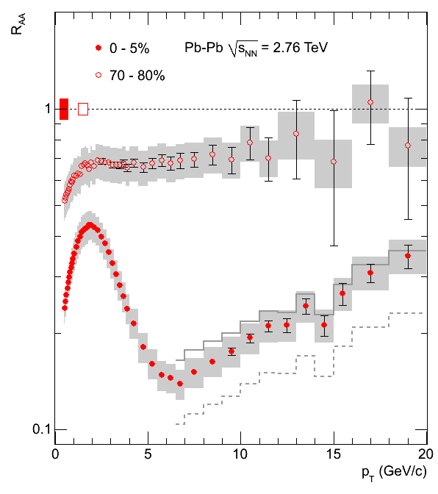
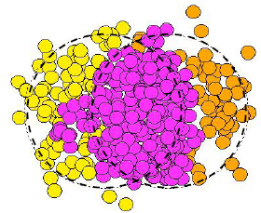
RHIC and LHC Data on heavy Ions
Very Strong Collective Flow Patterns
Consistent with Perfect Fluid Hydrodynamics
Small Viscosity to Entropy
PLB 696 (2011) 30-39
“Jet quenching” => Large Energy Loss /Length
Strongly Interacting QGP Paradigm:
Well thermalized Quark Gluon Plasma

Slide 3
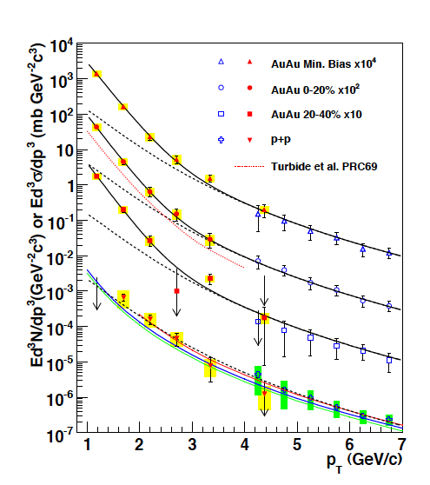
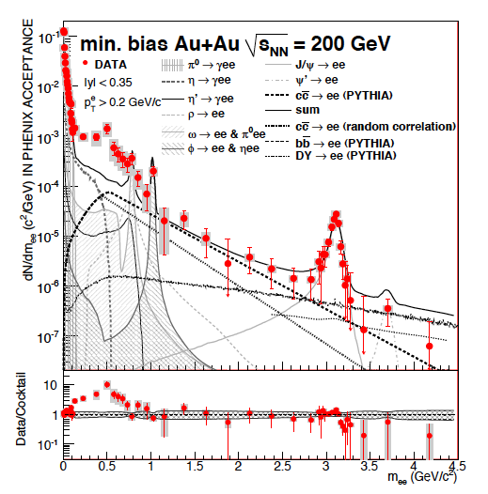
Photons and Dileptons
QGP & Hydro:
Magnitude and shape
Flow not explained
QGP & Hydro
Magnitude and shape not explained
Dilepton have p_T slope of 100 MeV

Slide 4
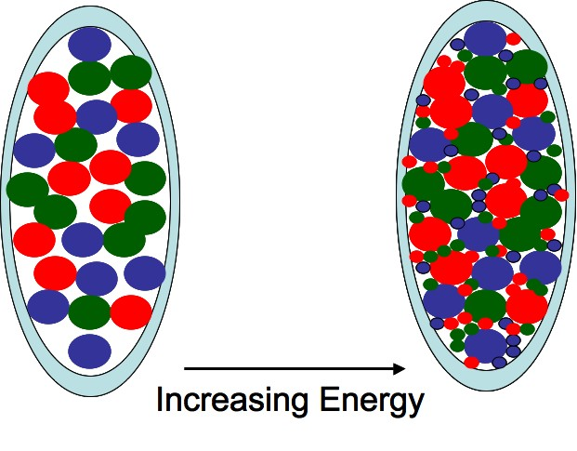


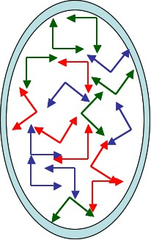
Saturation and Coherent Fields:
Color Glass Condensate:
High density gluon fields:
Parton distributions replaced by ensemble of coherent classical fields
Renormalization group equations for sources of these fields

Slide 5
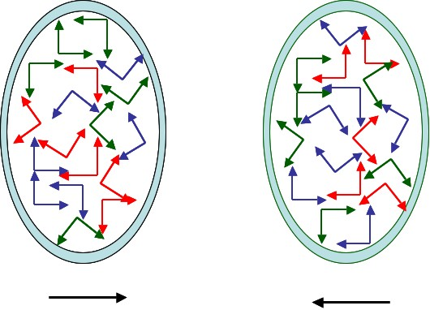
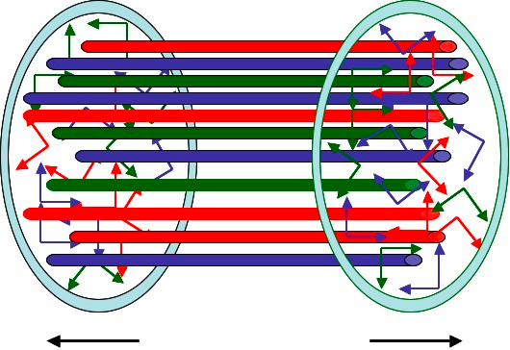
Collisions of two sheets of colored glass
Sheets get dusted with color electric and color magnetic fields
The initial conditions for a Glasma evolve classically and the classical fields radiate into gluons
Longitudinal momentum is red shifted to zero by longitudinal expansion
But the classical equation are chaotic:
Small deviations grow exponentially in time

Slide 6



Chaos and Turbulence:
CGC field is rapidity independent => occupies restricted range of phase space
Wiggling strings have much bigger classical phase space
A small perturbation that has longitudinal noise grows exponentially
After a time
system isotropizes,
But it has not thermalized!

Slide 7




Thermalization naively occurs when scattering times are small compared to expansion times. Scattering is characterized by a small interaction strength.
How can the system possibly thermalize, or even strongly interact with itself?
Initial distribution:
A thermal distribution would be:
Only the low momentum parts of the Bose-Einstein distribution remain
As dynamics migrates to UV, how do we maintain isotropy driven by infrared modes with a scale of the saturation momentum?

Slide 8





Phase space is initially overoccupied
Chemical potential is at maximum the particle mass
But for isotropized Glasma distribution

Slide 9


Where do the particle gluons go?
If inelastic collisions were unimportant, then as the system thermalized, the ratio of the energy density and number density are conserved
One would form a Bose-Einstein Condensate
Overoccupied phase space => Field coherence in important
Interactions can be much stronger that g^2
Might this be at the heart of the large amount of jet quenching, and strong flow patterns seen at RHIC?
Problem we try to solve:
How does the system evolve from an early time overoccupied distribution to a thermalized distribution
We argue that the system stays strongly interacting with itself during this time due to coherence

Slide 10
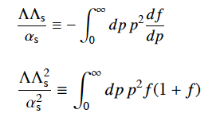





First: Kinetic Evolution Dominated by Elastic Collisions in a Non-Expanding Glasma
Blaizot, Gelis, Liao, LM, Venugopalan
Small angle approximation for transport equation:
Due to coherence, the collision equation is independent of coupling strength!
There is a fixed point of this equation corresponding to thermal equilibrium when

Slide 11
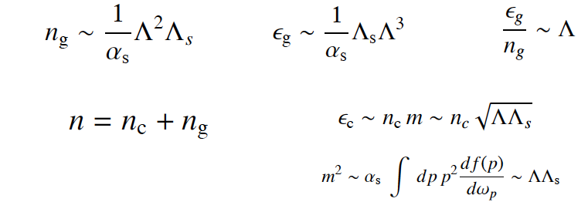

Estimates of various quantities
(Momentum integrations are all dominated by the hard scale)
The collision time follows from the structure of the transport equation and is
The scattering time is independent of the interaction strength

Slide 12
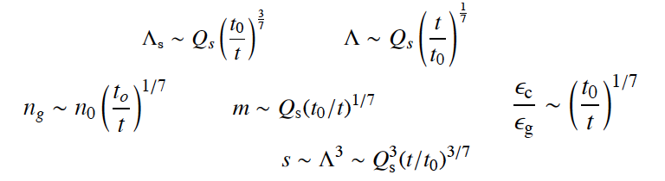




Thermalization in a non-expanding box
So that
At thermalization

Slide 13
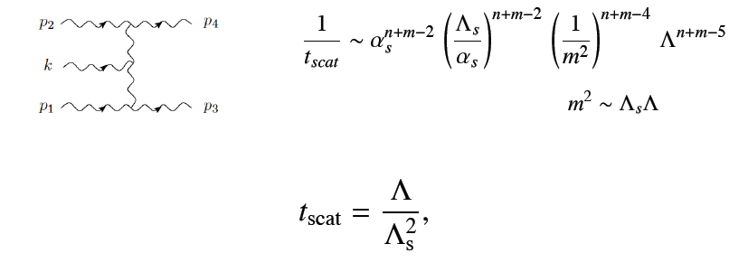


How do inelastic processes change this?
Rates of inelastic and elastic processes are parametrically the same
What about the condensate? Difficult to make definite statement.
In relaxation time limit, we would expect:
Either
or
Condensate would rapidly evaporate near thermalization time

Slide 14




Effect of Longitudinal Expansion
Assume approximate isotropy restored by scattering.
Will check later that this is consistent.

Slide 15

The asymmetry parameter:
Take moments of transport equation
Prove that the solutions for these moments reduce to constants times the ultraviolet scale at large times
Need to know solutions to transport equation to determine the value of the anisotropy parameter

Slide 16
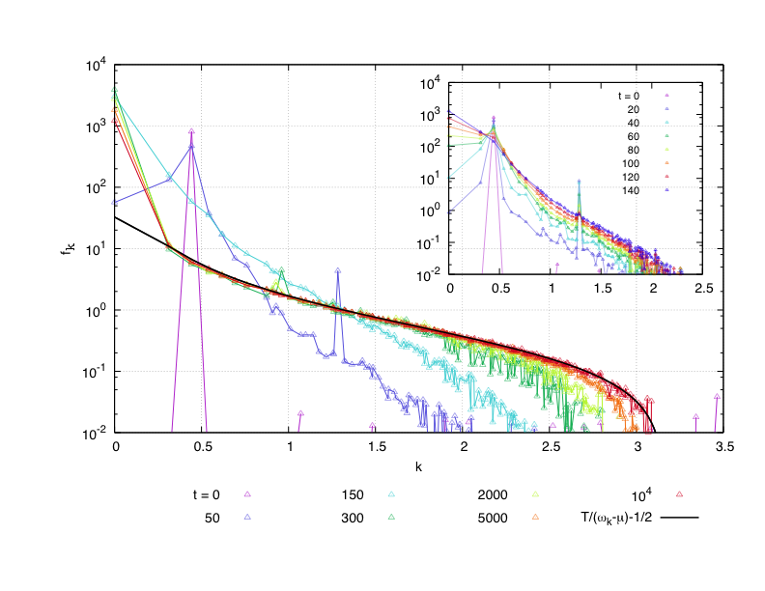
Gelis and Eppelbaum
Prelimnary

Slide 17

Phenomenological Consequences:
Flow is more easily generated since system is anisotropic and also generates flow at earliest times
Jet quenching at early times should be stronger due to coherence of media
Will get more flow for photons than hydrodynamic simulations, but enough?
Contribution to di-lepton spectrum from gluons annihilating in condensate to virtual quark loop. Not suppressed by powers of interaction due to coherence. Di-lepton pair will have very small transverse momentum because condensate gluons have very small transverse momentum.
Geometric scaling of photon and di-lepton distributions lead to huge enhancements

