Slide 1
Leptonic SUSY Searches at CMS
Claudio Campagnari
UC Santa Barbara

Slide 2
SUSY? What SUSY?
Experimentalist view: search for new physics in events with lepton(s) and MET
  Well motivated by dark matter, SUSY or not
  CMS categories:
    New Physics where MET really matters: SUSY
    Other New Physics: EXOTICA
Leptonic “SUSY” searches at CMS are signature-based searches
  Strategies only loosely based on SUSY prejudices
    Not optimized for the CMSSM at all
  This is likely to change in 2012: we will have more searches targeted to specific final states

Slide 3
One Common Theme
Initial searches target high cross-section
High cross-section means strong production
Strong production means there must be jets in the final state
All searches require jets in addition to leptons and MET
Also generally high H_{T}
  Prejudice: New Physics at high mass → high HT
  High H_{T} → Less SM background
This is also likely to change in 2012, eg, EWK-ino searches

Slide 4
It’s the background, stupid!
All the work goes in estimating the background
“Instrumental backgrounds”, eg, fake leptons, are clearly data driven.
CMS has gone to great lengths to minimize reliance on Monte Carlo also for “physics backgrounds”, ie, for tail of SM physics processes

Slide 5
“Tried and true” background estimation recipe:
  Check SM MC prediction in a background control region
    Maybe normalize to the control region
  Use the SM MC tail prediction with uncertainties
CMS “SUSY” leptonic analyses rely as little as possible on this procedure.

Slide 6
So what is done instead? Tricks!
PROs:
  Less reliance on modeling of SM tails…what if the tool that we use is wrong?
  A good trick relies on well understood physics arguments
CONs:
  Hard
  Most of these tricks are not perfect
    Corrections, arguments, …..
  A trick not well motivated and well understood can be a trap
Important: does not mean you throw away the SM prediction.

Slide 7
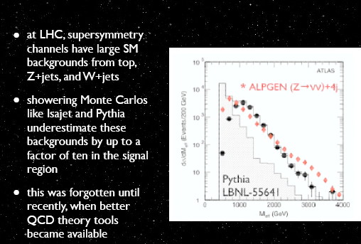
(Extreme) Example

Slide 8
Multiple techniques
In CMS a signature is often probed by multiple techniques, multiple overlapping signal regions
What is then the “bottom line limit” for a given channel?
  If more than 140 characters, it does not fit in a tweet
Who cares, that is not the point
  We want find “something new”
  We do not know what the “something new” is
  We must search broadly
  Limit setting is not the goal
    But it can be done anyway
    Efficient communication of the information on what it is that we did not find is important
      Some comments at the end of the talk

Slide 9
CMS “SUSY” searches
Channel | Signature | Documentation | Lumi
all-hadronic | inclusive jets+MHT | SUS-11-004 | 1.1 fb⁻¹
(0-leptons) | α_{T} + H_{T} | arXiv:1109.2532 | 1.1 fb⁻¹
 | MT2 | SUS-11-005 | 1.1 fb⁻¹
 | razor | arXiv:1107.1279 | 35 pb⁻¹
 | b-jets + MET | SUS-11-006 | 1.1 fb⁻¹
single lepton | e/μ + jets + MET | SUS-11-015 | 1.1 fb⁻¹
di-lepton | opposite-sign (no Z) | SUS-11-011 | 0.98 fb⁻¹
 | Z + (MET templates) | SUS-11-017 | 0.98 fb⁻¹
 | Z + (JZB) | SUS-11-012 | 0.19 fb⁻¹
 | same-sign | SUS-11-013 | 2.1 fb⁻¹
mullti-lepton | ≥3 leptons | SUS-11-013 | 35 pb⁻¹
lepton+photon | e/μ + γ + MET | arXiv:1105.3152 | 35 pb⁻¹
photons | γ/γγ + jets + MET | SUS-11-009 | 1.1 fb⁻¹
long-lived | displaced fermions | EXO-11-004 | 1.1 fb⁻¹
particles | stopped gluinos | EXO-11-020 | 0.89 fb⁻¹
 | R-hadrons | EXO-11-022 | 1.1 fb⁻¹
Signatures with taus not well explored
b-content (with or without) of lept. signatures not explored at all
This is will improve in the future

Slide 10
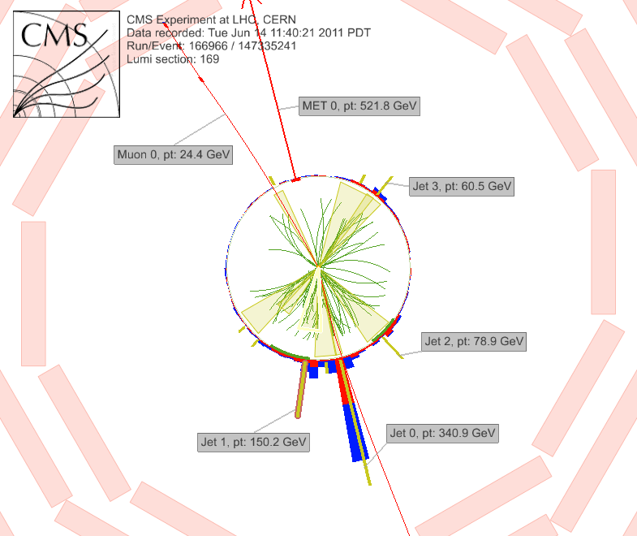
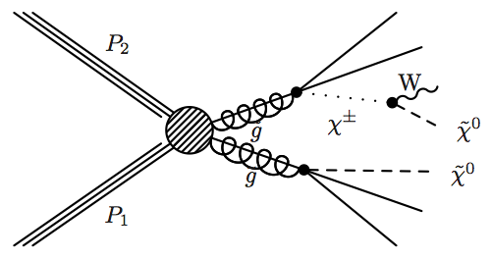
Single Lepton Search
example signal:
SUSY with χ± decay
MET
jets
muon
jet
lepton
}
MET
jet
jet
jets
jet
Require isolated lepton ➞ suppress QCD
Signature: single lepton (e/μ) + jets + MET
Challenge: estimating “tails” of ttbar/W+jets MET, H_{T} distributions

Slide 11
Single leptons: backgrounds
W+jets and tt➞ℓ+jets (~75%)
  Challenge: dominant bkg, don’t want to rely solely on MC for tails of initial state radiation, large top boost
  Two tricks (see following)
tt➞ℓ⁺ℓ⁻ (~15%)
  With lost lepton (not reconstructed/isolated, outside acceptance)
  Estimate using dilepton data control sample, scale by probability to lose lepton
W+jets/ttbar with W➞ τ ➞ e/μ decays (~10%)
  Estimate using μ+jets data control sample, replace μ with expected τ response
QCD bkg (~1%)
  Small ➞ verify using data-driven technique, 2D extrapolation isolation vs. MET
Other backgrounds (~1%)
  DY, single top ➞ small, obtained from MC

Slide 12
Single lepton: first trick
Signal: high MET
In W+jets and tt➞ℓ+jets MET comes from ν in W→ℓν
Assumption: P_{T} spectrum of ν and ℓ are the same
Not totally true, need corrections
  ℓ can only be reconstructed in |η|<2.4
  ν resolution, scale, not the same as ℓ
  W-polarization introduces a difference in the P_{T} spectra in lab frame (dominant effect)

Slide 13
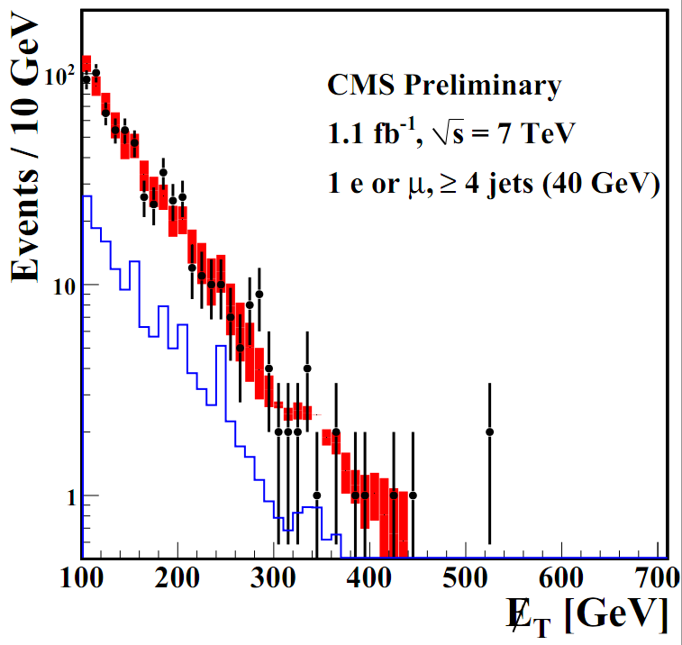
Can then use lepton P_{T} spectrum after full selection (no. of jets, HT, etc) to predict MET spectrum without using tt/W+jets MC
data
total bkg prediction
dilepton+τ prediction
2 signal regions (defined a priori)
4 jets, HT>500 GEV
MET > 250 GeV (loose)
MET > 350 GeV (tight)
SUS-11-015
250
 | MET > 250 GeV | MET > 350 GeV
predicted | 49.8 ± 8.8 ± 10.8 | 12.1 ± 4.3 ± 3.6
observed | 52 | 8
350
No excess.
Caveat: any NP with lept. spectrum
= to MET spectrum would be
calibrated away
MET (GeV)

Slide 14
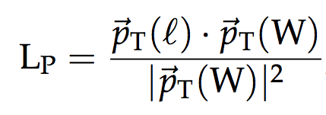
Single lepton: second trick
L_{P} tends to be small for SUSY and large for ttbar and Wjets
L_{P} is related to the decay angle of the W in ttbar and Wjets. The decay angle depends on the W polarization, which is well known.
  → L_{P} is under control for SM

Slide 15
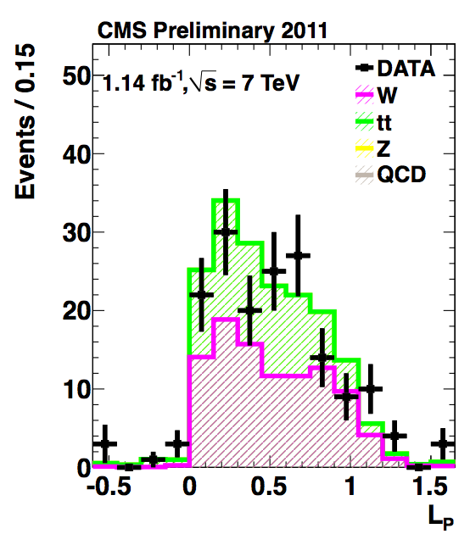
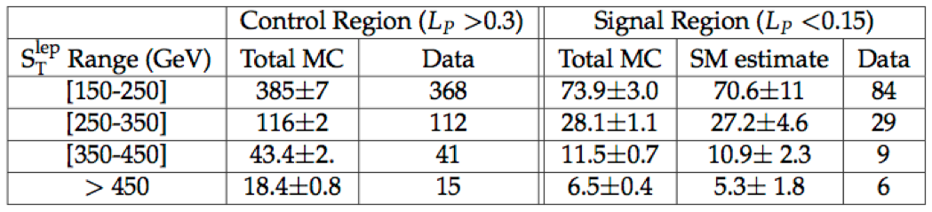
μ-channel, S_{T}^{lep} 250-350 GeV
Analysis is performed by looking at L_{P} in bins of S_{T}^{lep} = P_{T}(ℓ) + MET
A signal would show up ay low L_{P} and high S_{T}^{lep}
signal region
control region
signal region: ≥3 jets + H_{T} > 500 GeV, 4 bins S_{T}^{lep} = p_{T}(l) + MET
No excess

Slide 16
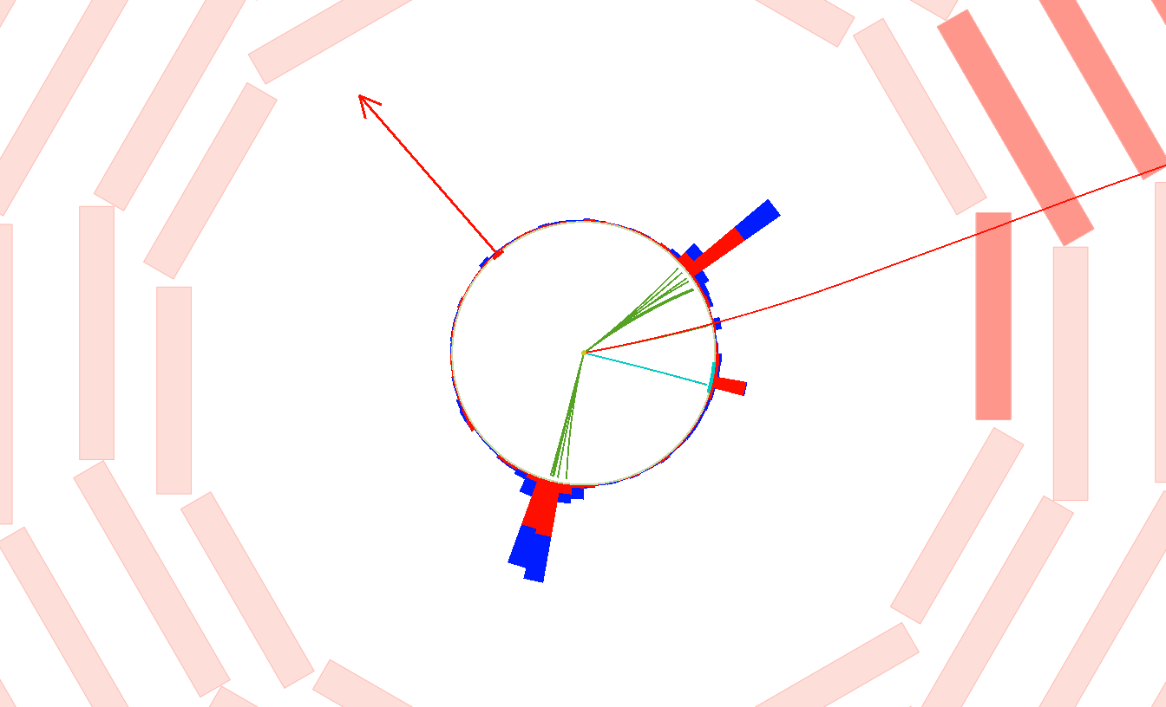
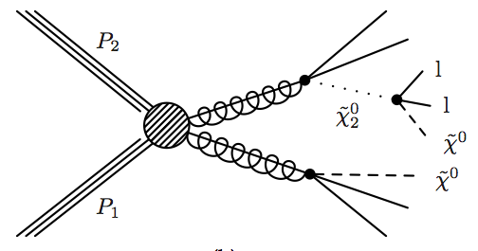
Opposite sign di-leptons (not from Z)
example signal:
SUSY with χ₂⁰ ➞ ℓ⁺ ℓ⁻ χ⁰ decay
MET
jets
jet
}
leptons
muon⁺
}
electron⁻
MET
jets
jet
Signature: opposite-sign (OS) leptons (ee/eμ/eμ) + jets + MET
Search for “kinematic edge” in dilepton mass distribution
Perform counting experiment in high MET vs. H_{T} signal region

Slide 17
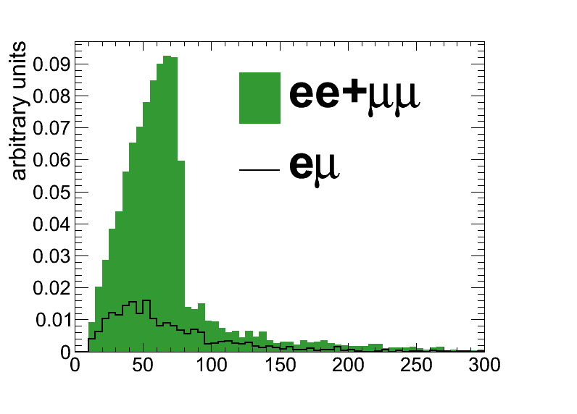
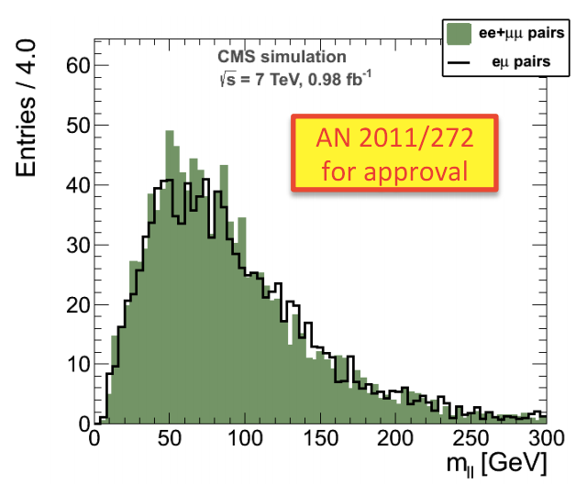
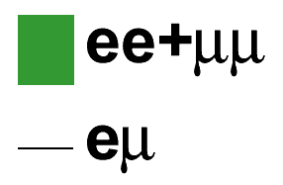

OS Edge search
χ₂⁰ ➞ ℓ⁺ℓ⁻ χ₁⁰ kinematic endpoint produces “edge” in ee+μμ dilepton mass distribution
  Potential “smoking gun” for new physics observation
  Relax cuts, exploit shape info ➞ complementary to high MET, H_{T} searches
  Edge position (m_{cut}) ➞ precise measurement related to SUSY particle masses
SM background: same yield/shape in opposite-flavor (eμ) vs. same-flavor (ee+μμ)
Search for edge in ee+μμ dilepton mass, take bkg shape from eμ sample
SUSY with
SM MC
ee + μμ
eμ
dilepton mass (GeV)
dilepton mass (GeV)

Slide 18
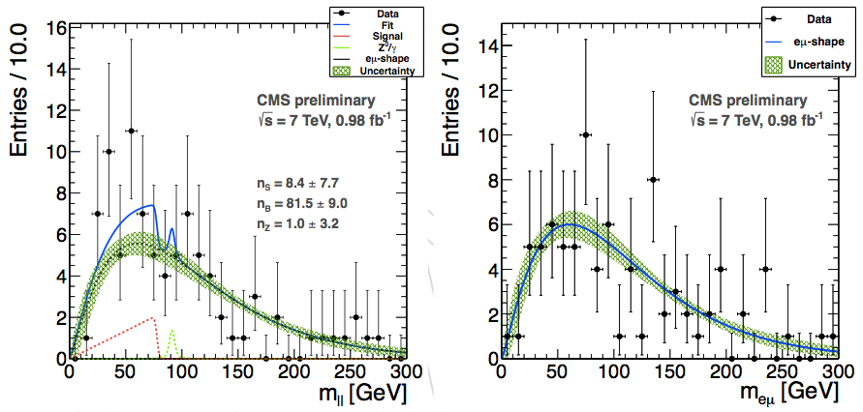
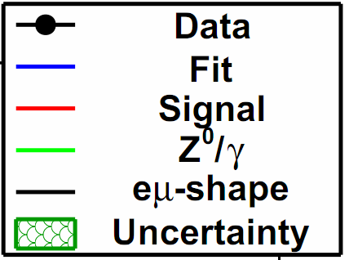
Edge search results (1.1/fb)
SUS-11-011
SUS-11-011
ee+μμ eμ
signal shape:
triangle ⊕ gaus
dilepton mass (GeV) dilepton mass (GeV)
No edge observed ➞ extract signal yield UL using maximum likelihood fit
Signal shape depends on 1 parameter only (edge position m_{cut}) ➞ scan m_{cut} and extract signal yield, and upper limit, at each point
  Signal yield consistent with 0 within ~2σ over full m_{cut} range (backup)
  Example fit shown: m_{cut} ~ 80 GeV

Slide 19
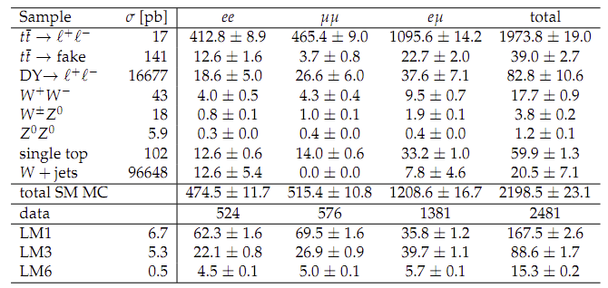
OS counting experiment in tails of SM (1.1/fb)
Two leptons, PT>20,10 GeV, two jets (Pt>30 GeV)
Sample is mostly ttbar

Slide 20
OS counting experiment in tails of SM (1.1/fb)
Two leptons, PT>20,10 GeV, two jets (Pt>30 GeV)
Plausible SUSY signals are small compared
to SM → search in the tails

Slide 21
OS counting experiment in tails of SM (1.1/fb)
Two leptons, PT>20,10 GeV, two jets (Pt>30 GeV)
Many SUSY signals have more SameFlavor
than OppositeFlavor pairs

Slide 22
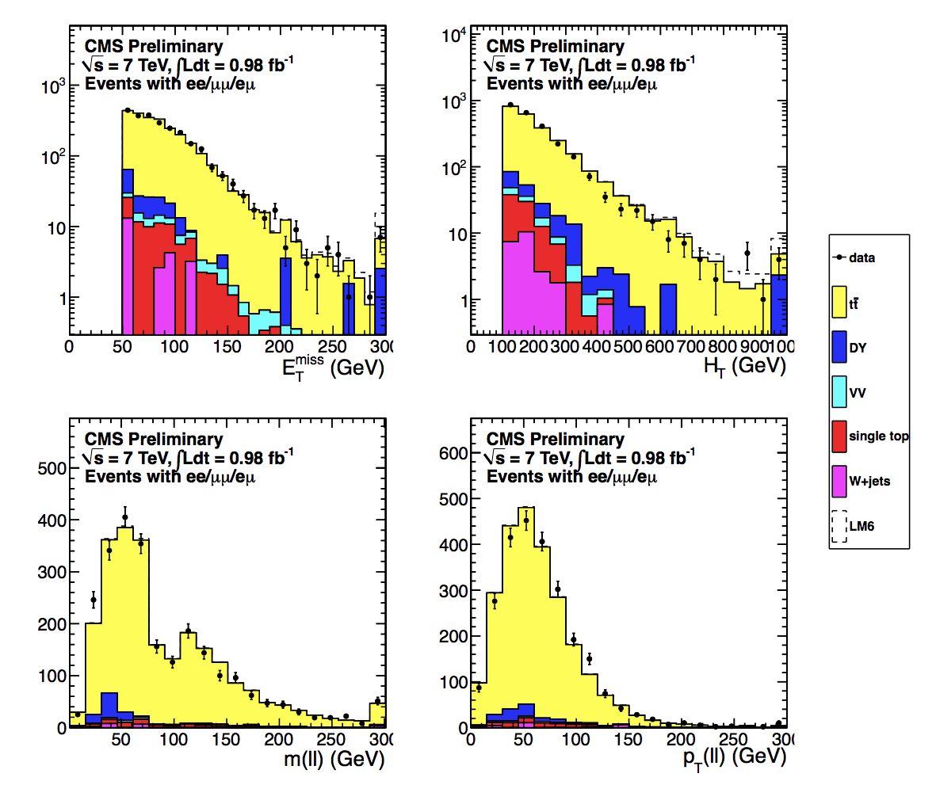
Nothing too exciting in kinematical distributions

Slide 23
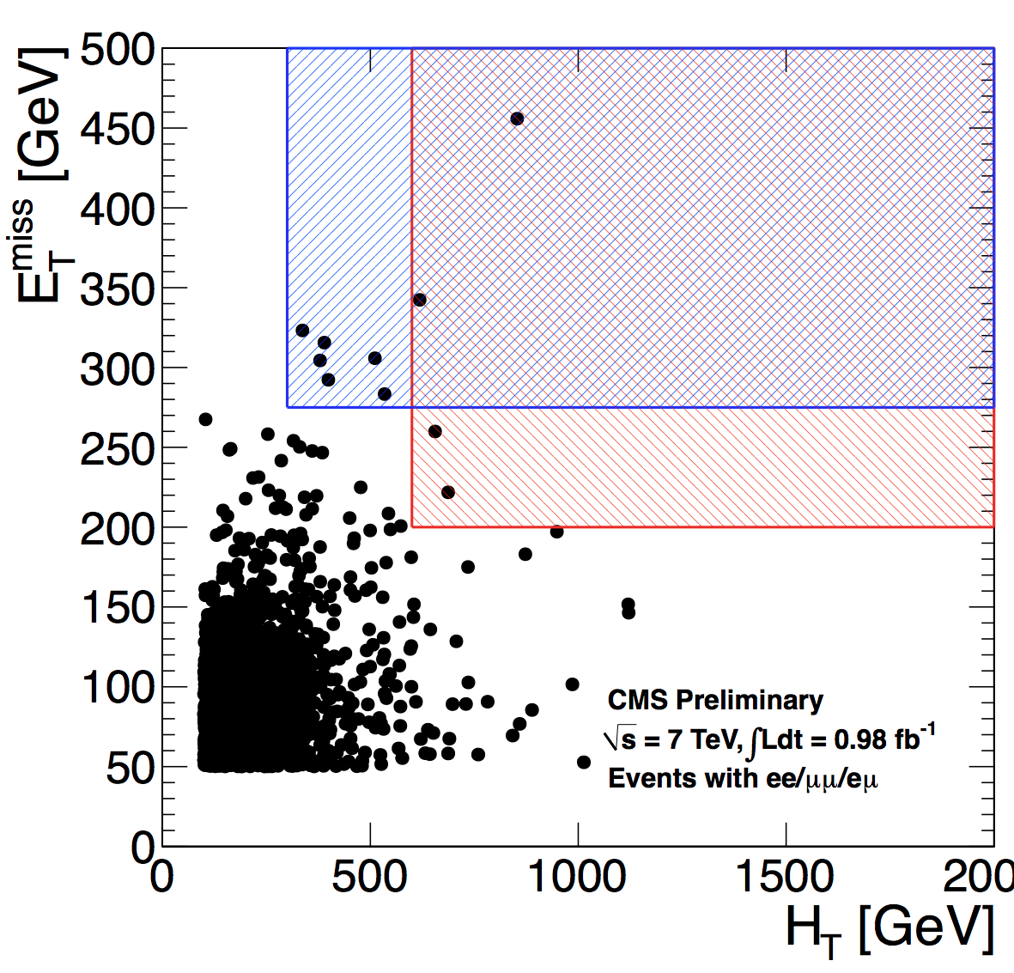
Counting experiment in tails of SM
Define two signal regions in tails of HT and MET
Tail = were expect “a few” SM events
Counting experiment
Compare OF vs SF yield

Slide 24
Tricks for counting experiment
Same P_{T} (ℓ) ≅ P_{T}(ν) method used in single lepton analysis
Extrapolate from low MET, low HT region under the assumption that HT and MET/sqrt(HT) are (almost) uncorrelated
  This is an empirical observation in ttbar MC validated in bulk of ttbar data

Slide 25
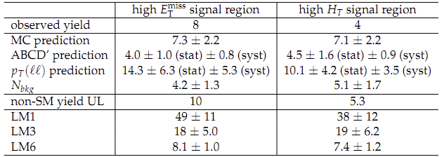
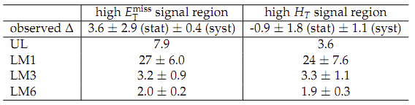
Summary of counting expt results
Data yield agrees with MC prediction as well as the two data driven methods
= efficiency corrected excess of SF events over OF events
No excess of SF events as would be expected in some SUSY models

Slide 26
Opposite sign Z+MET
example signal:
SUSY with χ⁰₂→Z χ⁰ decay
Signature: Z + jets + MET
Backgrounds
  Instrumental MET in pp→Z+jets
    Data driven
  tt→ e⁺e⁻ or μ⁺μ⁻ where the dilepton mass is consistent with the Z
    From MC or (better) fro eμ sample

Slide 27
Two data driven methods for Z+jets
“Template” method
  Use measured MET distributions in γ+jets and multijet events as a function of HT, N_{jets}, … to obtain a predicted MET distribution in the Z+jets sample
method
  Signal: large positive JZB
  Z+jets background: symmetric (+ve or –ve) JZB
    Use –ve JZB events to subtract off Z+jets in signal region

Slide 28
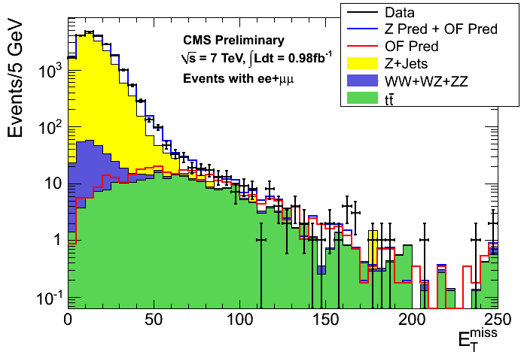
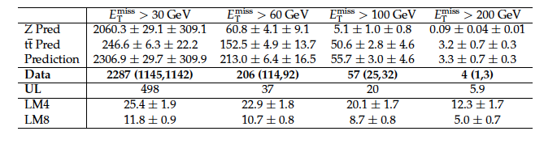
Z + Met template results
No excess of events
Note that at high MET
the Z+jets BG becomes
~ irrelevant
≥ 2 jets

Slide 29
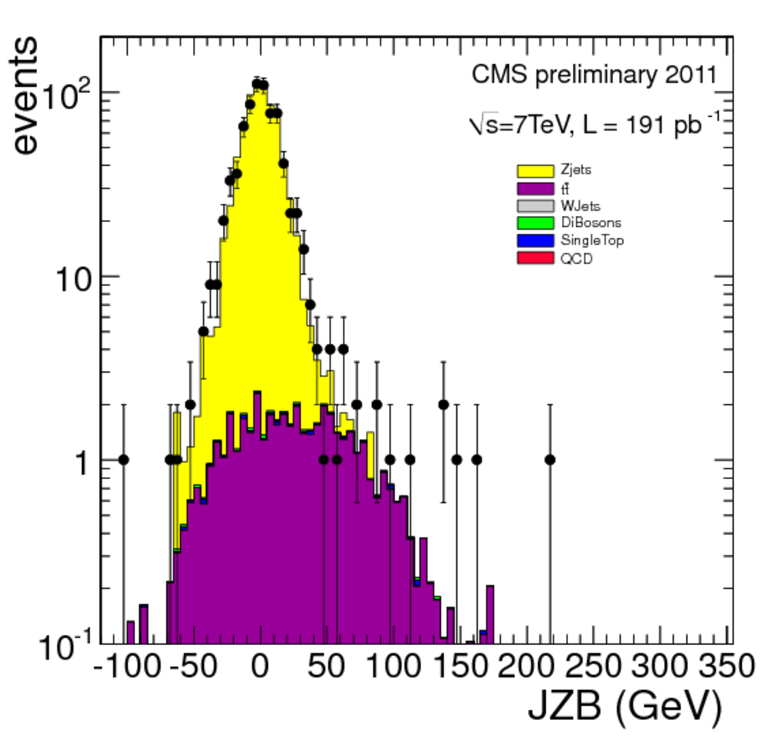

JZB results
No excess of events

Slide 30
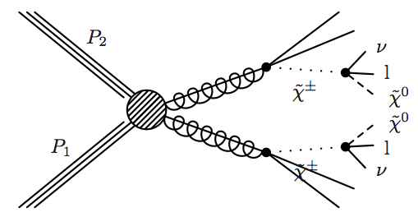
Same Sign Dileptons
example signal:
SUSY with 2 χ± decays
jets
}
MET
SS leptons
jets
Require 2nd same-sign lepton ➞ suppress SM backgrounds
Signature: sign-sign (SS) leptons + jets + MET
Challenge: estimating backgrounds from fake leptons

Slide 31
SS search strategy
Three complementary samples
  ee, eμ, μμ high P_{T} (P_{T}>20,10 GeV)
  ee, eμ, μμ low P_{T} (P_{T}>10 for e, P_{T}> 5 for μ)
    More sensitive to compressed SUSY spectra, but higher BG
  eτ, mτ, ττ (P_{T}>15 for τ, P_{T}>10 for e, P_{T}> 5 for μ)
    In case New Physics likes taus
Several signal regions at high MET and HT
  Where we expect only a few SM events
  Chosen with an eye towards possible SUSY features

Slide 32
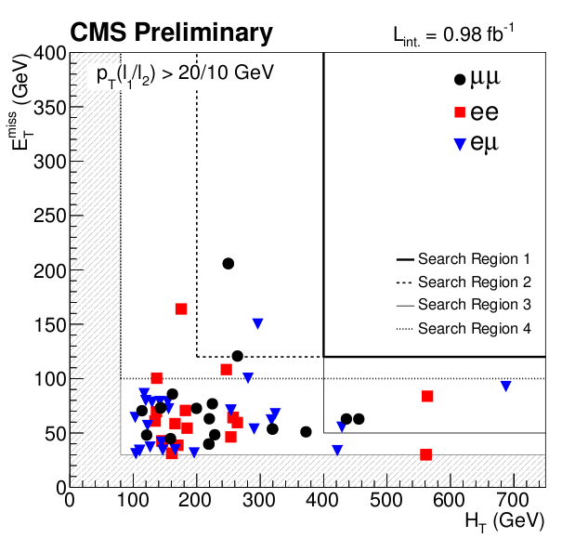
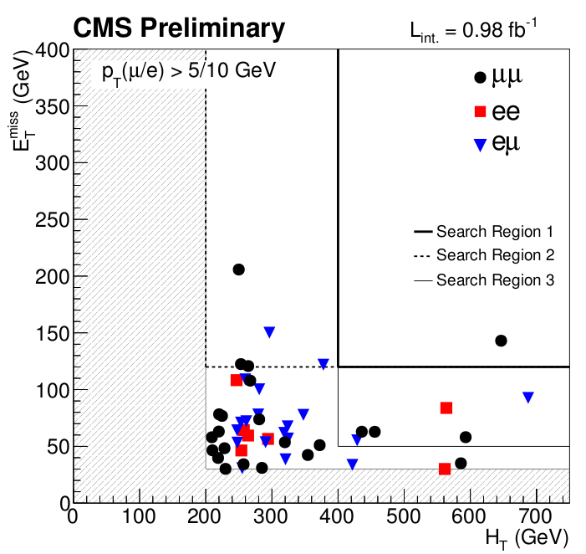
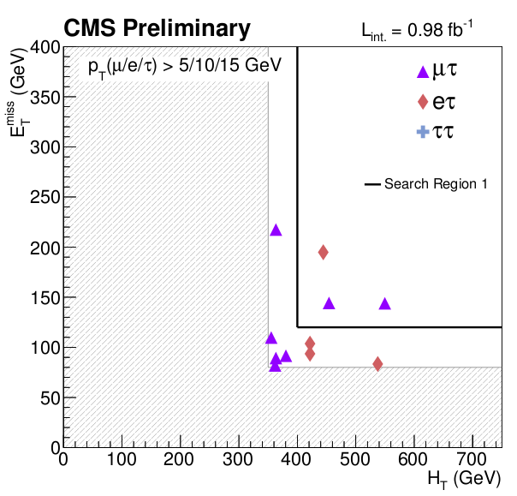

Slide 33
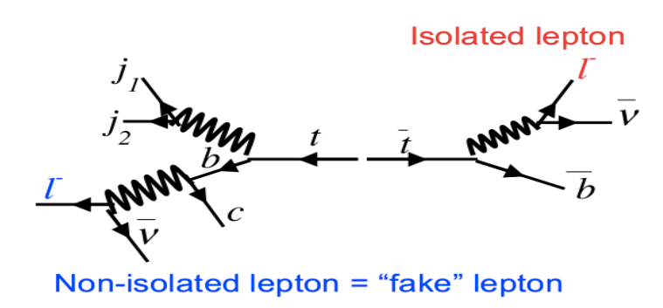
Same Sign Backgrounds
isolated lepton
ℓ⁻
dominant background:
ttbar with “fake” lepton from b➞ℓ±
ℓ⁻
non-isolated “fake” lepton
Events with “fake” (non-W/Z) leptons (dominant)
  Must be a data driven BG estimate
    Fake rate method (same as discussed yesterday for Wjets BG in H→WW talk)
    B tag-and-probe ➞ extract b➞ℓ± isolation distributions from b-enriched sample
  Validated in lower MET, lower HT control region
Rare SM processes with SS leptons
  Estimate from MC
  ttW, qq➞q’q’W±W±: never measured in pp collisions ➞ measurement critical for future SS analysis
Opposite-sign leptons with charge mis-ID (~10%)
  Charge mis-ID rate validated using same-sign Z sample in data

Slide 34

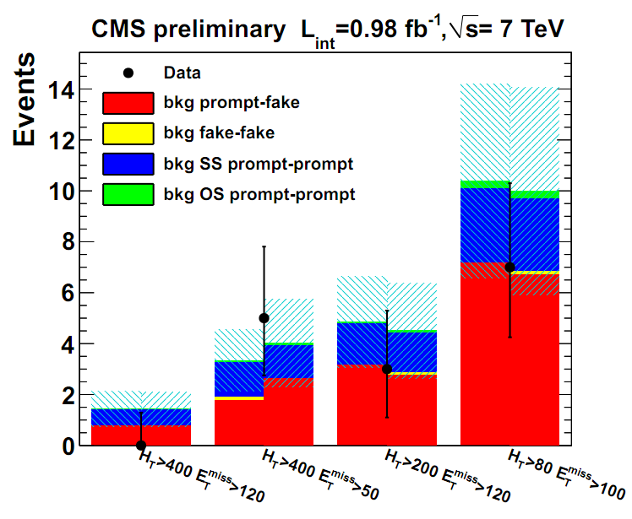
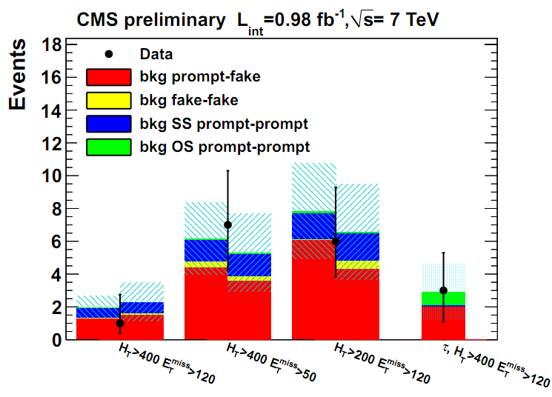
SS Results
single fake
double fake
SM SS processes
charge mis-ID
Two alternative (but similar) fake
estimates are shown
high P_{T} lepton sample
Low P_{T} lepton + τ ➞ hadrons sample
SUS-11-010
SUS-11-010
systematic uncertainty band
4 search
regions
Good agreement observed yields vs. both bkg predictions in all samples and signal regions ➞ no signs of new physics
  Note sizable contribution from SM SS processes
34

Slide 35
Interpretation
Interpreting LHC non-Discoveries

Slide 36
Three type of interpretation
cMSSM
Simplified Models
“Outreach”
Disclaimer: opinions expressed are mine and not necessarily shared
By CMS. Although they should be.

Slide 37
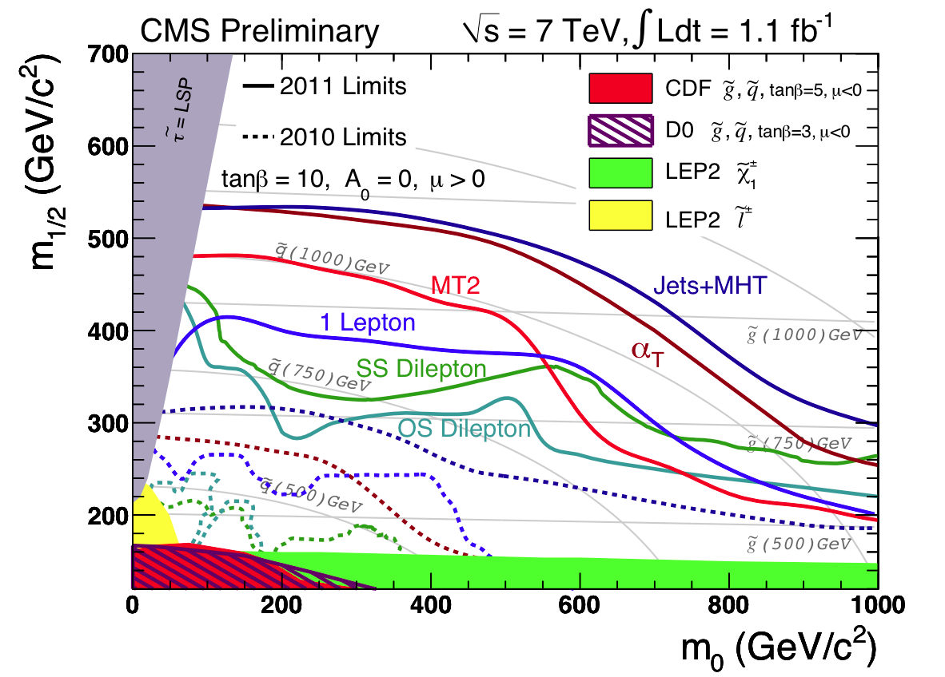
The “currency” to communicate results.
Or to show that “I am better than you”
People have told me “this is the most useless plot ever”
Others think it’s great
Truth probably in the middle

Slide 38
Simplified models
Many simplified models have been probed, more are added every week
A nice industry
I think that for leptonic final states it is difficult to make general use of the information presented this way
  Because leptons in SUSY come at end of complicated decay chains
  And there are two decay chains
  May be more useful for hadronic final states?

Slide 39
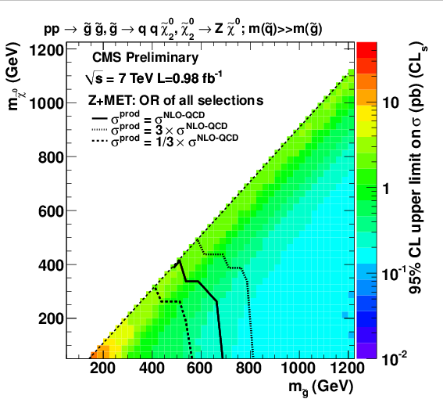
Example of leptonic simplified model (T5zz)
Used to “interpret” Z+jets search
Would like results to be applicable with a
minimum of effort to similar processes
Here we have 100% BR for the decay chain
  Unrealistic
You cannot simply rescale results based on branching ratios
  Because efficiencies for various cuts depend on what happens on both sides

Slide 40
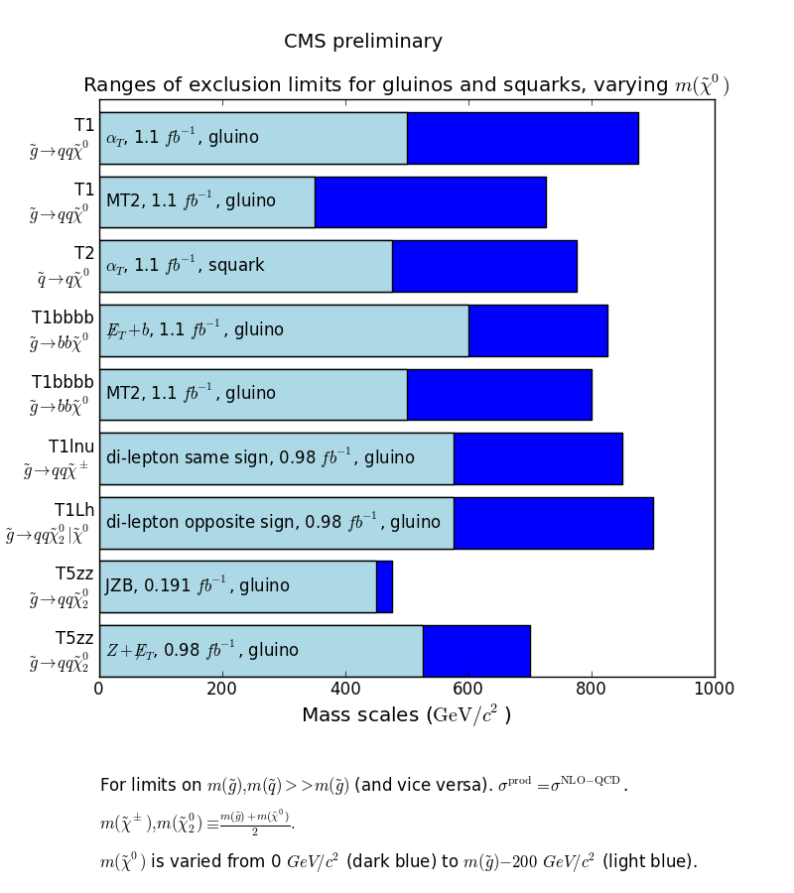

Slide 41
Outreach
Present clear definitions of signal regions
Present event yields, background predictions with uncertainties
  Possibly even recast as upper limits on number of events beyond the Standard Model
Present clear instructions on how to do an approximate detector simulation so that anybody can interpret the results for they favorite model
Sit back, relax, and let JoAnne et al. do their thing
This approach has been taken by some analysis-authors at CMS, but there is still not full buy-in from the collaboration
  Under this discussion
I think it makes sense

Slide 42
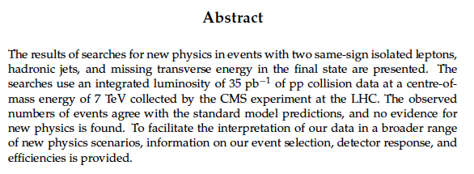
Outreach example (from 2010 Same Sign Dilepton Search)
JHEP 1106:077,2011
http://arxiv.org/abs/1104.3168
It is in the abstract.
To emphasize that this is a major part of the scientific result in the paper

Slide 43
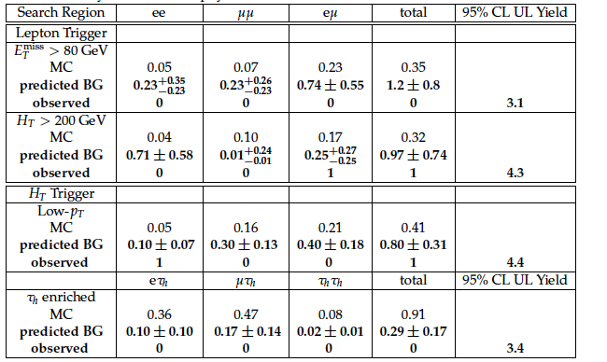
Upper yields in number of events are given.
Any model that “predicts” more than this number of events after all cuts is excluded

Slide 44
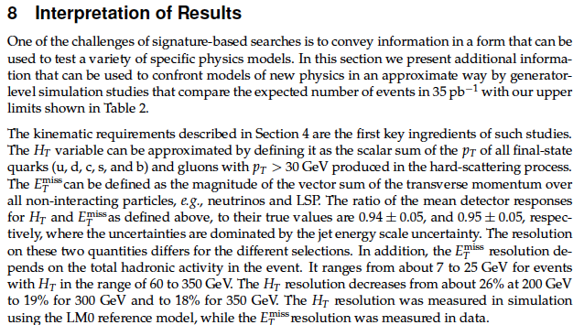
Tells you how to calculate HT and MET from parton level
Tells you what the response and the resolution on these quantities is

Slide 45
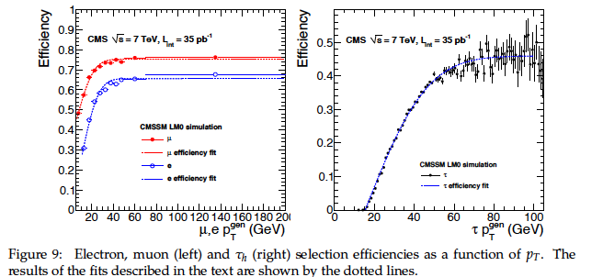
Gives you efficiency parametrizations

Slide 46
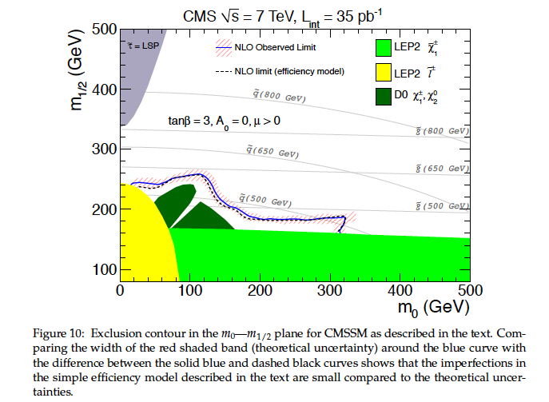
Demonstrates that if instead of the full CMS simulation you only had the
efficiency model described in the paper, you would get ~ the same cMSSM limit

Slide 47
Conclusion
No sign of new physics with ~ 1/fb
Results with ~ 5/fb to come over the next few months
How to best communicate our “zeroes” to the phenomenology community is an ongoing process
Most of our searches have been general and signature based
  But some signatures still not very explored (eg: events with leptons with and without b-quarks)
In 2012 likely to add more targeted searches to more specific signatures

Slide 48
The End

Slide 49
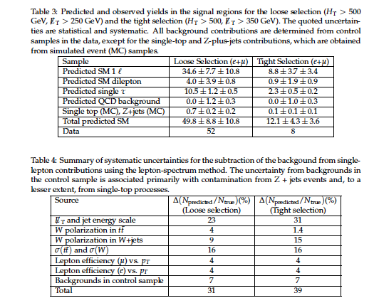
Single lepton tables

Slide 50
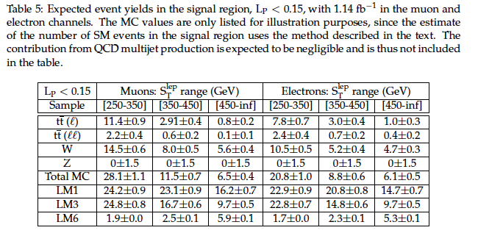

Slide 51
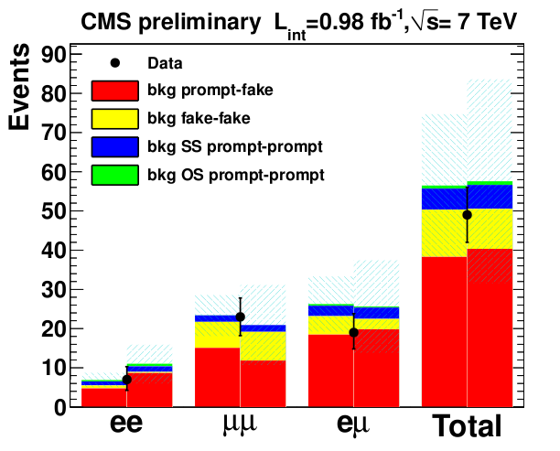
Low pt control region

Slide 52
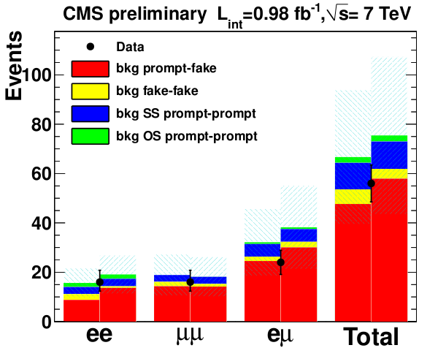
High Pt control region

Slide 53
