Slide 1
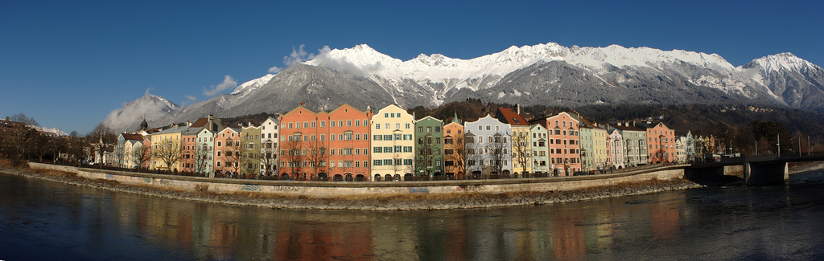

Firenze, May 21st 2012: New quantum states of matter in and out of equilibrium
1700 m
Atoms with tunable interactions in optical lattice confinement
Hanns-Christoph Nägerl
Institut für Experimentalphysik, Universität Innsbruck

Slide 2
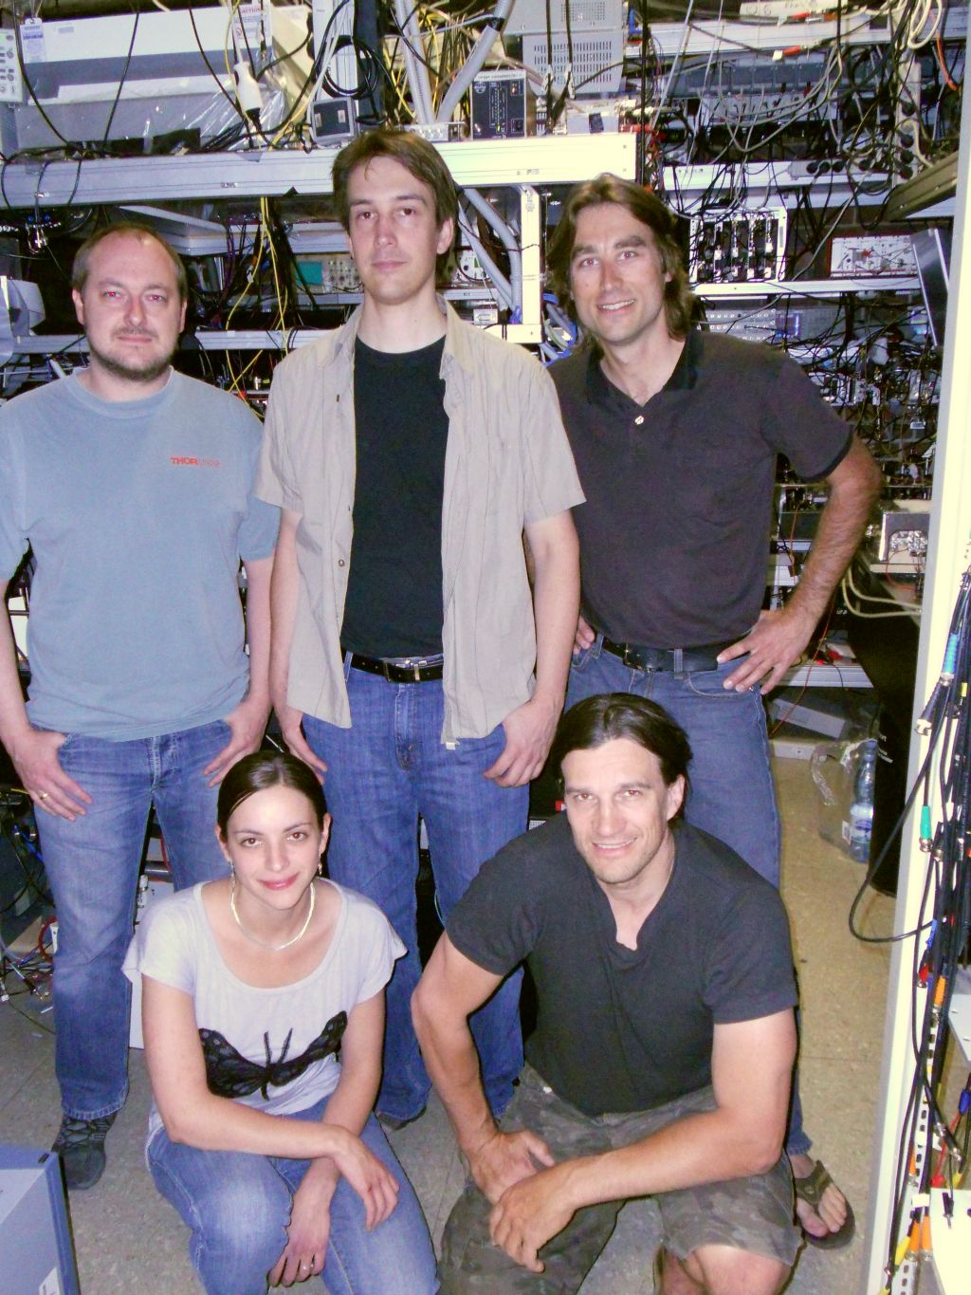
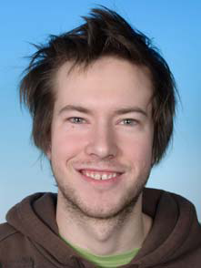
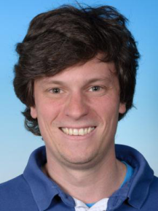
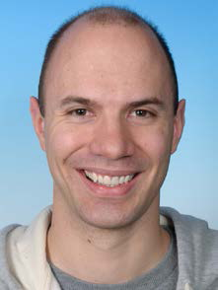
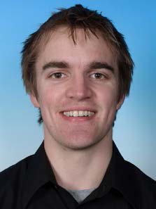
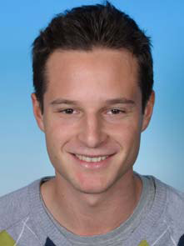

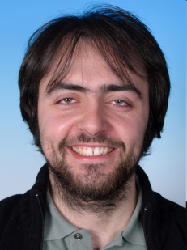
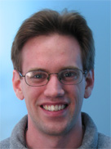
CsIII-Project Team Members & Collaborators…
new phd and master students:
B. Rutschmann
Florian
Meinert
Philipp
Meinmann
Nobie
Redmon
Michael Gröbner
Elmar
Haller
(now to
Glasgow)
Johann Danzl
(now to
Göttingen)
Manfred
Mark
theory support (Strasbourg/Innsbruck/Pittsburgh):
Guido Pupillo / Marcello Dalmonte / Andrew Daley
collaborators:
P. Schmelcher (Hamburg)
V. Melezhik (Dubna)
H. Ritsch (Innsbruck)
N. Bouloufa (Orsay)
O. Dulieu (Orsay)
T. Bergeman (Stony Brook)
H.-P. Büchler (Stuttgart)
J. Aldegunde (Durham)
J. Hutson (Durham)
P. S. Julienne (NIST)
Katharina
Lauber
CsIII-Team

Slide 3
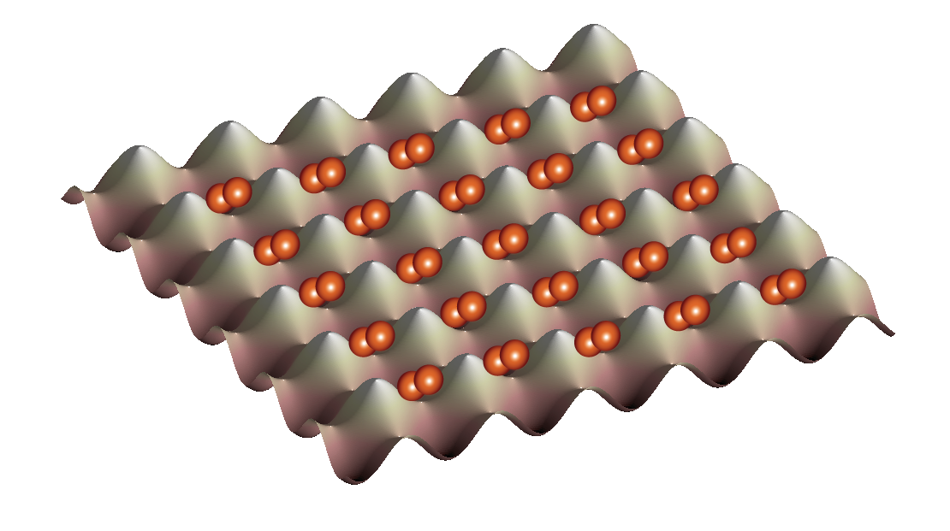
Motivation: Bosons in lattices and confined dimensions
Bose-Hubbard Physics
U<0 and U=U(n)
n = particle number at the lattice sites

Slide 4
Tuning of interactions: Feshbach resonances
scattering length a_{S} = a_{S} (B)
a_{S}
E
a_{bg}
two atoms
molecule
B₀
B
B
Feshbach resonance
¢ = coupling

Slide 5
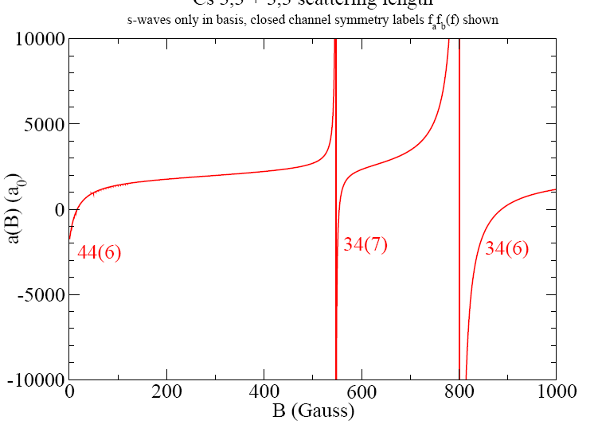
Tuning of interactions: Feshbach resonances
scattering length for 2 atoms in hyperfine states (F,m_{F})= (3,3)
broad s-resonances
10
calculations by P. Julienne
et al., NIST
s
s
5
scattering length a_{S} (1000 a₀)
0
-5
this talk…
(let’s zoom in)
-10
magnetic field B (Gauss)

Slide 6
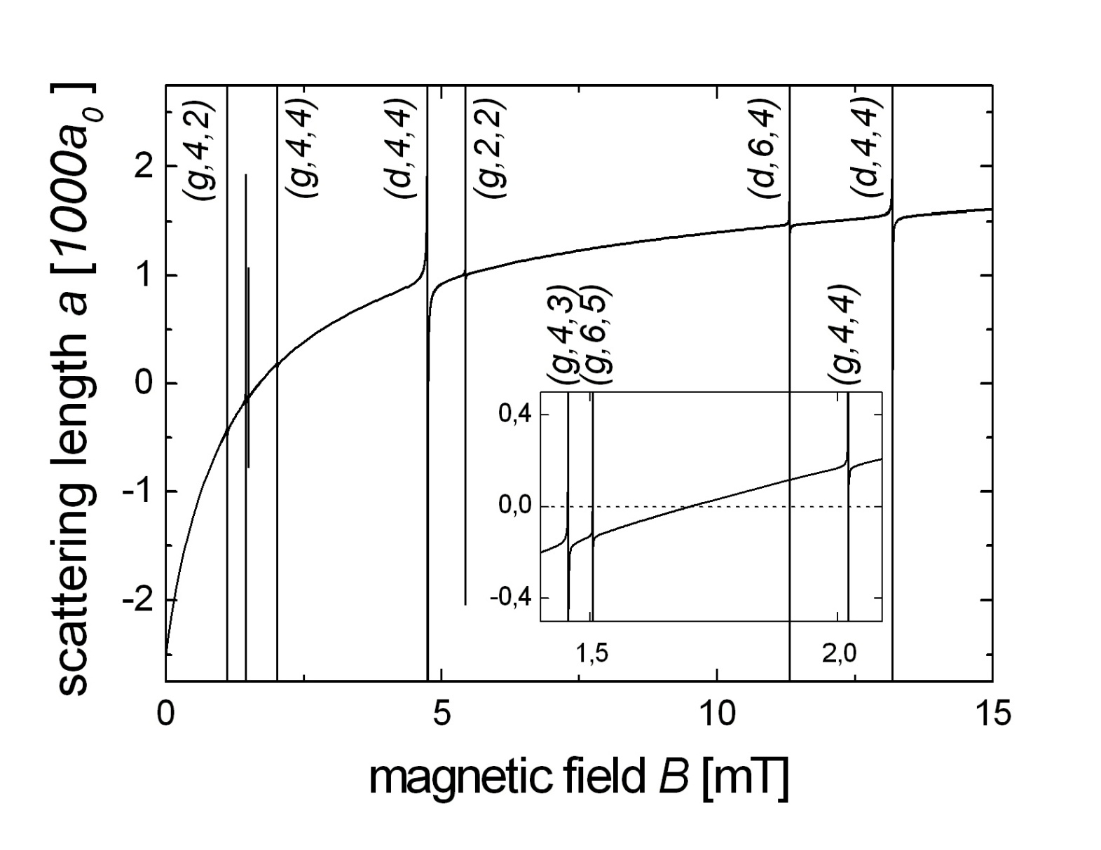
Tuning of interactions: Feshbach resonances
scattering length for 2 atoms in hyperfine states (F,m_{F})= (3,3)
narrower d-resonances
very narrow g-resonances
g
d
g
g
g
d
2
g
d
1
tune here
0
scattering length a_{S} (1000 a₀)
…or here
-1
zero
crossing
make BEC here
-2
make mol’s here…
0
50
100
150
magnetic field B (Gauss)
calculations by P.Julienne et al., NIST

Slide 7
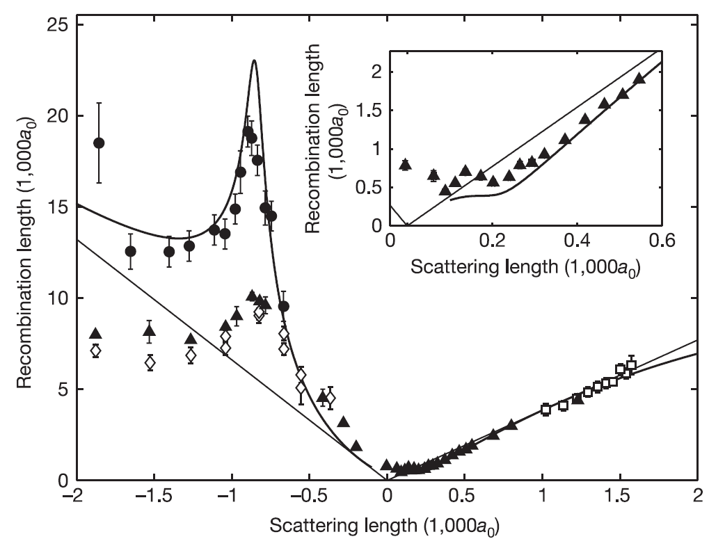
Tuning of interactions: three-body loss
K₃ = three-body loss rate coefficient
Kraemer et al., Nature 440, 315 (2006)
½₃ / K₃^{1/4}
recombination length ½₃ (1000 a₀)
Efimov resonance
scattering length a_{S} (1000 a₀)
K₃ / a⁴

Slide 8
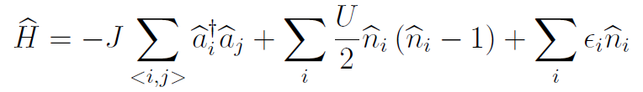


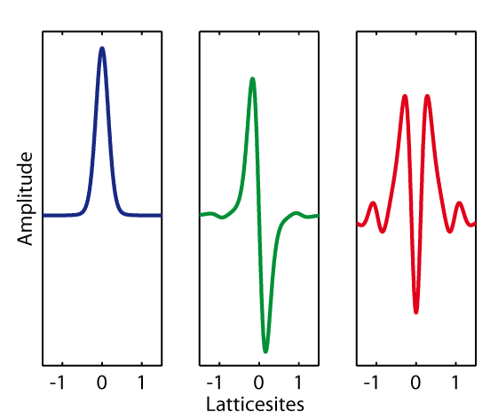


Basic concepts of lattice physics
The standard Bose-Hubbard model
Approximations
Interactions
U’
No nearest neighbor interaction
Tunneling
J
Interaction
U
External potential
ε
J’
Tunneling
No next nearest neighbor tunneling
Tunneling matrix element
Bloch bands
Higher Bloch bands omitted
On-site interaction energy
Interaction potential
Simple non-regularized pseudopotential
External energy shift

Slide 9
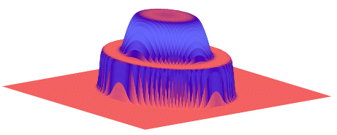

Properties of the Bose-Hubbard (BH) model
Groundstates at T=0
Phase diagram
Superfluid
J»U
µ/U
Delocalized particles
Coherent phase
No excitation gap
insulator n=2
superfluid
insulator n=1
J/U
Experiment
Mott insulator
J«U
External confinement
Localized particles
No phase coherence
Excitation gap
‘wedding cake structure’
Exp‘s: Bloch, Esslinger, Greiner,…

Slide 10
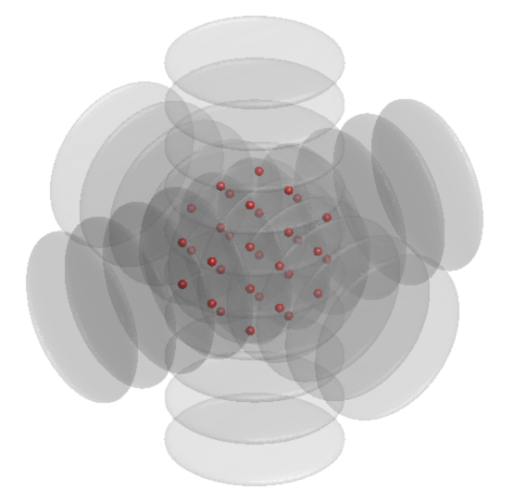





Probing the phase transition
Experimental setup
Measurement method
Probe coherence by ToF measurements
superfluid
µ/U
insulator n=1
J/U
Lattice depth
Lattice depth
Tunneling
J
time
Scattering length
Interaction
U
Dipole trap
External potential
ε
superfluid
Mott insulator

Slide 11
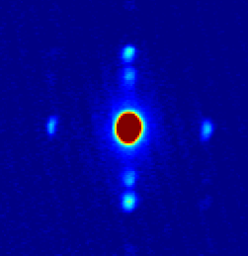
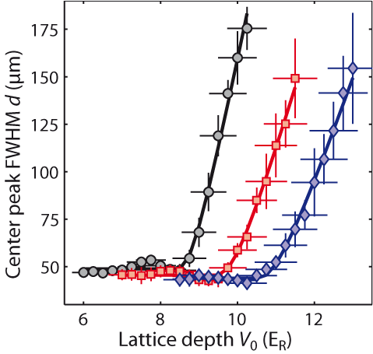
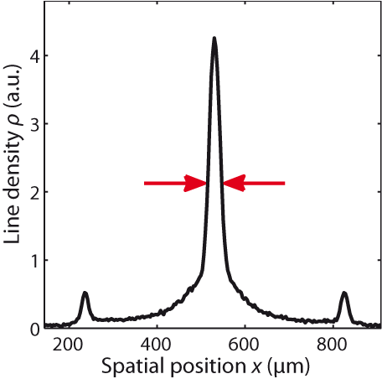
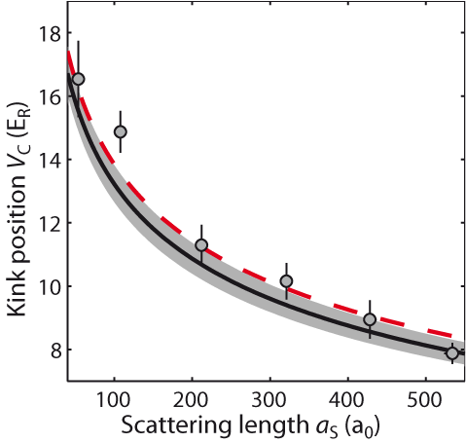
Probing the phase transition
Observable
Results
‘Kink’ in FWHM
a_{S}=
212 a₀
320 a₀
427 a₀
Phase transition point
FWHM
µ/U
J/U
Mark et al. Phys. Rev. Lett. 107, 175301 (2011)

Slide 12



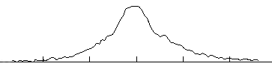
Measuring the excitation spectrum
MI excitation spectrum
Measurement method
Elementary MI excitations
Amplitude modulation
Experimental sequence
U
2U
U
Lattice depth
time

Slide 13
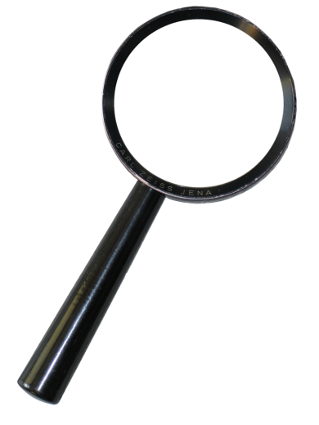
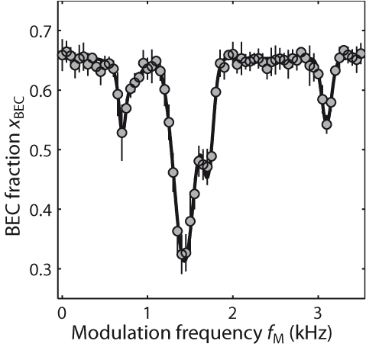
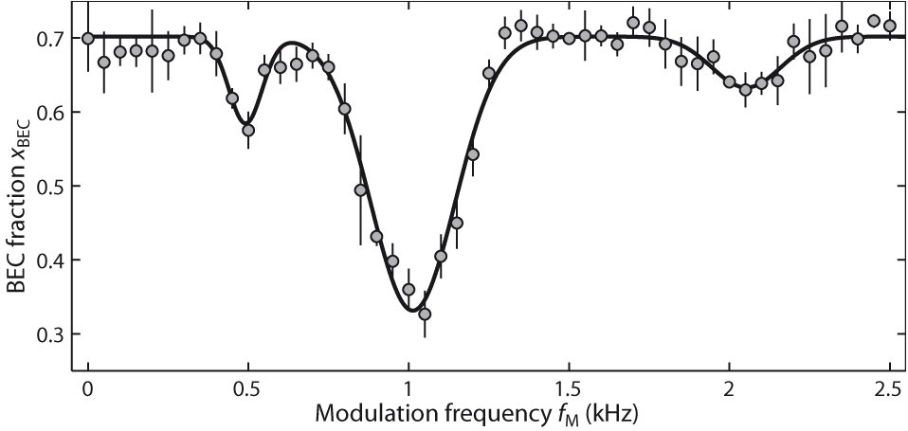
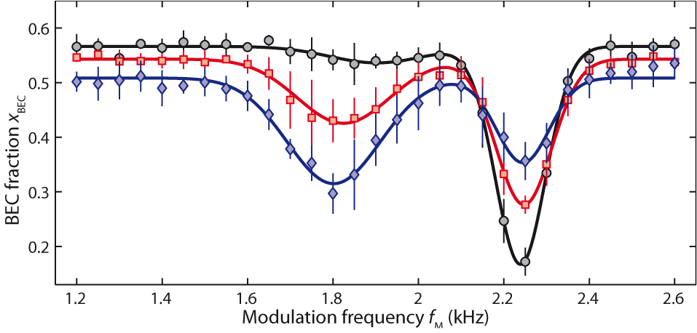
Measuring the excitation spectrum
Results
Resonance splitting near U-peak
U
2U
320 a₀
a_{S}=212 a₀
U
2U
U
427 a₀
Density dependence
Mark et al. Phys. Rev. Lett. 107, 175301 (2011)

Slide 14



Beyond the standard BH model
Approximations
Three particles
Bloch bands
3x two-particle interactions
Interaction potential
Effective interactions
Invalid for strong interactions
Two particles
Johnson et al. New J. Phys. 11, 093022 (2009)
Efimov physics
Energy
Energy
Kraemer et al. Nature 440, 315 (2006)
-1/a
+1/a
dimer
-a
+a
Busch et al. Found. of Physics 28, 549 (1998)
Schneider et al. Phys. Rev. A 80, 013404 (2009)
Büchler et al. Phys. Rev. Lett. 104, 090402 (2010)
Efimov trimer

Slide 15
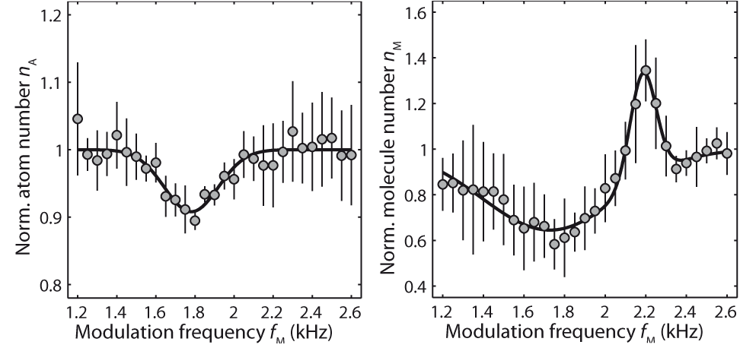
Beyond the standard BH model
Expectation
Measurement
High density
Intermediate
Low density
Density dependence
U
U(2)
3U(3)-2U(2)
U(2)
3xU
3xU(3)
427 a₀
Three-body loss
Double occupancy
U(2)
3U(3)-U(2)
3U(3)-2U(2)
427 a₀
427 a₀
Mark et al. Phys. Rev. Lett. 107, 175301 (2011)

Slide 16
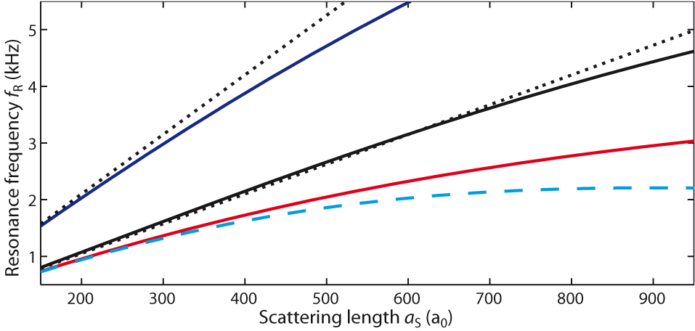
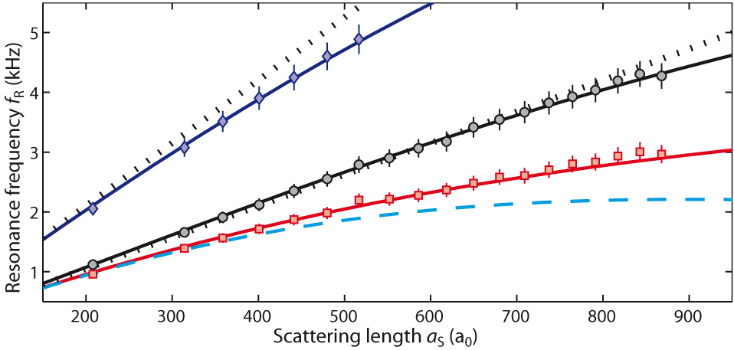
Theory and Experiment
Mark et al. Phys. Rev. Lett. 107, 175301 (2011)
U_{BH}
3U(3)-U(2)
U_{BH}
2U_{BH}
3U(3)-U(2)
2U_{BH}
U(2)
U(2)
3U(3)-2U(2)
3U(3)-2U(2)
(see also work by I. Bloch‘s group,
S. Will et al., Nature 465, 197 (2010))

Slide 17

Attractive interactions
BH model with negative U
J«|U|
Mott insulator
Three-body loss
Γ₃
Γ₃
J«|U|
Mott insulator
Superfluid
J»|U|
Metastable
Highly excited state of the system
Γ₃

Slide 18
Preparation of the attractive MI state
Lattice loading
Repulsive Mott insulator
depth 20 E_{R}
Switch to attractive a
Wait / modulate
Γ₃
Switch to repulsive a
Observe overall heating

Slide 19
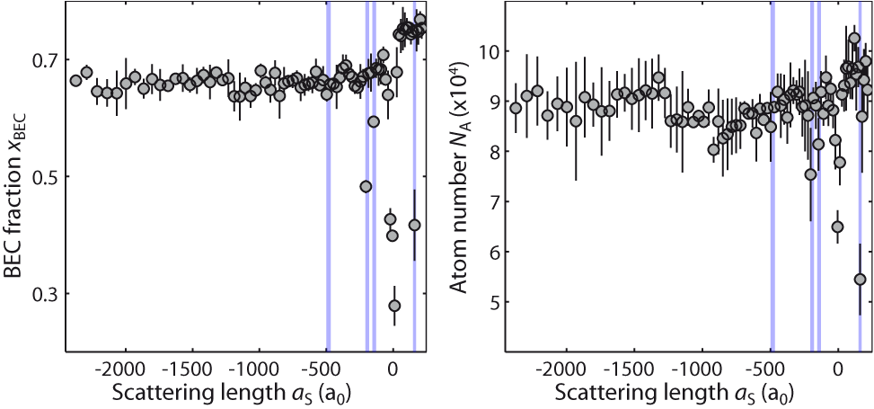
Stability of the attractive MI state
Varying interactions
hold time = 50 ms
blue areas: narrow Feshbach resonances
zero crossing
Mark et al., to appear in PRL (2012)

Slide 20
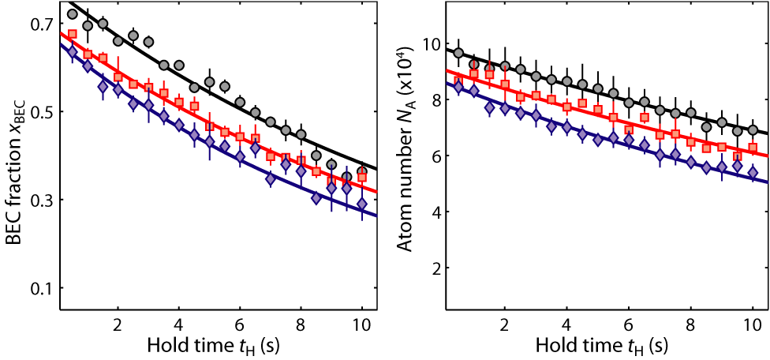
Stability of the attractive MI state
Varying interactions
hold time = 50 ms
Varying the hold time
-2000 a₀
-240 a₀
+220 a₀
Mark et al., to appear in PRL (2012)

Slide 21
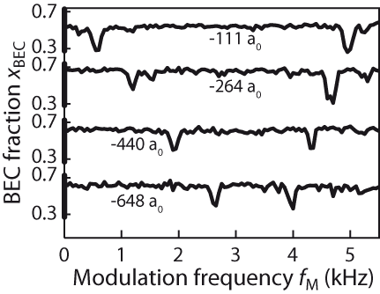
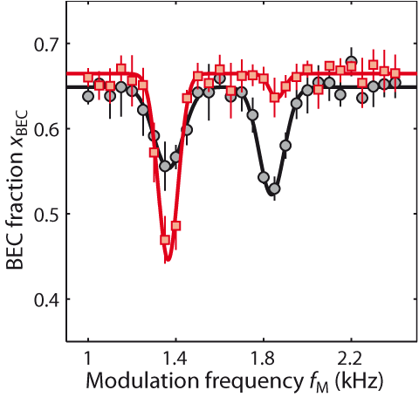
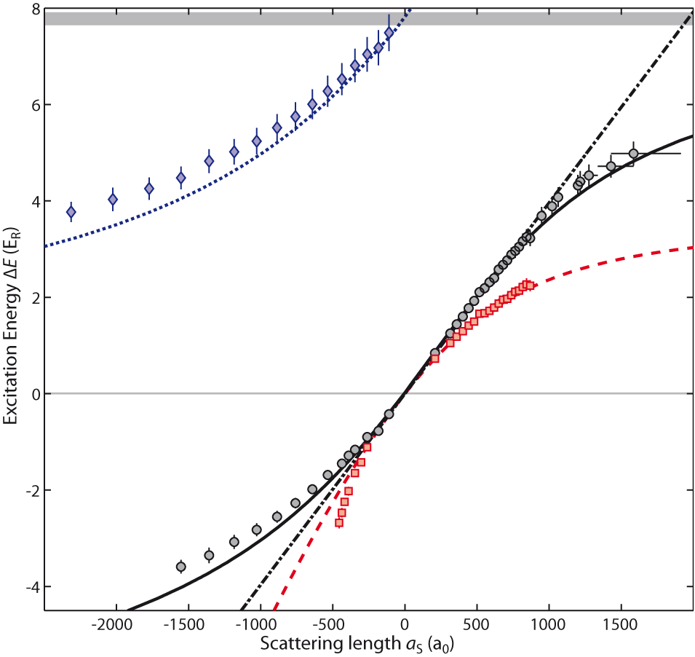
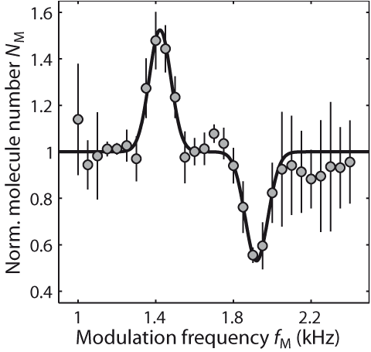
De-excitation spectrum
Excitation resonances
U*(2)
U(2)
3U(3)-2U(2)
U(2)
Mark et al., to appear in PRL (2012)
U_{BH}
-306 a₀
U*(2)
U(2)
3U(3)-2U(2)
3U(3)-2U(2)
-306 a₀
?

Slide 22
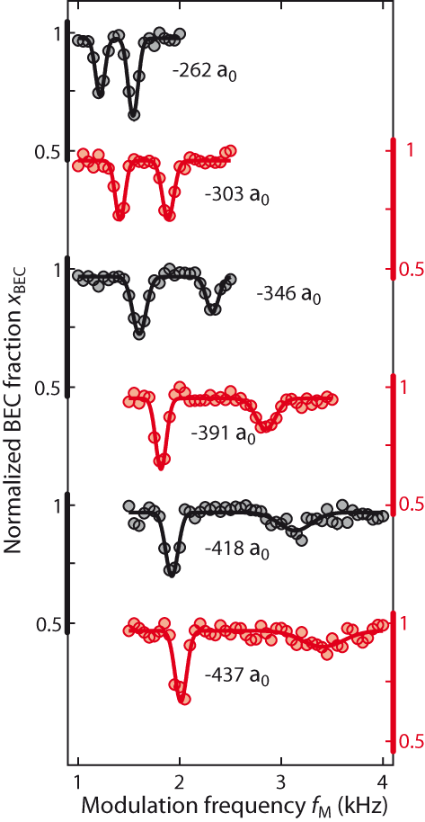
Three-body loss resonance
Fast broadening of the resonance
Three-body loss rate
Three-body loss
Γ₃
Γ₃
Rate of three-body loss without lattice
Kraemer et al., Nature 440, 315 (2006)
Mark et al., to appear in PRL (2012)

Slide 23





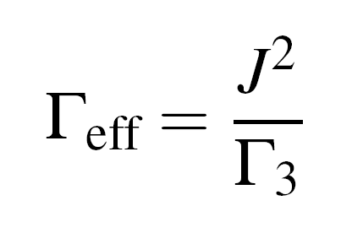

Suppressed three-body loss: Quantum Zeno effect
Analogy
:
Large three-body loss stabilizes!

Slide 24
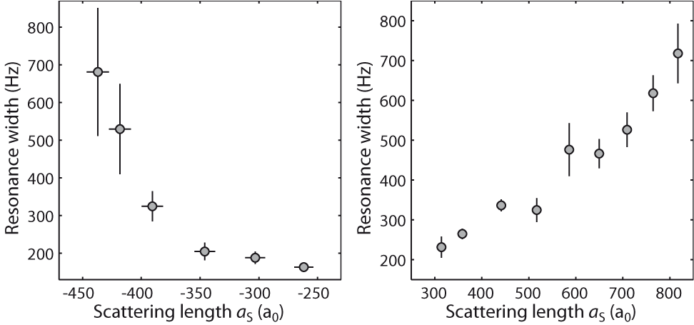
Comparison of loss widths
Attractive interactions
Repulsive interactions

Slide 25
Comparison of loss widths
Attractive interactions
Repulsive interactions

Slide 26
Comparison of loss widths
Attractive interactions
Repulsive interactions
Γ₃

Slide 27
Comparison of loss widths
Attractive interactions
Repulsive interactions
superfluid of dimers? (Theroy: A. Daley et al., PRL 2009)

Slide 28
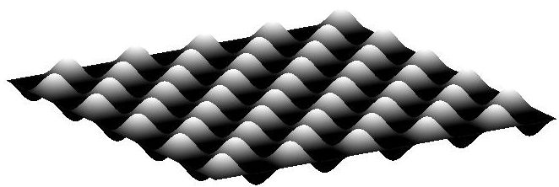
Ongoing work
Start with one-atom Mott insulator…

Slide 29
Ongoing work
Then apply lattice tilt and create „doublons“…
see Greiner group
„quantum magnetism“

Slide 30
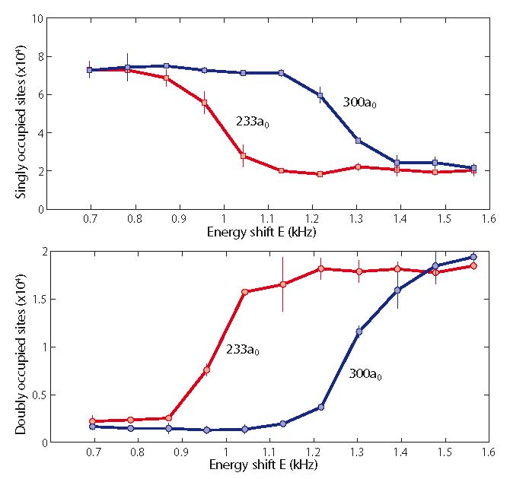
Ongoing work: Doublon creation (very preliminary)
in an array of 1D-tubes
so far: 75%
doublon creation

Slide 31
Ongoing work
… and then watch dynamics as the lattice depth is lowered…

Slide 32
Thank you!

