Slide 1
Universal Dynamics in Generalized Gibbs Ensembles
Alexei Tsvelik
Brookhaven National Laboratory

Slide 2
What are GGEs?
Imagine 1D integrable system subject to a sudden change of H. Even if the system was initially in the ground state, after this change it becomes a superposition of states with oscillatory exponents:
After a period of time the oscillatory exponents cancel each other and
diagonal density matrix remains.
Conjecture:
I_{i} – integrals of motion
(including energy)

Slide 3
Assumptions and conditions.
T is temperature for the I₁ =E, in what follows I fix μ₁ = 1.
It will be assumed that all integrals of motion are finite
which can occur only if the change excites particles in a limited range of momenta.
The universality occurs when T << energy density.

Slide 4
1D integrable models
The path to universality:
Integrability, Lie group symmetry.
The result: for all models possessing these properties the low-T spin dynamics is determined by a universal action of a ferromagnet defined on the corresponding group. The low
energy modes have
spectrum.
ρ ∼ energy density

Slide 5
Example. 1D fermions with attractive SU(N)-invariant interaction.
Lorentz invariance emerges at low energies when one linearizes
the spectrum:
This effective low energy theory is called Chiral Gross-Neveu model:

Slide 6
Continue about SU(N) Chiral Gross-Neveu
Excitations:
Bethe Ansatz equations for
the massive sector
are gapless phasons and massive (gapful) particles transforming
according to
Crucial fact: integrals do not depend on
auxiliary parameters λ

Slide 7
Example: S=1/2 XXZ antiferromagnet
In this limit the spectrum coincides
with the one of spin sectror of SU(2)
Chiral Gross-Neveu.
The Bethe Ansatz:
The integrals of motion depend on
Θ only:

Slide 8
GGE thermodynamics for N=2
When the energy density ~ L, solutions of BA eq-ns group into “strings”:
Roots of BA eq-ns are described by distribution functions of occupied
and unoccupied roots :

Slide 9
Thermodynamic BA equations
Equations for density distribution functions:
One minimizes the free energy with respect to ρ_{n} to obtain equations
for excitation energies:
The key feature:
the “driving term”
K is present in ONE
equation only. Thus one
can declare ε₀ fixed.

Slide 10
Ferromagnet emerges
Equations for n=1,2,… include only positive energies :
Invert the kernel:
In the limit T=0 the excitation energies are

Slide 11
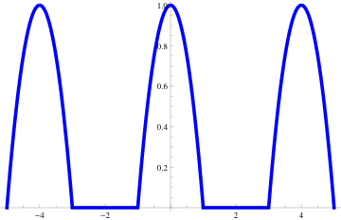
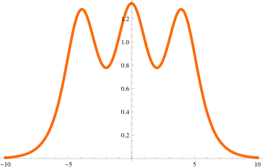
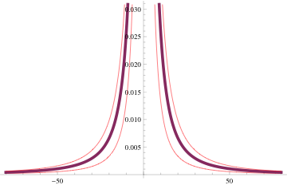
GGE state
In order for free energy to be finite, ε₀(θ) must have a finite support

Slide 12
Il finale:
In the low-T limit the TBA equations for the spin sector are exactly
like TBA for a spin S=1/2 ferromagnet at thermodynamic equilibrium:
on a lattice
Are energy and momenta of n-magnon bound states.

