Slide 1
Neutrino diffraction : finite-size correction to Fermi’s golden rule k.ishikawa, Hokkaido University with m.sentoku, and y.tobita
Is neutrino interference (diffraction) observable?
(1) Neutrino is a quantum mechanical wave and interacts with matter extremely weakly.
(2) Neutrino should show a phenomenon of interference or diffraction, in a double slit-like experiment.
(3)However, it is very hard to control the neutrino , from the above (1).
Hence a new method must be considered.
(4)Our answer and proposal ”
Neutrino diffraction is observable . Use a pion (and other particle) decay process !”

Slide 2
Contents of this talk
References
K.Ishikawa and Y. Tobita arXiv: 1206.2593, 1109.3105, 1109.4968 ,others [hep-ph], prog.theo.phy.(2009)
K.I and Yabuki, progress of theo.physics(2002),
K.I and T.Shimomura,progress of theo.physics(2005)
Introduction
Fermi’s golden rule : finite-size correction
Probability to detect a neutrino in pion decay
Light-cone singularity and neutrino diffraction
Implications

Slide 3
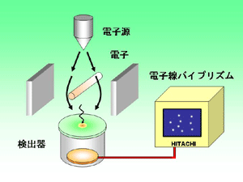
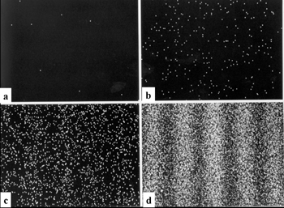
I. Single electron interference (Tonomura)
Number of events N_a<N_b<N_c<N_d
interference pattern becomes clear and visible in d
We study single neutrino interference

Slide 4

Unknown facts on neutrinos
Absolute neutrino mass
Tritium decay electron spectrum
- less double Beta decay
Cosmology gives bound.
Unclear now !

Slide 5
Scattering ,interference, and diffraction of neutrino ( our works)
１．Neutrino is a quantum mechanical wave , so its distribution reveals single quantum interference.
２．Neutrino is identified from physical reactions with a nucleon in nucleus.
３. １ and ２ are combined to the probability to detect the neutrino at a finite distance. This supplies ordinary results at the infinite distance and a new physical quantity from the finite-size correction.
４．Diffraction is a main part of the finite-size correction and is observed easily with a large number of events.

Slide 6
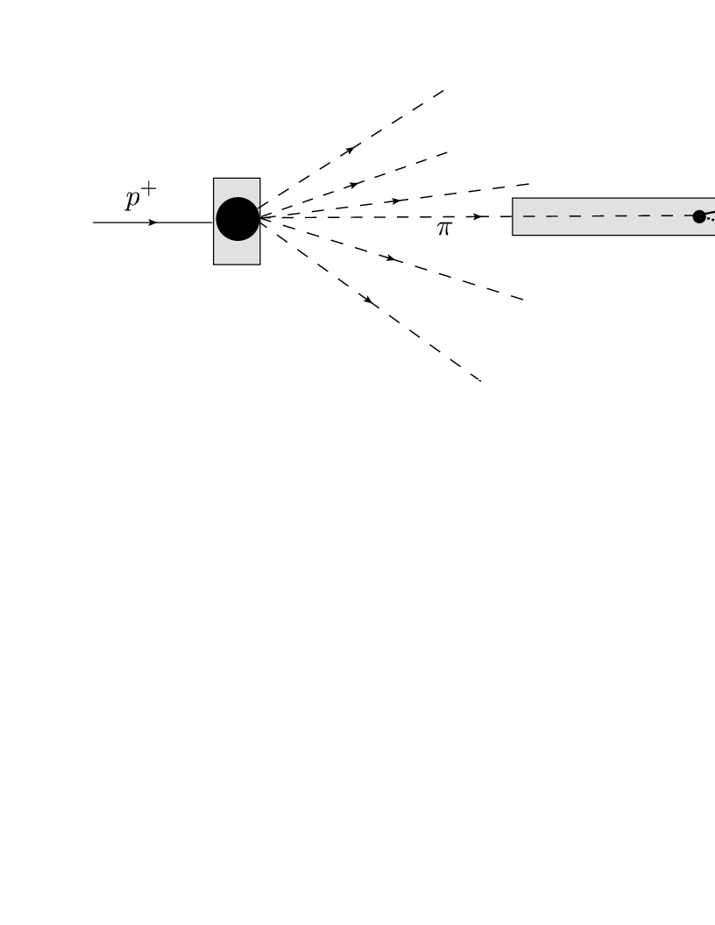
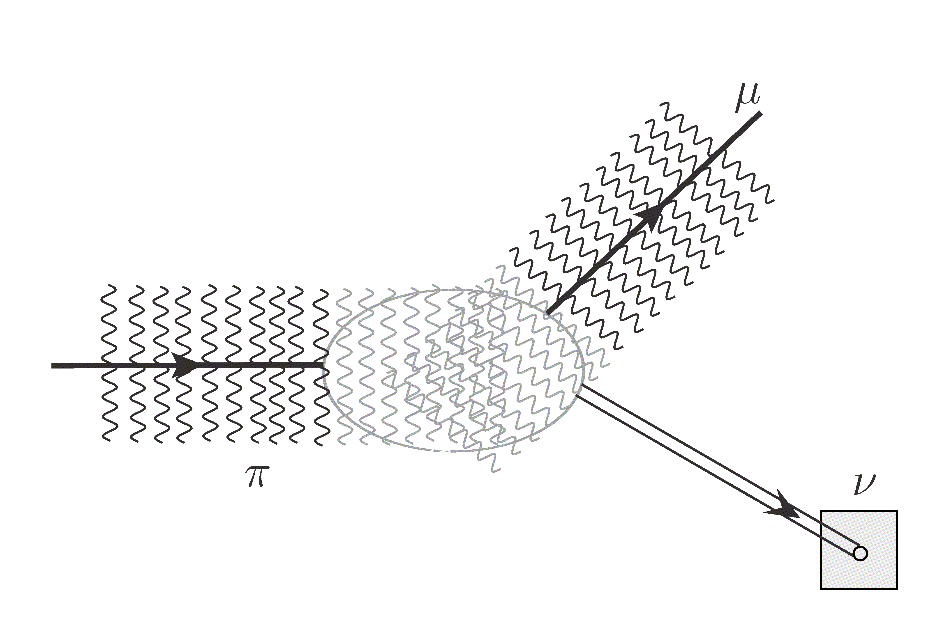
Real pion decays
experiment
which?
Distance L=cT
Particle decay
(traditional ?)
Decay product of wave is measured in wave packet

Slide 7
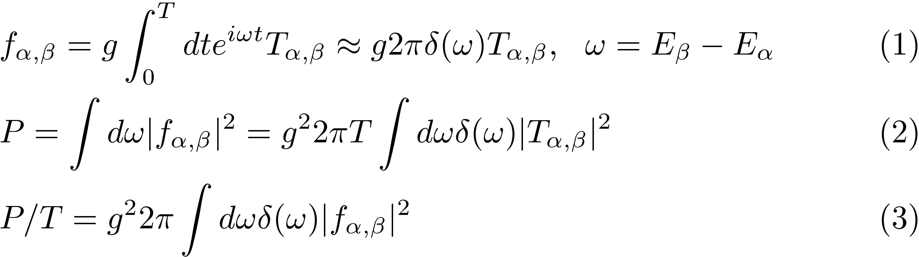
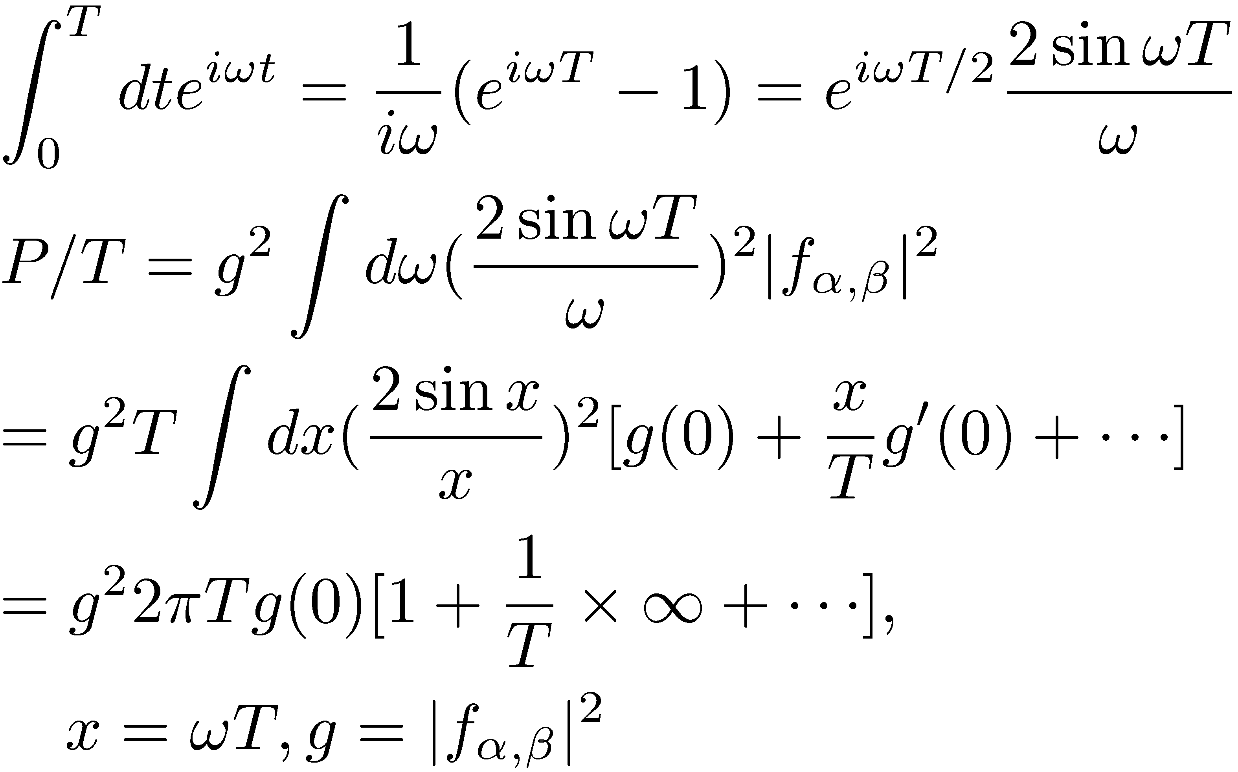
2. Fermi’s Golden rule
2-1. Transition rate at a large T is:
Dirac(1927),
Fermi Golden rule (1949),
2-1.T is large but finite. Compute a finite-T correction to above Eq.(3).
Correction diverges

Slide 8
1/T correction diverged.
For a correct calculation :
To compute transition probability at a finite T, boundary condition should be taken into account.
For a rigorous treatment of scatterings ,out-going (in-coming) state is expressed by a wave packet that is localized in space and time. (LSZ,55)
Compute the finite-size (time) correction with the transition amplitude defined by wave packets. Then a unique value is obtained.

Slide 9
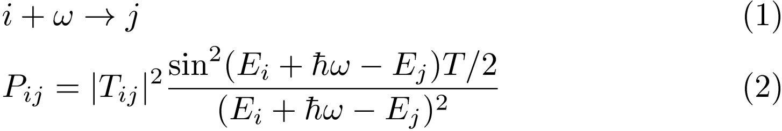
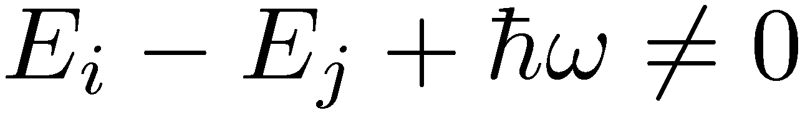
What is the finite-size effect ？
１．Quantum mechanical transition in a finite time interval Ｔ.
２．Violates the energy conservation
３．States at ultra-violet energy region, J , gives a universal correction and is important in relativistic invariant system.
Compute a finite-size correction of the probability to detect the neutrino !!

Slide 10
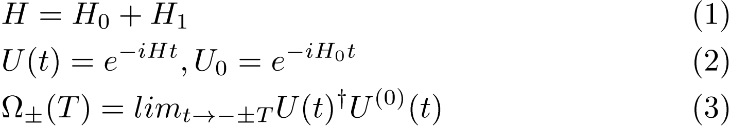
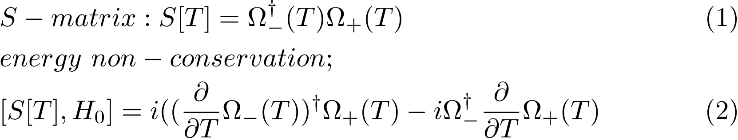
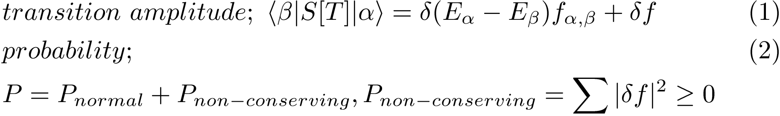
Transition in a finite time-interval
S[T] ;S matrix for a finite time interval T.
Finite-size correction

Slide 11
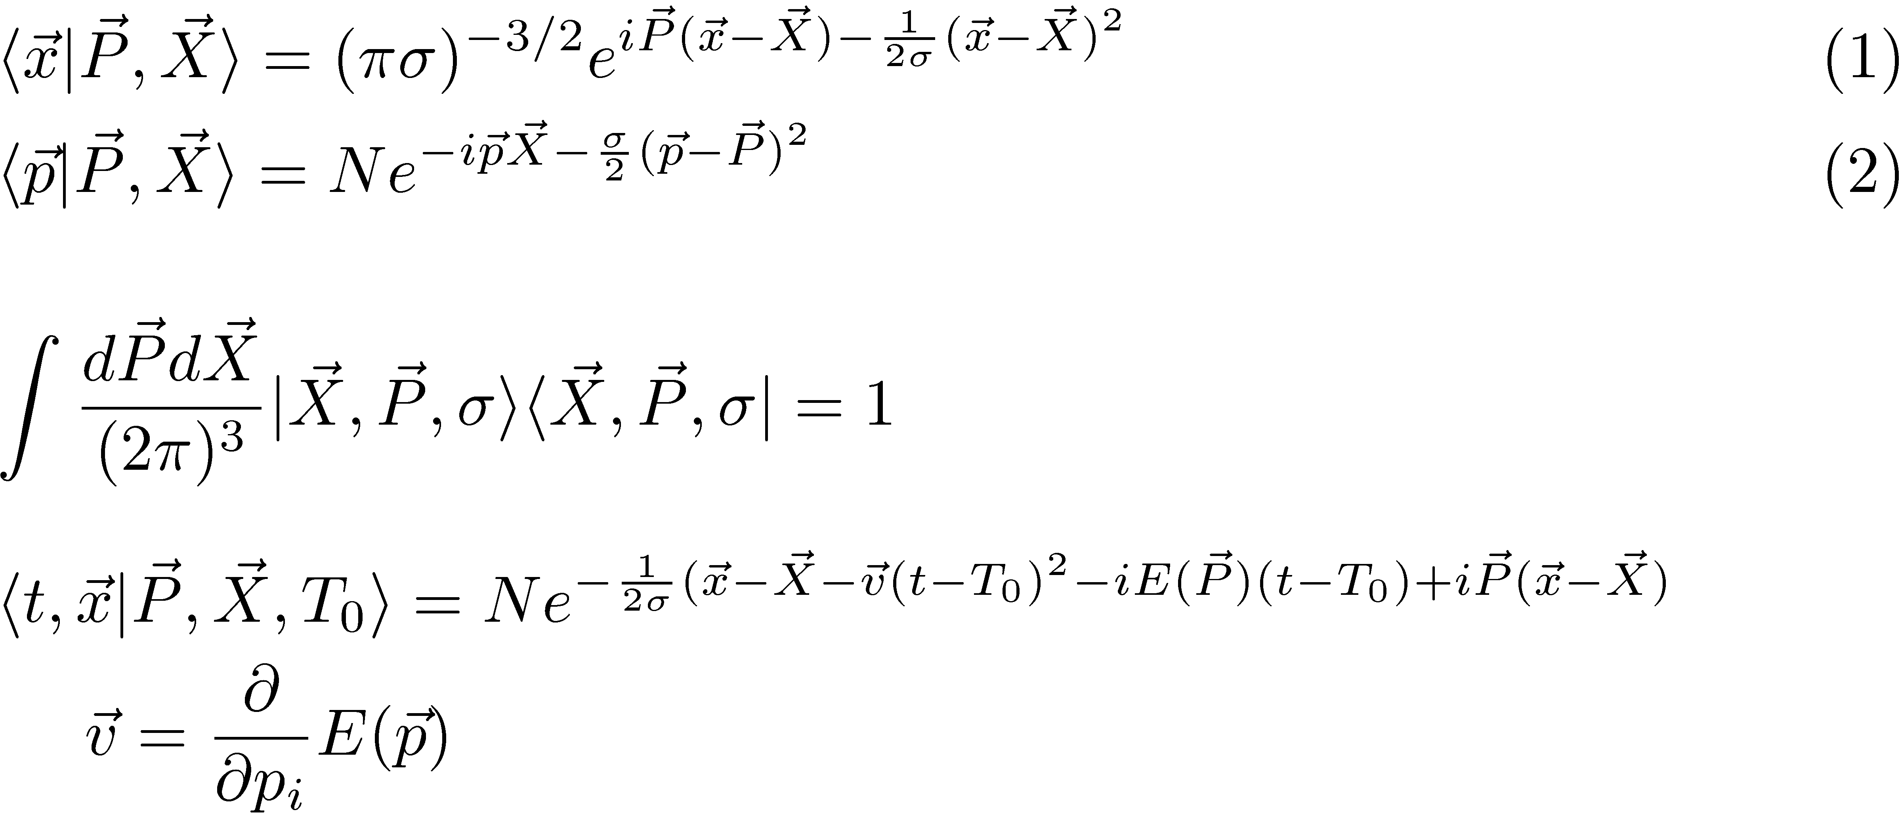
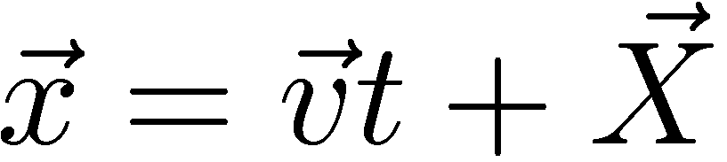
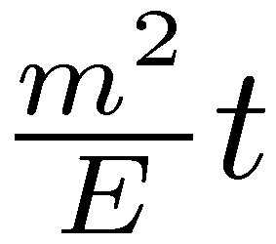
Wave packets dynamics
K.I and T.shimomura(prog.theor.phys:2005)
Complete set
Wave packet moves with this velocity .
And a slow phase

Slide 12
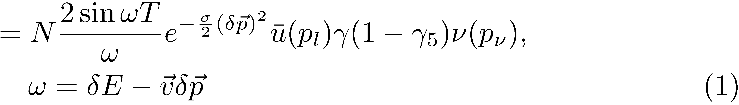
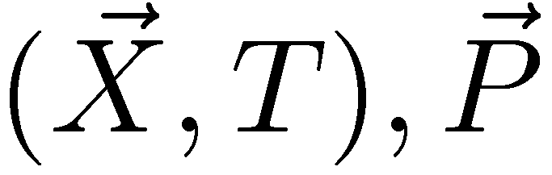
3. Neutrino diffraction(ishikawa and tobita)
decay amplitude
Neutrino’s momentum and position are measured
Plane waves
Wave packet
Integration over x and t = interaction region is in a moving frame

Slide 13
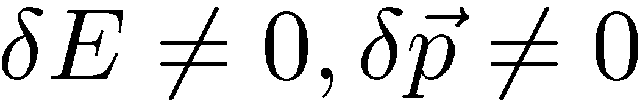
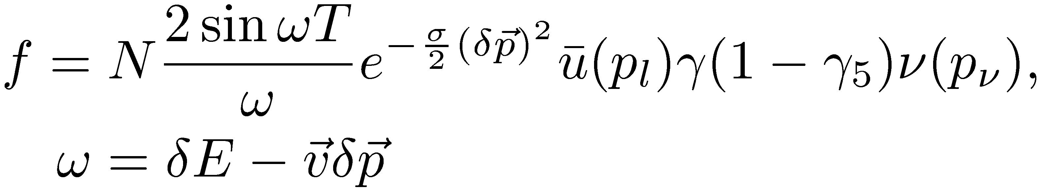
Wave packet effects
1 . Approximate conservation of the energy in the moving frame. (Pseudo-Doppler shift)
2 . Large T correction emerges for light particles,
because the there are many states of

Slide 14
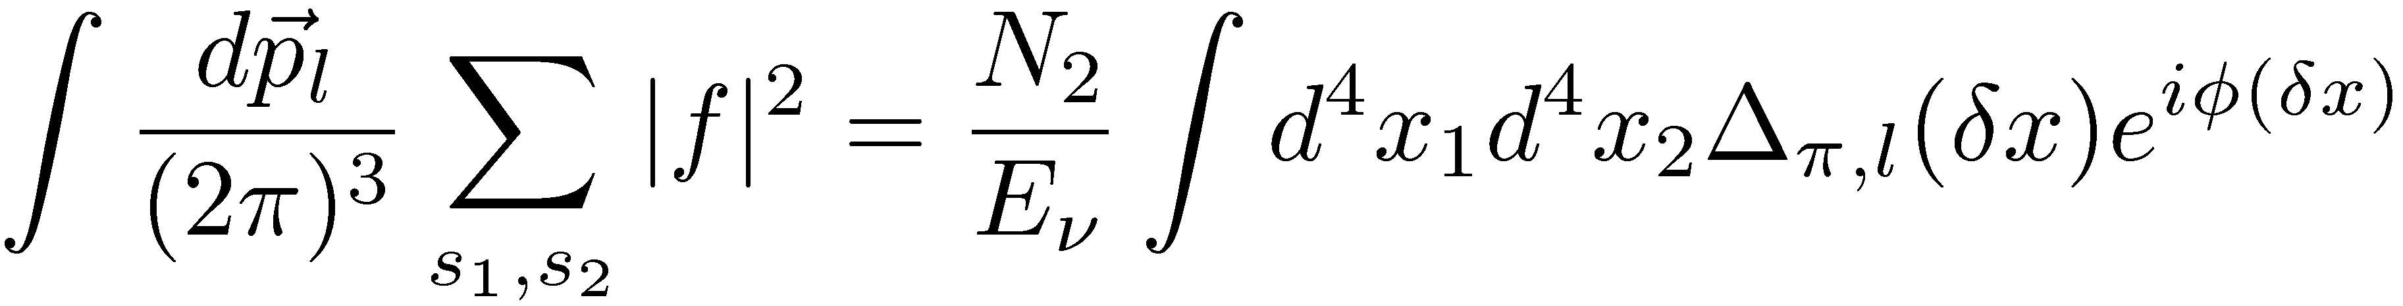

4. Rigorous calculation :Express the probability with a correlation function
decay amplitude
Probability is expressed with a correlation function
Correlation function
(Only If energy-momentum is conserved)
1.Correlation function has a light-cone singularity which is generated by a superposition of relativistic waves.
2.The light-cone singularity is real and long-range and gives the finite-size correction.
Since the energy conservation is violated, this has anomalous properties.
3. Wave packet ensures asymptotic boundary condition （ＬＳＺ） and leads new effects .

Slide 15
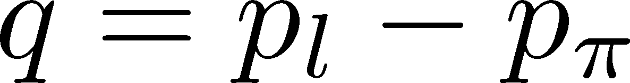
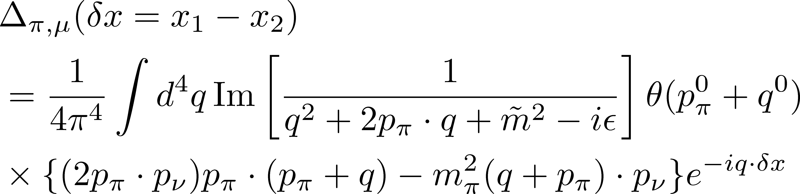
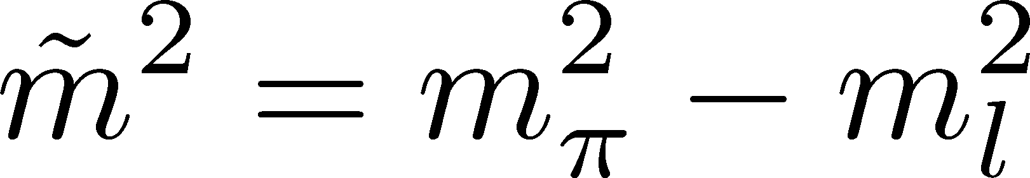
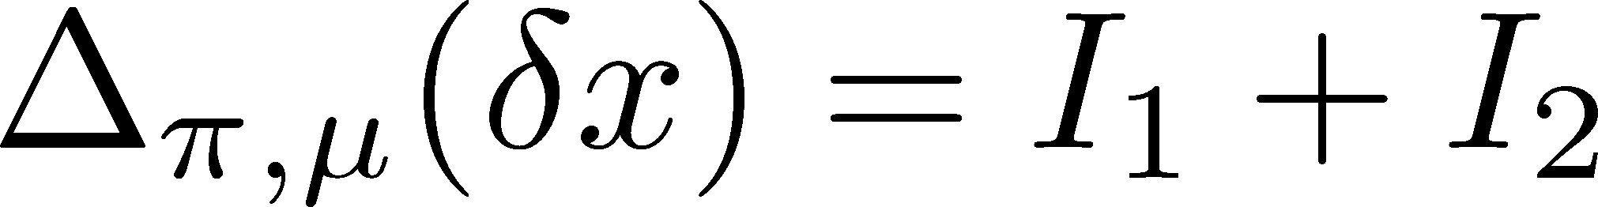
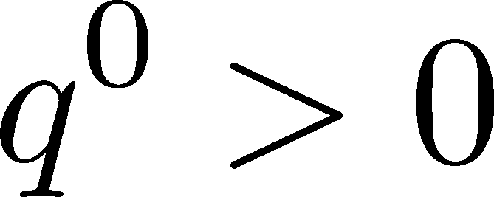
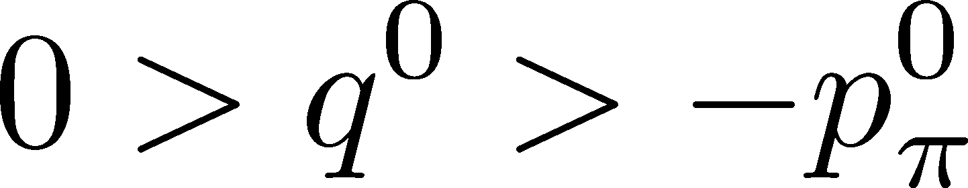
Correlation function
Integration variable is change to
Integral region is separated in two parts
Finite size correction
(energy non-conserving)
Normal term

Slide 16

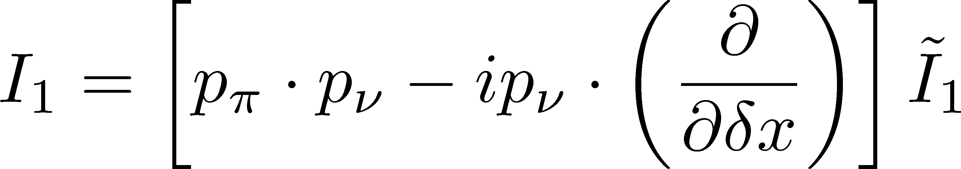


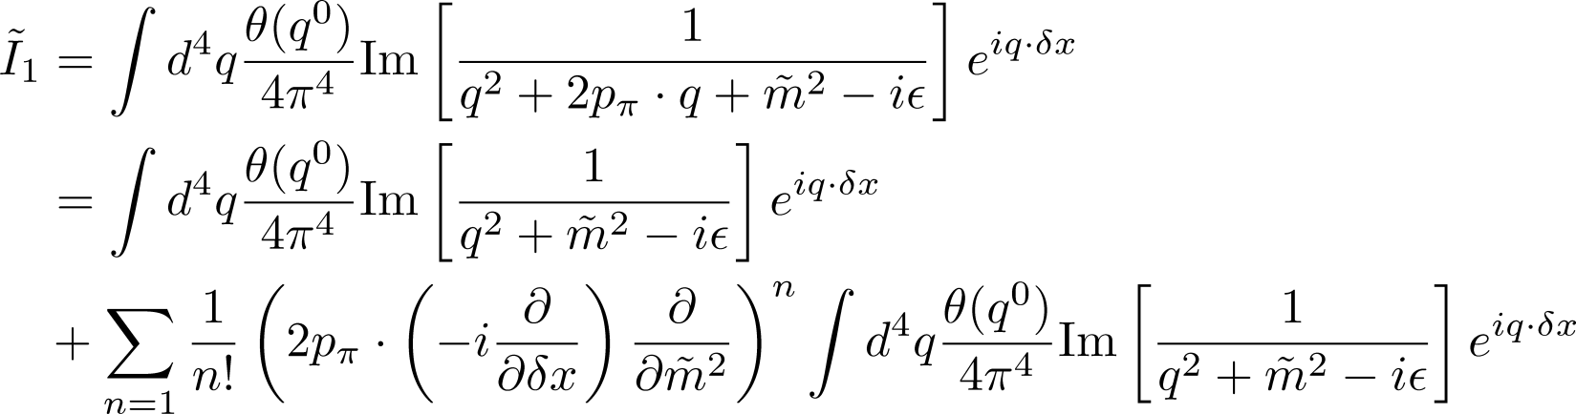
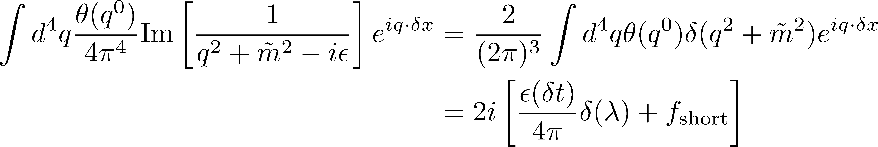
I_1: Extract the light-cone singularity
About
To extract light-cone singularity expanding in
convergence condition:
Green’s function
Light-cone singularity

Slide 17
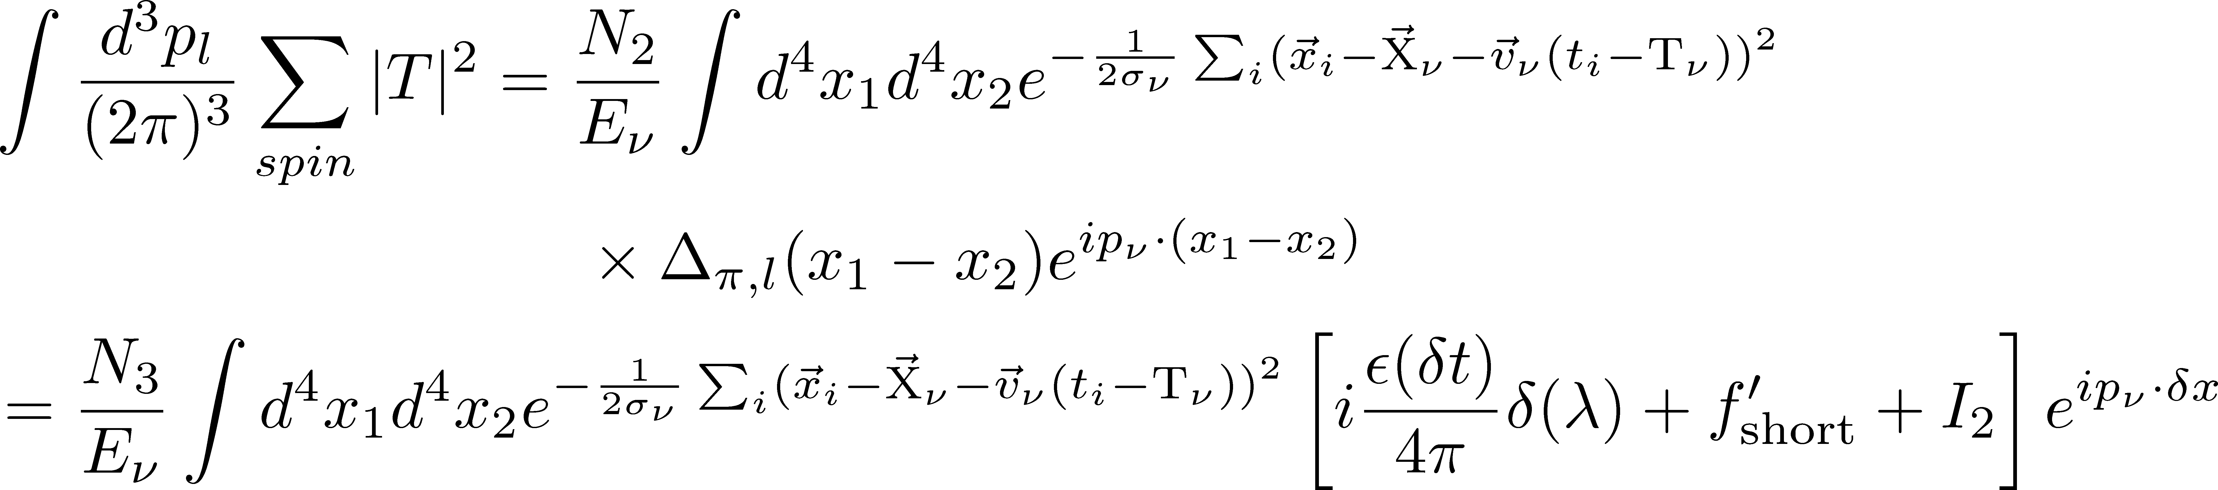
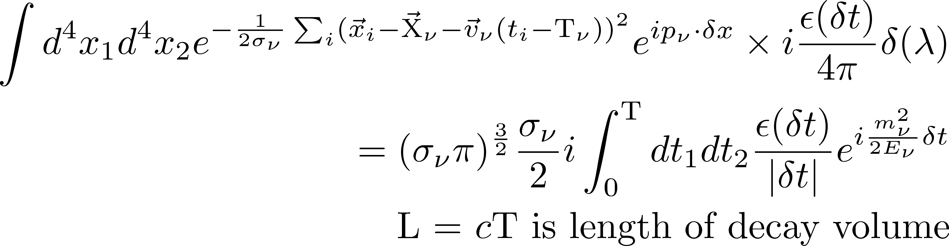
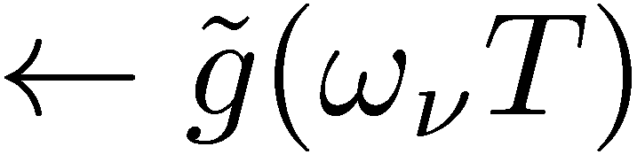
Integration over space-time coordinates
I_1: Long-range term
I_2 short range term

Slide 18
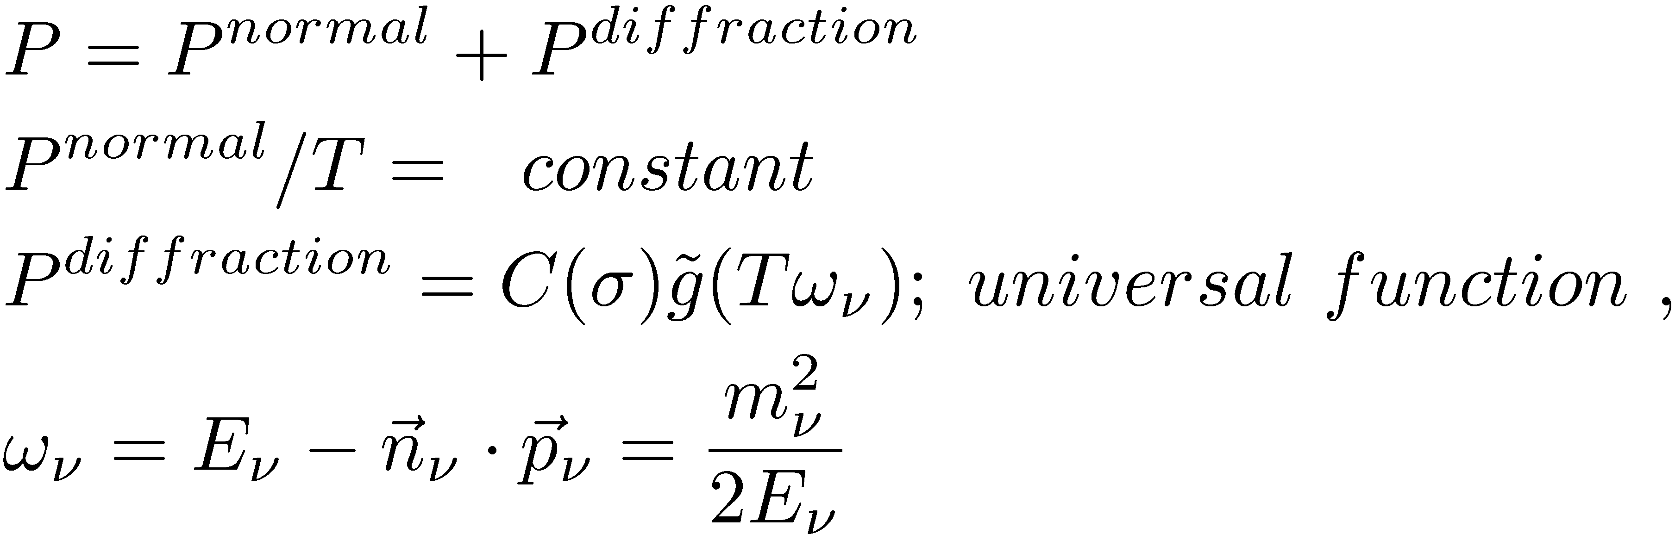
Probability at a finite distance
Probability is composed of the normal term and a T-dependent diffraction term, which gives a finite-size correction.

Slide 19
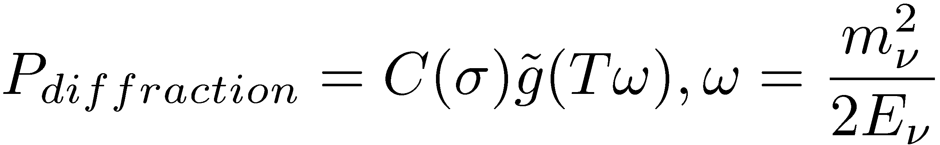
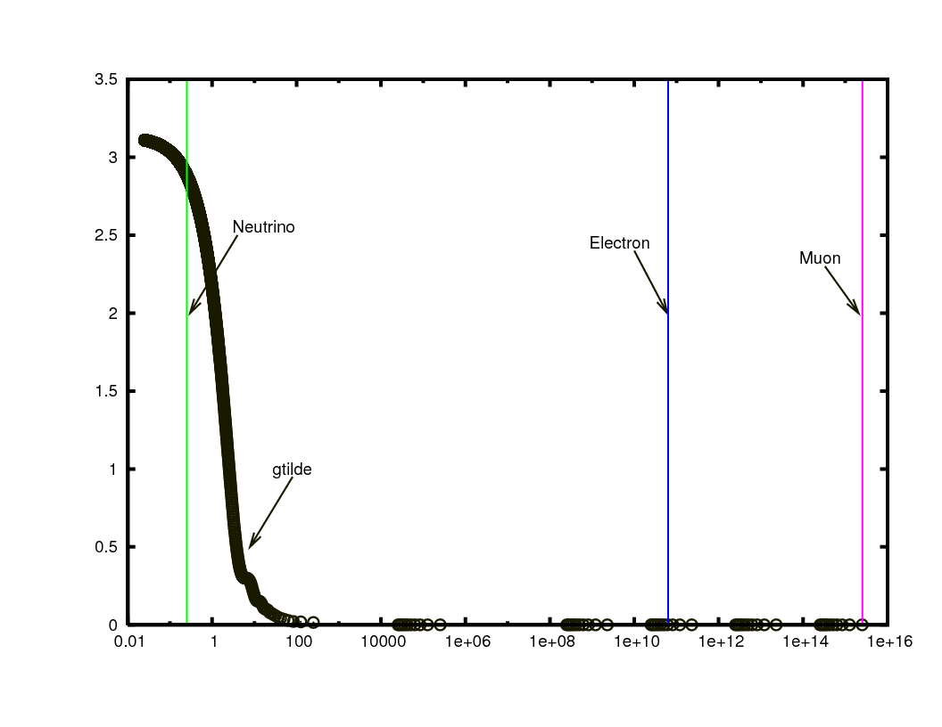
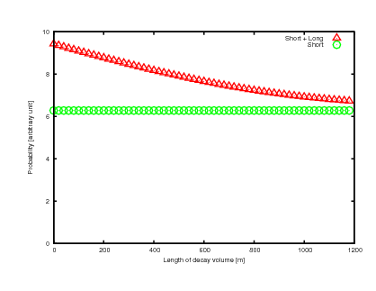


Diffraction term + normal term (muon neutrino)
P_diffraction
P/T
Length(M)

Slide 20
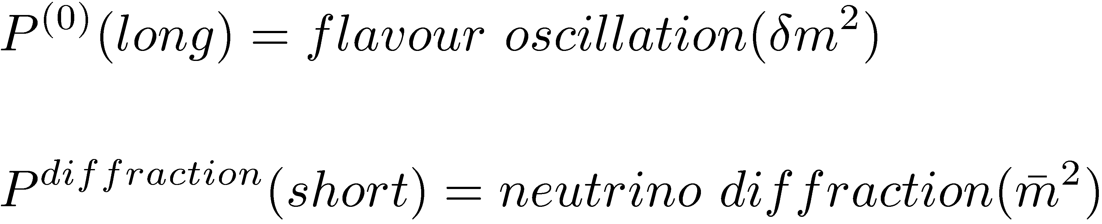
For three flavors
standard
Kayser,-,-,-Akhmedov, et al, Smirnov,--
New term

Slide 21
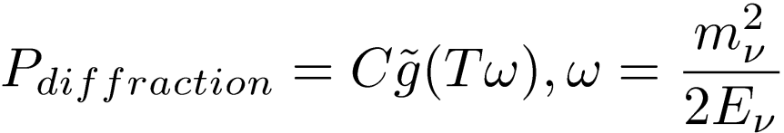
５．Diffraction term in a muon neutrino
P_diffraction
P/T
P_normal
Length(M)

Slide 22
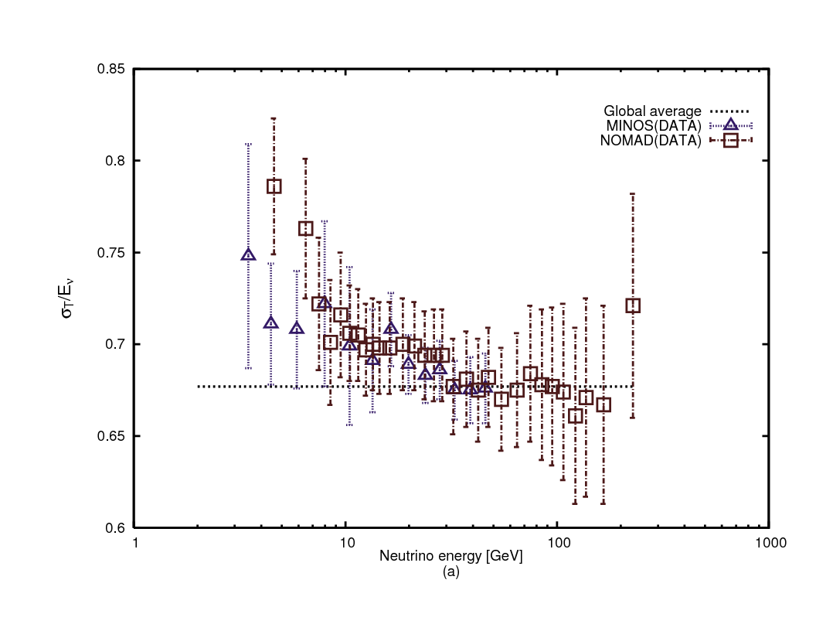
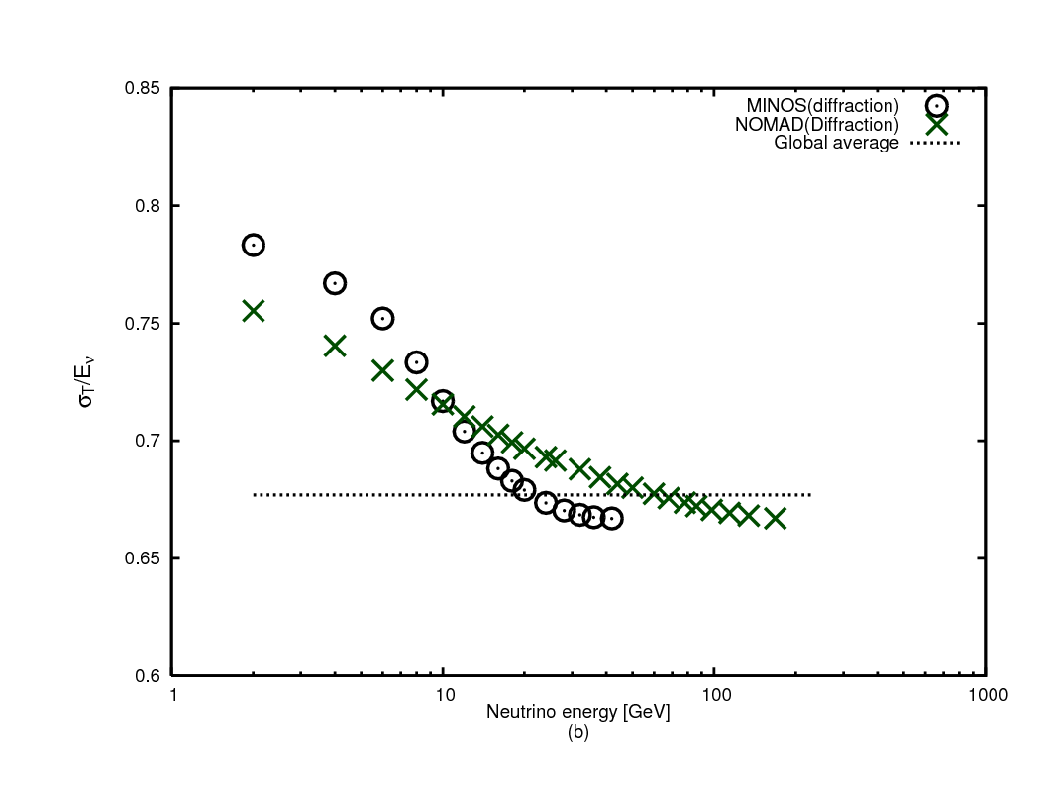
\nu_mu-nucleon total cross section
Experiments.:
NOMAD & MINOS
theory：normal+diffraction

Slide 23
Electron mode: helicity suppression
The normal term in the electron mode is suppressed by the angular momentum and energy-momentum conservation. (Steinberger,Rudermann-Finkelstein,Sasaki-Oneda-Ozaki,)
Since the finite-size correction does not conserve the energy, it violates the helicity suppression .
When the neutrino is detected, the electron mode is enhanced.

Slide 24
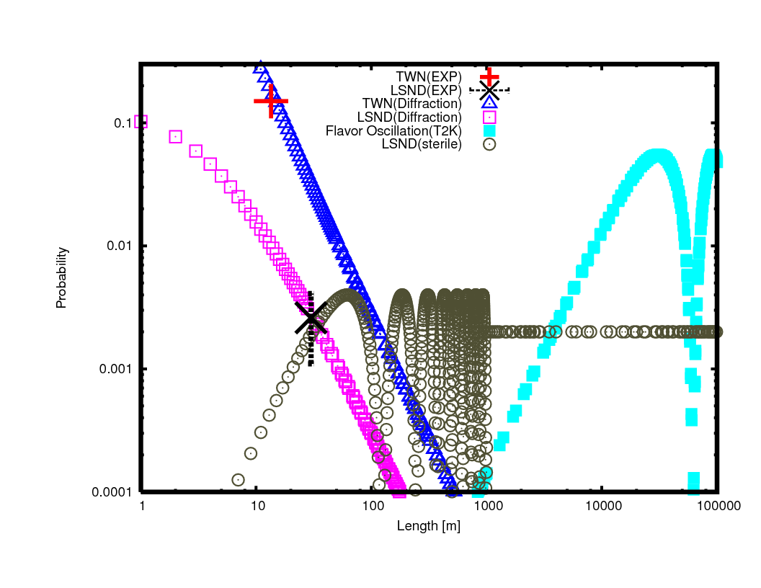
Diffraction Events(enhances electron neutrino）
Diffraction
neutrino oscillation
Exp.（lSND,TWN)
Normal calculation(helicity suppression)
Distance[M]

Slide 25
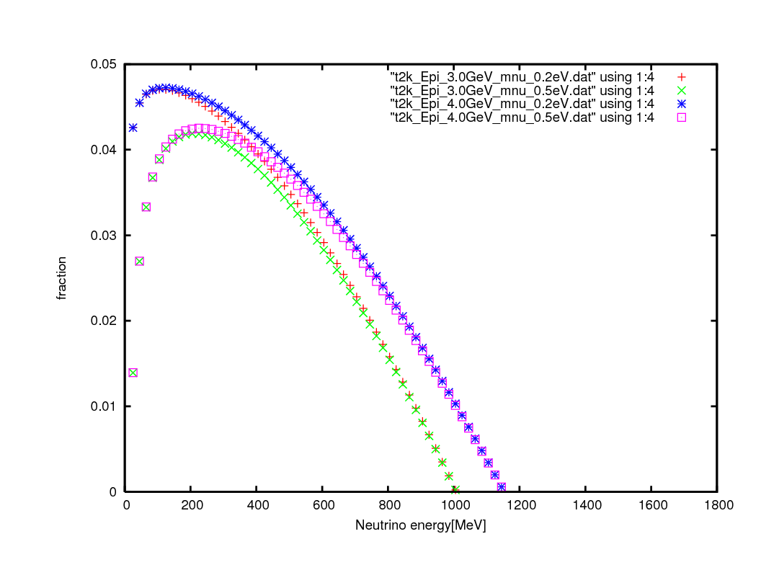
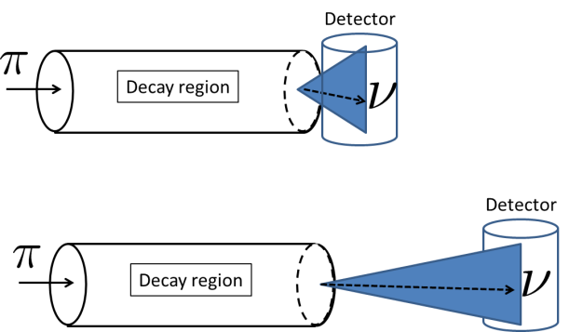
Diffraction prediction of the electron neutrino diffraction(T2K、on axis)

Slide 26
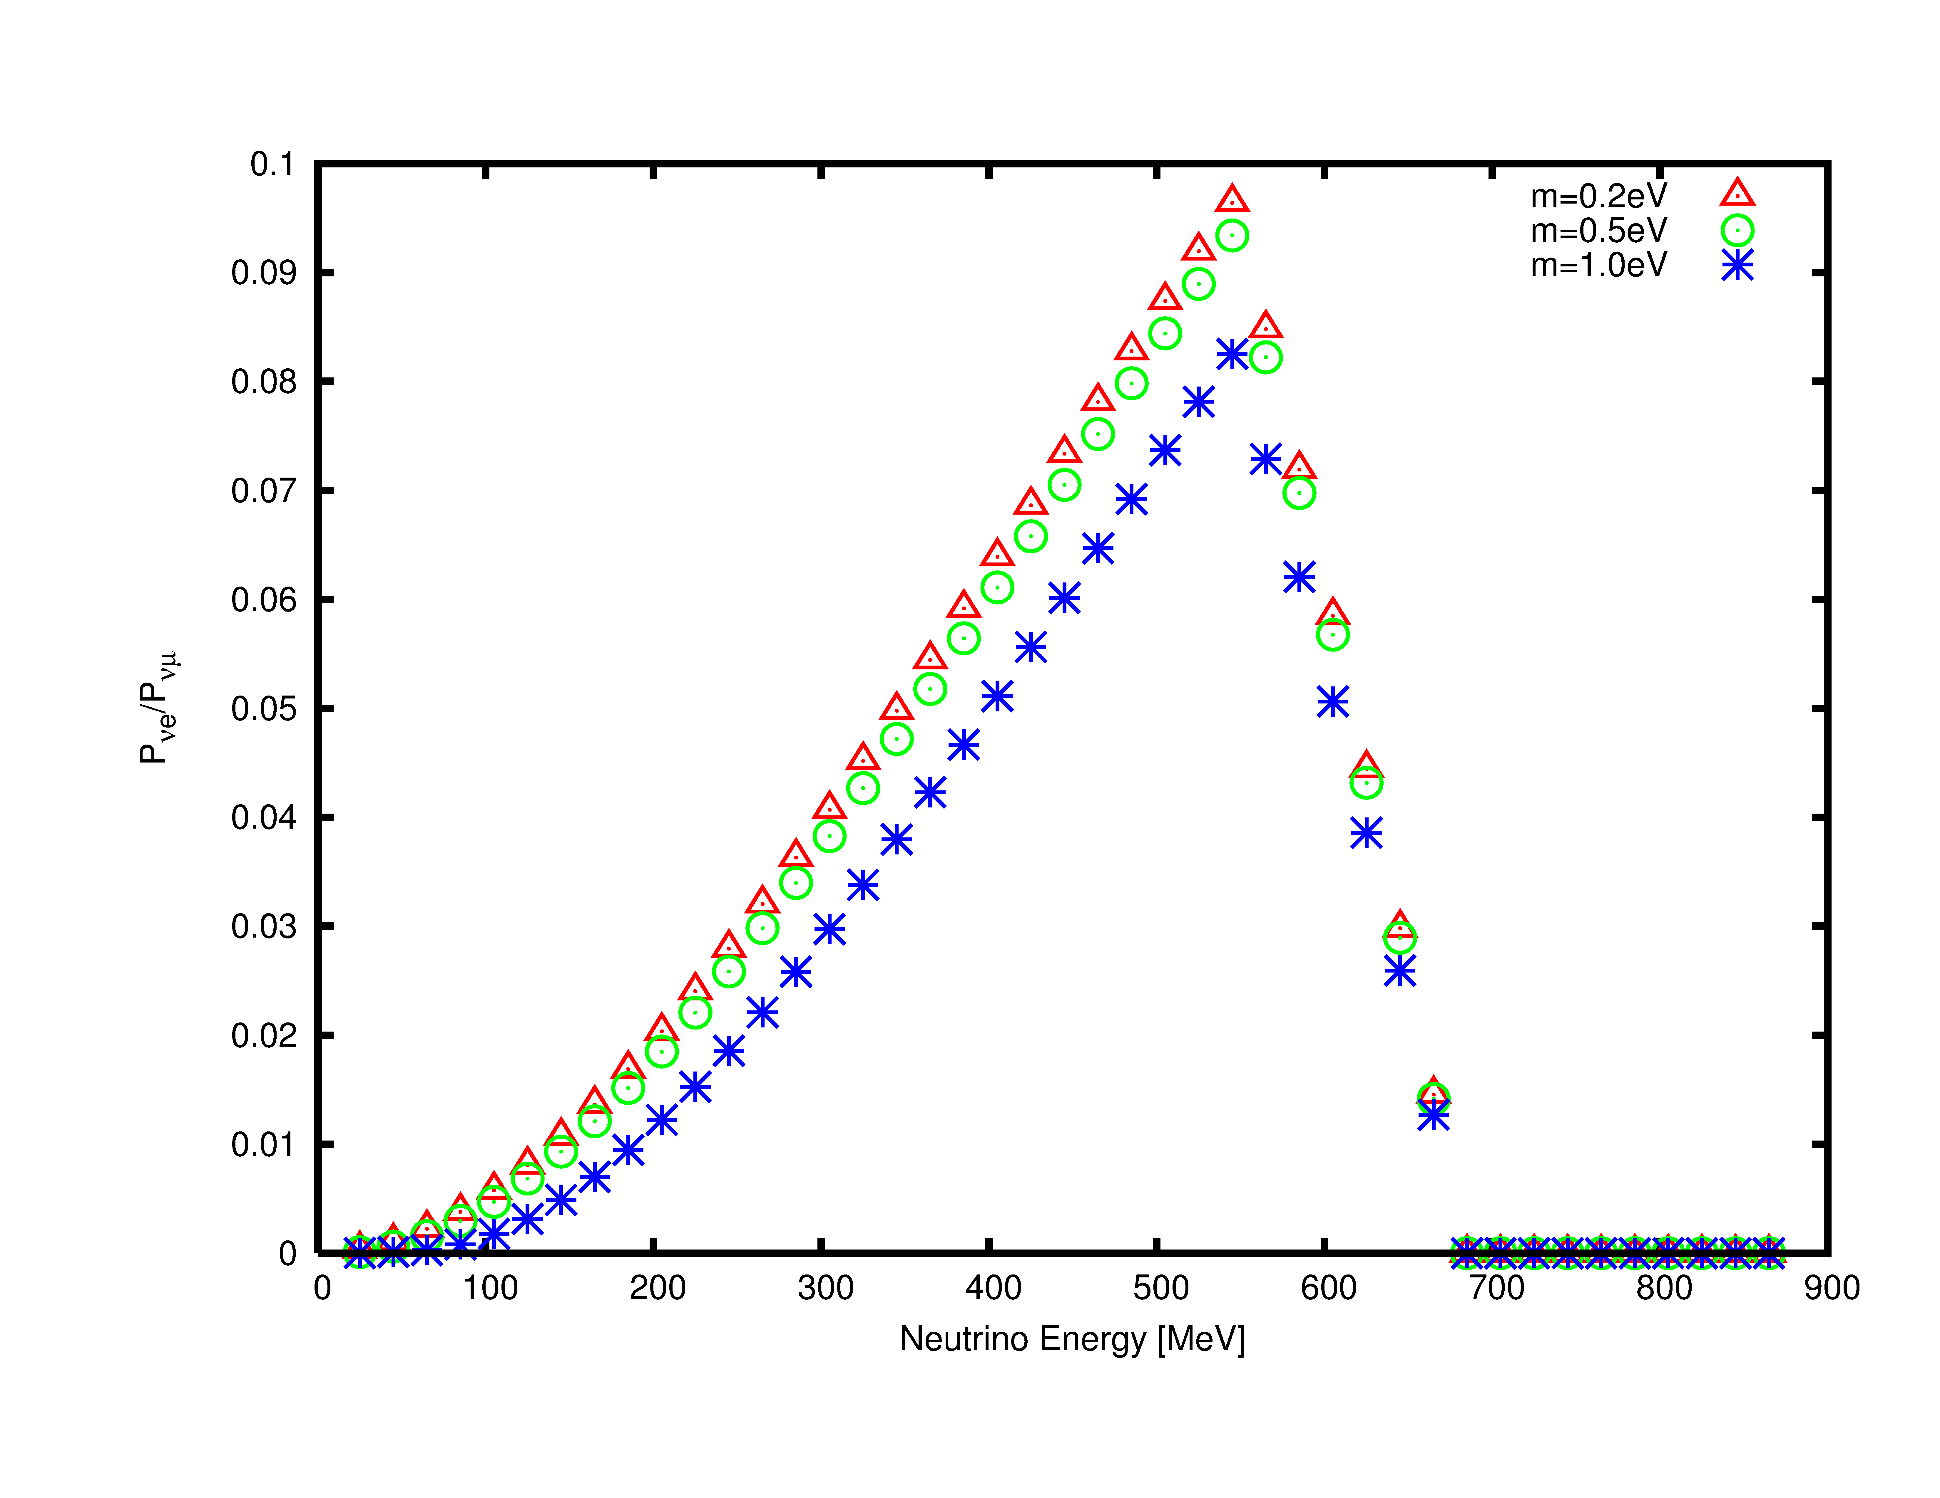
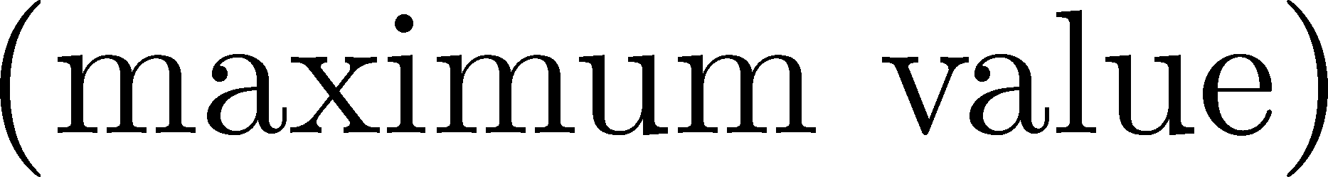

L_{decay-detector} = 170[m], axis = 2.5 degree, Detector 3[m]x3[m]
～10% excess (maximum)

Slide 27
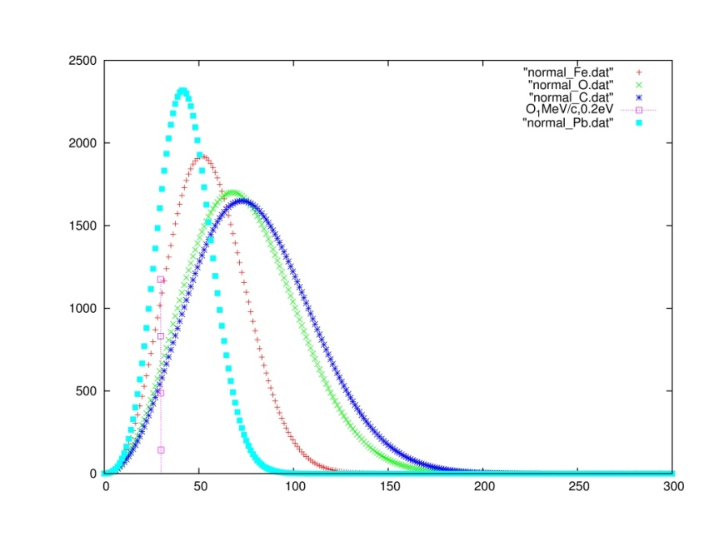
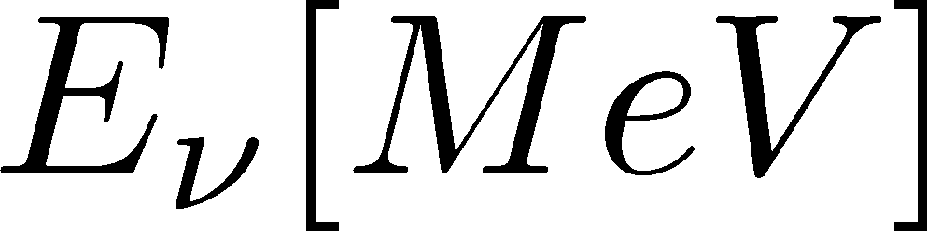
Neutrino from decay of pion at rest
Pb
Fe
O
C
Probability
50
100
150
赤は通常の保存則での計算値(～30MeV)です

Slide 28
Anomalous properties of the diffraction
１ neutrino diffraction is easily observed once the statistics becomes large. Single quantum interference
２ energy conservation is violated : finite-size effect
３ lepton number appears to be non-conserved.
P(L) decreases with L , so unitarity appears to be violated. But they are not.： finite-size effect and retarded effect.
４ pion life time varies due to the measurement, quantum Zeno effect . However the majority of the pion are unchanged because the neutrino interacts with matter so weakly.

Slide 29
Comparisons with previous experiments
Diffraction effect has been observed but that has not been recognized. So, unusual events have been regarded as anomalous events . They are explained with the neutrino diffraction.
High energy neutrino nucleon scattering cross section decreases with the energy slowly. This is understood by the diffraction effect of the neutrino process.
High precision experiment may provide the neutrino absolute mass.

Slide 30
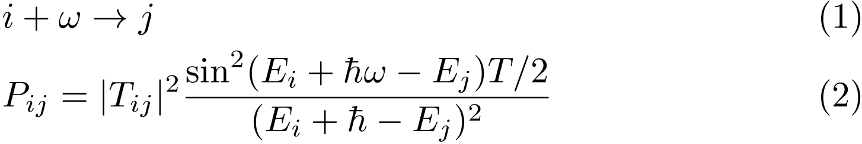
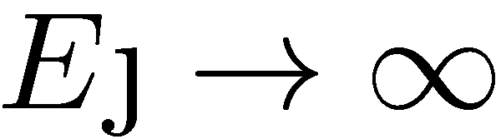
The neutrino diffraction is a finite-size correction
Why does the neutrino diffraction emerge?
1.Transition in a finite time interval Ｔ,
, violates the energy conservation .
2.States at ultra-violet energy region
give a universal correction.
3. Relativistic invariance >> large momentum states

Slide 31



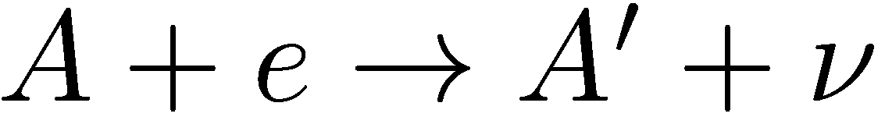

Other channels on the neutrino processes
1. muon decay
2. neutron decay
3.nucleus decays
4.neutrino scattering
(In progress)

Slide 32
New phenomena caused by finite-size effects
１．Emission of light particles .
Energy non-conserving transition lead background noises that has universal properties.
“theory of universal noises “
２．Interference and diffraction.
interference of a new scale that is very different from wave length “physics of a new scale ”
３．Energy shift ： “pseudo-Doppler shift ”

Slide 33
６．conclusion
Finite-size correction to the probability to detect the neutrino is large.
With enough number of neutrino events,
the neutrino diffraction, which is the main part of the finite-size correction, is easy to observe and may provide the absolute neutrino mass.

