Slide 1
How Well Can We Measure Neutron Star Radii?
Cole Miller
University of Maryland
Collaborators: Romain Artigue, Didier Barret,
Sudip Bhattacharyya, Stratos Boutloukos, Novarah
Kazmi, Fred Lamb, Ka Ho Lo

Slide 2
Measuring stellar radii
Ordinary star, like the Sun
Too far for angular resolution
But can get luminosity L
If we assume blackbody, R²=L/(4πσT⁴)
But for NS, usually gives ~5 km!
Why? Spectral shape is ~Planck, but inefficient emission
Need good spectral models
But data usually insufficient to test

Slide 3
Ray Tracing and Light Curves
Rapidly rotating star 300-600 Hz v_{surf}~0.1-0.2c SR+GR effects
Light curve informative about M, R Miller & Lamb 1998 Bogdanov+ 07, 08, 12 Many others...
Must deal carefully with degeneracies
Will now focus on our results from Lo et al., arXiv:1304.2330
Weinberg, Miller, and Lamb 2001
(synthetic data only!)

Slide 4
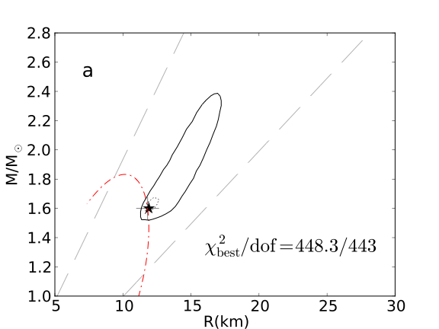
High inclinations allow tight constraints on M and R
Spot and observer inclinations = 90°, high background

Slide 5
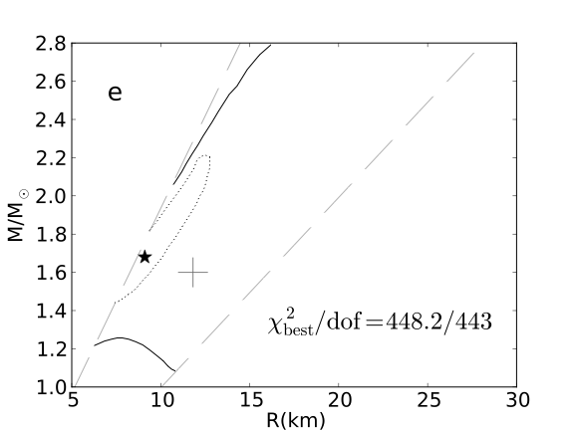
Low inclinations produce looser constraints
Amplitude similar to the previous slide, but low spot and
observer inclinations, low background

Slide 6
Independent knowledge of the observer’s inclination can increase the precision
spot and observer inclinations = 90°, high background
Observer inclination unknown

Slide 7
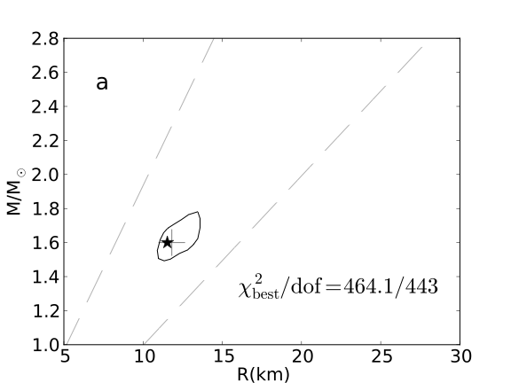
Independent knowledge of the observer’s inclination can increase the precision
spot and observer inclinations = 90°, high background
Observer inclination known to be 90°

Slide 8
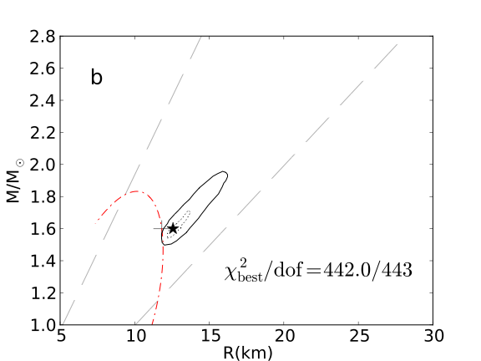
Incorrect modeling of the spot shape increases the uncertainties
spot and observer inclinations = 90°, medium background
Actual spot elongated E-W by 45°

Slide 9
Phase Accumulation from GWs
aLIGO/Virgo: >=2015
Deviation from point mass in NS-NS inspiral: accumulated tidal effects
For aLIGO, can measure tidal param (Del Pozzo+ 2013: distinguish R~11, 13 km with 15 events?)
Recent analytics confirmed by numerical relativity (Bernuzzi et al. 2012)
High-freq sensitivity key
Damour et al., arXiv:1203.4352
High-freq modeling, too

