Slide 1

Mixed order phase transitions
David Mukamel
Amir Bar, DM (PRL, 122, 01570 (2014))

Slide 2
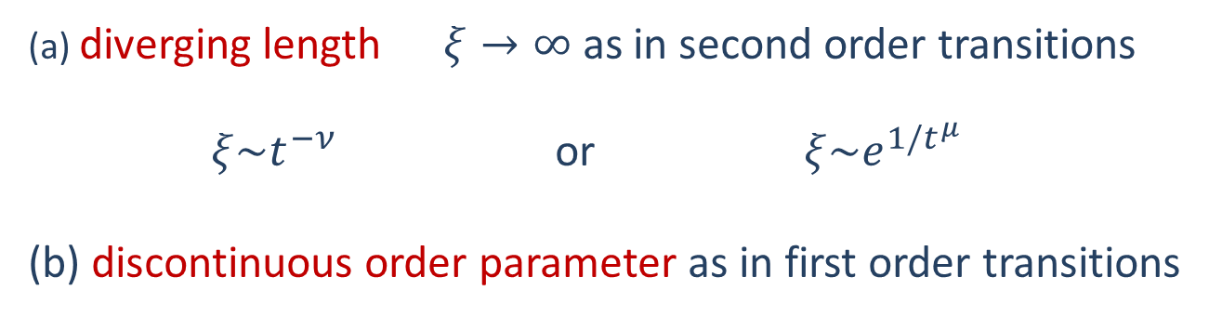
Phase transitions of mixed order
(a) diverging length $ξ→∞$ as in second order transitions
$ξ\sim t^{−ν}$ or $ξ\sim e^{1/t^{μ}}$
(b) discontinuous order parameter as in first order transitions

Slide 3

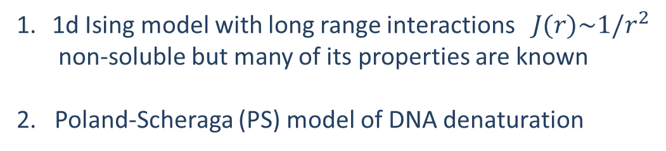


Examples:
1d Ising model with long range interactions $J(r)\sim 1/r^{2}$
non-soluble but many of its properties are known
2. Poland-Scheraga (PS) model of DNA denaturation
$$ξ\sim e^{1/t^{μ}}$$
$ξ\sim t^{−ν}$
3. Jamming transition in kinetically constrained models
Toninelli, Biroli, Fisher (2006)
$$ξ\sim e^{1/t^{μ}}$$
4. “Extraordinary transition” in network rewiring Liu, Schmittmann, Zia (2012)

Slide 4

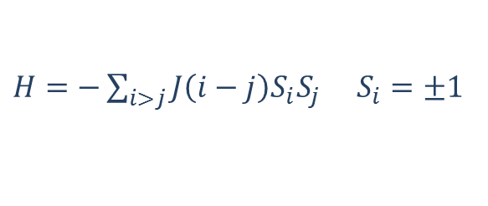
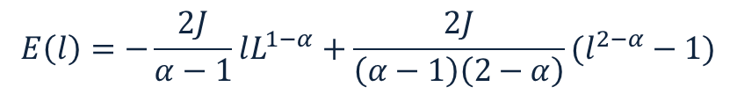

IDSI : Inverse Distance Square Ising model
$H=−\sum_{i>j}{J\left(i−j\right)S_{i}S_{j}}$ $S_{i}=±1$
$J(i−j)\sim \frac{J}{{\left(i−j\right)}^{α}}$ $α=2$
For $1<α≤2$ the model has an ordering transition at finite T
A simple argument:
$$l$$
++++++++++++-----------------++++++++++++++++++++
1 L
$$E\left(l\right)=−\frac{2J}{α−1}lL^{1−α}+\frac{2J}{\left(α−1\right)\left(2−α\right)}(l^{2−α}−1)$$
Anderson et al (1969, 1971); Dyson (1969, 1971); Thouless (1969); Aizenman et al (1988)…

Slide 5

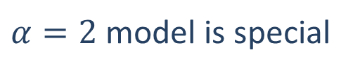
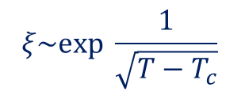
$α=2$ model is special
The magnetization m is discontinuous at $T_{c}$ (“Thouless effect”)
Thouless (1969), Aizenman et al (1988)
$$ξ\sim exp \frac{1}{\sqrt{T−T_{c}}}$$
KT type transition, Cardy (1981)
Phase diagram
H
T
IDSI
Fisher, Berker (1982)

Slide 6



Dyson hierarchical version of the model (1971)
$$1/2^{6}$$
$$1/2^{4}$$
$$1/2^{2}$$
Mean field interaction within each block
The Dyson model is exactly soluble demonstrating the Thouless effect

Slide 7

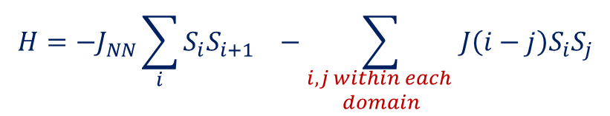

Exactly soluble modification of the IDSI model
microscopic configuration:
+++++++++------------------------+++++++++++++++++---------------------
$$H=−J_{NN}\sum_{i}{S_{i}S_{i+1} −\sum_{\begin{aligned}i,j within each \\ domain\end{aligned}}{J\left(i−j\right)S_{i}S_{j}}}$$
$$J(i−j)\sim \frac{1}{{\left(i−j\right)}^{2}}$$
$$J_{NN }, J\left(i−j\right)>0$$
The interaction is in fact not binary but rather many body.

Slide 8
Summery of the results
diverging correlation length at $T_{c} ξ\sim {\left(T−T_{c}\right)}^{−ν}$with nonuniversal $ν$
Extreme Thouless effect with $m=0→m= ±1$
Phase diagram
H
T
The model is closely related to the PS model of DNA denaturation

Slide 9
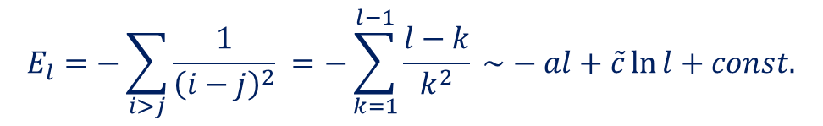

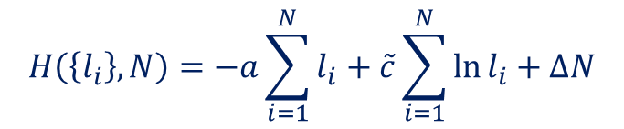

The energy of a domain of length $l$
$$E_{l}=−\sum_{i>j}{\frac{1}{{\left(i−j\right)}^{2}} =−\sum_{k=1}^{l−1}{\frac{l−k}{k^{2}}}} \sim −al+\tilde{c}\ln{l+const.}$$
Interacting charges representation:
$$H\left(\left\{l_{i}\right\}, N\right)=−a\sum_{i=1}^{N}{l_{i}}+\tilde{c}\sum_{i=1}^{N}{\ln{l_{i}+ΔN}}$$
$a, \tilde{c}, Δ >0$
Charges of alternating sign (attractive) on a line
Attractive long-range nearest-neighbor interaction
Chemical potential
--suitable representation for RG analysis
--similar to the PS model

Slide 10
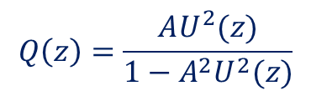

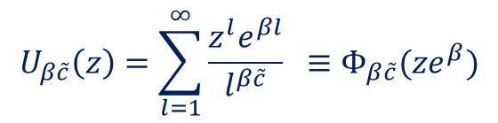
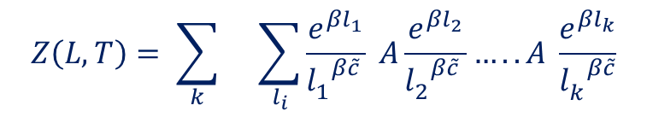
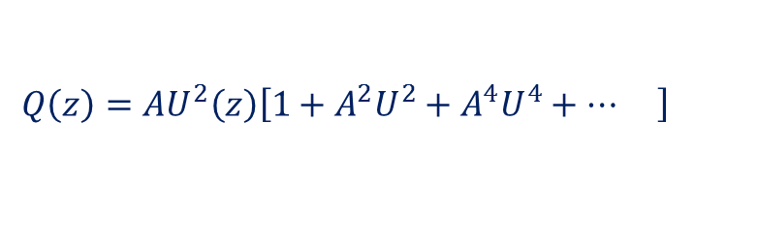
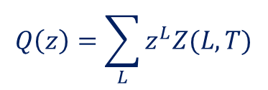
Analysis of the model
$$Z\left(L,T\right)= \sum_{k}{}\sum_{l_{i}}{\frac{e^{βl_{1}}}{{l_{1}^{}}^{β\tilde{c} }}} A\frac{e^{βl_{2}}}{{l_{2}^{}}^{β\tilde{c}} }…..A \frac{e^{βl_{k}}}{{l_{k}^{}}^{β\tilde{c}}}$$
$$l_{1}+ …+l_{k}=L$$
Grand partition sum
$$Q\left(z\right)=\sum_{L}{z^{L}Z(L, T)}$$
$$Q\left(z\right)=AU^{2}\left(z\right)\left[1+A^{2}U^{2}+A^{4}U^{4}+…\left.\right]\right.$$
Polylog function
$$U_{β\tilde{c}}\left(z\right)=\sum_{l=1}^{∞}{\frac{z^{l}e^{βl}}{l^{β\tilde{c}}} ≡Φ_{β\tilde{c}}(ze^{β})}$$
$$Q\left(z\right)=\frac{AU^{2}(z)}{1−A^{2}U^{2}(z)}$$

Slide 11

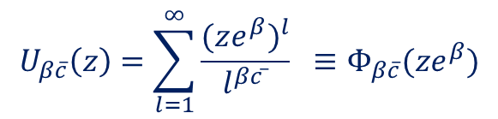




Polylog function
$$U_{β\overline{c}}\left(z\right)=\sum_{l=1}^{∞}{\frac{{(ze^{β})}^{l}}{l^{βc ̅}} ≡Φ_{β\overline{c}}(ze^{β})}$$
$$Q\left(z\right)=\frac{AU^{2}(z)}{1−A^{2}U^{2}(z)}$$
$z^{∗}$ is the closest pole to the origin
$$Q(z)\sim z^{∗L}e^{−βF\left(L,T\right)}\sim {\left[z^{∗}e^{−βf\left(T\right)}\right]}^{L}$$
$$z^{∗}=e^{βf(T)}$$
$$U\left(z^{∗},T\right)=1/A$$
$A<1,$ferromagnetic coupling

Slide 12



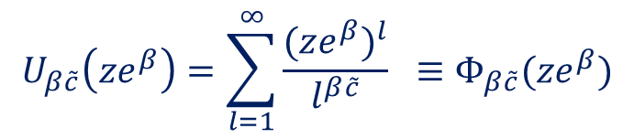










$$β→0$$
$$U(ze^{β})$$
$$U_{β\tilde{c}}\left(ze^{β}\right)=\sum_{l=1}^{∞}{\frac{{(ze^{β})}^{l}}{l^{β\tilde{c}}} ≡Φ_{β\tilde{c}}(ze^{β})}$$
$$̇$$
$$̇$$
$$̇$$
$$\left(1<\right) 1/A$$
$$β_{c}$$
$$1 β→∞$$
$$1$$
$$ze^{β}$$
$$̇$$
$$z^{∗}e^{β}$$
$$1$$
$$ze^{β}$$
Phase transition: ${(z}^{∗}e^{β_{c}})=1 , β_{c}\tilde{c}≡c$
Unlike the PS model the parameter c is not universal

Slide 13



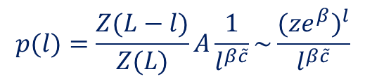


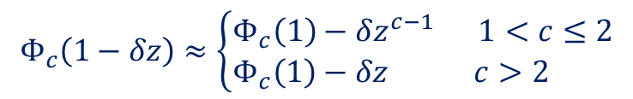


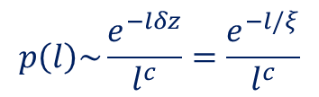
Nature of the transition
$$p(l)=\frac{Z(L−l)}{Z(L)}A\frac{1}{l^{β\tilde{c}}}\sim \frac{{(ze^{β})}^{l}}{l^{β\tilde{c}}}$$
Domain length distribution
Close to $T_{c}$: $z=1−δz$
$$p\left(l\right)\sim \frac{e^{−lδz}}{l^{c}}=\frac{e^{−l/ξ}}{l^{c}}$$
$$c≡β_{c}\tilde{c}$$
characteristic length $ξ=\frac{1}{δz }$
$$ξ→∞ for T→T_{c}$$
$$Φ_{c}\left(1−δz\right)≈\left\{\begin{aligned}Φ_{c}\left(1\right)−δz^{c−1} 1<c≤2 \\ Φ_{c}\left(1\right)−δz c>2 \end{aligned}\right.$$
$t≡T−T_{c}\sim \left\{\begin{aligned}δz^{c−1} 1<c≤2 \\ δz c>2 \end{aligned}\right.$
$$ν=\left\{\begin{aligned}\frac{1}{c−1} 1<c≤2 \\ \\ 1 c>2\end{aligned}\right.$$
$$ξ\sim t^{−ν}$$

Slide 14

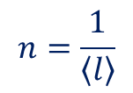



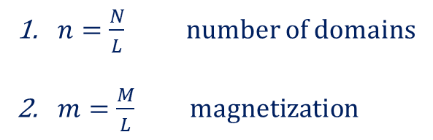
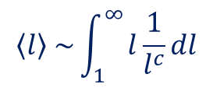



Two order parameters
$n=\frac{N}{L}$number of domains
$m=\frac{M}{L}$ magnetization
1. $n$order parameter
$$n=\frac{1}{\left\langle l\right\rangle }$$
Where at ${ T}_{c}$
$$\left\langle l\right\rangle \sim \int_{1}^{∞}{l\frac{1}{l^{c}}dl}$$
for $1<c≤2 \left\langle l\right\rangle →∞$
for $c>2 \left\langle l\right\rangle$ is finite
$n$ is continuous $1<c≤2$
$n$ is discontinuous $c>2$
in both cases $ξ→∞$

Slide 15





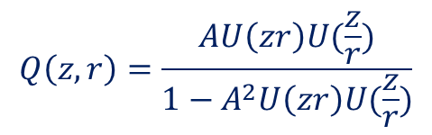

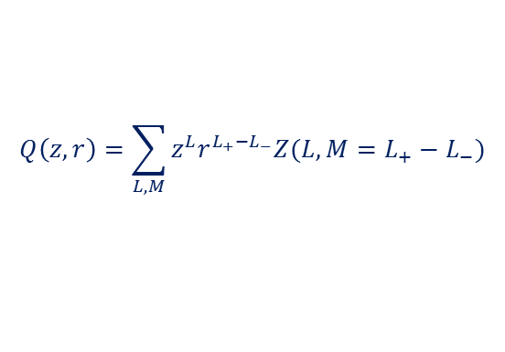

2. $m$order parameter
$Z\left(L,M\right)$ $L=\sum{l_{i} M=\sum{{\left(−1\right)}^{i}l_{i}}}$
$$Q\left(z,r\right)=\sum_{L,M}{z^{L}r^{L_{+}{−L}_{−}}Z(L,M=L_{+}−L_{−})}$$
$$Q\left(z,r\right)=\frac{AU\left(zr\right)U(\frac{z}{r})}{1−A^{2}U\left(zr\right)U(\frac{z}{r})}$$
$m=−\frac{∂\ln{z^{∗}(r)}}{∂\ln{r}}$ $(r=1)$
$h≡\ln{r }$is the magnetic field
$T>T_{c}$ $m=0 (r→\frac{1}{r}$ symmetry)
$T<T_{c}$ either $zr=1$or $\frac{z}{r}=1$
$$m=±1$$
Extreme Thouless effect

Slide 16
Phase diagram
I n is continuous
II and III n is discontinuous

Slide 17






$\left(h,T\right)$phase diagram
$$m=1$$
$$h$$
$$−1<m<1$$
$$T$$
$$m=−1$$

Slide 18
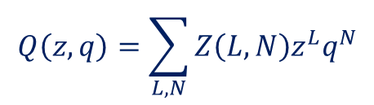
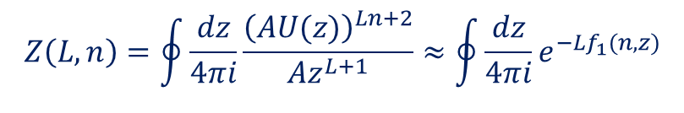

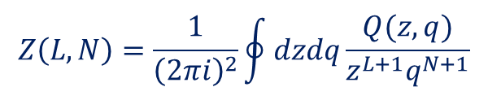
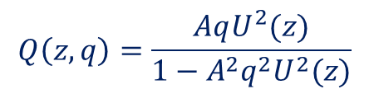

Canonical analysis
Free energy $F\left(L,N,T\right)=Lf(n,T)$
$$Q\left(z,q\right)=\sum_{L,N}{Z\left(L,N\right)z^{L}q^{N}}$$
$$Q\left(z,q\right)=\frac{AqU^{2}(z)}{1−A^{2}q^{2}U^{2}(z)}$$
$$Z\left(L,N\right)=\frac{1}{{\left(2πi\right)}^{2}}\oint{dzdq\frac{Q(z,q)}{z^{L+1}q^{N+1}}}$$
$$Z\left(L,N\right)=e^{−βLf(n,T)}$$
$$Z\left(L,n\right)=\oint{\frac{dz}{4πi}\frac{{\left(AU(z)\right)}^{Ln+2}}{Az^{L+1}}}≈\oint{\frac{dz}{4πi}e^{−Lf_{1}(n,z)}}$$

Slide 19

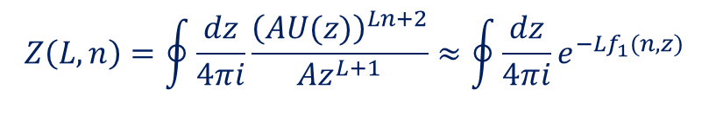


$$Z\left(L,n\right)=\oint{\frac{dz}{4πi}\frac{{\left(AU(z)\right)}^{Ln+2}}{Az^{L+1}}}≈\oint{\frac{dz}{4πi}e^{−Lf_{1}(n,z)}}$$
saddle point:
$$n=\frac{U(z^{∗})}{z^{∗}U′(z^{∗})}$$
$$f\left(n>n_{c}\right)=lnz^{∗}−nln\left[AU(z^{∗})\right]$$
$$f\left(n<n_{c}\right)=lnz_{c}−nln\left[AU(z_{c})\right]$$

Slide 20
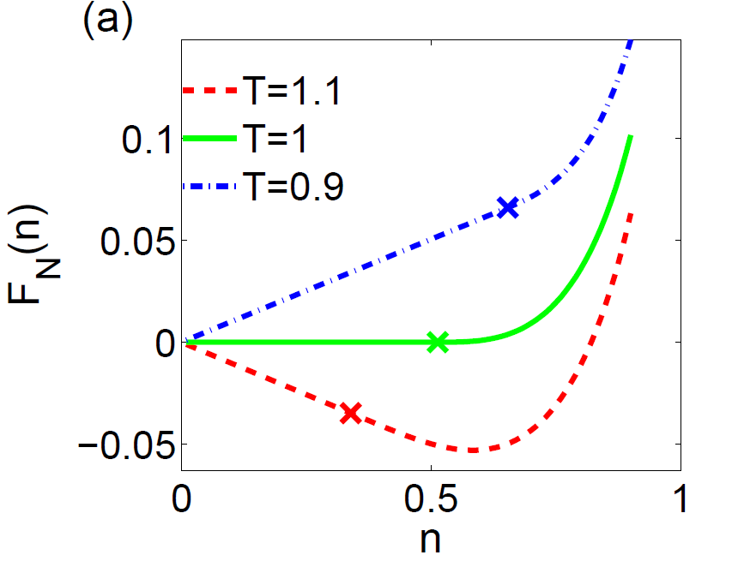
c=2.5

Slide 21

Finite L correction:
$$c=2.5 L=1000$$

Slide 22
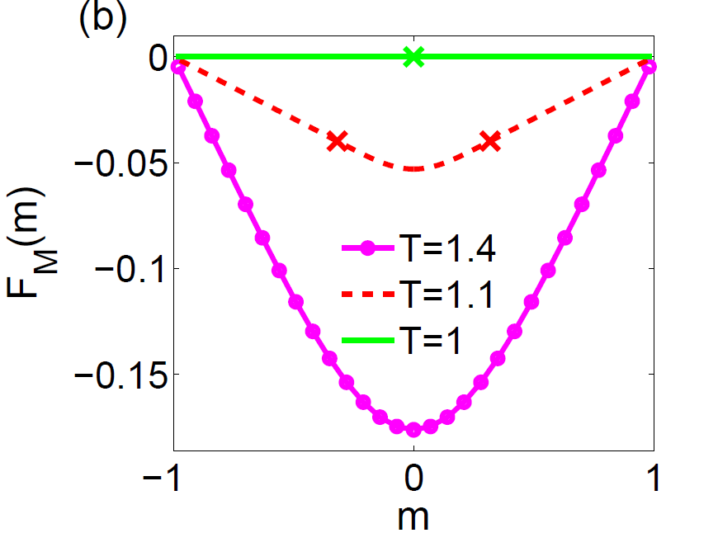
c=2.5

Slide 23
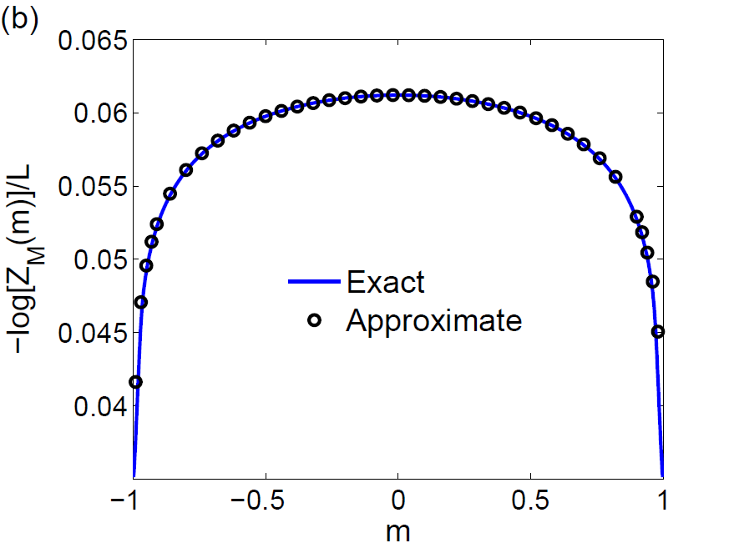
Finite L corrections
c=2.5 L=1000

Slide 24

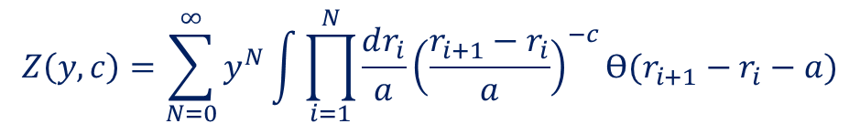
Renormalization group - charges representation
+ - + -
$$Z\left(y,c\right)=\sum_{N=0}^{∞}{y^{N}\int{\prod_{i=1}^{N}{\frac{dr_{i}}{a}}}}{\left(\frac{r_{i+1}−r_{i}}{a}\right)}^{−c}Ɵ(r_{i+1}−r_{i}−a)$$
y - fugacity a - short distance cutoff
Length rescaling $a→ae^{κ}$
This can be compensated by y rescaling $y→ ye^{κ(1−c)}$

Slide 25


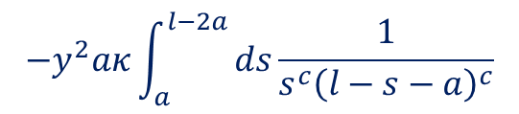


$$Ɵ\left(r_{i+1}−r_{i}−ae^{κ}\right)≈Ɵ\left(r_{i+1}−r_{i}−a\right)−aκδ(r_{i+1}−r_{i}−a)$$
$$s$$
$$l−s$$
+ - + -
$$l$$
$$−y^{2}aκ\int_{a}^{l−2a}{ds\frac{1}{s^{c}{\left(l−s−a\right)}^{c}}}$$
The integral scales like $1/l^{c}$ hence it does not renormalize c .
Rather it renormalizes y.

Slide 26



Renormalization group equations
$$\frac{dy}{dκ}=xy+y^{2}$$
$$\frac{dx}{dκ}=0$$
$$x≡1−c$$
compared with the Kosterlitz-Thouless model:
$$\frac{dy}{dκ}=xy$$
$$\frac{dx}{dκ}=y^{2}$$

Slide 27




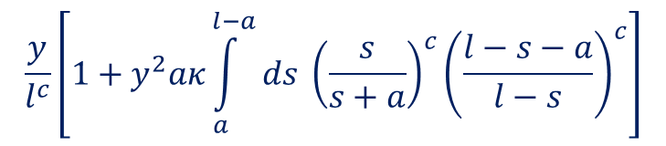

In the KT case:
$$s$$
$$l−s$$
+ - + -
$$l$$
Contribution of the dipole to the renormalized partition sum:
$$\frac{y}{l^{c}}\left[1+y^{2}aκ\int_{a}^{l−a}{ds {\left(\frac{s}{s+a}\right)}^{c}{\left(\frac{l−s−a}{l−s}\right)}^{c}}\right]$$
$$1−\frac{a}{s}−\frac{a}{l−s}$$
$$\frac{y}{l^{c}}\left[1+y^{2}κlnl\right]$$
renormalizes c.
(Cardy 1981)

Slide 28
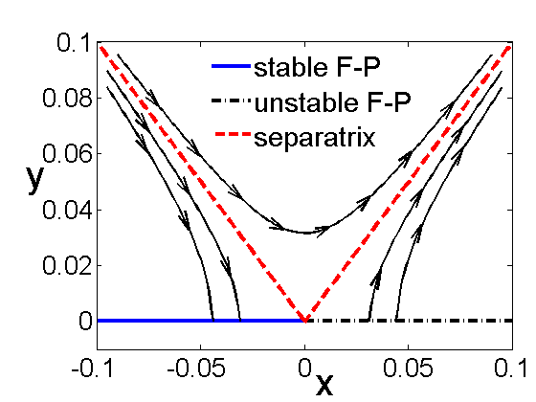
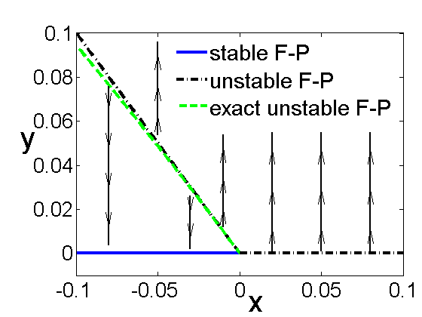
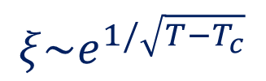
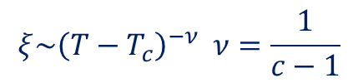




$$\frac{dy}{dκ}=xy+y^{2}$$
$$\frac{dx}{dκ}=0$$
$$\frac{dy}{dκ}=xy$$
$$\frac{dx}{dκ}=y^{2}$$
$$x≡1−c$$
Line of fixed points $y^{∗}=−x^{∗}$
$$ξ\sim {\left(T−T_{c}\right)}^{−ν} ν=\frac{1}{c−1}$$
$$ξ\sim e^{1/\sqrt{T−T_{c}}}$$

Slide 29
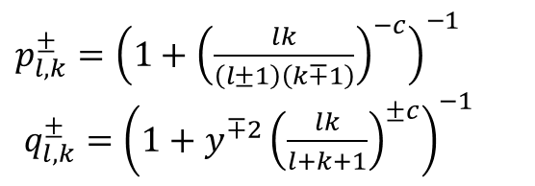

Coarsening dynamics
  Particles with n-n logarithmic interactions
  Biased diffusion, annihilation and pair creation
$$l_{1}$$
$$l_{2}$$
$$l_{3}$$
$$l_{4}$$
$$p_{l_{1},l_{2}}^{+}$$
$$q_{l_{3},l_{4}}^{−}$$
$$q_{l_{5},l_{6}}^{+}$$
$$l_{5}$$
$$l_{6}$$
$p_{l,k}^{±}={\left(1+{\left(\frac{lk}{\left(l±1\right)\left(k∓1\right)}\right)}^{−c}\right)}^{−1}$
$q_{l,k}^{±}={\left(1+y^{∓2}{\left(\frac{lk}{l+k+1}\right)}^{±c}\right)}^{−1}$

Slide 30

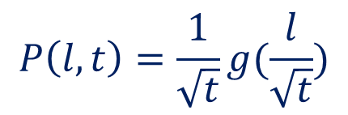
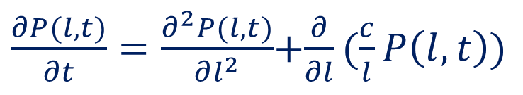
Coarsening dynamics
$$T=∞→T<T_{c}$$
The coarsening is controlled by the T=0 (y=0) fixed point
$\frac{∂P(l,t)}{∂t}=\frac{∂^{2}P(l,t)}{∂l^{2}}$+$\frac{∂}{∂l}(\frac{c}{l}P\left(l,t\right))$
$$P\left(l,t\right)=\frac{1}{\sqrt{t}}g(\frac{l}{\sqrt{t}})$$
Like the dynamics of the T=0 Ising model

Slide 31


Slide 32




Coarsening dynamics
$$T=∞→T=T_{c}$$
$$P\left(l,t\right)=\frac{1}{l^{c}}g(\frac{l}{t^{1/z}})$$
Expected scaling form
$$g\left(x≪1\right)=1 g(x≫1)\sim e^{−x}$$
$n=\frac{1}{<l>}$ - number of domains
$n\sim t^{−ε(c)}$ with $ε\left(c\right)=\frac{2−c}{z}$

Slide 33





L=5000 c=1.5 $T=T_{c}$
$$P\left(l,t\right)t^{1.5}$$
z=2
z=1.5
$$l/t^{0.5}$$
$$l/t^{0.66}$$
$$P\left(l,t\right)\sim \frac{1}{l^{c}}f\left(\frac{l}{t^{1/z}}\right)$$

Slide 34




$n\sim t^{−ε(c)}$ with $ε\left(c\right)=\frac{2−c}{z}$
-
Voter model (y=0, fixed c)

Slide 35
Summary
Some models exhibiting mixed order transitions are discussed.
A variant of the inverse distance square Ising model is studied
and shown to have an extreme Thouless effect, even in the presence
of a magnetic field
Relation to the IDSI model is studies by comparing the renormalization
group transformation of the two models.
The model exhibits interesting coarsening dynamics at criticality.

Slide 36




Domain representation of the $\frac{1}{r^{2}}$Ising model
(Fortuin-Kasteleyn representation)
$$H=−\sum{J_{i,j}}(σ_{i}{ ,σ}_{j})$$
$$λ_{r}=e^{βJ_{r}(σ_{i},σ_{j})}−1$$
$$Z\left(L\right)=\sum_{σ}{\prod_{i,j}{(1+λ_{i−j})}}=\sum_{σ}{\sum_{E}{\prod_{i,j}{{λ_{i−j}^{}}^{E_{i,j}}}}}$$
$E_{i,j}=0,1$ defines a graph on the vertices $1,…,L$
The sum is over all graphs E

Slide 37



A graph can be represented as composed of sub-graphs
separated by “breaking points”
$$λ_{r}=e^{βJ_{r}(σ_{i},σ_{j})}−1$$
One has to calculate $P\left(l\right)$- the probability that the distance between
adjacent breaking points is $l.$

