Slide 1
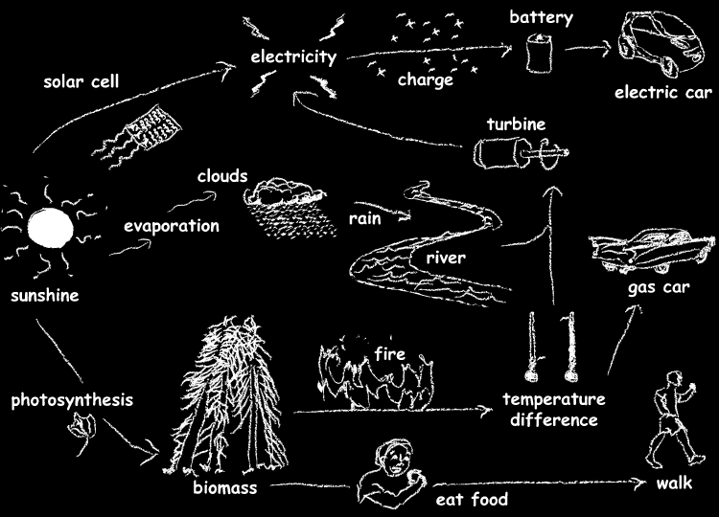
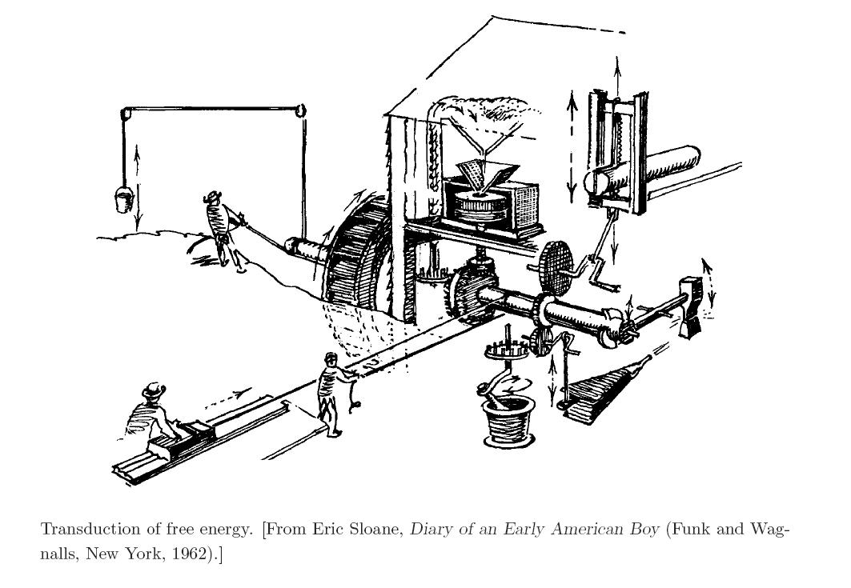
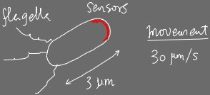
Adaptation as a nonequilibrium paradigm
Shouwen Wang and Lei-Han Tang
Beijing Computational Science Research Center
Hong Kong Baptist University
Philip Nelson: Biological Physics, 2004
GGI Workshop on “Advances in Nonequilibrium Statistical Mechanics”, 26-30 May, 2014
Notes:
All organisms participate in energy transduction. Life is possible only when driven out of equilibrium, which need to be supported by energy flow. Harvesting energy is a big deal in a cell as small as E coli, which is packed with clever molecular circuits (biological organization, EGD Cohen). This is great news for nonequilibrium stat mech. One may think of bounds such as Carnot efficiency etc. In this talk, we look at a small component of this process, the sensing of nutrient molecules. The upshot is to try to establish a link between energy dissipation and the functionality the molecular circuit supports. Here we have a well-defined functionality, and we can do many things with a model proposed to describe the behavior. Yet we are still struggling with going beyond the descriptive level and gain a deeper understanding of the connection.

Slide 2
Outline
Sensory adaptation in E. coli
Adaptation from a discrete-state Markov model: the Energy-Speed-Accuracy (ESA) Tradeoff
Exact results on the NESS: phase diagram, probability distribution, linear response
Harada-Sasa: dissipation vs function?

Slide 3
Adaptation in E. coli chemosensing

Slide 4
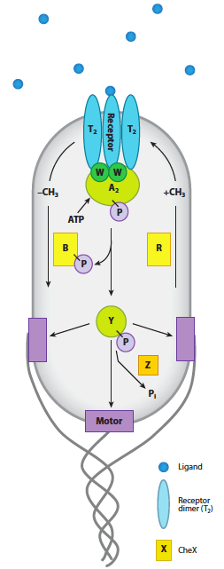
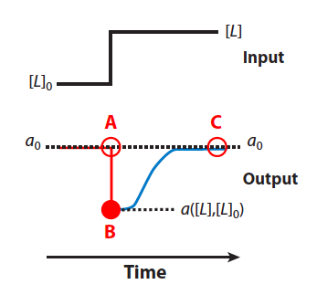
Bacterial chemotaxis: sensory adaptation
Yuhai Tu, Annu Rev Biophys 42:337-59 (2013)
Signal:
ligand molecules
Optimal sensitivity:
To be sensitive to the environmental signal, the activity “a” of the receptor should neither be idle nor saturated (50-50 is about optimal).
Methylation
circuit monitoring CheA activity
Sensing module
Adaptation
Upshift in ligand
concentration
transient suppression
of receptor activity
followed by recovery
to previous level to
maintain sensitivity
“activity”
~50%
Swimming module
Notes:
Mean activity of receptors tracked experimentally. Define adaptation, and accuracy already at this stage. Adaptation achieved via methylation of the receptor protein.

Slide 5
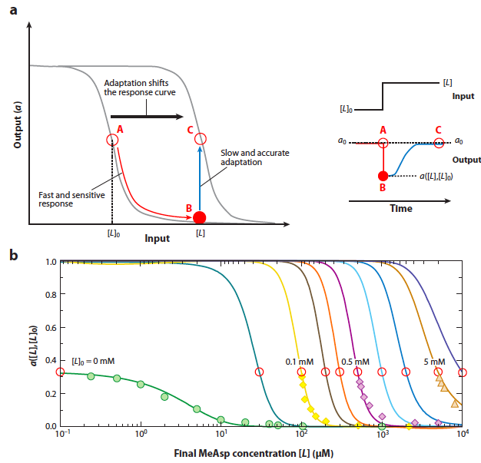
Adaptation: methylation of receptor proteins
Yuhai Tu, Annu Rev Biophys 42:337-59 (2013)
s
Scheme:
allostery
m
a
spectator
Robust adaptation except m dynamics cannot be equilibrium!
MWC model
minutes
seconds
no adaptation
Notes:
Define the “optimal activity level” at 50-50. Most sensitive to environment. Introduce transient response

Slide 6
Adaptation: methylation of receptor proteins
s
Scheme:
m
Suppose (a,m) follows relaxational dynamics under a potential F(a,m)
a
spectator
Robust adaptation except m dynamics cannot be equilibrium!
Contradiction!

Slide 7
A statistical mechanical model of receptor dynamics
Lan, Sartori, Neumann, Sourjik, Tu
Nature Physics 2012, 8:422

Slide 8
Discrete Markov Model of Adaptation
Lan et al., Nature Physics 2012, 8:422
s
Scheme:
Fast receptor activation/deactivation at a given m:
“detailed balance” for a:
m
a
spectator
Slow methylation dynamics:
α = nonequilibrium parameter
Notes:
Define the “optimal activity level” at 50-50. Most sensitive to environment. Introduce transient response

Slide 9
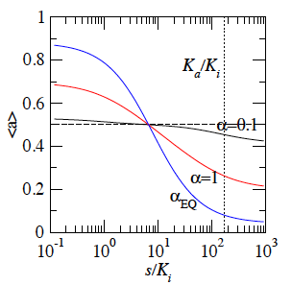
Adaptation at α < 1
Lan et al., Nature Physics 2012, 8:422
For small α, <a> is a weak function of s centered around
for
adaptation accuracy:
Claim (the Energy-speed-accuracy (ESA) trade-off relation):
dissipated power
methylation frequency

Slide 10
We have obtained exact results for
Adaptation error
NESS probability distribution P(a,m)
Rate of energy dissipation
Fluctuation and linear response spectrum
Generalized Herada-Sasa equality

Slide 11
Moment equation
Phase diagram
perfect adaptation
Adaptation is possible only when
“Adaptation error” determined by probabilities at the boundary of the methylation range.
Genuine phase transition in the nonequilibrium model when the methylation range is infinite.

Slide 12
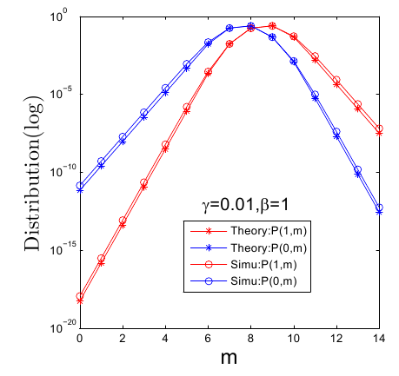
NESS Distribution
a = 1
a = 0
large methylation range m₀
=> better adaptation.

Slide 13
Energy dissipation rate
Power needed to keep the system in the NESS:
in units of k_{B}T
forward
prob current
backward prob current
Exactly:

Slide 14
NESS
a = 1
Modified ESA tradeoff
a = 0
total dissipated power
Time to complete one cycle to the nearest methylation boundary:

Slide 15
Fluctuation spectrum and transient response

Slide 16
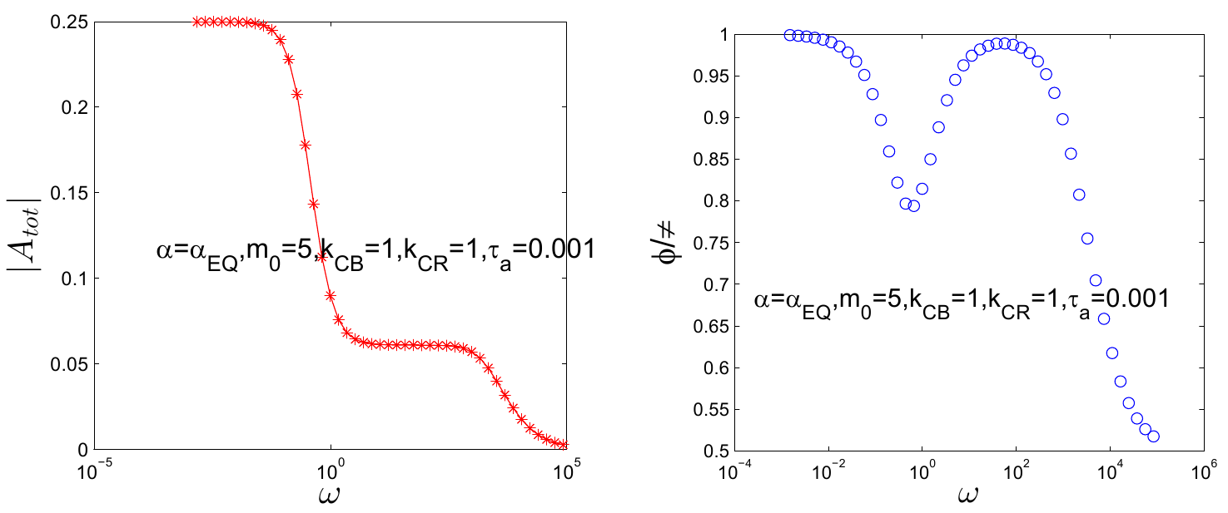
Activity: frequency-resolved linear response
Mean activity under sinusoidal perturbation
equilibrium
slow component (m)
fast component (a)
transient response
nonequilibrium
adaptation
Notes:
Overdamped HMO,

Slide 17
Linearized Langevin description
Substitute:

Slide 18
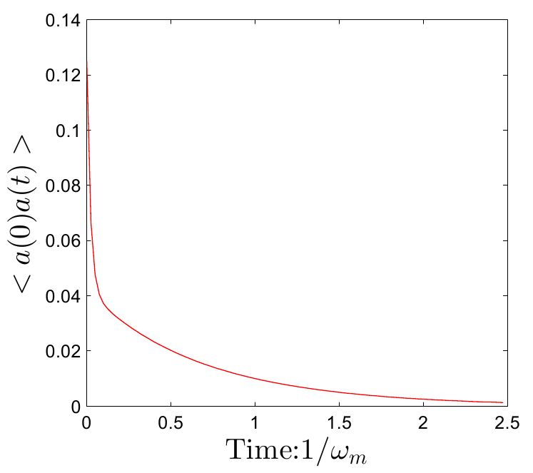
Auto-Correlation function
Auto-correlation function for activity

Slide 19
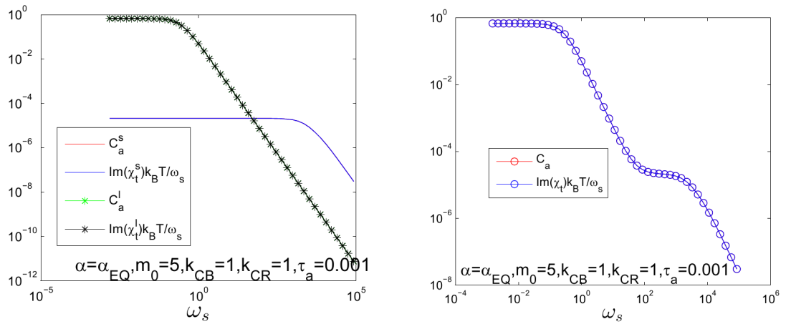
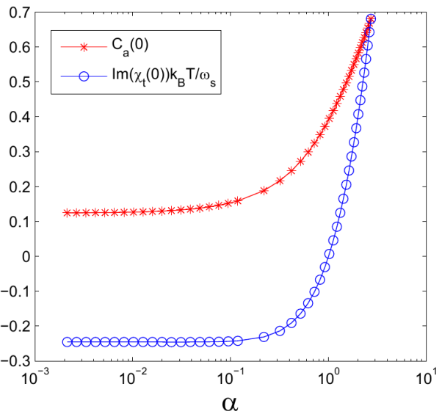
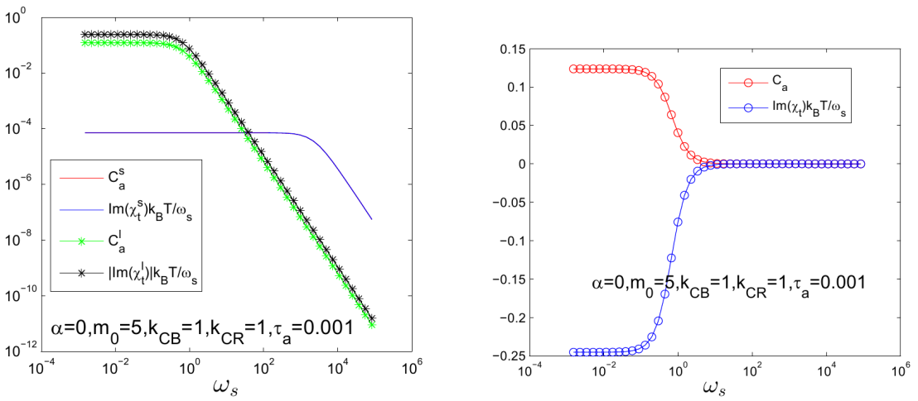
FDT for different steady state
break detailed balance
Equilibrium
Exact FDT for equilibrium model
FDT still holds in the high frequency region

Slide 20
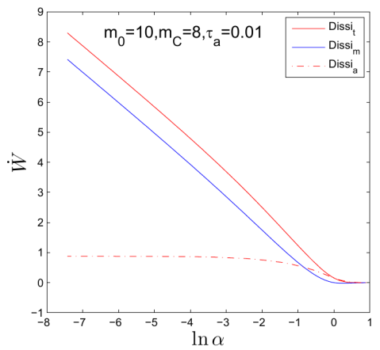
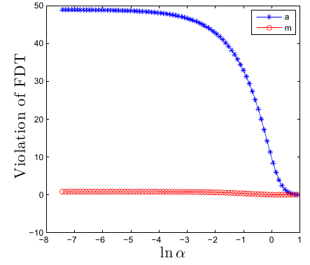
Harada-Sasa equality ?
Langevin eq’n for a particle
Only consider violation of FDT
Harada-Sasa for a dynamics?
m-dynamics dissipation
a-dynamics dissipation

Slide 21
Generalized Harada-Sasa for discrete-state systems
M Baiesi, C Maes, and B Wynants, Phys Rev Lett 103: 010602 (2009)
E Lippiello, M Baiesi and A Sarracino, Phys Rev Lett 112: 140602 (2014)
Observable:
Harada-Sasa recovered only when

Slide 22
Summary
Analytical solution of the model: exact NESS distribution
Exact formula for energy dissipation in the NESS
Adaptation error decreases exponentially with methylation range, with a rate proportional to
Failed attempt on making use of Harada-Sasa
Understanding the “Energy-Speed-Accuracy Trade-off” from information thermodynamics ongoing
s
m
a

Slide 23
Supported by the RGC of the HKSAR

Slide 24
Thank you for your attention!

