Slide 1


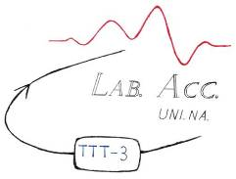
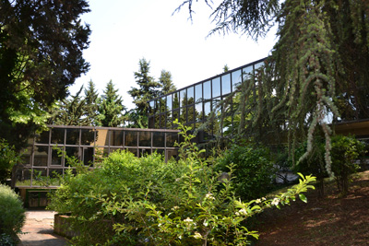
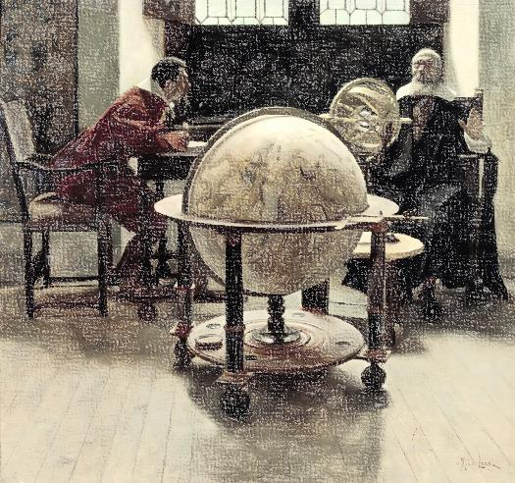
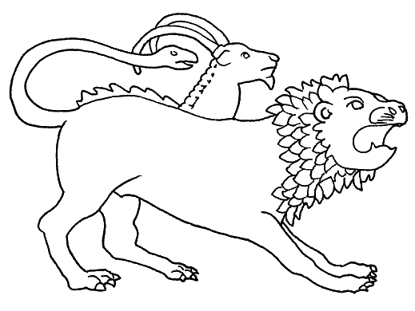
GGI School – Frontiers in Nuclear and Hadronic Physics
Istituto Nazionale
di Fisica Nucleare
Spectroscopy of Light Nuclei with
Low and Medium Energy Nuclear Reactions
Ivano Lombardo, Daniele Dell’Aquila
Dip. di Fisica, Università di Napoli Federico II
& INFN – Sez. di Napoli
Univ. Napoli Federico II and INFN – Napoli
ivlombardo@na.infn.it
Arcetri, 24/02/2016

Slide 2
Exotic structures in light nuclei
Complexity of nuclear force → dominant phenomena of nucleon-nucleon correlations which determine a spatial re-organization of the nucleons in bounded sub-units → the constituent clusters.
¹²O
¹³O
¹⁴O
¹⁵O
¹⁶O
¹⁷O
¹⁸O
¹⁹O
²⁰O
²¹O
²²O
¹¹N
¹²N
¹³N
¹⁴N
¹⁵N
¹⁶N
¹⁷N
¹⁸N
¹⁹N
²⁰N
²¹N
C
⁸C
⁹C
¹⁰C
¹¹C
¹²C
¹³C
¹⁴C
¹⁵C
¹⁶C
¹⁷C
¹⁸C
¹⁹C
²⁰C
α
B
⁸B
⁹B
¹⁰B
¹¹B
¹²B
¹³B
¹⁴B
¹⁵B
¹⁷B
¹⁹B
α
Univ. degli Studi di Napoli Federico II & INFN - Napoli
Be
⁷Be
⁸Be
⁹Be
¹⁰Be
¹¹Be
¹²Be
¹⁴Be
α
Li
⁶Li
⁷Li
⁸Li
⁹Li
¹¹Li
linear chain
¹⁰Be,¹³⁻¹⁴C,¹⁶C(?),…
He
³He
⁴He
⁶He
⁸He
H
¹H
²H
³H
α
α
n
core
α
α
α
core
neutron skin
⁸He,C
α-cluster
⁸Be
neutron halo
⁶He,¹¹Li,¹¹Be
dilute gas
¹²C 0⁺,¹⁶O,²⁰Ne(?)
Structure → Nuclear Spectroscopy!

Slide 3
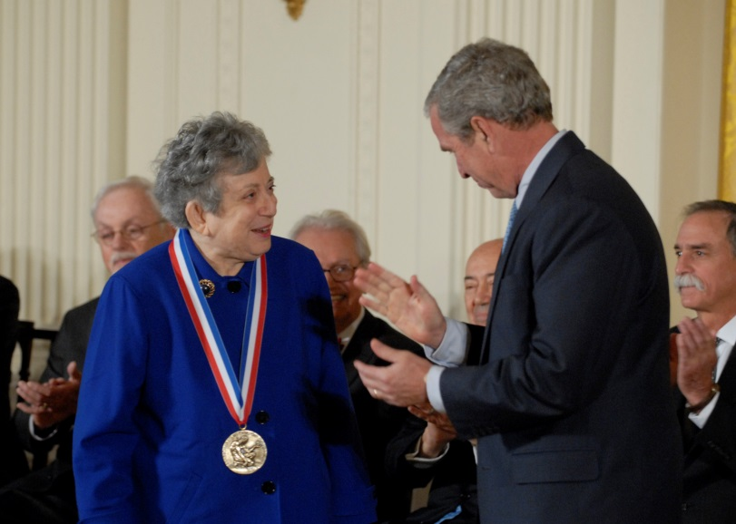
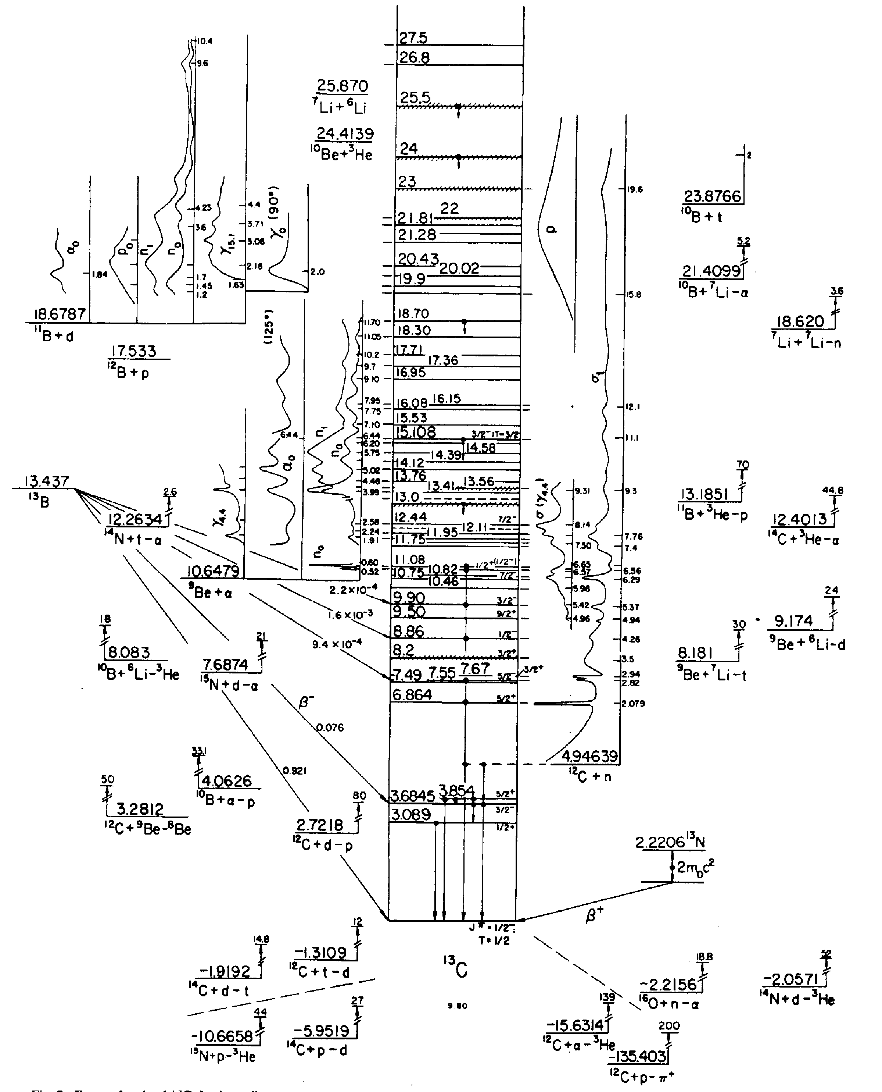
The Fundametals of Nuclear Spectroscopy
Fay Ajzenberg Selove (1926 – 2012)
Fay Ajzenberg – Selove (1926 – 2012) devoted her life to collect all the data obtained by experimental groups studying nuclear reactions →
Nuclear Spectroscopy database (A<=20).
Univ. degli Studi di Napoli Federico II & INFN - Napoli
Spectroscopy of a Nuclear State → Energy, spin, parity, total width, partial widths,
wave function …
→ NOT SIMPLE!
http://www.tunl.duke.edu/nucldata/
Signature of α-clustering in nuclei

Slide 4
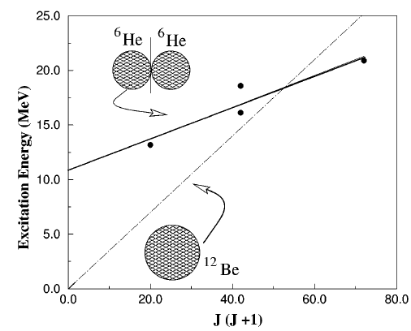
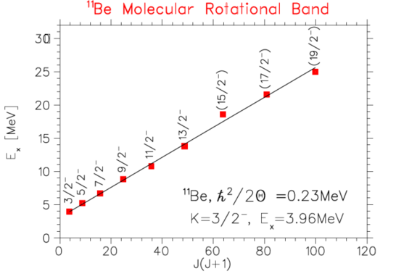
Evidencing α – clustering in light nuclei
Some signatures that α-cluster structure appears in nuclei:
1. Strong deformation → “abnormal” shape due to α-clustering → Rotational bands with anomalously large moment of inertia [E_{x} vs J(J+1)]
Univ. degli Studi di Napoli Federico II & INFN - Napoli
vonOertzen and Milin, Lect. Not. Phys. 875 (2012)
M. Freer et al, PRL 82 (1999)
A simple classical mechanics exercise!
Importance of determining J^{π}

Slide 5
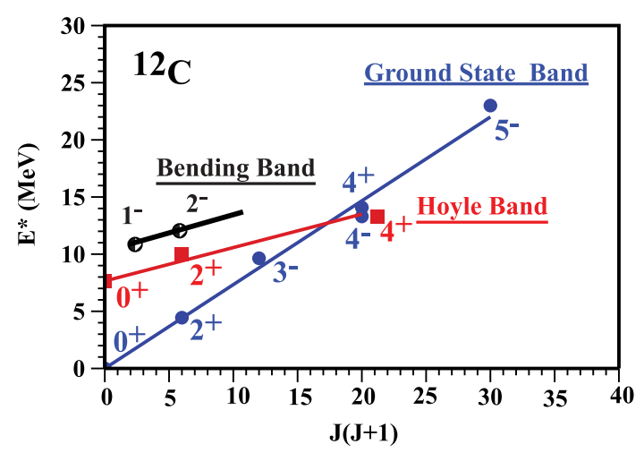
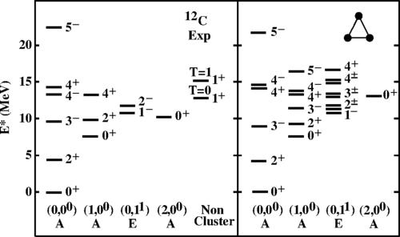
Evidencing α – clustering in light nuclei
Some signatures that α-cluster structure appears in nuclei:
2. Appearance of sequences of levels (E_{x}, J^{π}) predicted by Quantum-mechanical rotation and vibration of triangular or tetrahedral structures (ACM)
D.J. Marin-Lambarri et al, PRL 113 (2014)
R. Bijker, F. Iachello, PRC 61 (2000)
Univ. degli Studi di Napoli Federico II & INFN - Napoli
Difficult to see close lying states

Slide 6
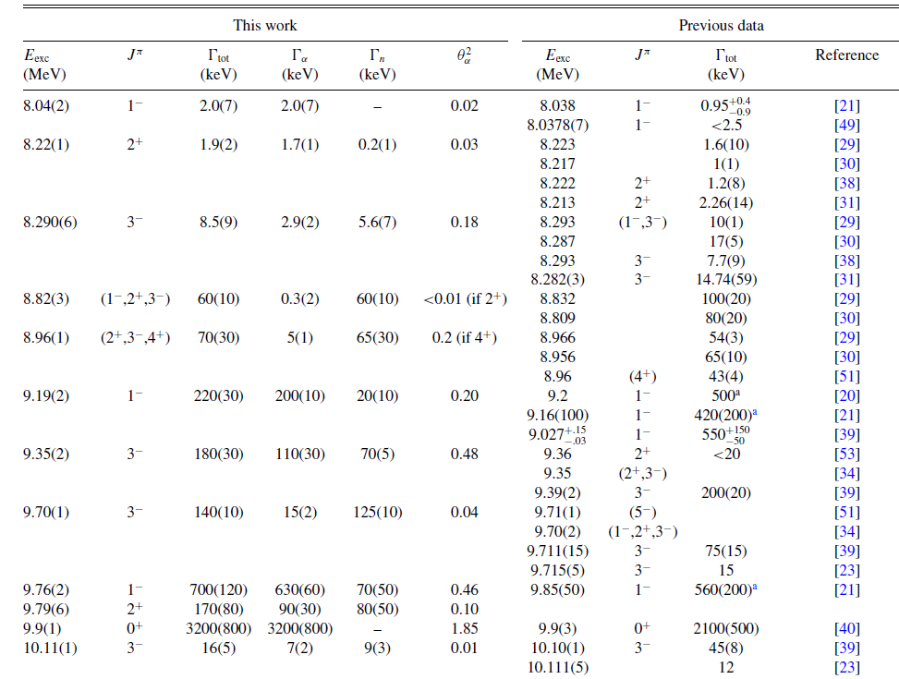
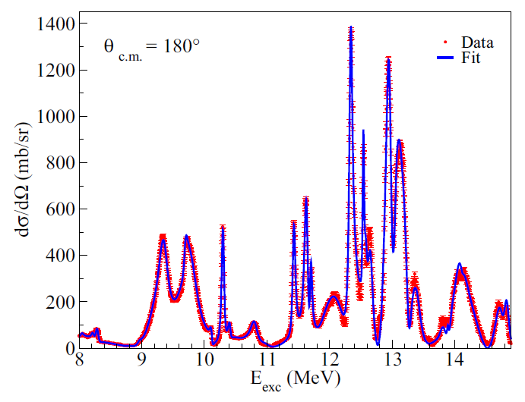
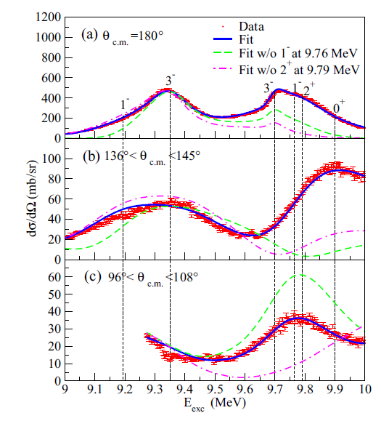
Evidencing α – clustering in light nuclei
Some signatures that α-cluster structure appears in nuclei:
3. Obs. of states with Γ_{α} close or larger respect to the Single Particle (Wigner) Limit
¹⁴C(α,α₀)
Univ. degli Studi di Napoli Federico II & INFN - Napoli
M.L. Avila et al, PRC 90 (2014) 024327
Common feature in light systems!

Slide 7
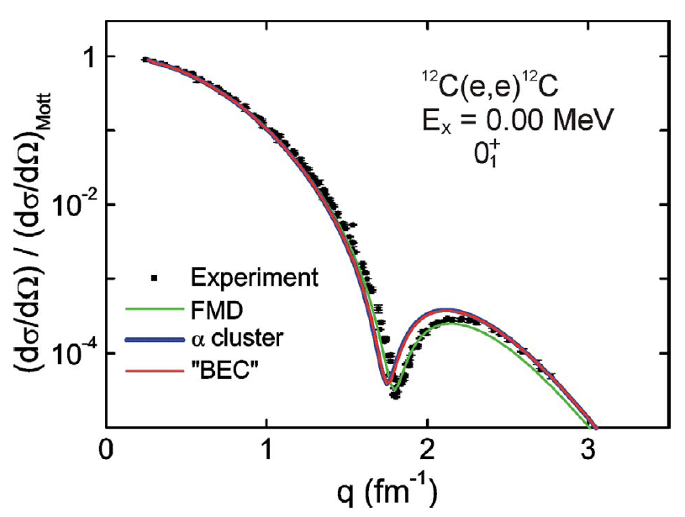
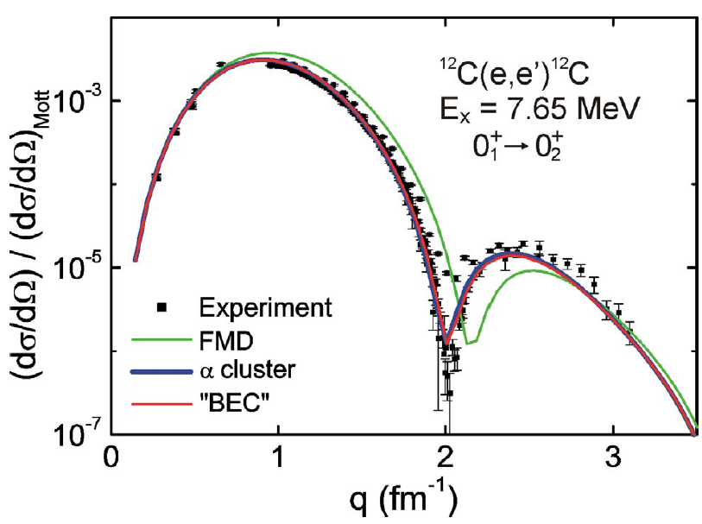
Evidencing α – clustering in light nuclei
Some signatures that α-cluster structure appears in nuclei:
4. Direct measurement of radii of GS and excited states of nuclei (e scattering)
5. Diffractional aspects of elastic scattering induced by protons (Napoli – Milano,1970)
M. Chernykh et al, PRL 98 (2007)
P. vonNeumann-Cosel , Hirschegg (2008)
Univ. degli Studi di Napoli Federico II & INFN - Napoli
6. Coulomb energy differences in Mirror Nuclei (Wildermuth – Tang)
7. Many other probes
C. Beck (ed.), Clusters in Nuclei, Springer

Slide 8
Now: at work!
How to explore the
Nuclear Cluster World
with Nuclear Reactions?
Univ. degli Studi di Napoli Federico II & INFN - Napoli

Slide 9
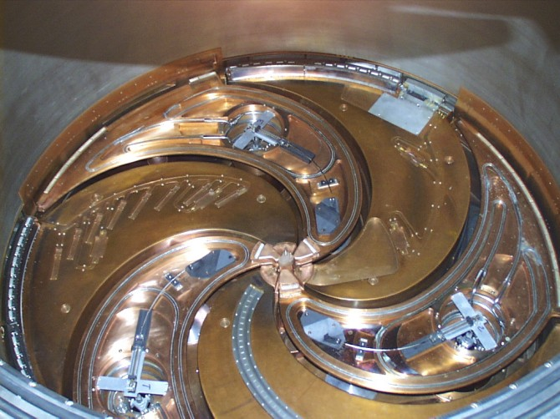
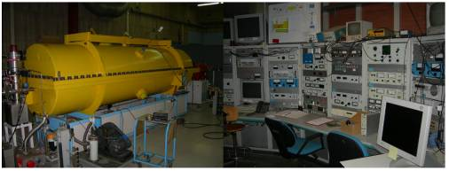
Nuclear Spectroscopy → Nuclear Reactions
Nuclear Reactions:
a + X → b + Y
1 + 2 → 3 + 4
Projectile + Target → Ejectile + Residual
X(a,b)Y
At high energies (>10 MeV): projectile + target → >2 reaction products
Univ. degli Studi di Napoli Federico II & INFN - Napoli
PROJECTILES: charged particles → accelerators
SC Cyclotron – LNS Catania
TTT-3 Tandem Accelerator, Naples
Low Energies (V_{max}= 3MV)
Excellent resolution (≈ 100 eV)
High Energies (80 A MeV)
Limited resolution (≈ 1%)
Not only stable beams → RIB!!!

Slide 10
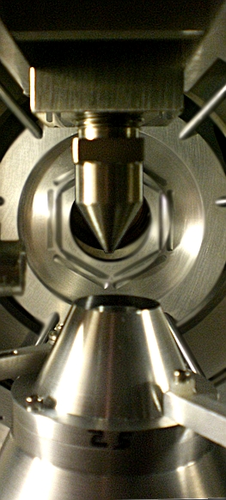
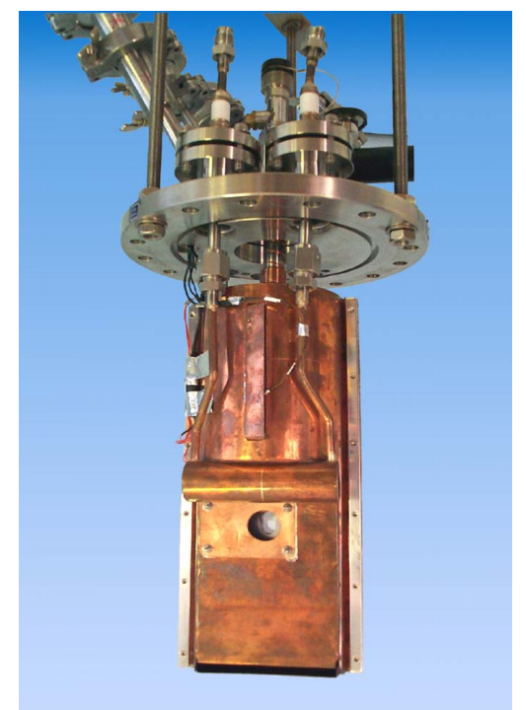
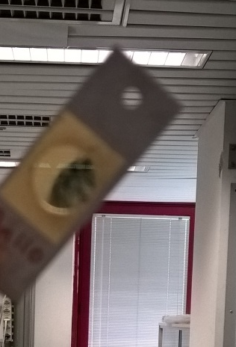
Nuclear Reactions: general instrumentation
TARGET → Solid? Gaseous? → Element!
The right isotope is needed !!!
Target thickness → compromise between energy resolution and yield
Univ. degli Studi di Napoli Federico II & INFN - Napoli
nozzle
beam
gas jet
Au 110 μg/cm²
= 57 nm !!!
pumping
GAS target
FRIB - MSU
Cryogenic H (solid) target
GANIL
(P. Dolegieviez et al, NIM A 564 (2006)
Advantages and disadvantages!

Slide 11
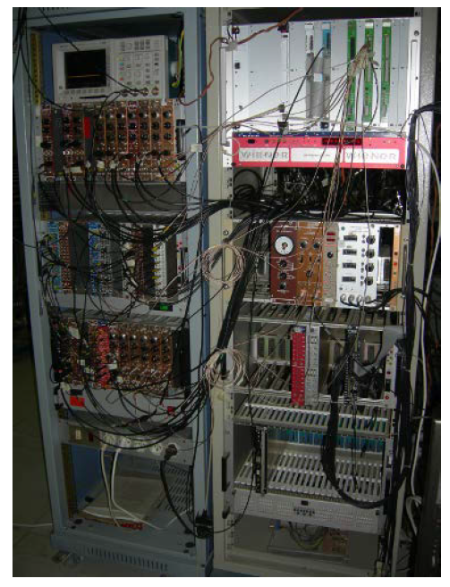
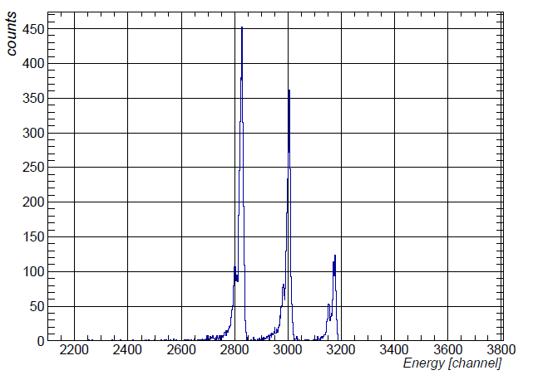
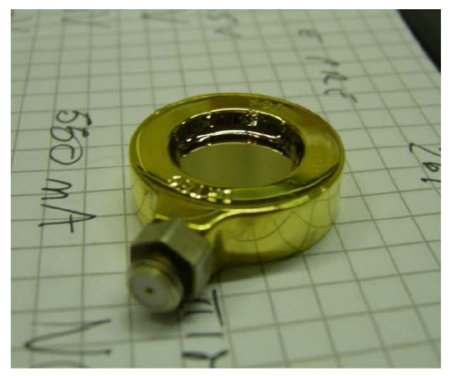
Nuclear Reactions: general instrumentation
DETECTORS → experiment !
A radiation goes inside the detector → response → electric signal → amplitude → E
Silicon detector
Acquisition
System
(ADC)
Univ. degli Studi di Napoli Federico II & INFN - Napoli
energy spectrum
Front-end
Electronics
(Analogic)
V
oscilloscope
Signal
inspection
t
Customization for each experiment!

Slide 12
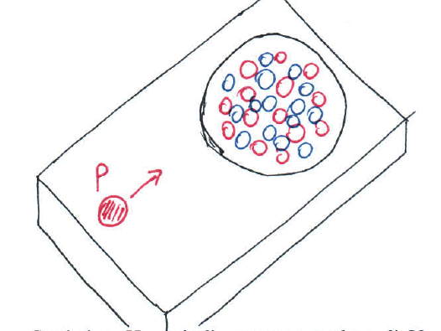
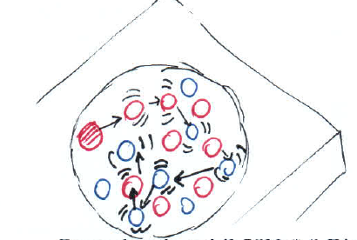
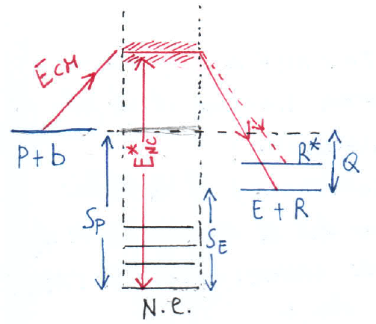
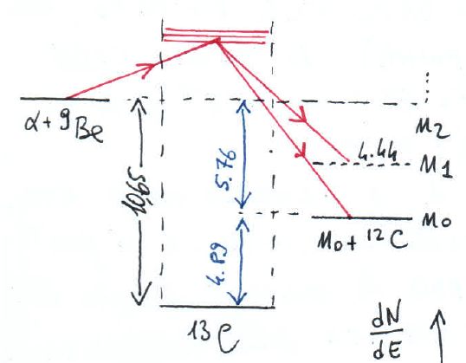

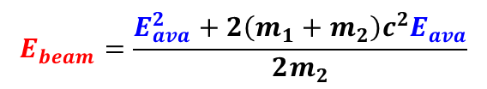


Schematic view of low energy Nuclear Reactions
At low energies → Compound Nucleus Reaction Mechanism (typical)
You can form the compound nucleus in the way you want; its decay depends solely by its structure at that given E_{x}
$$1_{}+2_{}→3_{}+4_{}$$
$$Q=\left(M_{1}+M_{2}−M_{3}−M_{4}\right)c^{2}$$
$$E_{cm}=\frac{M_{2}}{M_{1}+M_{2}}E_{beam}$$
independence hypothesis (Bohr)
W. Panoksky and M. Phillips,
Classical Electricity and Magnetism,
Cap. 17, Addison – Wesley (1962)
Univ. degli Studi di Napoli Federico II & INFN - Napoli
$$E_{beam}=\frac{E_{ava}^{2}+2\left(m_{1}+m_{2}\right)c^{2}E_{ava}}{2m_{2}}$$
Now → the tools of Nuclear Reactions

Slide 13
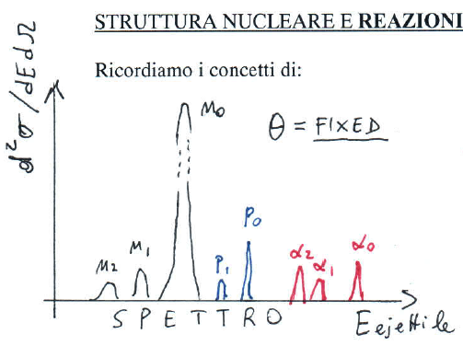
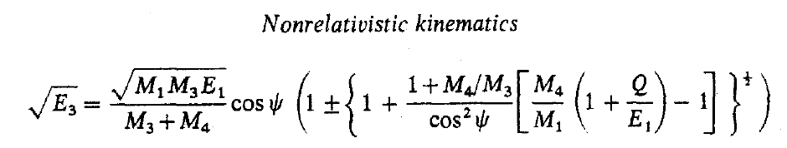
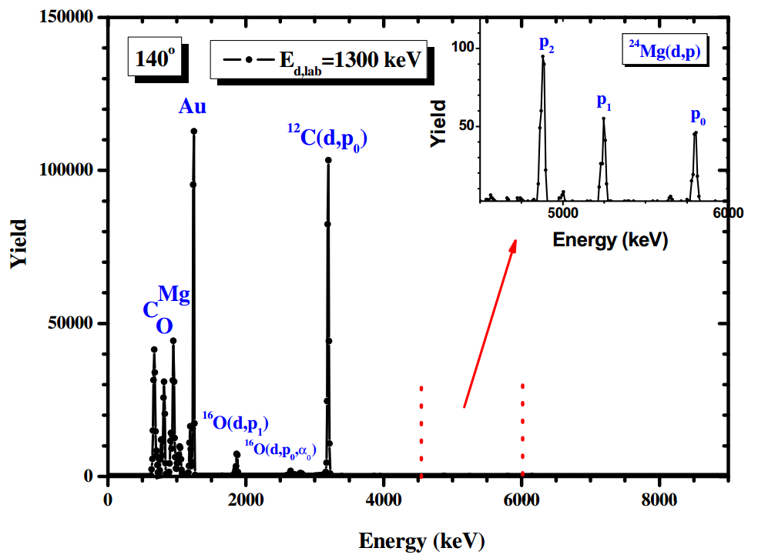
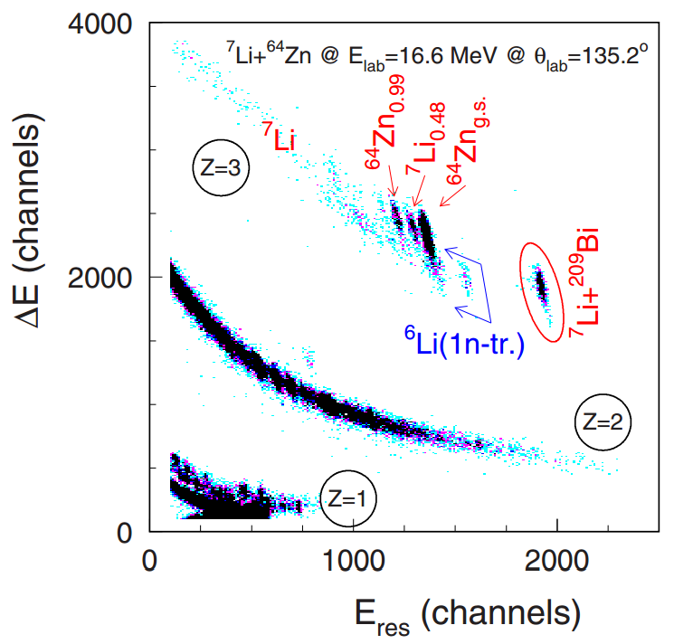
[1]: Energy Spectrum
Energy Spectrum
Histogram of energies of all particles emitted in a given nuclear reaction at a given laboratory angle θ, where we place a detector.
Useful to → identify the reaction process
Univ. degli Studi di Napoli Federico II & INFN - Napoli
ELA
J.P. Fernandez Garcia et al, PRC 92 (2015)
d + ²⁴Mg(Au)
V. Paneta et al, NIM B 319 (2014)
Particle identification → difficult at low energies

Slide 14
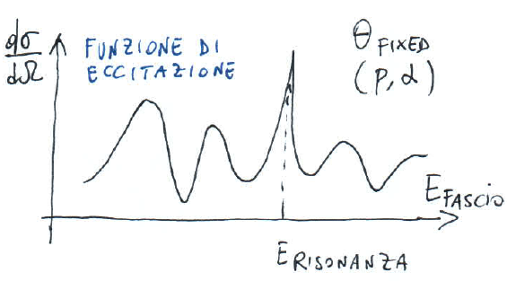
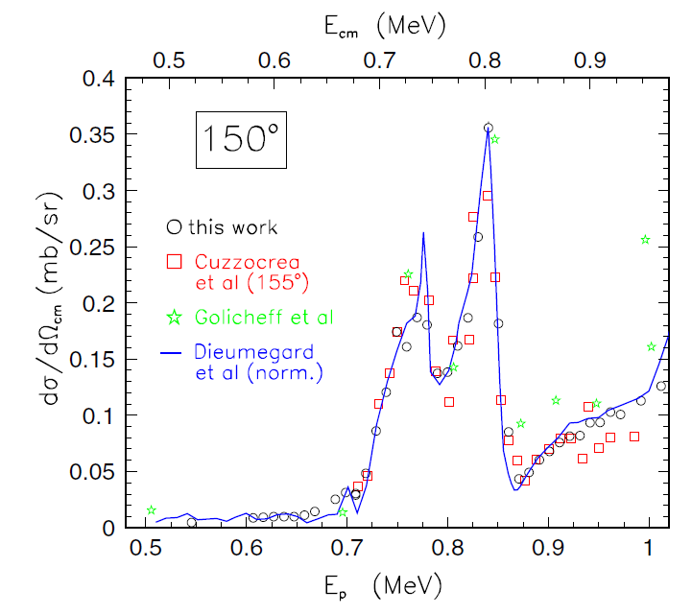
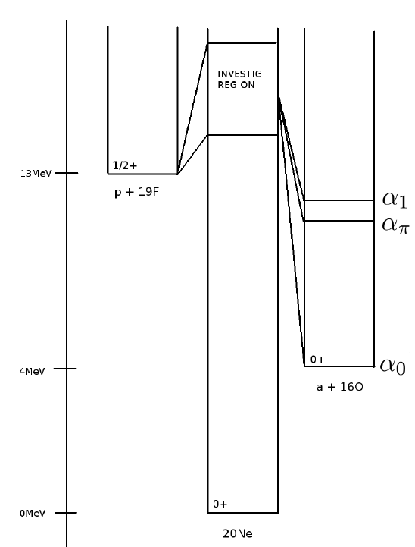
[2]: Excitation Functions
Excitation Function
Differential cross section dσ/dΩ_{cm} as a function of the beam (or the E_{CM} or the E_{x}) energy → useful to visualize the contribution given by excited states in the compound nucleus to the reaction process
E_{beam}
R – matrix analysis → E_{x}, Γ, J^{π} of states
E_{res}
Deviation from Breit-Wigner shape of resonances
→ intereference effects
p + ¹⁹F → α +¹⁶O_{gs} «¹⁹F(p,α₀)¹⁶O»
Univ. degli Studi di Napoli Federico II & INFN - Napoli
I. Lombardo et al, JPG 40 (2013)
R – matrix theory for data interpretation

Slide 15
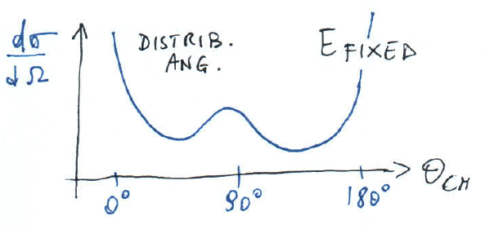
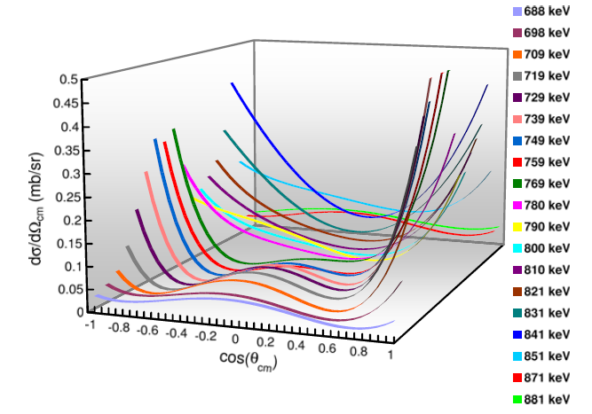
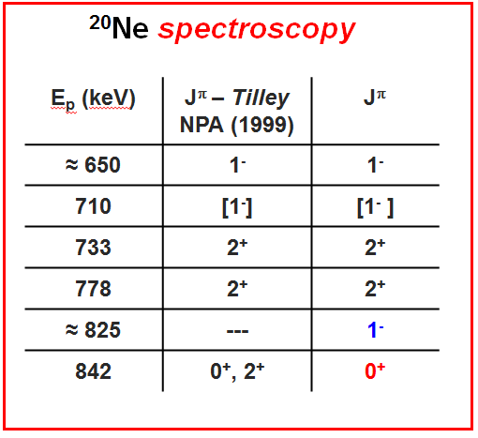
[3]: Angular Distributions
Differential cross section dσ/dΩ_{cm} measured at a fixed energy as a function of the CM angle →
useful to determine the spin of a resonant state
Nuclear Reaction Theory → Legendre/Cosine Polynomial expansion (even terms)
Odd terms → interference between opposite – parity close lying states
p + ¹⁹F →²⁰Ne* → α +¹⁶O_{gs}
Univ. degli Studi di Napoli Federico II & INFN - Napoli
I. Lombardo et al, JPG 40 (2013)
R – matrix theory for data interpretation

Slide 16
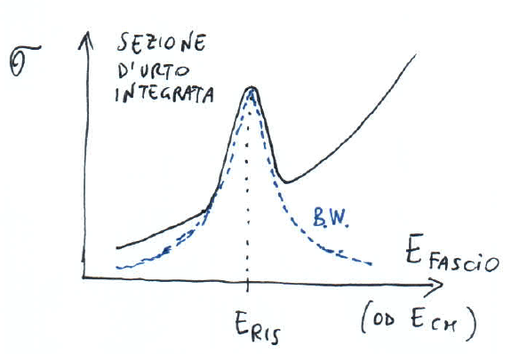
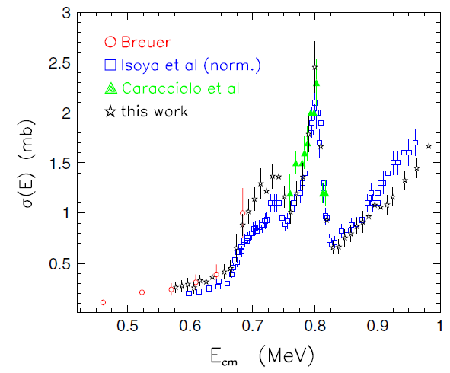
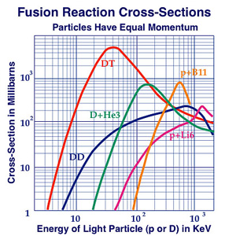
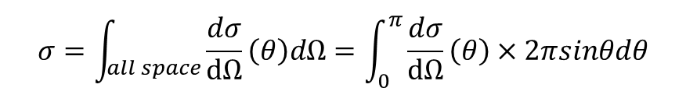
[4]: Integrated Cross Section
From available experimental angular distributions:
$$σ=\int_{\begin{aligned}all space \\ \end{aligned}}{\frac{dσ}{dΩ}\left(θ\right)dΩ}=\int_{0}^{π}{\frac{dσ}{dΩ}\left(θ\right)×2πsinθdθ}$$
Very useful to determine the partial decay widths Γ_{i}
Applied physics → overall yield of reaction products
Nuclear Astrophysics → reaction rate !
Resonances → BW shapes (NOT in the case of two close resonances with same J^{π} values → interference)
p + ¹⁹F →²⁰Ne* → α +¹⁶O_{gs}
Univ. degli Studi di Napoli Federico II & INFN - Napoli
I. Lombardo et al, JPG 40 (2013)
R – matrix theory for data interpretation

Slide 17
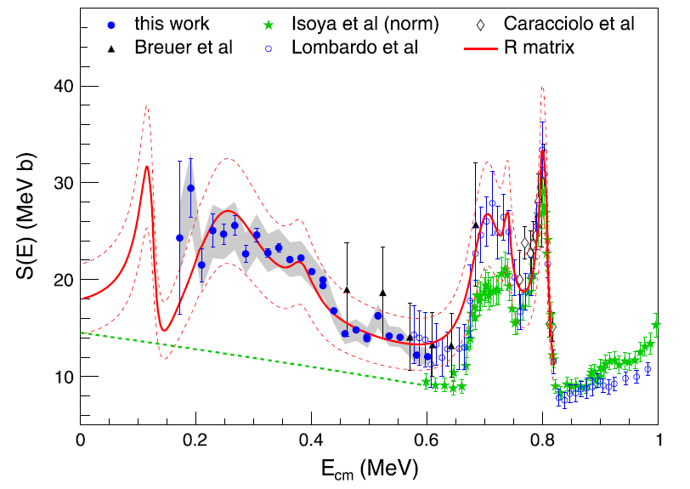
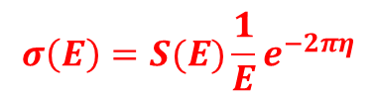

[5]: Astrophysical S-factor
resonance
Sub-Coulomb energies → Astrophysics and Fusion
X-sect. → suppressed by the barrier transparency
Typically: exoergic reactions (Q>0)
BW formula → not more a Lorentzian: Γ_{a}(E)
σ(E)
LOGARITMIC SCALE
non-resonant
$$σ\left(E\right)=\frac{λ^{2}}{4π}\frac{2J+1}{\left(2J_{1}+1\right)\left(2J_{2}+1\right)}(1+δ_{12})\frac{Γ_{a}{\left(E\right) Γ}_{b}}{{(E−E_{R})}^{2}+{Γ^{2}}/4}$$
direct measurements
Astrophysical Factor S(E):
⇓
2⁺
Univ. degli Studi di Napoli Federico II & INFN - Napoli
$$σ\left(E\right)=S(E)\frac{1}{E}e^{−2πη}$$
E₀
E_{coul}
extrapolation
2⁺
S(E)
direct measurement
I. Lombardo et al, Phys. Lett. B 748 (2015)
THM
low-energy tail
of broad resonance
sub-threshold resonance
non resonant
process
p + ¹⁹F →²⁰Ne* → α +¹⁶O_{gs}
-E_{r}
0
E_{r}
interaction energy E
NACRE and NACRE2 → databases

Slide 18
Examples of (some) best suited
Nuclear Reactions
for Nuclear Cluster studies
Univ. degli Studi di Napoli Federico II & INFN - Napoli

Slide 19
Resonant Elastic Scattering – 1
1 – Resonant elastic scattering with α-particles (direct and inverse kinematics):
Compound nucleus states characterized by pronounced large α-width
Simultaneous analysis of scattering and reaction channels → Γ_{α} → γ²_{α}
Direct kinematics
(old style)
Inverse kinematics
(K.P. Artemov et al)
Univ. degli Studi di Napoli Federico II & INFN - Napoli
⁴He⁺⁺
beam
detector
target
⁴He gas
Pros: excellent energy resolution (VdG, tandem…)
Angular Distributions → Simple to be obtained
Pros: short time exp. Excitation Function → one shot
Radioactive ion beams → can be used!
Cons: α-beams → not easy
Excitation function → HUNDREDS of energy changes
Cons: stopping power in the gas!
Angular distributions → complex apparatus!
Very complex detectors → ANASEN @ FSU

Slide 20
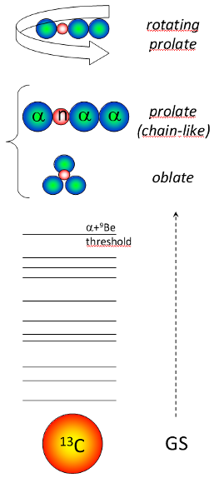
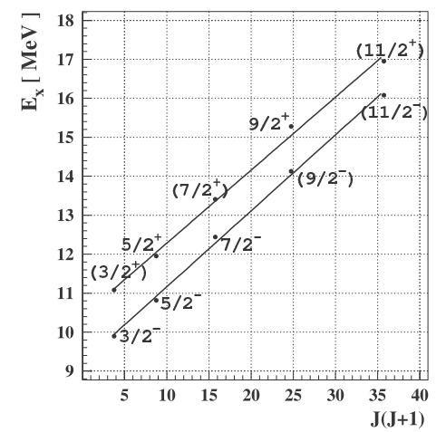
Resonant Elastic Scattering – 2
Operative example: α + ⁹Be elastic scattering for the structure of ¹³C
Proposed J^{π} assignment based on the possible existence of rotational bands of molecular-like
α-states.
Univ. degli Studi di Napoli Federico II & INFN - Napoli
M.Milin, W.vonOertzen, EPJA 14 (2002)

Slide 21
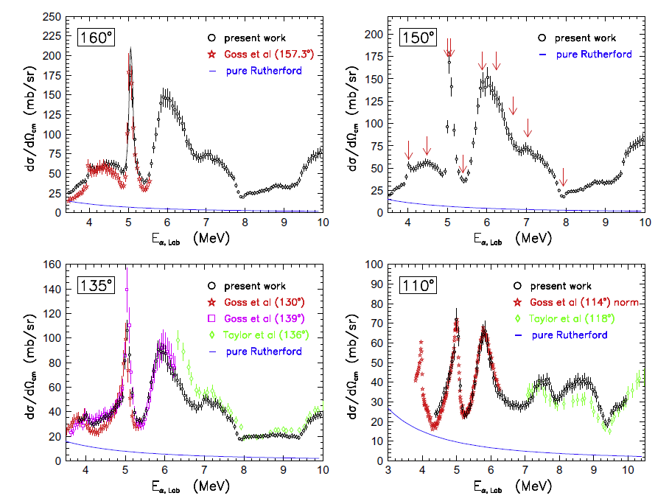
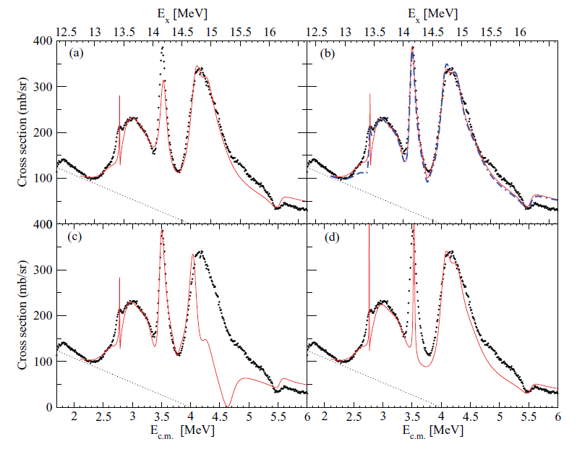
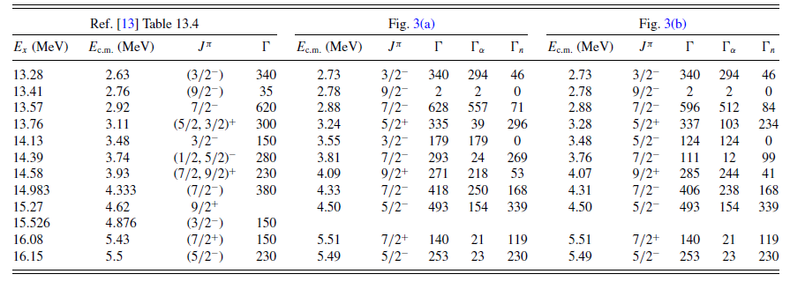
Resonant Elastic Scattering – 3
α + ⁹Be elastic scattering for the structure of ¹³C
M. Freer et al, PRC 84 (2011)
Univ. degli Studi di Napoli Federico II & INFN - Napoli
~180°
I. Lombardo et al, NIM B 302 (2013)
Work in progress

Slide 22
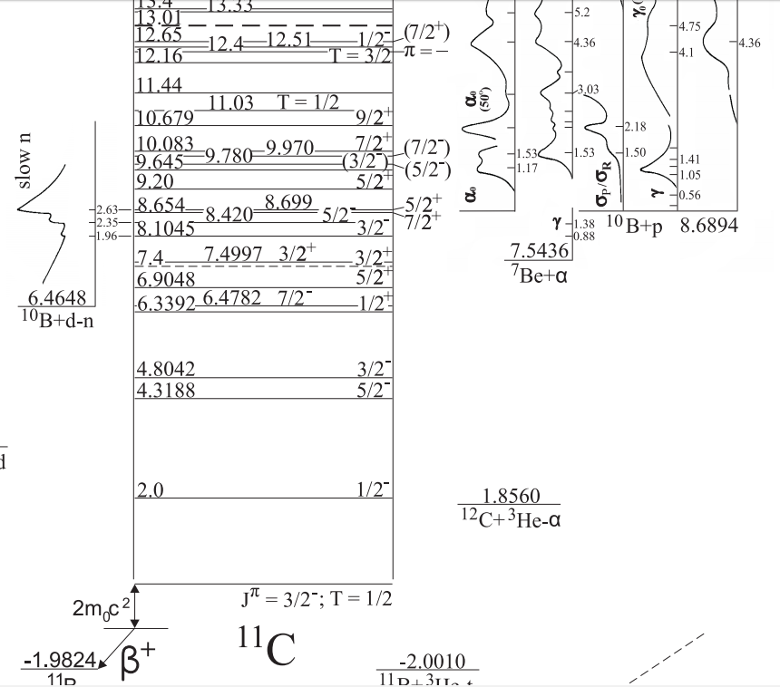
Compound Nucleus Reactions – 1
Compound nucleus (low energy) nuclear reactions: (p,α), (n,α), (d,α) etc.
Operative example: ¹⁰B(p,α) ⁷Be nuclear reaction:
Structure of the compound nucleus, ¹¹C (clustering, IAS …)
Astrophysical importance → ¹⁰B destruction in stars
Applied physics context → a-neutronic fusion
Univ. degli Studi di Napoli Federico II & INFN - Napoli
8.69
α₁
p+¹⁰B
3⁺
γ
α₀
0.429 1/2⁻
7.54
GS 3/2⁻
α+⁷Be
0
E_{x}
_{(MeV)}
¹¹C
Several tentative J^{π} values

Slide 23



Compound Nucleus Reactions – 2
¹¹C spectroscopy → R – matrix fit of several reaction channels (AZURE2)
Univ. degli Studi di Napoli Federico II & INFN - Napoli
10.1 (5/2⁺)
Chiari
Chiari
9.820
(1/2⁺)
9.36 (5/2⁻)
Cronin
9.183
7/2⁺
I. Lombardo et al, J. Phys. G 43 (2016)

Slide 24



Analysis of ejectile energy in Nuclear Reactions
In a Nuclear Reaction, we can have 1 + 2 → 3 + 4*
If 4 is a cluster – interesting nucleus → spectroscopy via outgoing channel analysis
Operative example 1: ¹²C(p,p’)¹²C*
Operative example 2: ¹⁴N(d,α)¹²C*
M. Freer et al, PRC 86 (2012)
Univ. degli Studi di Napoli Federico II & INFN - Napoli
I. Lombardo et al, in preparation
very preliminary
Discovery of 0⁺, 2⁺ … excited states of ¹²C

Slide 25





α – transfer (direct) reactions
Some light nuclei [⁶Li, ⁷Li] → very low α-separation threshold (1.47 – 2.47 MeV) → pronounced α+d and α+t structure → well suited for direct α-transfer reactions
¹²C(⁶Li,d)¹⁶O*
A. Cunsolo et al, PRC 18 (1978)
A. Cunsolo et al, PRC 21 (1980)
$$\vec{J}=\vec{J_{α}}+\vec{J_{12C}}+\vec{l_{α}}=\vec{l_{α}}$$
$π={\left(−1\right)}^{l_{a}}$ natural parity states
¹²C(⁶Li,d)¹⁶O*→α+¹²C (angular correlations)
Univ. degli Studi di Napoli Federico II & INFN - Napoli
HF
DWBA
Fantastic tool → Magn. Spect. + Si array

Slide 26





Sequential break – up into clusters
At intermediate energies (20-200 A.MeV) and with RIB → projectile inelastic scattering (or multi-nucleon transfer) → QP * → cluster decay via particle correlations
From energy and momentum conservation (classical view) → relative energy E_{rel} →
E_{x} = E_{rel} + E_{th}
(primary process)
φ
$$E_{rel}=\frac{M_{LI}{×E}_{HI}}{M_{LI}+M_{HI}}+\frac{M_{HI}{×E}_{LI}}{M_{LI}+M_{HI}}−\frac{2\sqrt{M_{LI}M_{HI}E_{LI}E_{HI}}\cos{φ}}{M_{LI}+M_{HI}}$$
Relativistic analysis → quadrimomenta p_{μ}
Univ. degli Studi di Napoli Federico II & INFN - Napoli
$$M_{inv}=\sqrt{\left({p^{μ}}_{HI}^{}+{p^{μ}}_{LI}^{}\right)\left(p_{μ HI}^{}+p_{μ LI}^{}\right)}$$
S. Marsh and W.D.M. Rae, Phys. Lett. B 153, 21 (1985)
J. Van Driel, S. Gonggrijp, R.V.F. Janssens, R.H. Siemssen,
K. Siwek-Wilczynska and J. Wilczynski, Phys. Lett. B 98 (1981)
¹⁴N+¹⁵⁹Tb ≈ 150 MeV
Very useful tool to make spectroscopy!

Slide 27


Correlations: a tool for spectroscopy
In Flight beams → short living RI → inelastic scattering or reactions on targets followed by break-up → cluster decay of nuclei → correlations (high energy and angular resolution)
Univ. degli Studi di Napoli Federico II & INFN - Napoli
R. Charity et al, PRC 78 (2008)
counts
Indra
INDRA data [¹²C+²⁴Mg@53 AMeV]
F. Grenier et al, NPA 811 (2008)
E_{k} (MeV)
An operative example: Unstable@LNS

Slide 28



The CHIMERA 4π multi-detector
CHIMERA (Charged Heavy Ion Mass Energy Resolving Array) [1,2]
[1] A. Pagano, Nucl. Phys. News 22, 25 (2012)
[2] A. Pagano et al., Nucl. Phys. A 734, 504 (2004)
1192 ΔE-E telescopes ($\sim 300μm$Si + CsI(Tl) scintillator);
9 forward rings ($1^{°}≤θ≤{30}^{°}$);
17 rings arranged in a sphere (${30}^{°}<θ≤{176}^{°}$);
First 3 forward rings→144 telescopes ($1^{°}≤θ≤7^{°}$) complete azimuthal coverage→ ΔE-E identification technique.
Univ. degli Studi di Napoli Federico II & INFN - Napoli
Good ⁴He – ⁶He separation;
beryllium line mainly dominated by ¹⁰Be
Target: polyethylene (CH₂ 50 μm)
Some runs on CD₂ (28 μm)
ΔE-E identification → good isotopic separation

Slide 29






FRIBs Facility @ LNS
Istituto Nazionale di Fisica Nucleare
LNS - Laboratori Nazionali del Sud
primary beam
spectator zone
exotic nucleus
production target
participant zone
[1] I. Lombardo et al., Nuc. Phys. B 215, 272 (2011).
Beam production→IFF (In Flight Fragmentation) technique → FRIBs (Flight Radioactive Ion Beams) facility @ INFN-LNS:
¹⁸O⁷⁺ at $56 MeV/u$ (superconducting cyclotron K800);
⁹Be ($1.5 mm$ thickness) production target;
LNS-FRS (Fragment-Recoil Separator) $Bρ≈2,8Tm$;
Univ. degli Studi di Napoli Federico II & INFN - Napoli
Tagging system [1] (particle by particle identification):
MCP large area detector;
DSSSD position sensitive detector ($≈13m$ after);
Identification (ΔE-ToF) plot FRIBs cocktail beam → good performances.
Quite high exotic beams intensity:
¹⁶C ($49.5 MeV/u$) ${10}^{5} pps$;
¹³B ($49.5 MeV/u$) ${5×10}^{4} pps$;
¹⁰Be ($56.0 MeV/u$) ${4×10}^{4} pps$;
Complete cocktail beam identification

Slide 30


Check on self-conjugated nuclei
Starting check → correlations between helium break-up fragments from self-conjugated nuclei
2α correlations → the ⁸Be spectroscopy:
Experimental data
MonteCarlo simulation
MonteCarlo simulation → good agreement with the experimental data for the 91.8 keV peak (⁸Be_{gs}) → good consistency of the procedure.
⁹Be 2.43 MeV (5/2⁻)
3.03 MeV (2⁺)
Possible contaminations of ⁹Be neutron decay → ghost peaks
3α correlations → the ¹²C spectroscopy:
Univ. degli Studi di Napoli Federico II & INFN - Napoli
⁸Be_{gs} (0⁺)
3 body correlations → good agreement with ¹²C known state in the literature
Good test for the experimental technique

Slide 31



⁶He+⁴He channel: the ¹⁰Be structure
Angular correlation analysis → take into account the
ψ opening angle of fragments, corrected by the
θ_{cm} recoil angle of the decaing source
[Marsh and Rae PLB 153 (1985)]
Test on the 11.8 MeV state → (4⁺)
13.5 MeV state→ (6⁺)
agreement with RES data ⁶He+⁴He
GS rotational band
K^{π}=0⁺ molecular band
K^{π}=1⁻ rotational band
Univ. degli Studi di Napoli Federico II & INFN - Napoli
Ref. [1]
6⁺ 13.5 MeV
Possible 6⁺ further member of the K=0⁺ molecular band → low statistics → new experiments are needed.
[1] G. Rogachev et al., J. Phys.: Conf. Ser. 569, 012004 (2014)
D. Dell’Aquila et al, Phys. Rev. C (2016) in press

Slide 32



⁶He-¹⁰Be coincidences: the ¹⁶C structure
¹⁶C two-body disintegration → ⁶He+¹⁰Be break-up channel → low statistics data.
Experimental data
Ref. [1]
Ref. [2]
Efficiency ¹H target
Efficiency ¹²C target
Enhancement at about 20.6 MeV → possible agreement with previous low statistics exp. [1][2]→ more statistics required to confirm the suggestion.
Univ. degli Studi di Napoli Federico II & INFN - Napoli
$$≈21 MeV$$
Ref. [3]
[1] N. I. Ashwood et al., Phys. Rev. C 70, 0644607 (2004)
[2] P.J. Leask et al., Jour. Phys. G: Nucl. Part. Phys. 27, B9 (2001)
[3] T. Baba, Y. Chiba and M. Kimura , Phys. Rev. C 90, 064319 (2014)
D. Dell’Aquila et al, Phys. Rev. C (2016) in press

Slide 33
Summary
Cluster Structure of Light Nuclei → Few – body effects of nuclear forces
α – clustering in Nuclei → Nuclear Spectroscopy data
Nuclear Spectroscopy → Nuclear Reactions (and β-decay, photoreactions…)
Signatures of α – clustering in light nuclei:
- rotational bands and moment of inertia;
- sequence of levels due to special symmetries;
- reduced partial width near to Wigner Limit;
- form factor in e – scattering;
- etc…
Fundamentals of Experimental Nuclear Reaction Physics
Low energy Nuclear Reaction → useful to do Spectroscopy
Spectra, Excitation Functions, Angular Distributions, Cross Section, S-factor
Nuclear Reactions and clustering:
- Elastic Resonant Scattering of α particles
- Compound Nucleus Reactions
- Ejectile Energy Analysis
- α-transfer: AD and AC
- Sequential Break-up in clusters
9. Example: ¹⁰Be and ¹⁶C studies at LNS – INFN with FRIBS
Univ. degli Studi di Napoli Federico II & INFN - Napoli
Thank you for your attention!

