Slide 1



The GGI
Alberto Lerda, Firenze, May 17, 2016

Slide 2
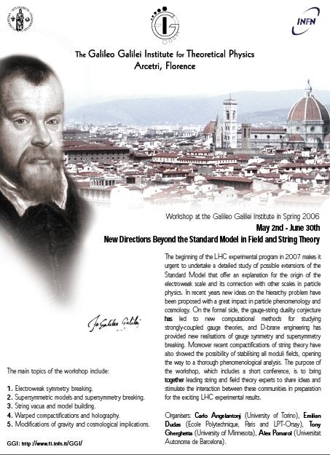
1° workshop (May-June 2006)

Slide 3
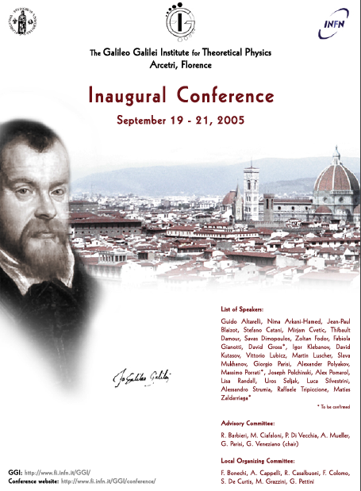
Inaugural Conference (September 2005)
1° workshop (May-June 2006)

Slide 4
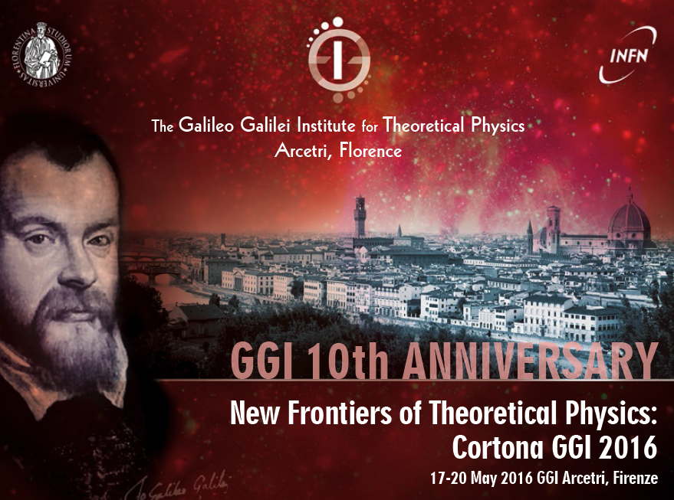

Slide 5
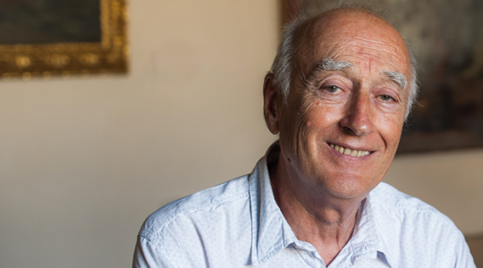
Pino Marchesini (‡ 20.04.2016)

Slide 6
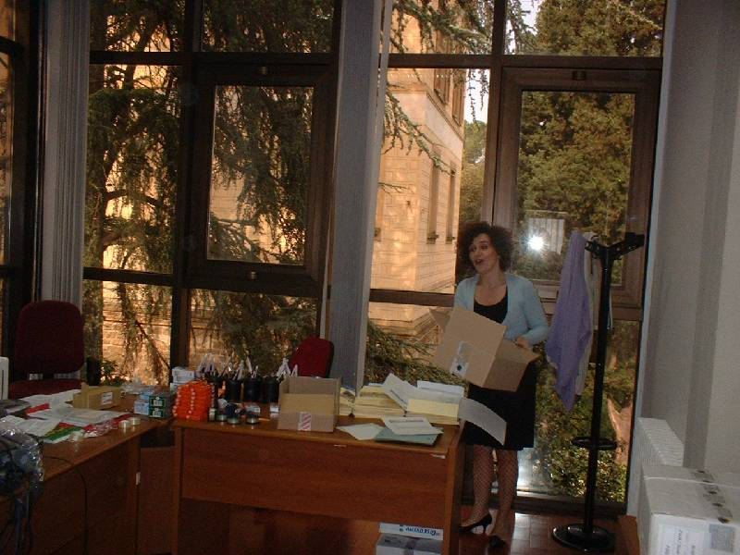
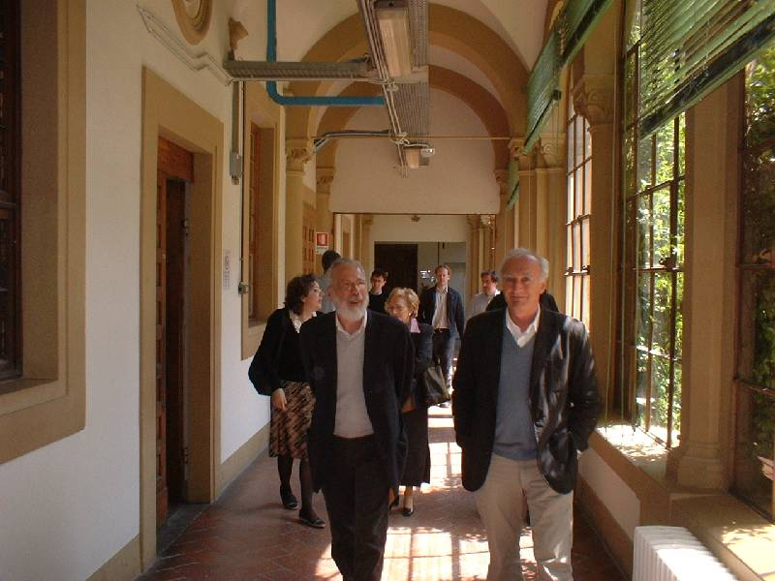
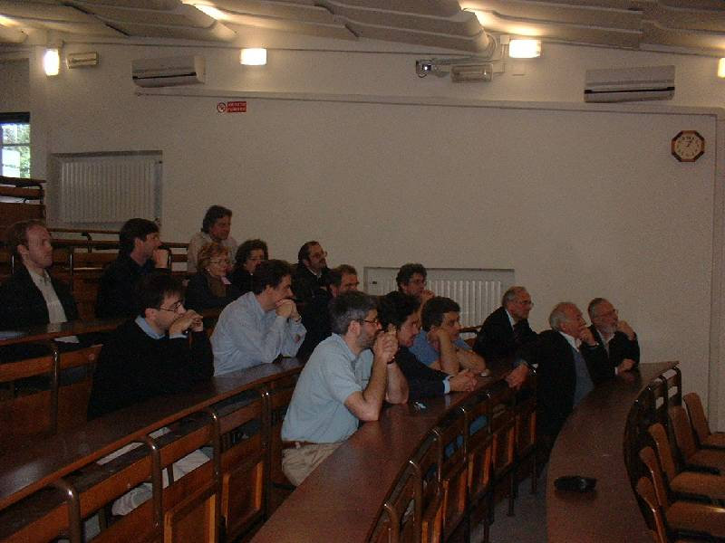
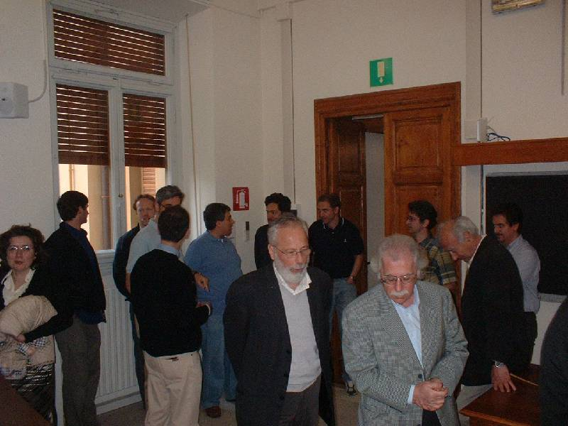

Slide 7
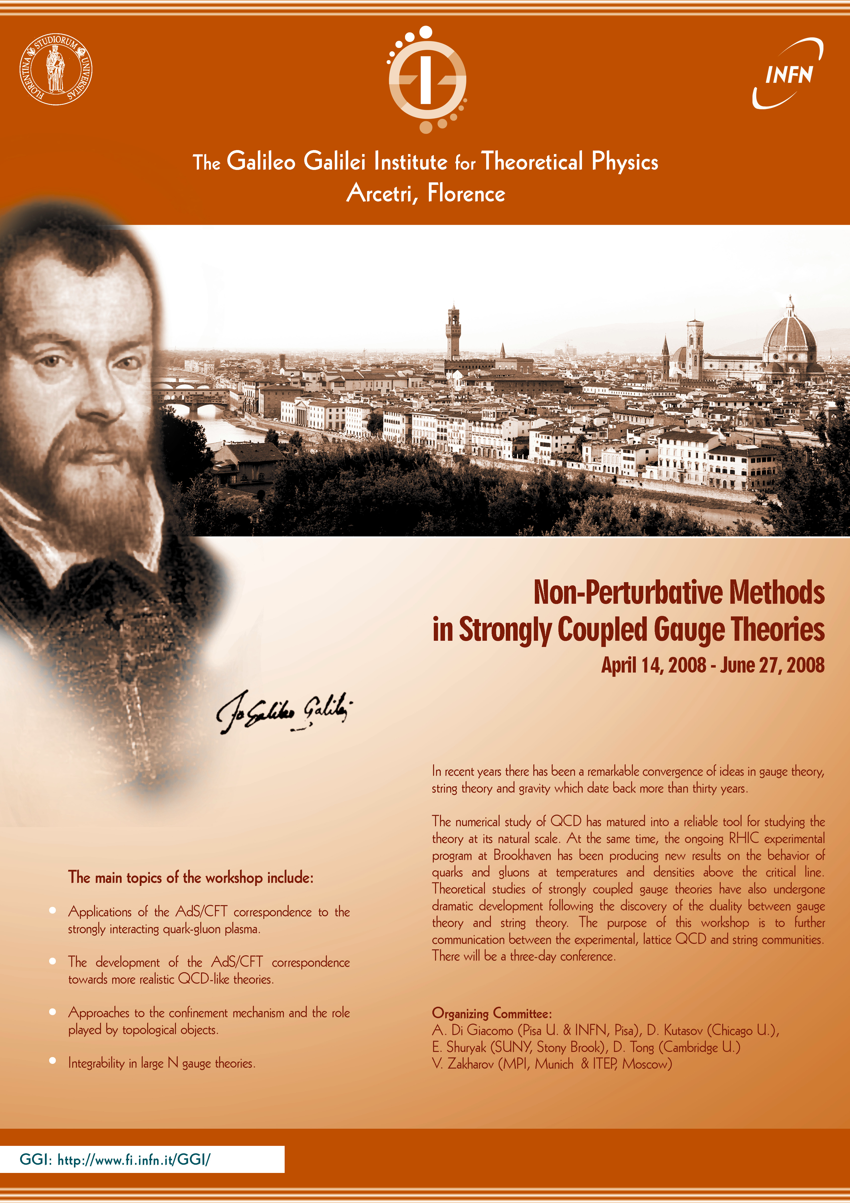
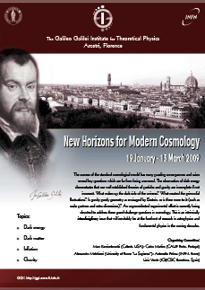
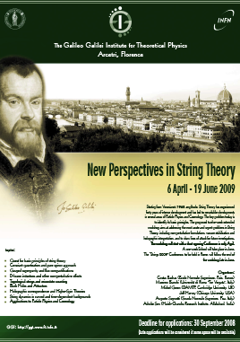
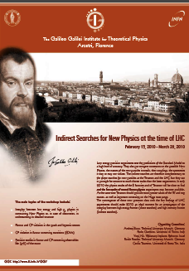
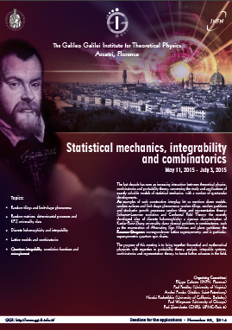
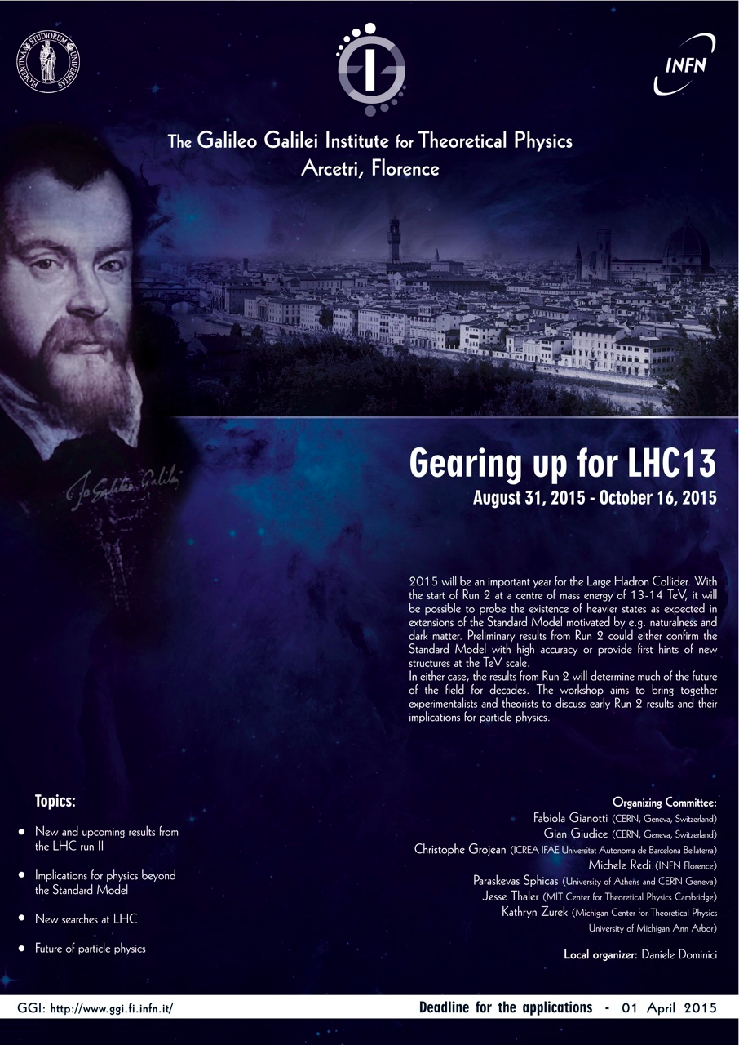
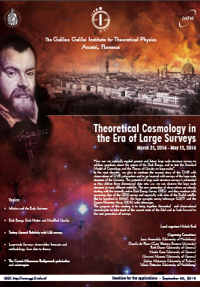
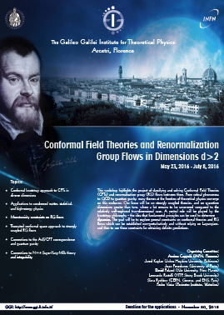
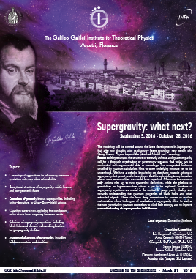
30 extended workshops with more than 3500 participants

Slide 8
Marchesini

Slide 9


Last year, we obtained a significant grant from the Simons Foundation to support “eminent scientists attending the GGI workshops” (GGI-Simons fellows)
Since a few years we have a program of schools for Ph.D. students

Slide 10
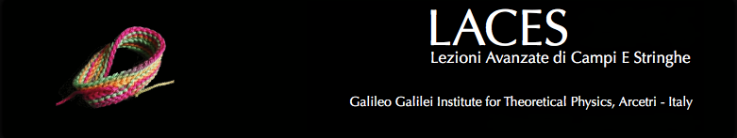
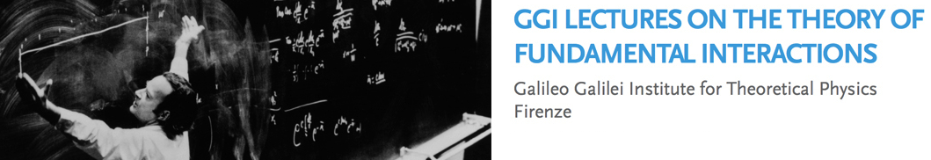



Slide 11
Special thanks to:
    The Directors of the INFN Florence section: E. Iacopini, P. Mandò and O. Adriani
    The GGI Secretaries and staff: A. Pagliai, M. Pazzaglia, A. Orlando, A. Annichini, M. Morandini, R. Baglioni
    Colleagues from Physics Department and INFN section of Florence, in particular the INFN coordinators D. Seminara and S. de Curtis
    The deputy coordinators of GGI: R. Casalbuoni and D. Dominici
    The Scientific and Advisory committees, and in primis G. Martinelli and G. Veneziano
    The INFN Executive Board and INFN Presidents: R. Petronzio and F. Ferroni
Since a few years we have a program of schools for Ph.D. students

Slide 12
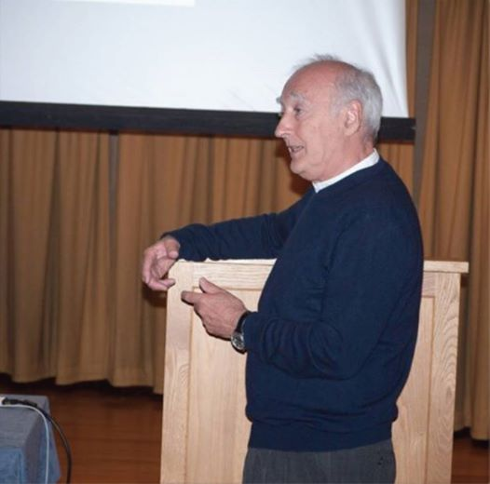
Thank you Pino !!

