Slide 1




The steps to the GGI realization
Roberto Casalbuoni
Dipartimento di Fisica e Astronomia, Sezione INFN,
Istituto G. Galilei per la Fisica Teorica (GGI),
Terza Cultura
Firenze - casalbuoni@fi.infn.it

Slide 2
First steps

Slide 3
1996 First idea by Marcello Ciafaloni and Giorgio Longhi: an institute in Arcetri of the type of the KITP in S. Barbara, putting together the 3 Tuscan Universities
The attempt failed
2003 Pino Marchesini became President of the National Theory Group of the INFN. Pino knew the idea from Marcello and conctacted Florence.

Slide 4
We agreed with the idea and we got a preliminary green light from the Rettore of UNIFI and Roberto Petronzio (member of the Executive Committee of the INFN), and from the National Theory Committee of INFN
January 2004 Pino promoted a small meeting in Genova with Carlo Becchi (former President of the INFN Theory Group), Riccardo Barbieri, Enrico Onofri and myself. General agreement with some worries about the long run
Decision about an International Launch Committee in order to obtain an independent opinion

Slide 5
The Launch Committee was composed by: David Gross, Giuseppe Marchesini, Alfred Mueller, Giorgio Parisi and Gabriele Veneziano (chair). The opinion of the Committee was positive
The idea was that INFN should provide the budget and the administrative staff, whereas UNIFI the building and one person for the computing services and assistance
The approval came in May 2004 by UNIFI and in July 2004 by INFN. The agreement between the two parties was signed in November 2004.

Slide 6
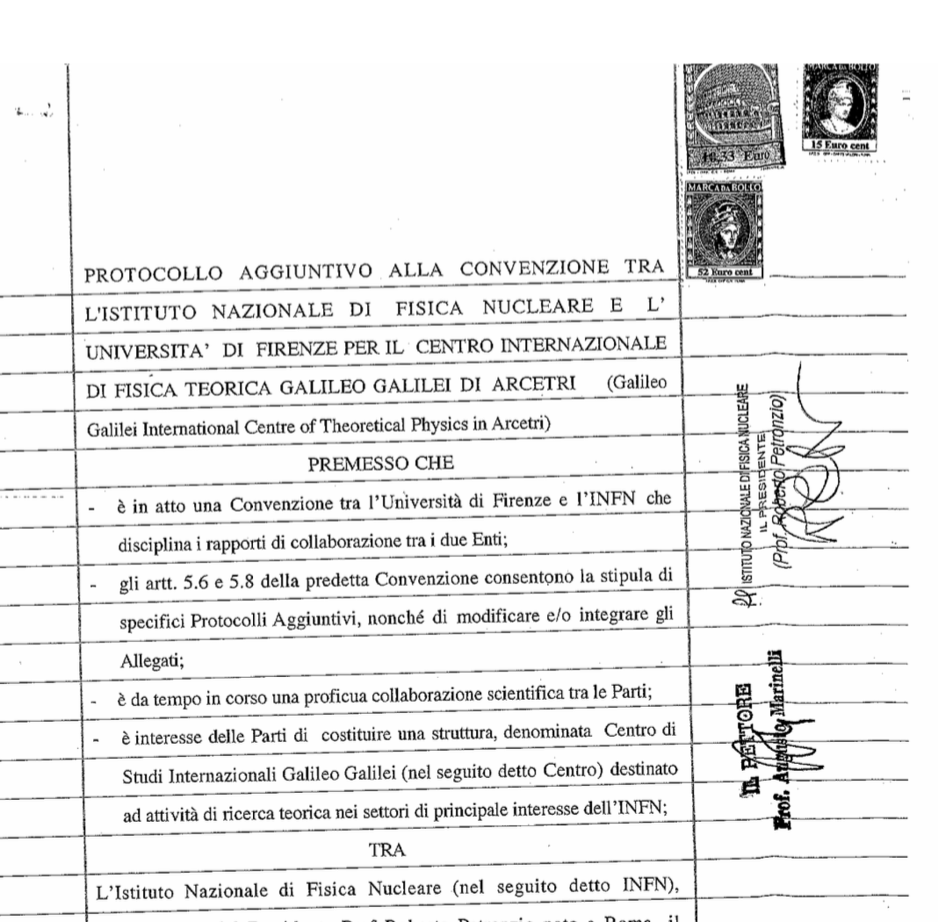
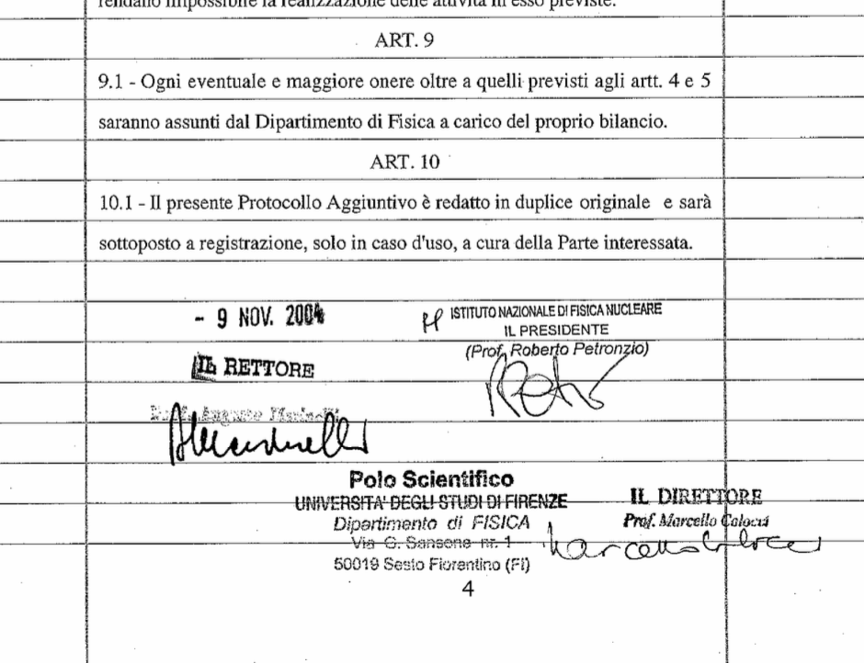
The GGI agreement between INFN and UNIFI, signed on November 9, 2004, by Augusto Marinelli (UNIFI rettore) and Roberto Petronzio (INFN President)

Slide 7
Inaugural Conference in September 2005 and the first Workshop in 2006
In March 2005, I spent two weeks at the KITP where David Gross and Martin Einhorn taught me all the tips and tricks to run the GGI
In Summer of 2005 the room A was renewed and furnished with screens, projectors etc. And we started the necessary actions to rebuild the area dedicated to the GGI

Slide 8
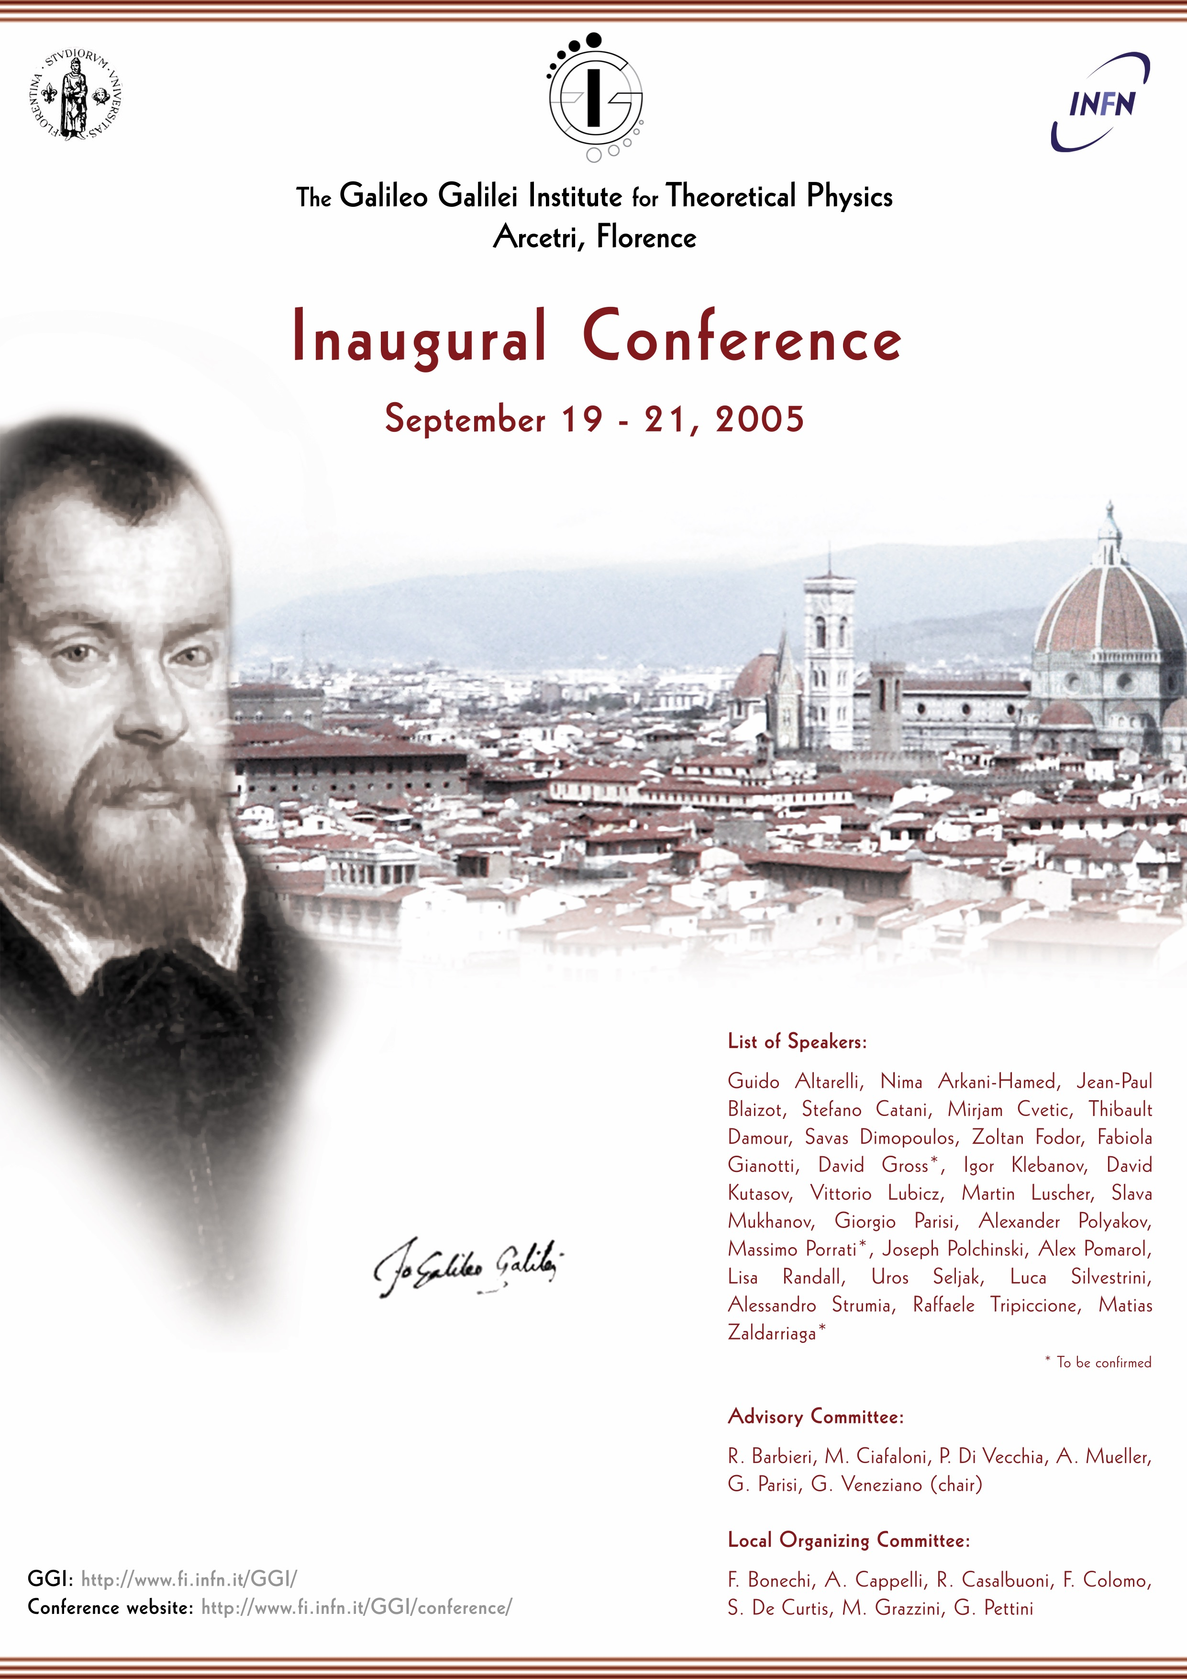
The inaugural Conference took place on September 19-21-2015.

Slide 9
After the conference, the renewal works started on October 2005 and ended on April 30, 2006
The first GGI Worksop: “New Directions Beyond the Standard Model in Field and String Theory” started on May 2, 2006, two days later

Slide 10
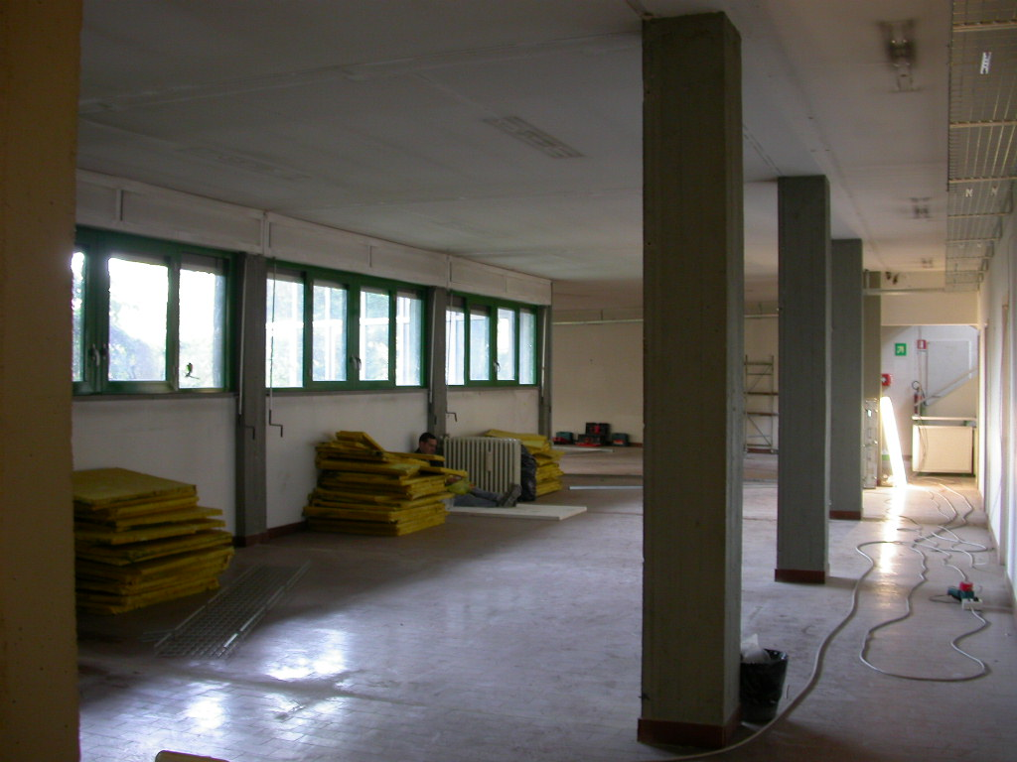
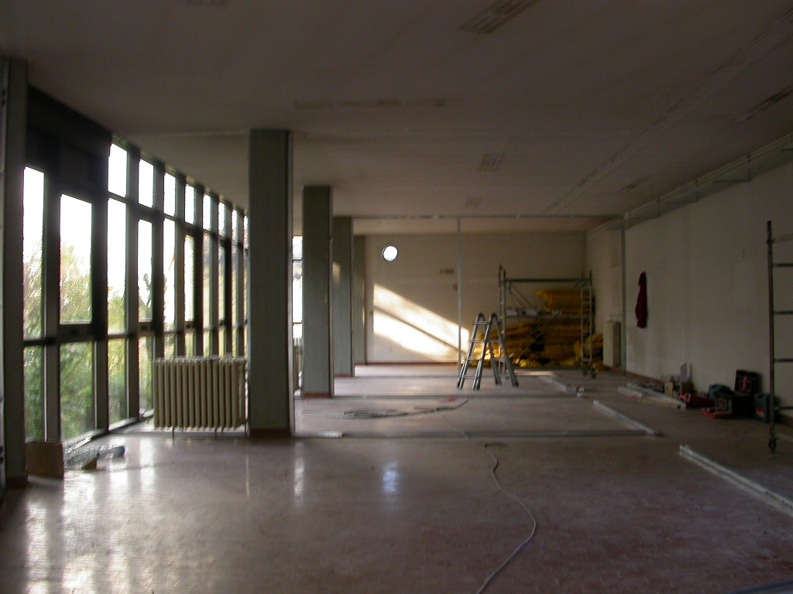
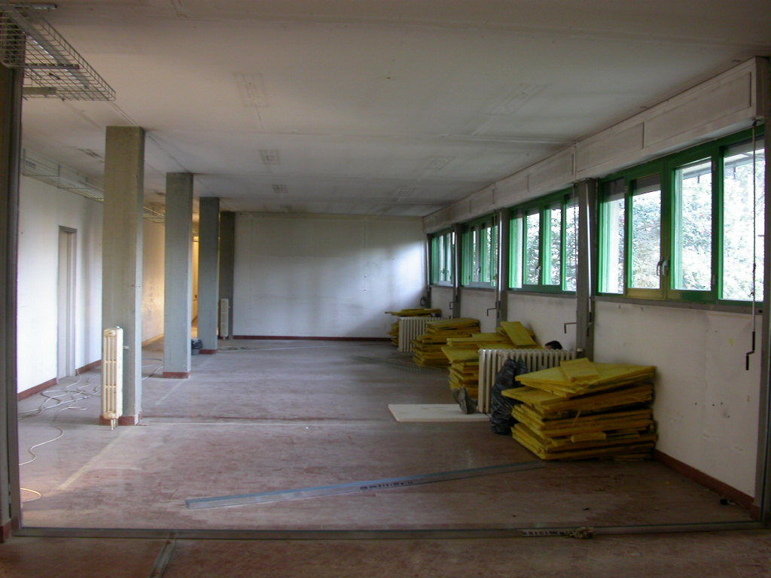
Both INFN and UNIFI contributed to the cost of the re-building

Slide 11
Two Committees: the Advisory to define the general policy of the GGI, the Scientific to select the workshop proposals
Advisory Committee: R. Barbieri, M. Ciafaloni, P. Di Vecchia, A. Mueller, G. Parisi, G. Veneziano (chair)
Scientific Committee: R.C., G. Dvali, M. Mangano, G. Marchesini (chair), G. Martinelli, E. Rabinovici, R. Rattazzi, A. Riotto, A. Sagnotti

Slide 12
Coordinator of the GGI: the President of the National Theory Group of the INFN, and the first one was Pino, followed by Guido Martinelli and then Alberto Lerda. The Deputy coordinator, for the local running, named from our Department after consultations with the Director of the Florence INFN Section. Actual Deputy Coordinator is D. Dominici
A The first Local Committee with the task of helping the Deputy Coordinator was composed by: A. Cappelli, S. De Curtis, D. Dominici, S. Catani, D. Seminara, M. Tarlini
Administrative staff: Antonella Pagliai and Margherita Pazzaglia. System manager: Antonio Orlando

Slide 13
The press

Slide 14
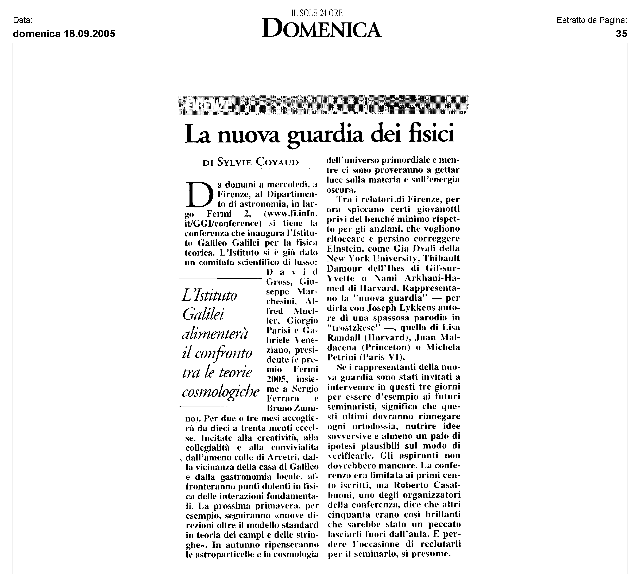

Slide 15
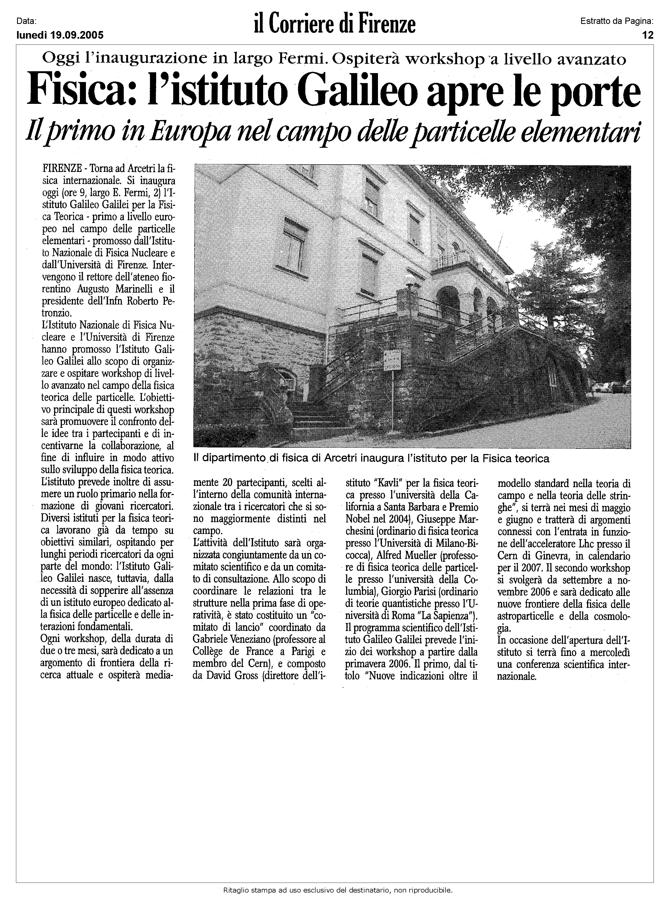

Slide 16
